Slide 1
STOCK PRICE PREDICTION USING DECISION TREE
NAME : MOHAMMED SAMEER
ROLL NO. : B19CS058
SECTION : 6CSE1
SUPERVISOR : L.MOHAN SIR
COORDINATOR : N.C SANTHOSH KUMAR SIR

Slide 2
ABSTRACT
In Stock Market Prediction, the aim is to predict the future value of the financial stocks of a company.
While supporters of the efficient market hypothesis believe that it is impossible to predict stock prices accurately, there are formal propositions demonstrating that accurate modeling and designing of appropriate variables may lead to models using which stock prices and stock price movement patterns can be very accurately predicted.
Predicting the stock market is one of the most important applications of Machine Learning in finance.
The recent trend in stock market prediction technologies is the use of machine learning which makes predictions based on the values of current stock market indices by training on their previous values.

Slide 3
Machine learning itself employs different models to make prediction easier and authentic.
There are other factors involved in the prediction, such as physical and psychological factors, rational and irrational behavior, and so on. All these factors combine to make share prices dynamic and volatile. This makes it very difficult to predict stock prices with high accuracy. The project focuses on the use of Regression and DECISION TREE based Machine learning to predict stock values. Factors considered are open, close, low, high and volume.

Slide 4
Problem Definition
Stock market prediction is basically defined as trying to determine the stock value and offer a robust idea for the people to know and predict the market and the stock
prices. It is generally presented using the quarterly financial ratio using the dataset.
Thus, relying on a single dataset may not be sufficient for the prediction and can give a result which is inaccurate.
Hence, we are contemplating towards the study of machine learning with various datasets integration to predict the market and the stock trends.
The problem with estimating the stock price will remain a problem if a better stock market prediction algorithm is not proposed.

Slide 5
Stock market prediction, calls for an ability to predict the effect of recent events on the investors.​
These events can be political events like a statement by a political leader, a piece of news on scam etc.​
It can also be an international event like sharp movements in currencies and commodity etc.​
All these events affect the corporate earnings, which in turn affects the sentiment of investors.​
All these factors make stock price prediction very difficult. Once the right data is collected, it then can be used to train a machine and to generate a predictive result.​

Slide 6
LITERATURE SURVEY
Existing System
Prediction of stock price variation is a very challenging task and the price movement behaves more like a random walk and time varying. In recent times, researchers have used various types of AI techniques to make trading decisions. The existing system does not perform well when there is a change in the operating environment. Few of the techniques used were Takagi-Sugeno (TS) technique which was used to predict the next week stock market prediction where the accuracy of the prediction was not efficient.
Disadvantages of Existing System
The existing system fails when there are rare outcomes or predictors, as the algorithm is based on bootstrap sampling. The previous results indicate that the stock price is unpredictable when the traditional classifier is used. The existence system reported highly predictive values, by selecting an appropriate time period for their experiment to obtain highly predictive 5 scores. The existing system does not perform well when there is a change in the operating environment. It doesn’t focus on external events in the environment, like news events or social media. It exploits only one data source, thus highly biased. The existing system needs some form of input interpretation, thus need of scaling. It doesn’t exploit data pre-processing techniques to remove inconsistency and incompleteness of the data.

Slide 7
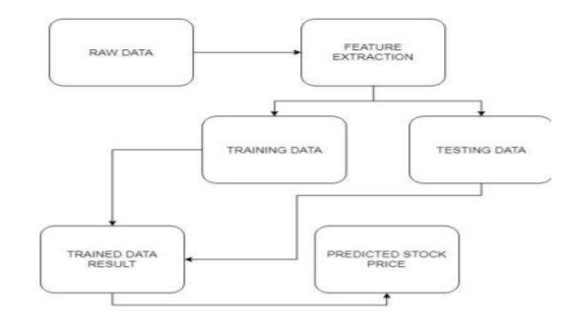
Architecture diagram

Slide 8
Algorithms and flowcharts
Decision Tree algorithm has become one of the most used machine learning algorithm both in competitions like Kaggle as well as in business environment.
Decision Tree can be used both in classification and regression problem
A decision tree algorithm performs a set of recursive actions before it arrives at the end result and when you plot these actions on a screen, the visual looks like a big tree, hence the name ‘Decision Tree’.

Slide 9
One of the widely used techniques in data mining is systems that create classifiers.
In data mining, classification algorithms are capable of handling a vast volume of information. It can be used to make assumptions regarding categorical class names, to classify knowledge on the basis of training sets and class labels, and to classify newly obtainable data. Classification algorithms in machine learning contain several algorithms, and in this work, the paper focused on the decision tree algorithm in general illustrate a structure of Decision Tree. Decision trees are one of the powerful methods commonly used in various fields, such as machine learning, image processing, and identification of patterns. Decision Tree are a successive model that unites a series of the basic test efficiently and cohesively where a numeric feature is compared to a threshold value in each test.

Slide 10
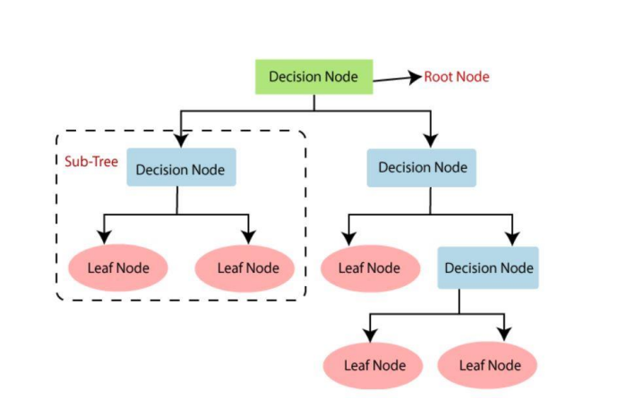
Decision Tree Algorithm

Slide 11
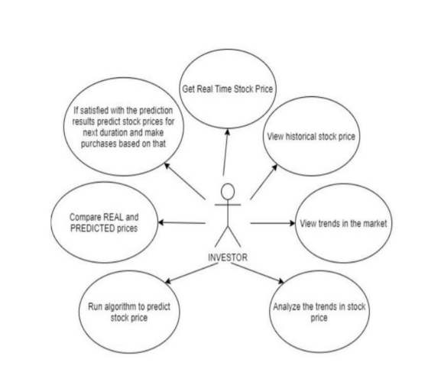
UML diagram of stock price prediction

Slide 12
Software Requirements
Languages : Python,
Libraries : Numpy , Pandas ,Matplotlib.
Operating Systems : Windows
Software : Python 3.5
Dependencies : OPENCV Libraries : panda, keras , Scipy , sklearn
Frame work : Flask Web site. Dataset : Online transaction dataset.

Slide 13
CONCLUSION AND FUTURE WORK
Dilemma between overfitting and actual prediction.
Ability to predict the general trend of a given stock.
Cannot predict uncertainties.
In the future, the accuracy of the stock market prediction system can be further improved by utilizing a much bigger dataset than the one being utilized currently.
Furthermore, other emerging models of Machine Learning could also be studied to check for the accuracy rate resulted by them.
Sentiment analysis though Machine Learning on how news affects the stock prices of a company is also a very promising area.

Slide 14
References
Indonesian Stock Price Prediction including Covid19 Era Using Decision Tree Regression
[1].Masoud, Najeb MH. (2017) “The impact of stock market performance upon economic growth”. International Journal of Economics and Financial Issues3 (4): 788–798.
3]. S. Sharma and B. Kaushik (2018), “Quantitative analysis of stock market prediction for accurate investment decisions in future,” Journal of Artificial Intelligence, vol. 11, pp. 48–54.

