Slide 1
Introduction to Geographic Information Systems (GIS)
Geographic Information Systems (GIS) is a technology that empowers users to visualize, analyze, and interpret spatial data. It integrates various data formats to produce insightful maps. The core components of GIS include hardware, software, data, people, and processes, each playing a crucial role in its functionality. GIS is essential across diverse fields such as urban planning, environmental management, and disaster response, facilitating informed decision-making through spatial analysis.

Slide 2

Types of GIS Maps
1
Thematic Maps
These maps focus on specific themes or topics, such as population density or land use, providing insights into spatial patterns and relationships.
2
Topographic Maps
Topographic maps represent physical landscape features and elevations, useful for understanding terrain and planning outdoor activities or constructions.
3
Choropleth Maps
Choropleth maps use color coding to represent data values in predefined areas, making it easy to visualize demographic and socio- economic information across regions.
Notes:
Focuses on a specific theme or topic (e.g., population, rainfall, literacy).
To visualize patterns and relationships across geographic areas.
Represents the physical features of the Earth's surface, including elevation.
Contour lines (show elevation/terrain)
Mountains, rivers, valleys, roads
A type of thematic map where areas are shaded or colored based on a variable.
Uses color gradients to show intensity (e.g., darker = higher value).

Slide 3

Analyzing Spatial Data
Statistical Analysis
Quantifying relationships for predictive modeling.
2
Spatial Analysis Techniques
Exploring relationships and uncovering patterns.
1
Geostatistics
Analyzing spatial correlations for better predictions.
3

Slide 4

Interpreting GIS Maps
1
Reading Map Symbols
Understanding symbols, colors, and legends is essential for accurately interpreting GIS maps.
2
Identifying Patterns
Look for spatial patterns and trends within the map, such as clustering or dispersion.
3
Making Informed Decisions
Effective interpretation of GIS maps aids in making strategic decisions.

Slide 5

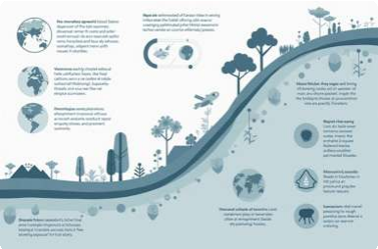

Applications of GIS Analysis
Urban Planning
GIS analysis helps urban planners visualize land use, transportation networks, and population distribution, leading to better planning outcomes.
Environmental Management
GIS is utilized for monitoring environmental changes, assessing natural resources, and managing conservation efforts effectively.
Public Health
GIS aids in tracking disease outbreaks, analyzing health services accessibility, and planning health interventions based on spatial data.

