Slide 1

Welcome
JIRA – Best Practices
by
Girish Godbole

Slide 2

Agile Concepts – I know Agile concepts. All set for Applied Agile.

Slide 3

How do I apply my agile skills ?
How do I Manage ?
Which Tool will help me ?

Slide 4

Not to Worry. We have Many Tools available in Market. Trello, Wrike, Teamwork, ClickUp, Asana, Wrike etc.
Let’s go for most widely used tool called - JIRA

Slide 5



What is JIRA?
JIRA is powerful Work management Tool.
Jira is great at helping your team plan and track all the work.
It can help teams work faster, communicate more effectively due to its well-managed workflow, Mapping and issue tracking ability with minimal effort.

Slide 6
Jira – Default Roles
- Administrators (people who administer a given project).
- Developers (people who work on issues in each project).
- Users (people who log issues on a given project).

Slide 7

Jira - Activities
Configure Boards
Configure and Generate Reports
Get Active Sprint Data
Manage Backlog
Plan and Manage Sprints
Plan and Manage Stories (User Story, Bug)
Setup Project

Slide 8








JIRA Hierarchy and Story definition
Portfolio Epic
Portfolio Epic and Initiative set by PMO and/or Lead BA/Product Owner
JIRA Portfolio
Initiative
Epics set by Asset BA/ Product Owner
User Story Types:
Development Story [BA]
Technical Debt Story [Dev Lead]
Automated Test story [Dev/QA]
QA Development story [QA]
SIT Test story [E2E QA Lead]
UAT Test story [BA]
No Spike or Chore Issue types
Epic
JIRA Projects
Story
Sub Task
Bug

Slide 9
Plan and Manage Sprints
How to create Sprint
How to Start Sprint
How to Manage Sprint
How to Manage Sprint Backlog

Slide 10
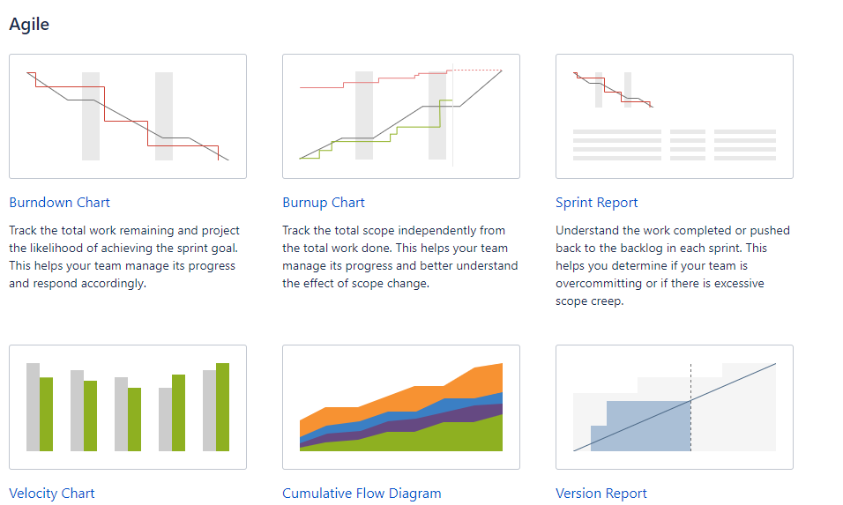
Jira – Configure and Generate Reports

Slide 11


