Slide 1
PYTHON
COURSE - 2
msatutorpy@gmail.com / +91 9581766965 Enrollment Form https://forms.gle/3xMz6beV7Bb9meHH6

Slide 2
Python Introduction –
Founder -> Guido van Rossam
Official launch / released date – Feb 1991.
High Level Programming Languages.
Object – Oriented Languages.
Python is Interpreted similar like perl and php.
Python is derived from many other computer languages including
ABC , Modula -3 , C , C++, Algo-68 Etc.

Slide 3
Python Features –
Easy to learn – doesn’t required c language.
Easy to read – high level language , understand very fast and easy.
Easy to maintain – don’t required lots of Addons .
Portable – Run on a wide variety of Hardware platforms , can be interpreted in a number of operating systems, including UNIX-based systems, Mac OS, Microsoft Windows .
Extendable - easily extensible with C/C++/Java code, and easily embeddable in applications. If 10k line of java code / c code is there then we can add those line in python instead of writing whole code in python again.
Embedded – Python can be added into another language code.

Slide 4
Databases – Provide interfaces to all major commerical db ,Postgresql,
Sqlite3, MYSQL.
GUI Programming – Tkinter / PyQt.
OOP’s concept – classes, objects, data hiding , Operator Overloading ,
Inheritance etc.
Python can be easily integrated with C, C++, Java, Active X etc.

Slide 5
Python is Freeware (No cost to pay for licence).
Python is Open Source ( Source code are available free ).
Python is Platform independent ( Write Once Run Anywhere.).
Python is Portability ( Moving from 1 O.S to another O.S).
Dynamic – Provide Dynamic data types
a=10
a=“Hello”
Garbage Collector – Automatic Garbage Collector.
Multiple Assignment – Python allows
a,b,c=1,2,3
d,e,f=3,4,”John”
Python is Case Sensitive.
Python syntax is taken from C and ABC languages.

Slide 6
Python Applications :-
Desktop / Standalone Applications .
Web Applications – Django (framework), Flask .
Database Applications - ( library Management System ) .
For Networking Applications .
Games (Pygames) .
GUI- Tkinter .
Data Analysis. (Data Science) .
Machine Learning / Artificial Intelligence / For IOT Applications .

Slide 7
Companies uses Python ---
Google .
Youtube .
Dropbox .
NASA.
IBM .
Mozilla .
Scientific & Research Organization .
Quora .
Etc .

Slide 8
Installation of Python 3.X
I will be showing you how to do install Python on your system.
Go to https://www.python.org/downloads
By default 32 bit Python get downloaded , if your system is 64 bit
then download 64 bit Python.
While installing Python in your system must check the Add to path.

Slide 9
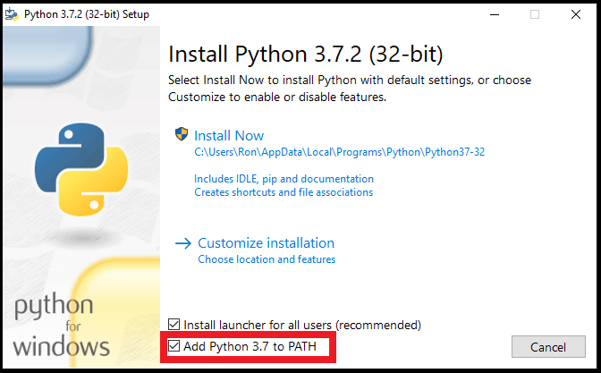

Slide 10
>> print(“hello world”)
>> a,b=10,20
>>print(a+b)
>> type(a)
>>a=True
>> type(a)
>> Bool
We need define data type in another programming languages.
Python is Dynamically Programming language.
Python is mix of :-
Functional Programming from C
OOP’s from C++
Scripting languages features from Perl and Shell Script.
Modular Programming features from Modula -3 .
Syntax from C and ABC languages.

Slide 11
A= 10
Print ( A )
Print (a)
Print ( “ number is :”,A)
X=2
def function1():
print(“inside function print ”,x)
function1()
# without x variable and with x variable .
Modules
import math
print(math.sqrt(4))
# Square root of 4 will be printed.

Slide 12
# Generating OTP in python.
import random print (random.randint(0,9),random.randint(0,9),random.randint(0,9),
sep="")
# Generating 5 digit of random number.
Import random as rn
Print(rn.randint(10000,99999))

Slide 13
Identifiers :-
identify using name
X=2, so X is identify .
def function1():
pass
#so function1 is identify ,
Class Test():
pass
So Identifier can be variable name, method name and class name.
Identifier are require .

Slide 14
Valid Identifier :-
To12
Javapython
_ajava_bpython
Non-valid Identifier:-
12tot
Ca$h
def
If
Range
Types of defined identifier –
if abc then it is Public identifier.
if _abc then it is Protected identifier.
If _ _ abc then it is Private identifier.
If _ _ main _ _ is Special variable predefined by python Start running of programme.

Slide 15
# Below the code for
>> import keyword
>> keyword.kwlist
[ False, _ _ _ _ _ _ , yield ]
Comments in Python:
Single line comment by #
Mutilines comment by """
This is line 1
This is line2 """
num=int ( input ( “ Enter the number : ”))
Print( “ Entered number is : ”,num)

Slide 16
Data Types in Python :
Int .
Float .
Bool .
Complex .
String .
Bytes .
Byte array .
Range .
List .
Tuple .
Set .
Frozenset .
Dict .
None .

Slide 17
Integer Different forms :-
a=10 – Decimal
b= 0b10 - Binary
c=0o10 – Octa
d=0X10
Base Conversion-
Bin(10) >> bin(0o10) >> bin(0X10)
Oct() , hex()
Float=10.01
Exponential form =1.2e3
Complex number – a = 10 +20j
a.real = 10.0
a.imag = 20.0
Bool – True and False.

Slide 18
Type Conversion :
int (123.4) - 123
Int(10+20j) – Type Error
Int(True) – 1
Int(“10”) – 10
Int(“0b1101”) – Type Error # it is binary string.
Float(10) – 10.0
Float(10+20j) – Type Error
Float(True) - 1.0
Float(“ten”) – Value Error
Float(“10” ) – 10.0
Float(“10.5”) – 10.5
Float(“0b1110”) – value Error

Slide 19
Byte data type- it is as like list only different is it is immutable & range is 0 to 256.Maximum number we can take is 255.
X=[1,3,255]
B=bytes(X)
Byte array data type- it is as like list diff is range is 0 to 256 ,it is
mutable.
X=[2,3,54]
B=bytearray(X)
B[1]=49

Slide 20
Assignment
Write few features of Python.
Is *Th valid identifier ?
WAP which take name from user and print them.
Wap which take float from user and print them.
WAP which can take either integer , float , bool with one input line.

Slide 21
String :
a=“ Hello world ”
Print (a); print (a [ 2:])
String Method :-
Strip () – remove whitespace . Print(a.strip())
Print(a.lower())
Print(a.islower()) – False as all are not in lower.
Print(a.replace(“H”,”J))
b=‘ a,b,c’
Print(b.split(“,”) – ‘a’ , ‘b’ , ‘c’
Str1=“ Learn”
Print(Str1.swapcase())

Slide 22
Capitalize () – first character of string as capital.
Title () – every first character of word in
sentences .
Lstrip () -> s=‘###learn” ; print(s.lstrip(“#”)
- o/p ->learn
Rstrip () # s.rstrip()
max(str1) – It will say most last character in
the string.
min(str1)- return minimum character value.
Str1.replace(“old”,”new”, times)
Center – s=“ab” ; print(s.center(5,”*”)) - **ab*

Slide 23
Ljust(width,fillchar) - padding is done using the character specified in the fillchar , default
padding is space.
S=‘ab”
Print(s.ljust(5,*)) - ab ***
Rjust(width,fillchar) – right justification.
Zfill(width) – pad string on the left with zeros.
Variablename.count(‘a’,beg=0,end=lent(str))
Find(str,beg=0,end=len(str)) – It will tell index of character / string if occur in string , if not found then return -1 .
Rfind(str,beg=0,end=len(str)) – check string from end & give index value .
S=‘ this is this ’
Print(s.rfind(‘this’,0,25) ) – o/p 8

Slide 24
Index()
Rindex (str1,beg=0,end=len(str1))
S=“ This is ” ; print( s.rindex(‘is’,0,25)) -> o/p – 6 .
Startwith (suffix,beg=0,end=len(str1))
S= ‘python programming is fun ‘
Print(s.startwith(‘is’,19,25)) -> o/p True.
Endwith (suffix,beg=0,end=len(str1))
S=‘python programming is fun ‘
Print(s.endswith(‘is’,10,21) - > o/p True

Slide 25
Isupper()
Islower ()
Isnumeric ()
Join (seq)
S=“_”
Seq=(“Py” , “ty”)
Print(s.join(seq)) -> o/p py_ty

Slide 26
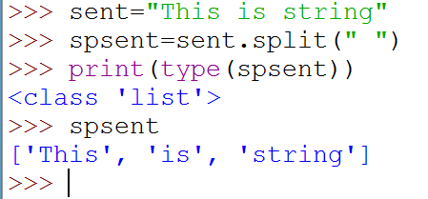
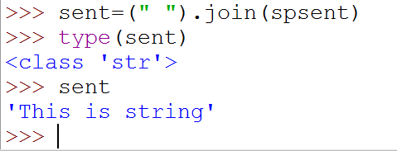
Split ()
Converting string to list.
Sten=“ This is string”
Sten.split(“”)
Join() - converting list to string.

Slide 27
List data type - order is preserve,duplicates allowed,heterogeneous values allowed,growable (add,remove) values sud be enclosed with [],Mutable.
+ sign is the list concatenation operation
* for the repetation operation
List () Method :-
Append()
Del list1
Clear()
Len(list1)
Max(list1)
Min(list1)

Slide 28
list.Count (“a”) – How many times a element has been appear in list.
List.remove(11) - Removing 11 element int from list.
Extend() – list1.extend(list2)
Index() – list1.index(‘Tom’) – Return index number of value.
Pop() – list1.pop(indexvalue)
Sort() – list1.sort()
Len() – len(list1)
#insert operation.
list1.insert(2,3444)
# in insert (indexnumber,value)

Slide 29
Tuple data type- order is preserve , dublicates allowed,heterogenous values added, not growable, IMMutable, values sud be enclosed with (),No Append
Function,No remove function.
Tup1=(11,”john”) ; print(tup1*2) ; print(tup1+tup1)
Tup1[2]=100 # ERROR
Tuple Method :-
count() – tup1=(111,’Tom’) ; print(tup1.count(111)) – No: of times that element appear.
del tup1 – To delete whole tuple , we can’t delete individual element .
Tup1=( 111, ‘Tom’) ;
print ( Tup1 * 2 ) - > ( 111, ‘Tom’, 111, ‘Tom’)

Slide 30
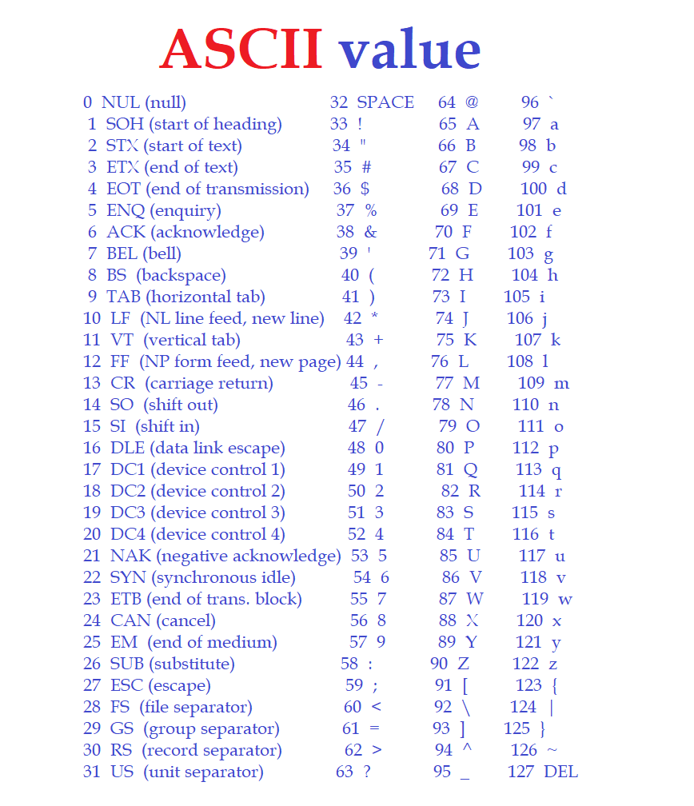

Slide 31
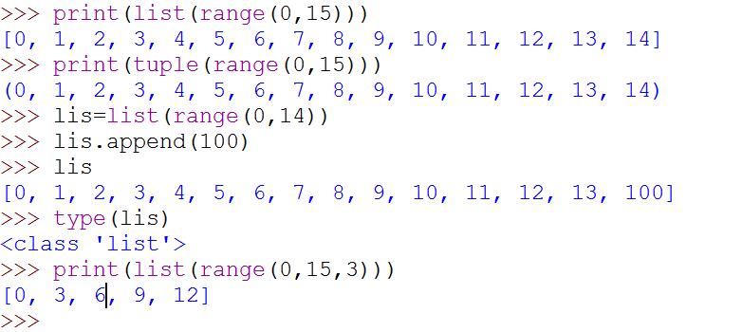
len (Tup1)
Max(Tup1) – work with number / characters only data types.
Min(Tup1) – work with number / characters only data types.
Range data type - IMMutable, Not growable.
print(list(range(0,15)))

Slide 32
Assignment
1- WAP which accept radius of a circle from the user and compute the area.
2 – WAP to find the biggest of three number .
3- WAP which accept a sequence of comma separated number from user and make it elements of list and another tuple.
EX :- input number = 1,8,3,5
List : [1,8,3,5]
Tuple : ( 1,8,3,5)
4- WAP to do conversion List1=[1,1,1,12,33] change to list1=[1,1,1,11,12,33] .

Slide 33
Set data type - order not preserved , duplicate not allowed ,{} to denote. Index & Sliding as order is not preserved. Heterogenous allowed , Mutable .
Set Methods :-
Add() – set1={“1”,3,’a’} ; set1.add(‘dam’)
Remove() – set1.remove(3)
Len() – len(set1)
Min() – min(set1)
Max() – max(set1)
sorted (set 1)

Slide 34
Set1.remove(203)
Set1.add(9)
Set1.union(set2)
Set1.intersection(set2)
Set1.difference(set2)
# making list into set & remove duplicate
S5=set ( [2,8,8,18])

Slide 35
Frozen set data type- same like set only it is IMMutable, duplicate not allowe , order not preserved,{},indexing and sliding not possible.
Frozenset Methods :
difference() , intersection() , isdisjoint() , issubset() , issuperset() ,
symmetric_difference() and union().
S1=frozenset({2,354,53})
S2=frozenset({12,44,23})
S1.intersection(s2)

Slide 36
Dictionary data type- key:value Pair ,Mutable, key value will be unique ,
value can be duplicate also . No duplicate key are allowed , keys are immutable ,
dict={‘a’:1 , ‘b’:’11’, ‘g’:’11’}
dict1['c']=20# Adding . # c is key and 2 is value.
del (dict [‘b’])
Dict1.keys()
Dict1.values()
Dict2=dict1.copy()
del dict1copy
Dict1.clear() – Remove all elements of the dictionary dict1.
Dict1.has_key() – Return Bool.
Dict1.setdefault (key,default=None)
Dict1.items()

Slide 37
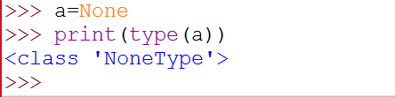
None data type- when nothing is available or nothing to print then print None.
def fun1():
a=10
print(fun1())
Pass data type- to prevent from crash or forward without any error the code.
Def passfun():
Pass
Passfun()
No CONSTANT concept in Python.

Slide 38
OPERATORS :-
1.Arithmetic Operators .
2.Relational Operators or comparison Operators .
3.Logical Operators .
4.Bitwise Operators .
5.Assignment Operators .
6.Special Operators .

Slide 39
1.Arithmetic Operators –
Addition +
Substraction -
Multiplication *
Exponential or power **
Division /
Floor Divison // if any number is float then result float else int result.
Modulo %

Slide 40
Relational Operator -
(>,>=,<,<=)
Equality operator - ( == , !=)
Print(10 == 20 )
Logical Operator -
Boolean: and , or , not , TRUE and FALSE -> False , TRUE or FALSE ->True.
Non Boolean : 0 mean =False , Non-zero means =True , empty string=False.
Print ( True and False)
Print ( True or False )

Slide 41
Bitwise Operator – This operator can only apply to int and bool.
&
|
^ =Ex-or
~ =Not
<< = bitwise left shift
>> = bitwise right shift
4 & 6 - > o/p 4
Print (10 << 2)

Slide 42
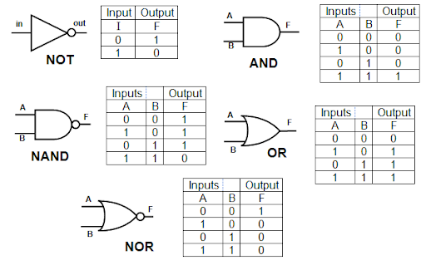

Slide 43
Compound Assignment Operators -
+= , -= , *=, /=, %=,//=,**=,&=,|=,^=,>>=,<<=
Ternary Operator :
X=30 if 10<20 else 40
X=first value if condition1 else second value if condition2 else
third value.
Y=10 if 20>30 else 40 if 50>60 else 70
Print(y)
Identity Operator :
1- is ( always check address comparison )
2- is not
A=10 ; b=10 ; print(A is b) # True.

Slide 44
Membership Operator :
1. in
2. not in
List1 = [10,30,500]
Print ( 20 in list1) # False .

Slide 45
Flow Control & Looping –
IF Statement (condition): -
num = int ( input ( “Enter the number “ ) )
If num = = 0
Print ( “ number enter is zero “)
ELIF (condition) :-
elIf num = = 2 :
Print ( “ number entered is 2 “)
Else Statement : -
Else :
Print ( “ number entered is not zero ” )

Slide 46
Looping –
For Loop
While Loop

Slide 47
Nested Loops –
# Program to generate prime number between 2 limits .
Import math
n = int ( input ( “ Enter a limit : ”))
For i in range ( 1,n ):
K = int ( math . Sqrt ( n))
For j in range ( 2, k+1 ) :
If i % j == 0 ; break
Else : print ( i )

Slide 48
Out put – Enter a limit : 12
1
2
3
5
7
11

Slide 49
Assignments –
1 – Python Program for Fibonacci Series.
2- Python Program for count the no: of vowels came in
sentence inputted by user.
3- Python Program to sum of all the elements in list.
4- Python Program to print square of number from 100 to
10,000 .
5 – Python Program to print First name , Middle name and
surname input given by user .

Slide 50
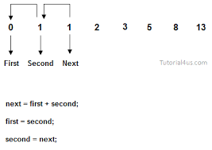

Slide 51
Control Statement
Break Statement – with the break we can stop the loop even then the condition is True.
i=1
while i < 6 :
print ( i)
if i = = 3 :
break
i + = 1
o/p - > 1
2
3

Slide 52
Control Statements –
Continue .
Break .
Pass – It is used as a placeholder function or loop can’t
have an empty body.

Slide 53
Functions :
A group of related statements to perform a specific task is known as function .
It help in break the program into smaller units , so that our process become
much easy and to find error also it is very useful .
Two types of Functions :
Built in Functions . – input () , print () .
User – defined Functions . – def function2 () .

Slide 54
Syntax :
def functionname ( parameters/arguments ) :
‘’’ function doc ‘’’
Function statements
Return ( expression )
def sumoftwo ( a , b ) :
# Preserving the order of parameter .
# a and b two number
Sum =0
Sum = a + b
return sum
Sumoftwo ( 11 , 12 )

Slide 55
Function Arguments :
1. Required Arguments .
2. Keyword Arguments .
3. Default Arguments .
4. Variable – length Arguments .

Slide 56
Anonymous Function :
Anonymous function is a function which is define without a name .
Anonymous function is defined using lambda keyword.
Anonymous function characteristics are :
It can take any number of arguments / parameters but
return only one value in the form of an expression.
It can’t contain multiple expressions .
It can’t have comments, docs .
It can’t be direct call as it require an expression .
Syntax :
Lambda [ argument 1 [ , argument2 .......
Arguments n ]] : expression

Slide 57
# definition of lambda .
Square = lambda x : x*x ;
# usage of lambda function .
n = int ( input ( “ Enter a number : ”))
Print ( “ square of ” , n , “ is ” , square ( n ) ) # lambda
function calling .
o/p –
Enter a number : 5
Square of 5 is 25

Slide 58
# lambda define
Sum = lambda x, y : x + y ;
m= int ( input ( “Enter first number : “))
n = int ( input ( “ Enter second number : ”))
Print ( “ sum of ” , m , n , “ and ” , n , “ is ” , sum ( m, n) )
o/ p –
Enter first number : 10
Enter second number : 20
Sum of 10 and 20 is 30

Slide 59
Lambda function :
It is a small anonymous f/n . Lambda f/n can take any no: of arguments but can only have one expression.
Lambda arguments : expression.
def myfun ( n) :
return lambda a:a*n
mydouble = myfun(2)
print (mydouble (11)) -> o/p 22
mytriple = myfun(3)
print(mytriple(11)) -> o/p 33

Slide 60
Recursive function.
def recursive_fun ( num) :
If num == 1 : return 1
Else :
Return ( num * recursive_fun ( num -1 ) )
num = int ( input ( “ Enter number : “ ))
If num > =1 :
Print ( “ The factorial is : “ , recursive_fun ( num ))

Slide 61
Function with more than one return value –
def calc ( a , b ) :
sum = a + b ; substract = a – b ; Multiply = a * b
Return sum , substract , Multiply
a = int ( input ( “ Enter first number : ”))
b = int ( input ( “ Enter second number :”))
sum , substract , Multiply = calc ( a , b )
Print ( “ Sum : ” , sum )
Print ( “ Substract : ”, substract )
Print ( “ Multiply : ” , Multiply )

Slide 62
Assignment :
WAP function to check whether a number is even or odd .
WAP function to calculate sum of 3 given numbers , it the
values are equal then return thrice of their sum .
WAP function to get a new string from a given string where
ls has been added to the front . If the given string already
begins with ls the return the string unchanged.
WAP function that will return true if the two given integer
values are equal or their sum or difference is 5 .

Slide 63
Module – Group of functions , variables , classes .
Libraries – Group of Modules.
Taking value from user –
A=int(input(“Enter the number ”)
Print(A)
# This Program is taking value from user. # # # a=int(input("Enter the number:")) # print(a)

Slide 64
# In above code if we give bool or float then error will come. # so to remove this we can use Eval . # b=eval(input(" Enter the value:")) print(b) # Eval will work with int() float() bool() list() tuple() set{} #Eval don't work with String() X.

Slide 65
Module – A file containing a set of functions you want to
include in ur applications .
Creating Module –
def greeting ( name ):
Print ( “ hello ” + name )
# Save it as mymodule.py
Using Created Module –
Import mymodule as ms
ms.greeting ( “ John”)
- > o/p hello John .

Slide 66
Seeing all functions in Module –
Import mymodule as ms
X = dir ( mymodule )
Print (X)
Import math as mt
Print ( dir ( mt ) )
Import module1 [ , module2 , [ , ....... moduleN ]
Import module1
Import module 2
Import module N

Slide 67
From math import pi
Print ( “ The value of pi is :” , pi )
Import math
Print ( “ The value of pi is : ” , math . pi )
* Python always search for variables in the local namespace .

Slide 68
Dir ( ) function :
Dir ( ) return the list which contain the names of all the
modules , variables and functions that are defined in a
module .
Import math ( )
C = dir ( math )
Print ( C )

Slide 69
Reload ( ) function
reloads a previously imported module. This is useful if you
have edited the module source file using an external editor
and want to try out the new version without leaving the
Python interpreter. The return value is the module object.
X= Reload ( module_name )

Slide 70
Date and Time Module :-
Import datetime
X=datetime.datetime.now()
Print (x)
Timedeltas :-
Using replace ( ) is not only the way to
calculate future or past date .We can also it by using timedelta class.

Slide 71
Import datetime
Today = datetime.date.today ( )
Print ( ‘ Today : ’ , today )
One_day = datetime.timedelta ( days = 1 )
Print ( “ one day : ” , one_day ) # 1day 0:00:00
Yestarday = today - one_day
Print ( “ yestarday : ” , yestarday )

Slide 72
Tomorrow = today + one_day
Print (‘” Tomorrow : ” , tomorrow )
Print ( “ tomorrow – yestarday : ” , tomorrow –
yestarday )
Print ( “ yestarday – tomorrrow : ” , yestarday –
tomorrow )

Slide 73
Assignment:
WAP function to reverse a string . Taking string name from user .
WAP function to calculate the no: of upper case and lower case
characters in a string , string input by user .
WAP function which take first _list and create new second_list
which don’t contain duplicates in second_list elements from
first_list . For ex:- l1=[1,2,2,2,3,2]->l2=[1,2,3]
WAP to display
a- Current date and time .
b- Current year .
c- Month of the year .

Slide 74
d- week number of the year .
e- weeknumber.
f- Day of the year .
g- Day of the month .
h- Day of the week .
WAP to determine whether a given year by user is a leap year or
not .
WAP to convert a string to datetime .
WAP to subtract 5 days from current date .

Slide 75
File Handling :
File is a named location on disk to store related information . It is
used to Permanently store data in a non-volatile memory
( hard disk ) .
Operations done on File :
1. Opening a File .
2. Read or Write ( Perform Operation )
3. Close the File .

Slide 76
OPENING A FILE :
We can specify the mode while opening a file . – r for read mode , w for write mode and a for append mode to the file .
We can open the file in two file type –
Text mode – which is regular normal file .
Binary mode – It returns bytes and this is the mode to
be used when dealing with non-text files like images ,
videos , exe files /
By default the File Type is Text mode .
Syntax :
File object = open ( filename [ , accessmode ] , [ , buffering ] )
By default the accessmode is read mode .

Slide 77
F = open ( “ abc .txt ” , ‘r’)
F = open ( “ C:/python/test.txt ” , “ r ” )

Slide 78
Modes for opening a file :
‘ r ’ – Opens a file in read mode only and the pointer
is placed at the beginning of the file . This is the default mode .
‘ rb ’ – Read only in binary format . Pointer at the
beginning of the file .
‘ r+ ’ – Open file with both read and write . Pointer at the beginning of the file .
‘ rb+ ’- Open file with both read and write in binary
format .

Slide 79
‘w ’- Open a file with write only . Overwrite the file if
the file exists
If the file doesn’t exist then create a new file .
‘ wb+ ’ - write with binary format .
‘ w+ ’ - Both write and read .
‘ wb+ ’ – write and read both in binary format .
‘ a ’- Open a file for appending . File pointer is at the end of file if the file exists .if the file doesn’t exist , it
creates a new file for writing.
‘ ab ’ - Open file for appending in binary file format .
‘ a+ ’ - Appending and reading .
‘ ab+ ’ - Append and reading in binary format .

Slide 80
Try :
with open("fname", "x") as fout:
#Work with your open file
except FileExistsError :
# Your error handling goes here

Slide 81
Attributes of file object :
Fileobject . Closed – Returns True if file is closed , False otherwise .
Fileobject. Mode – Returns access mode with which file was opened .
Fileobject. Name – Returns name of the file .
Fileobject . Softspace - Returns 0 if space is explicitly required with print , else 1 .
fo = open ( “ abc .txt ” , “w ”)
Print ( “ Name of the file : ” , fo.name )
Print ( “ Closed or Not : ” , fo.closed)
Print ( “ Opening mode : ” , fo.mode )

Slide 82
Closing a File & Write in a File :
fo = open ( “bin.txt” ,”w” )
Print ( “ Name of the file : ”, fo.name )
fo.write ( “ Programming with python . \n let’s try python .\n” )
fo.close ()
Print(“ File closed .” )
Print ( “ Closed or not :”, fo.closed)
Write a File :
fo.write ( “ This is first line .\n This is second line in file.”)

Slide 83
Fileobj . Seek (start , current , end ) –
Fileobj.Seek(bytenumber,0)
Fileobj.tell ()- It will returns the current file location .
S=fo.read ( 10 ) # Read upto 10 bytes .
Print ( “ Read String is : ” , s )
# current position .
Pos= fo. Tell () ;
Print ( “ current file positon : ” , pos )
Posseek = fo .seek ( 0, 0 ) # Repositon to beginning once again .
S2= fo. Read ( 10 ) ; fo.close ()

Slide 84
File. Read line () -
File . write () –
Check the programme for reading line by line , writing into
file line by line .

Slide 85
Renaming a File :
Os.rename (“oldname” , “ Newname” )
Deleting a File :
Os.remove ( Filename )

Slide 86
Directories in Python :
Mkdir () method – os.mkdir ( “dirname” )
Chdir () method – os.chdir ( “dirname ” )
Os.chdir(“foldername2”) – changing path / directory to
foldername2
Getcwd () method – displays the current working directory .
Rmdir () method – delete the directory .
os.rmdir ( “ dirname ” )

Slide 87
Program to copy a text file to another file .
File1= input ( “ Enter the source file to be copied :” )
File2 = input ( “ Enter the destination file to be copied : ”)
Fileopen=open(File1,”r”)
Filewrite = open(File2, “w”)
For line in fileopen.readlines():
Filewrite.write ( line )
Fileopen.close ( )

Slide 88
Assignment :
WAP to count the number of lines in a file .
WAP to append a file with the contents of another file.
WAP that counts the number of times the first three letters of the alphabet
( A,a,B,b,C,c) occur in a file . Considering both lowercase and uppercase .
WAP to compare two files .
WAP to delete a sentence from the specified position in a file .

Slide 89
Advanced Python :-
Object Oriented Programming :
A Class is a base of Object Oriented Programming . A Class contain a collection of
data ( variables ) and methods ( functions ) that act on those data variable.
Advantages of OOP’s :-
Simplicity . – Class Student then behaviour as method and variable names roll etc
Modifiability . – Particular class can only be modify .
Extensibility and Maintainability . – Adding property and easy to do correction in one class .
Re – usability . – Inheritance concept .
Security . – Access specified , code will not be able to access other program data.
An Object is said to be an instance of a class and the process of creating
A class is called instantiation .

Slide 90
Basic program of class and object made .
Built in Attribute Methods :-
Getattr ( obj , name )
hasattr ( obj , name )
Setattr (obj,name , value )
Delattr ( obj , name )

Slide 91
Built in Class Atrributes :-
__dict__ - Attribute contain the dictionary containing
the class namespace .
__doc__ - it describe the class or class documentation
string , by default None.
__name__ - contain Class name .
__module__ - Module name in which the class is
defined.
__bases__ - contain an empty tuple containing the base classes ,in the order of their occurrence in the base
class list .

Slide 92
Destructor in Python :
By default python automatically remove used memory spaced .
Automatically deletes an object that is no longer in use (Garbage Collector).
Special method __del__() , called a destructor , that is invoked when the instance is about to be destroyed .This method might be used to clean up any non memory resources used by an instance .
Programme made for destructor in python .

Slide 93
Encapsulation .
Data Hiding :-
Private data or function of a class can’t be accessed from
outside the class while public data or function can be accessed from anywhere .
Programme made to show data hiding .
Example: Public Attributes
class employee:
def __init__(self, name, sal):
self.name=name
self.salary=sal

Slide 94
Example: Protected Attributes
class employee:
def __init__(self, name, sal):
self._name=name # protected attribute
self._salary=sal # protected attribute
Example: Private Attributes
class employee:
def __init__(self, name, sal):
self.__name=name # private attribute
self.__salary=sal # private attribute

Slide 95
Inheritance :
Single level inheritance .
Multi level inheritance .
Multiple inheritance .
Hierarchical inheritance.
Hybrid inheritance .

Slide 96
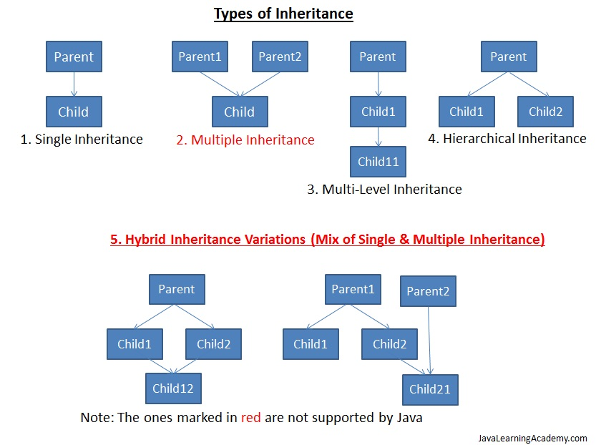

Slide 97
Multi Level Inheritance :
Created a programme to elaborate this concept .
Multiple Inheritance :
Create a Programme to elaborate this concept.
Invoking the Base class Constructor :
By using base class constructor __init__ () .
Made Programme to elaborate .

Slide 98
Method overriding .
# created programme of Method overriding.
Polymorphism
Method in the child class that has the same name , same
arguments and same return type as a method in the parent
class. When this method is called then the child method will get invoke instead of parent class .
Same display name method in parent and child class.

Slide 99
Python do not have method overloading .
Python support Operator Overloading .
‘ + ’ operator is used for adding two integer as well as
concatenating two strings .
‘ * ’ operator for multiply and repeat of string .
Print ( 1 + 2 )
Print ( “a” + “b” )

Slide 100
Assignment :
WAP to find the area and perimeter of a rectangle using classes and objects .
Define a class to represent a bank account . Include the following details like name of the depositor, account number ,
type of account , balance amount in the account . Write methods to assign initial values to deposit an amount , withdraw an amount after checking the balance , to display name , account number , account type and balance .

Slide 101
WAP to implement the following .
Create a base class called person consisting of name and code . Create 2 child classes
A- Account with member_pay
B- Admin with experience and inherit the base class .
Create a class Employee with name , code , experience and
pay by inheriting the above classes.
Explain the constructor with python example .

Slide 102
EXCEPTION HANDLING :-
An Exception is an abnormal condition that is caused by a runtime error in the program . It disturbs the normal flow of the program .
An example is divisible by 0 then interpreter will display error
message.
If we want the program to continue with the execution of the remaining code then we should try to catch the exception object thrown by the error condition and then display appropriate messages for
taking corrective actions .This process is known as exception
Handling .

Slide 103
Python has a collection of built in Exception classes .
for example – assertion Error , Attribute Error ,
keyError , Keyboard Interrupt , Value Error , Arithmetic Error , IOError etc .
Every try block be followed by atleast one except statement .
Try and one particular except .
Try and generic except .
Try and except clause with multiple exceptions .

Slide 104
Try and Finally .
Finally block can be used with try block . Finally block will
execute for sure.
We can’t use except clause and finally together .
We can’t use else clause and finally together.
Only try and finally can be use together .
Exception with Argument : Argument give more information about the exception .

Slide 105
Raising and Exception :
It is also possible to define a new exception and raise it if needed .This is done using raise statement .
This raise is equal to throw clause in java .
User – Define Exception :
Python also allows us to create our own exceptions by
deriving classes from the standard built in exceptions .This is
useful when we need to provide more specific information when an exception is caught.

Slide 106
Assertion :
Assertion is a checking in python that can be turned on or off while testing a program . In assertion an expression is tested and if the result is false , an exception is raised . i.e assert will become active .
Assert keyword is used .
If the expression is evaluated to False , Python raises an
AssertionError exception . Assertion Exception will be caught and performed using
try – except , but if not handled then they will terminate
the program and produce a trace back .

Slide 107
REGULAR EXPRESSIONS :
A Regular Expression helps to match or find other strings or sets of strings , using a specialized syntax held in a pattern . Grep command widely used in linux .
Re module is used for Regular Expressions .
Re module raises the exception re.error if an error occurs while compiling or using a regular expression .
Match () function – It is to match Regular Expression pattern to string with
Optional flags .
Syntax :
Re.match ( pattern , string , flags=0)
Match () function search pattern at beginning of string only .
If pattern not found then NONE return .

Slide 108
Search () function :
Different between Search () and Match () is that Match () only search the pattern at the beginning of the string whereas Search () search the pattern in whole string .
Search and Replace ()
Search and replace is done in python with help of sub method in re module .
Syntax :
Re.sub ( pattern , repl ,string , max=() )

Slide 109
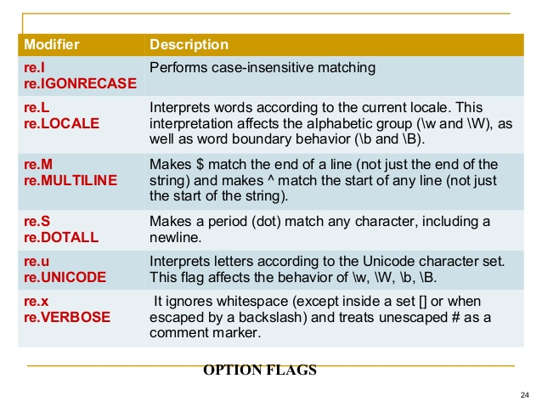

Slide 110
Find all () method :
It searches all patterns and returns a list.
Compile () method :
It compiles a regular expression pattern into a regular
expression object , which can be use many times.
Re.compile() and saving the resulting regular expression
object for reuse is more efficient when the expression will be used several times in a single program.

Slide 111
Assignment :
Given a string like “1,3-6,23,133,143,18-20,32”, produce the list
[1,3,4,5,6,23,133,143,18,19,20,32]
WAP to check the validity of password input by users . Validation (At least 1 letter between [a-z ] and 1 letter between [A-z] .Atleast 1 number between [0-9] . At least 1 character from [$#@] . Minimum length 6 characters. Maximum length 16 characters .
Create a file Test.txt . Write into file & Retrieve all lines that contain “the”.
Retrieve lines that have two consecutive O’s .

Slide 112
Data Base Programming :
Python ( Data base – Application Programming Interface ) . Supports a large number of database like Oracle , MS-SQL
Server 2000 , mySQL , Sybase etc .
Following steps for Data Base Programming :-
1. Connection with the database .
2. Issuing SQL Statements .
3. Stored Procedure .
4. Closing the Connections .

Slide 113
1. Connecting to a Data Base .
2. Creating Tables .
3. Insert Operation .
4. Update Operation .
5. Delete Operation .
6. Read Operation .
Fetch one ()
Fetch all ()
Row count ()

Slide 114
Exception Handling in Databases :
Data base Error .
Data Error .
Integrity Error .
Interface Error .
Not Supported Error .
Etc

Slide 115
MULTI THREADING :-
A Thread or a Thread of Execution is defined in computer science as the smallest unit that can be scheduled in an operating system.
Threads are normally created by a fork of a computer script or
program in two or more parallel (which is implemented on a single processor by multitasking) tasks. Threads are usually contained in
processes. More than one thread can exist within the same process. These threads share the memory and the state of the process. In
other words: They share the code or instructions and the values of
its variables. There are two different kind of threads:
Kernel threads
User-space Threads or user threads

Slide 116
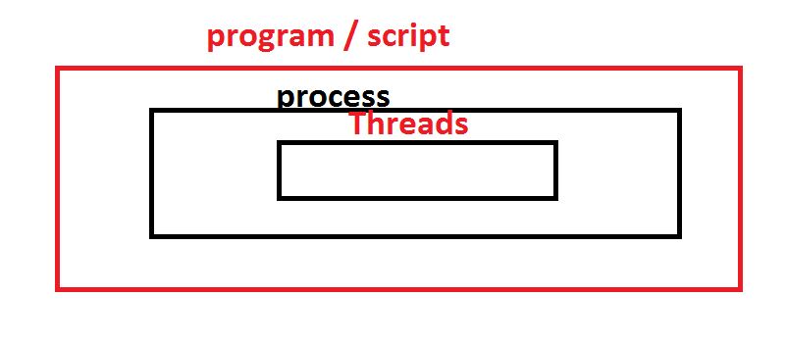

Slide 117
Modules :
Numpy .
Pandas .
Matplotlib ( Data Visualization )
Tkinter.
WebScraping.
Django Web Application python .
Data Science .

Slide 118
Django – Web Frame work .
MVT Patter –
Model – contain Data base .
View – The controller Regular HTML file .
Template – Pages which contain Dynamic element .
Template is a simple text file . It can create any text-based
format like
XML , CSV etc .

Slide 119
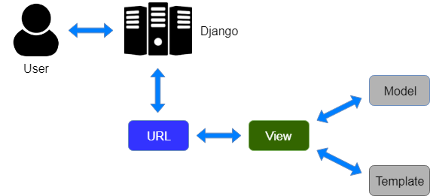

Slide 120
THANK YOU.
https://forms.gle/SFgZiiDTi2p5FoiQA

