Slide 1
Syllabus :
P Y T H O N

Slide 2
Getting Started: What is Python? Comparison of Python with other languages & Salient feature of Python . Execution model of Python & User Domains for Python . Industries using Python . Job Trends .
Python Applications :-
Companies using Python
Introduction : Installing Python 3.X Python Installer . Python 2.7 v/s Python 3.5 / Jupyter / Pycharm / Anaconda .

Slide 3
Core Python :
Indentation in Python .
Identifiers in Python .
Reserved Keywords in Python .
Variables .
Comments in Python .
Input , Output and Import Functions .
Displaying the output .
Reading the input .
Importing the function .

Slide 4
Data Types .
Numbers .
Type Conversion .
Assignment .

Slide 5
Data Types with Methods –
Int .
Float .
Bool .
Complex .
Bytes .
Byte array .
String .
List .
Tuple .
Range .
Set .
Frozenset .
Dictionary .
None .
Pass .
Assignment .

Slide 6
OPERATORS :-
1.Arithmetic Operators .
2.Relational Operators or comparison Operators .
3.Equality Operators .
4.Logical Operators .
5.Bitwise Operators .
6.Compound Assignment Operators .
6.Special Operators .

Slide 7
Flow Control .
Looping .
Nested Loops .
Control Statements .
Assignment .

Slide 8
Functions .
Basic useful Functions .
Advance Functions continued .
Anonymous Functions .
Recursive Functions .
Function with more than one return value.
Problem Discussion .
Assignment .

Slide 9
Modules and Packages .
Import Statement .
Dir() function .
Reload () function .
Date and Time Modules .
Problem Discussion .
Assignment .

Slide 10
File Handling .
Operations done with file .
Directories in Python .
Assignment .

Slide 12
Advanced Python –
OOPS Concept –
Class Definition .
Objects .
Destructors in Python .
Encapsulation .
Data Hiding .
Inheritance .
Method Overriding .
Polymorphism .
Assignment .

Slide 13
Exception Handling .
Built in Exceptions .
Handling Exceptions .
Exceptions Operations .
Assertions in Python .
Assignment .

Slide 14
Regular Expressions .
Match () function .
Search () function .
Search and replace .
Regular Expressions Patterns .
Character classes .
Special Character classes .

Slide 15
Repetition Cases .
Find all () method .
Compile () method .
Assignment .

Slide 16
Data base Programming .
Connecting to a Data base .
Creating Tables .
Insert Operation .
Update Operation .
Delete Operation .
Read Operation .

Slide 17
Transaction control .
Disconnecting from a Data base .
Exception Handling in Data bases .
Assignment .

Slide 19
Modules –
Numpy .
Pandas .
Matplotlib ( Data Visualization )
Django Web Application python .
Data Science .

Slide 20
Machine Learning / Deep Learning .
Many Projects Based on Real Time Problem .
And Many More.

Slide 21
Python Introduction –
Founder -> Guido van Rossam
Official launch date – Feb 1991.
High Level Programming Languages.
Object – Oriented Languages.
Python is Interpreted similar like perl and php.
Python is derived from many other computer languages including ABC , Modula -3 , C , C++, Algo-68 Etc.

Slide 22
Python Features –
Easy to learn – doesn’t required c language.
Easy to read – high level language , understand very fast and easy.
Easy to maintain – don’t required lots of Addons .
Portable – Run on a wide variety of Hardware platforms , can be interpreted in a number of operating systems, including UNIX-based systems, Mac OS, Microsoft Windows .
Extendable - easily extensible with C/C++/Java code, and easily embeddable in applications. If 10k line of java code / c code is there then we can add those line in python instead of writing whole code in python again.
Embedded – Python can be added into another language code.

Slide 23
Databases – Provide interfaces to all major commerical db ,Postgresql , sqlite3.
GUI Programming – Tkinter.
OOP’s concept – classes,objects,data hiding , Operator Overloading , Inheritance etc.
Python can be easily integrated with C, C++, Java,Active X etc.

Slide 24
Python is Freeware (No cost to pay for licence).
Python is Open Source ( Source code are available free ).
Python is Platform independent ( Write Once Run Anywhere.).
Python is Portability ( Moving from 1 O.S to another O.S).
Dynamic – Provide Dynamic data types
a=10
a=“Hello”
Garbage Collector – Automatic Garbage Collector.
Mulitple Assignment – Python allows
a,b,c=1,2,3
d,e,f=3,4,”John”
Python is Case Sensitive.
Python syntax is taken from C and ABC languages.

Slide 25
Python Applications :-
Desktop / Standalone Applications .
Web Applications – Django (framework) , Flask .
Database Applications - ( library Management System ) .
For Networking Applications .
Games (Pygames) .
GUI- Tkinter .
Data Analysis. (Data Science) .
Machine Learning / Artificial Intelligence / For IOT Applications .

Slide 26
Companies uses Python ---
Google .
Youtube .
Dropbox .
NASA.
IBM .
Mozilla .
Scientific & Research Organization .
Quora .
Etc .

Slide 27
Installation of Python 3.X
I will be showing you how to do install Python on your system.
Go to https://www.python.org/downloads
By default 32 bit Python get downloaded , if your system is 64 bit then
in download 64 bit Python.
While installing Python in your system must check the Add to path.

Slide 28
>> print(“hello world”)
>> a,b=10,20
>>print(a+b)
>> type(a)
>>a=True
>> type(a)
>> Bool
We need define data type in another programming languages.
Python is Dynamically Programming language.
Python is mix of :-
Functional Programming from c
OOP’s from c++
Scripting languages features from Perl and Shell Scrip.
Modular Programming features from Modula -3 .
Syntax from C and ABC languages.

Slide 29
A= 10
Print ( A )
Print (a)
Print ( “ number is :”,A)
X=2
def function1():
print(“inside function print ”,x)
# without x variable and with x variable .
Modules
import math
print(math.sqrt(4))
# Square root of 4 will be printed.

Slide 30
# generating OTP in python.
import random print (random.randint(0,9),random.randint(0,9),random.randint(0,9),
sep="")
# Generating 5 digit of random number.
Import random as rn
Print(rn.randint(10000,99999))

Slide 31
Identifiers :-
identify using name
X=2, so x is identify .
Def function1():
pass
#so function1 is identify ,
Class Test():
So Identifier can be variable name, method name and class name.
Identifier are require .

Slide 32
Valid Identifier :-
To12
Javapython
_ajava_bpython
Non-valid Identifier:-
12tot
Ca$h
def
If
Range
Types of defined identifier –
if _abc then it is private identifier.
If _ _ abc then it is Strongly identifier.
If _ _ main _ _ is Special variable predefined by python Start running of programme.

Slide 33
# Below the code for
>> import keyword
>> keyword.kwlist
[ False, _ _ _ _ _ _ , yield ]
Comments in Python
Single line comment by #
Multilines comment by ''' this is multline
commment
'''
num=int ( input ( “ Enter the number : ”))
Print( “ Entered number is : ”,num)

Slide 34
Data Types in Python .
Int .
Float .
Bool .
Complex .
String .
Bytes .
Byte array .
Range .
List .
Tuple .
Set .
Frozenset .
Dict .
None .

Slide 35
Integer Different forms “:-
a=10 – Decimal
b= 0b10 - Binary
c=0o10 – Octa
d=0X10
Base Conversion-
Bin(10) >> bin(0o10) >> bin(0X10)
Oct() , hex()
Float=10.01
Exponential form =1.2e3
Complex number – a = 10 +20j
a.real = 10.0
a.imag = 20.0
Bool – True and False.

Slide 36
Type Conversion
int (123.4) - 123
Int(10+20j) – Type Error
Int(True) – 1
Int(“10”) – 10
Int(“”0b1101”) – Type Error
Float(10) – 10.0
Float(10+20j) – Type Error
Float(True) - 1.0
Float(“ten”) – Value Error
Float(“”10” ) – 10
Float(“10.5”) – 10.5
Float(“0b1110”) – value Error

Slide 37
Byte data type- it is as like list only different is it is immutable & range is 0 to 256.
X=[1,3,256]
B=bytes(X)
Byte array data type- it is as like list diff is range is 0 to 256 ,it is mutable.
X=[2,3,54]
B=bytearray(X)
B[1]=49

Slide 38
Assignment
Write few features of Python .
Is *Th valid identifier ?
WAP which take name from user and print them.
Wap which take float from user and print them .
WAP which can take either integer , float , bool with one input line .

Slide 39
String :
a=“ Hello world ”
Print (a); print (a [ 2:])
String Method :-
Strip () – remove whitespace . Print(a.strip())
Print(a.lower())
Print(a.islower()) – False as all are not in lower.
Print(a.replace(“H”,”J))
b=‘ a,b,c’
Print(b.split(“,”) – ‘a’ , ‘b’ , ‘c’
Str1=“ Learn”
Print(s.swapcase())

Slide 40
Capitalize () – first character of string as capital.
Title () – every first character of word in sentences .
Lstrip () -> s=‘###learn” ; print(s.lstrip(“#”) - o/p ->learn
Rstrip ()
max(str1) – It will say most last character in the string.
min(str1)- retrun minimum character value.
replace(“old”,”new”, times)
Center – s=“ab” ; print(s.center(5,”*”)) - **ab*

Slide 41
Ljust(width,fillchar) - padding is done using the character specified in the fillchar , default padding is space.
S=‘ab”
Print(s.ljust(5,*)) - ab ***
Rjust(width,fillchar) – right justification.
Zfill(width) – pad string on the left with zeros.
Count(str,beg=0,end=lent(str))
Find(str,beg=0,end=len(str)) – It will tell index of character / string if occur in
string , if not found then return -1 .
Rfind(str,beg=0,end=len(str)) – check string from end & give index value .
S=‘ this is this ’
Print(s.rfind(‘this’,0,25) ) – o/p 8

Slide 42
Index()
Rindex (str1,beg=0,end=len(str1))
S=“ This is ” ; print( s.rindex(‘is’,0,25)) -> o/p – 6 .
Startwith (suffix,beg=0,end=len(str1))
S= ‘python programming is fun ‘
Print(s.startwith(‘is’,19,25)) -> o/p True.
Endwith (suffix,beg=0,end=len(str1))
S=‘python programming is fun ‘
Print(s.endswith(‘is’,10,21) - > o/p True

Slide 43
Isupper()
Islower ()
Isnumeric ()
Join (seq)
S=“_”
Seq=(“Py” , “ty”)
Print(s.join(seq)) -> o/p py_ty

Slide 44
List data type - order is preserve,duplicates allowed,heterogeneous values allowed,growable (add,remove) values sud be enclosed with [],Mutable.
+ sign is the list concatenation operation
* for the repetation operation
List () Method :-
Append()
Del()
Clear()
Len(list1)
Max(list1)
Min(list1)

Slide 45
list.Count (“a”) – How many times a element has been appear in list.
List.remove(11) - Removing 11 element int from list.
Extend() – list1.extend(list2)
Index() – list1.index(‘Tom’) – Return index number of value.
Pop() – list1.pop(indexvalue)
Sort() – list1.sort()
Len() – len(list1)

Slide 46
Tuple data type- order is preserve , dublicates allowed,heterogenous values
added,not growable,IMMutable,values sud be enclosed with (),No Append function.
Tup1=(11,”john”) ; print(tup1*2) ; print(tup1+tup1)
Tup1[2]=100 # ERROR
Tuple Method :-
Count() – tup1=(111,’Tom’) ; print(tup1.count(111)) – No: of times that element appear.
Del tup1 – To delete whole tuple , we can’t delete individual element .
Tup1=( 111, ‘Tom’) ; print ( Tup1 * 2 ) - > ( 111, ‘Tom’, 111, ‘Tom’)

Slide 47
len (Tup1)
Max(Tup1) – work with number data types only.
Min(Tup1) – work with number data types only.
Range data type - IMMutable, Not growable.
print(list(range(0,15)))

Slide 48
Assignment
1- WAP which accept radius of a circle from the user and compute the area.
2 – WAP to find the biggest of three number .
3- WAP which accept a sequence of comma separated number from user and make it
elements of list and another tuple.
EX :- input number = 1,8,3,5
List : [1,8,3,5]
Tuple : ( 1,8,3,5)

Slide 49
Set data type - order not preserved , duplicate not allowed ,{} to denote. Index & Sliding as order is not preserved. Heterogenous allowed , Mutable .
Set Methods :-
Add() – set1={“1”,3,’a’} ; s1.add(‘dam’)
Remove() – set1.remove(3)
Len() – len(set1)
Min() – min(set1)
Max() – max(set1)
Sorted (set 1)

Slide 50
Set1.remove(203)
Set1.add(9)
Set1.union(set2)
Set1.intersection(set2)
Set1.difference(set2)
# making list into set & remove duplicate
S5=set ( [2,8,8,18])

Slide 51
Frozen set data type- same like set only it is IMMutable, duplicate not allowe , order not preserved,{},indexing and sliding not possible.
Frozenset Methods :
difference() , intersection() , isdisjoint() , issubset() , issuperset() , symmetric_difference() and union()
S1=frozenset({2,354,53})
S2=frozenset({12,44,23})
S1.intersection(s2)

Slide 52
Dictionary data type- key:value Pair ,Mutable, key value will be unique , value can be duplicate also . No duplicate key are allowed , keys are immutable ,
dict={‘a’:1 , ‘b’:’11’}
dict[‘c’:2] # Adding . # c is key and 2 is value.
del (dict [‘b’])
Dict1.keys()
Dict1.values()
Dict2=dict1.copy()
Dict1.clear() – Remove all elements of the dictionary dict1.
Dict1.has_key() – Return Bool.
Dict1.setdefault (key,default=None)
Dict1.items()

Slide 53
None data type- when nothing is available or nothing to print then print None.
def fun1():
a=10
print(fun1())
Pass data type- to prevent from crash or forward without any error the code.
Def passfun():
Pass
Passfun()
No CONSTANT concept in Python.

Slide 54
Assignment :
WAP which accept the radius of a circle from the user and compute the area.
WAP to find the biggest of three number .
WAP which accept a sequence of comma separated numbers from user and
generate a list and a tuple with user inputted sequence numbers .
EX : - user input = 1,8,8,9,34
list = [ 1, 8, 8, 9 , 34 ]
Tuple = ( 1, 8, 8, 9 , 34 )

Slide 55
OPERATORS :-
1.Arithmetic Operators .
2.Relational Operators or comparison Operators .
3.Logical Operators .
4.Bitwise Operators .
5.Assignment Operators .
6.Special Operators .

Slide 56
1.Arithmetic Operators –
Addition +
Substraction -
Multiplication *
Exponential or power **
Division /
Floor Divison // if any number is float then result float else int result.
Modulo %

Slide 57
Relational Operator -
(>,>=,<,<=)
Equality operator - ( == , !=)
Print(10 == 20 )
Logical Operator -
Boolean: and , or , not , TRUE and FALSE -> False , TRUE or FALSE ->True.
Non Boolean : 0 mean =False , Non-zero means =True , empty string=False.
Print ( True and False)
Print ( True or False )

Slide 58
Bitwise Operator – This operator can only apply to int and bool.
&
|
^ =Ex-or
~ =Not
<< = bitwise left shift
>> = bitwise right shift
4 & 6 - > o/p 4
Print (10 << 2)

Slide 59
Compound Assignment Operators -
+= , -= , *=, /=, %=,//=,**=,&=,|=,^=,>>=,<<=
Ternary Operator :
X=30 if 10<20 else 40
X=first value if condition1 else second value if condition2 else third value.
Y=10 if 20<30 else 40 if 50<60 else else 70
Print(y)
Identity Operator :
1- is ( always check address comparison )
2- isnot
A=10 ; b=10 ; print(a is b) # True.

Slide 60
Membership Operator :
1. in
2. not in
List1 = [10,30,500]
Print ( 20 in list1) # False .

Slide 61
Flow Control & Looping –
IF Statement : -
Num = int ( input ( “Enter the number “ ) )
If num = = 0
Print ( “ number enter is zero “)
Else Statement : -
Else :
Print ( “ number entered is not zero ” )
ELIF :-
If num = = 2 :
Print ( “ number entered is 2 “)

Slide 62
Looping –
For Loop
While Loop

Slide 63
Nested Loops –
# Program to generate prime number between 2 limits .
Import math
n = int ( input ( “ Enter a limit : ”))
For i in range ( 1,n ):
K = int ( math . Sqrt ( n))
For j in range ( 2, k+1 ) :
If i % j == 0 ; break
Else : print ( i )

Slide 64
Out put – Enter a limit : 12
1
2
3
5
7
11

Slide 65
Assignments –
1 – Python Program for Fibonacci Series.
2- Python Program for count the no: of vowels came in sentence inputted by user.
3- Python Program to sum of all the elements in list.
4- Python Program to print square of number from 100 to 10,000 .
5 – Python Program to print First name , Middle name and surname input given by user .

Slide 66
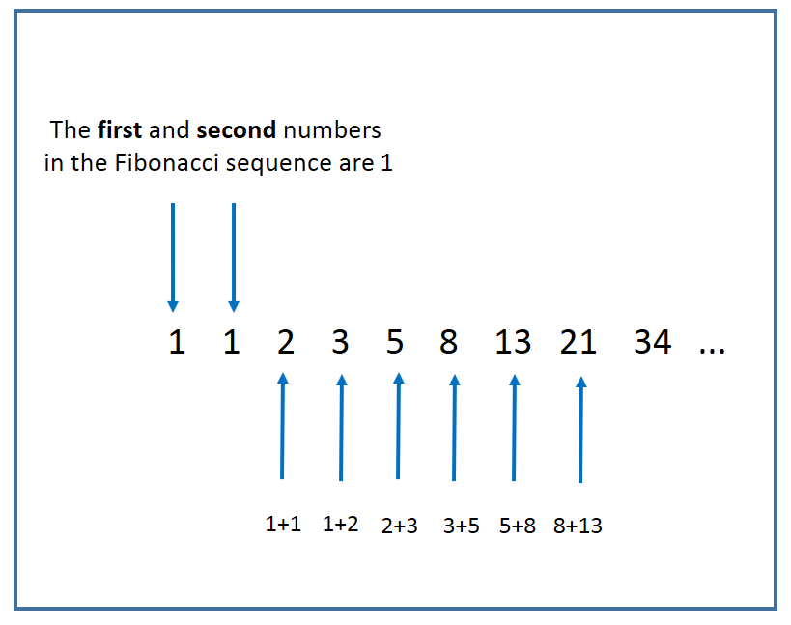

Slide 67
Control Statement
Break Statement – with the break we can stop the loop even then the condition is True.
i=11
while i < 6 :
print ( i)
if i = = 3 :
break
i + = 1
o/p - > 1
2
3

Slide 68
Control Statements –
Continue .
Pass – It is used as a placeholder function or loop can’t have an empty body.

Slide 70
Functions :
A group of related statements to perform a specific task is known as function .
It help in break the program into smaller units , so that our process become
much easy and to find error also it is very useful .
Two types of Functions :
Built in Functions . – input () , print () .
User – defined Functions . – def function2 () .

Slide 71
Syntax :
Def functionname ( parameters ) :
‘’’ function doc ‘’’
Function statements
Return ( expression )
Def sumoftwo ( a , b ) :
# Preserving the order of parameter .
# a and b two number
Sum =0
Sum = a + b
return sum
Sumoftwo ( 11 , 12 )

Slide 72
Function Arguments :
1. Required Arguments .
2. Keyword Arguments .
3. Default Arguments .
4. Variable – length Arguments .

Slide 73
Anonymous Function :
Anonymous function is a function which is define without a name .
Anonymous function is defined using lambda keyword.
Anonymous function characteristics are :
It can take any number of arguments / parameters but return only one value in the
Form of an expression.
It can’t contain multiple expressions .
It can’t have comments .
It can’t be direct call as it require an expression .
Syntax :
Lambda [ argument 1 [ , argument2 ....... Arguments n ]] : expression

Slide 74
# definition of lambda .
Square = lambda x : x*x ;
# usage of lambda function .
n = int ( input ( “ Enter a number : ”))
Print ( “ square of ” , n , “ is ” , square ( n ) ) # lambda function calling .
o/p –
Enter a number : 5
Square of 5 is 25

Slide 75
# lambda define
Sum = lambda x, y : x + y ;
m= int ( input ( “Enter first number : “))
n = int ( input ( “ Enter second number : ”))
Print ( “ sum of ” , m , n , “ and ” , n , “ is ” , sum ( m, n) )
o/ p –
Enter first number : 10
Enter second number : 20
Sum of 10 and 20 is 30

Slide 76
Lambda function :
It is a small anonymous f/n . Lambda f/n can take any no: of arguments but can only have one expression.
Lambda arguments : expression.
def myfun ( n) :
return lambda a:a*n
mydouble = myfun(2)
print (mydouble (11)) -> o/p 22
mytriple = myfun(3)
print(mytriple(11)) -> o/p 33

Slide 77
Recursive function .
def recursive_fun ( num) :
If num == 1 : return 1
Else :
Return ( num * recursive_fun ( num -1 ) )
num = int ( input ( “ Enter number : “ ))
If num > =1 :
Print ( “ The factorial is : “ , recursive_fun ( num ))

Slide 78
Function with more than one return value –
def calc ( a , b ) :
sum = a + b ; substract = a – b ; Multiply = a * b
Return sum , substract , Multiply
a = int ( input ( “ Enter first number : ”))
b = int ( input ( “ Enter second number :”))
sum , substract , Multiply = calc ( a , b )
Print ( “ Sum : ” , sum )
Print ( “ Substract : ”, substract )
Print ( “ Multiply : ” , Multiply )

Slide 79
Assignment :
WAP function to check whether a number is even or odd .
WAP function to calculate sum of 3 given numbers , it the values are equal then return thrice of their sum .
WAP function to get a new string from a given string where ls has been added to the front . If the given string already begins with ls the return the string unchanged.
WAP function that will return true if the two given integer values are equal
or their sum or difference is 5 .

Slide 80
Module – Group of functions , variables , classes .
Libraries – Group of Modules.
Taking value from user –
A=int(input(“Enter the number ”)
Print(A)
# This Program is taking value from user. # # # a=int(input("Enter the number:")) # print(a)

Slide 81
# In above code if we give bool or float then error will come. # so to remove this we can use Eval . # b=eval(input(" Enter the value:")) print(b) # Eval will work with int() float() bool() list() tuple() set{} #Eval don't work with String() X.

Slide 82
Module – A file containing a set of functions you wan to include in ur applications .
Creating Module –
def greeting ( name ):
Print ( “ hello ” + name )
# Save it as mymodule.py
Using Created Module –
Import mymodule as ms
ms.greeting ( “ John”)
- > o/p hello John .

Slide 83
Seeing all functions in Module –
Import mymodule as ms
X = dir ( mymodule )
Print (X)
Import math as mt
Print ( dir ( mt ) )
Import module1 [ , module2 , [ , ....... moduleN ]
Import module1
Import module 2
Import module N

Slide 84
From math import pi
Print ( “ The value of pi is :” , pi )
Import math
Print ( “ The value of pi is : ” , math . pi )
* Python always search for variables in the local namespace .

Slide 85
Dir ( ) function :
Dir ( ) return the list which contain the names of all the modules , variables and functions that are defined in a module .
Import math ( )
C = dir ( math )
Print ( C )

Slide 86
Reload ( ) function
reloads a previously imported module. This is useful if you have edited the module source file using an external editor and want to try out the new version without leaving the Python interpreter. The return value is the module object.
Reload ( module_name )

Slide 87
Date and Time Module :-
Import datetime
X=datetime.datetime.now()
Print (x)
Timedeltas :-
Using replace ( ) is not only the way to calculate future or past date .We can also it by using timedelta class.

Slide 88
Import datetime
Today = datetime.date.today ( )
Print ( ‘ Today : ’ , today )
One_day = datetime.timedelta ( days = 1 )
Print ( “ one day : ” , one_day ) # 0:00:00
Yestarday = today - one_day
Print ( “ yestarday : ” , yestarday )

Slide 89
Tomorrow = today + one_day
Print (‘” Tomorrow : ” , tomorrow )
Print ( “ tomorrow – yestarday : ” , tomorrow – yestarday )
Print ( “ yestarday – tomorrrow : ” , yestarday – tomorrow )

Slide 90
Assignment
WAP function to reverse a string . Taking string name from user .
WAP function to calculate the no: of upper case and lower case letters
in a string , string input by user .
WAP function which take first _list and create new second_list which don’t
contain duplicates in second_list elements from first_list .
WAP to display
a- Current date and time .
b- Current year .
c- Month of the year .

Slide 91
d- week number of the year .
e- weekday of the week .
f- Day of the year .
g- Day of the month .
h- Day of the week .
WAP to determine whether a given year by user is a leap year or not .
WAP to convert a string to datetime .
WAP to subtract 5 days from current date .

Slide 92
File Handling :
File is a named location on disk to store related information . It is used to
Permanently store data in a non-volatile memory ( hard disk ) .
Operations done on File :
1. Opening a File .
2. Read or Write ( Perform Operation )
3. Close the File .

Slide 93
Opening a File :
We can specify the mode while opening a file . – r for read mode , w for write mode and a for append mode to the file .
We can open the file in two file type –
Text mode – which is regular normal file .
Binary mode – It returns bytes and this is the mode to be used when dealing with non-text files like images , videos , exe files /
By default the File Type is Text mode .
Syntax :
File object = open ( filename [ , accessmode ] , [ , buffering ] )
By default the accessmode is read mode .

Slide 94
Buffering :
In computer science, a data buffer (or just buffer) is a region of a physical memory storage used to temporarily store data while it is being moved from one place to another .
If the buffering value is set to 0 then no buffering takes place.
If the buffering value is set to 1 then buffering is performed while accessing a file .
If we specify the buffering value as an integer greater than 1 then buffering
Action is performed wiht the indicated buffer size .
F = open ( “ abc .txt ” , ‘r’)
F = open ( “ C:/python/test.txt ” , “ r ” )

Slide 95
Modes for opening a file :
‘ r ’ – Opens a file in read mode only and the pointer is placed at the beginning of the file . This is the default mode .
‘ rb ’ – Read only in binary format . Pointer at the beginning of the file .
‘ r+ ’ – Open file with both read and write . Pointer at the beginning of the file .
‘ rb+ ’- Open file with both read and write in binary format .

Slide 96
‘w ’- Open a file with write only . Overwrite the file if the file exists
If the file doesn’t exist then create a new file .
‘ wb+ ’ - write with binary format .
‘ w+ ’ - Both write and read .
‘ wb+ ’ – write and read both in binary format .
‘ a ’- Open a file for appending . File pointer is at the end of file if the file exists .if the file doesn’t exist , it creates a new file for writing.
‘ ab ’ - Open file for appending in binary format .
‘ a+ ’ - Appending and reading .
‘ ab+ ’ - Append and reading in binary format .

Slide 97
‘ x ’ - Open file for exclusive creation . If the file already exists , the operation fails .
When you specify exclusive creation, it clearly means, you would use this mode for exclusively creating the file. The need for this is required when you won't accidentally truncate/append an existing file with either of the modes w or a.
In absence of this, developers should be cautious to check for the existence of the file before leaping to open the file for updation.

Slide 98
Try :
with open("fname", "x") as fout:
#Work with your open file
except FileExistsError :
# Your error handling goes here

Slide 99
Attributes of file object :
File . Closed – Returns True if file is closed , False otherwise .
File . Mode – Returns access mode with which file was opened .
File . Name – Returns name of the file .
File . Softspace - Returns 0 if space is explicitly required with print , else 1 .
Fo = open ( “ abc .txt ” , “w ”)
Print ( “ Name of the file : ” , fo.name )
Print ( “ Closed or Not : ” , fo.closed)
Print ( “ Opening mode : ” , fo.mode )

Slide 100
Closing a File & Write in a File :
fo = open ( “bin.txt” ,”wb” )
Print ( “ Name of the file : ”, fo.name )
fo.write ( “ Programming with python . \n let’s try python .\n” )
fo.close ()
Print(“ File closed .” )
Print ( “ Closed or not :”, fo.closed)
Write a File :
Fo.write ( “ This is first line .\n This is second line in file.”)

Slide 101
File.fileno () – Returns an integer number ( file descriptor ) of the file .
File . Seek (start , current , end ) –
File.tell ()- It will returns the current file location .
S=fo.read ( 10 ) # Read upto 10 bytes .
Print ( “ Read String is : ” , s )
# current position .
Pos= fo. Tell () ;
Print ( “ current file positon : ” , pos )
Posseek = fo .seek ( 0, 0 ) # Repositon to beginning once again .
S2= fo. Read ( 10 ) ; fo.close ()

Slide 102
File. Read line () -
File . write () –
Check the programme for reading line by line , writing into file line by line .

Slide 103
Renaming a File :
Os.rename (“oldname” , “ Newname” )
Deleting a File :
Os.remove ( Filename )

Slide 104
Directories in Python :
Mkdir () method – os.mkdir ( “dirname” )
Chdir () method – os.chdir ( “dirname ” )
Getcwd () method – displays the current working directory .
Rmdir () method – delete the directory .
os.rmdir ( “ dirname ” )

Slide 105
Program to copy a text file to another file .
File1= input ( “ Enter the source file to be copied :” )
File2 = input ( “ Enter the destination file to be copied : ”)
Fileopen=open(File1,”r”)
Filewrite = open(File2, “w”)
For line in fileopen.readlines():
Filewrite.write ( line )
Fileopen.close ( )

Slide 106
Assignment :
WAP to count the number of lines in a file .
WAP to append a file with the contents of another file.
WAP that counts the number of times the first three letters of the alphabet ( A,a,B,b,C,c) occur in a file . Considering both lowercase and uppercase .
WAP to compare two files .
WAP to delete a sentence from the specified position in a file .

Slide 107
Advanced Python :-
Object Oriented Programming :
A Class is a base of Object Oriented Programming . A Class contain a collection of data ( variables ) and methods ( functions ) that act on those data .
Advantages of OOP’s :-
Simplicity . – Class Student then behaviour as method and variable names roll etc
Modifiability . – Particular class can only be modify .
Extensibility and Maintainability . – Adding property and easy to do correction in one class .
Re – usability . – Inheritance concept .
Security . – Access specified , code will not be able to access other program data.
An Object is said to be an instance of a class and the process of creating
A class is called instantiation .

Slide 108
Basic program of class and object made .
Built in Attribute Methods :-
Getattr ( obj , name )
hasattr ( obj , name )
Setattr (obj,name , value )
Delattr ( obj , name )

Slide 109
Built in Class Atrributes :-
__dict__ - Attribute contain the dictionary containing the class namespace .
__doc__ - it describe the class or class documentation string , by default None.
__name__ - contain Class name .
__module__ - Module name in which the class is defined.
__bases__ - contain an empty tuple containing the base classes ,in the order of thier occurrence in the base class list .

Slide 110
Destructor in Python :
By default python automatically remove used memory spaced .
Automatically deletes an object that is no longer in use (Garbage Collector).
Special method __del__() , called a destructor , that is invoked when the instance is about to be destroyed .This method might be used to clean up any non memory resources used by an instance .
Programme made for destructor in python .

Slide 111
Encapsulation .
Data Hiding :-
Private data or function of a class can’t be accessed from outside the class while public data or function can be accessed from anywhere .
Programme made to show data hiding .
Example: Public Attributes
class employee: def __init__(self, name, sal): self.name=name self.salary=sal

Slide 112
Example: Protected Attributes
class employee: def __init__(self, name, sal): self._name=name # protected attribute self._salary=sal # protected attribute
Example: Private Attributes
class employee: def __init__(self, name, sal): self.__name=name # private attribute self.__salary=sal # private attribute

Slide 113
Inheritance :
Single level inheritance .
Multi level inheritance .
Multiple inheritance .

Slide 114
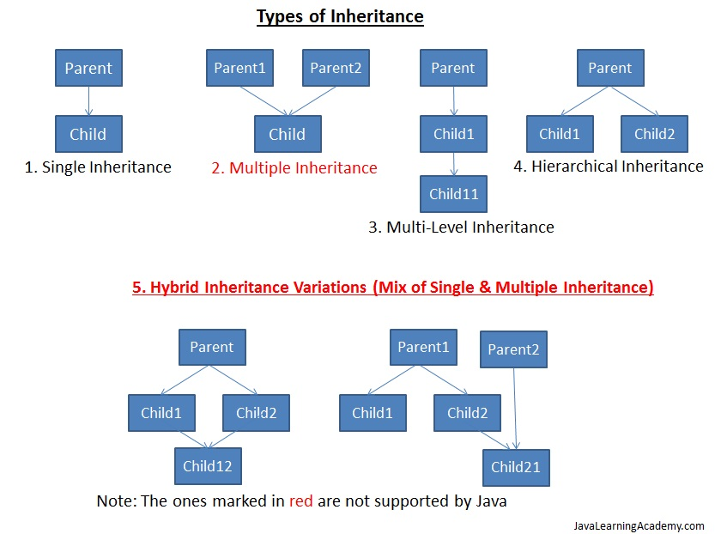

Slide 115
Multi Level Inheritance :
Created a programme to elaborate this concept .
Multiple Inheritance :
Create a Programme to elaborate this concept.
Invoking the Base class Constructor :
By using base class constructor __init__ () .
Made Programme to elaborate .

Slide 116
Method overriding .
Polymorphism
Method in the child class that has the same name , same arguments and same return type as a method in the parent class. When this method is called then the child method will get invoke instead of parent class .
Same display name method in parent and child class.

Slide 117
Python doesn’t method overloading .
Python support Operator Overloading .
‘ + ’ operator is used for adding two integer as well as concatenating two strings .
‘ * ’ operator for multiply and repeat of string .
Print ( 1 + 2 )
Print ( “a” + “b” )

Slide 118
Assignment :
WAP to find the area and perimeter of a rectangle using classes and objects .
Define a class to represent a bank account . Include the following details like name of the depositor, account number , type of account , balance amount in the account . Write methods to assign initial values to deposit an amount , withdraw an amount after checking the balance , to display name , account number , account type and balance .

Slide 119
WAP to implement the following .
Create a base class called person consisting of name and code . Create 2 child classes
A- Account with member_pay
B- Admin with experience and inherit the base class .
Create a class Employee with name , code , experience and pay by inheriting the above classes.
Explain constructor with python example .

Slide 120
Exception Handling :-
An Exception is an abnormal condition that is caused by a runtime error in the program . It disturbs the normal flow of the program .
An example is divisible by 0 then interpreter will display error message.
If we want the program to continue with the execution of the remaining code then we should try to catch the exception object thrown by the error condition and then display appropriate messages for taking corrective actions .This process is known as exception Handling .

Slide 121
Python has a collection of built in Exception classes .
for example – assertion Error , Attribute Error , keyError , Keyboard Interrupt , Value Error , Arithmetic Error , IOError etc .
Every try block be followed by atleast one except statement .
Try and one particular except .
Try and generic except .
Try and except clause with multiple exceptions .

Slide 122
Try and Finally .
Finally block can be used with try block . Finally block will execute for sure.
We can’t use except clause and finally together .
We can’t use else clause and finally together.
Only try and finally can be use together .
Exception with Argument : Argument give more information about the exception .

Slide 123
Raising and Exception :
It is also possible to define a new exception and raise it if needed .This is done using raise statement .
This raise is equal to throw clause in java .
User – Define Exception :
Python also allows us to create our own exceptions by deriving classes from the standard built in exceptions .This is useful when we need to provide more specific information when an exception is caught.

Slide 124
Assertion :
Assertion is a checking in python that can be turned on or off while testing a program . In assertion an expression is tested and if the result is false , an exception is raised . i.e assert will become active .
Assert keyword is used .
If the expression is evaluated to False , Python raises an AssertionError exception . Assertion Exception will be caught and performed using
try – except , but if not handled then they will terminate the program and produce a trace back .

Slide 125
Regular Expressions :
A Regular Expression helps to match or find other strings or sets of strings , using a specialized syntax held in a pattern . Grep command widely used in linux .
Re module is used for Regular Expressions .
Re module raises the exception re.error if an error occurs while compiling or using a regular expression .
Match () function – It is to match Regular Expression pattern to string with
Optional flags .
Syntax :
Re.match ( pattern , string , flags=0)
Match () function search pattern at beginning of string only .
If pattern not found then NONE return .

Slide 126
Search () function :
Different between Search () and Match () is that Match () only search the pattern at the beginning of the string whereas Search () search the pattern in whole string .
Search and Replace ()
Search and replace is done in python with help of sub method in re module .
Syntax :
Re.sub ( pattern , repl ,string , max=() )

Slide 127
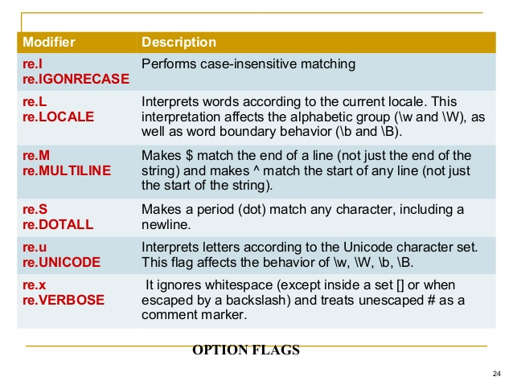

Slide 128
Find all () method :
It searches all patterns and returns a list.
Compile () method :
It compiles a regular expression pattern into a regular expression object , which can be use many times.
Re.compile() and saving the resulting regular expression object for reuse is more efficient when the expression will be used several times in a single program.

Slide 129
Assignment :
Given a string like “1,3-5,23,133,143,18-20,32”, produce the list
[1,3,4,5,23,133,143,18,19,20,32]
WAP to check the validity of password input by users . Validation (At least 1 letter between [a-z ] and 1 letter vetween [A-z] .Atleast 1 number between [0-9] . At least 1 character from [$#@] . Minimum length 6 characters. Maximum length 16 characters .
Create a file Test.txt . Retrieve all lines that contain “the”.
Retrieve lines that have two consecutive O’s .

Slide 130
Data Base Programming :
Python ( Data base – Application Programming Interface ) . Supports a large number of database like Oracle , MS-SQL Server 2000 , mySQL , Sybase etc .
Following steps for Data Base Programming :-
1. Connection with the database .
2. Issuing SQL Statements .
3. Stored Procedure .
4. Closing the Connections .

Slide 131
Sqlite 3 is not a client server Database instead it is a embedded into end program i.e Sqlite software need not to be installed on end user system , without this also they can update the data .
Whereas Postgresql is a client server Database i.e Postgresql should be
Installed on both client as well as server system . – At Last .
SQLite and PostgreSQL are among the most widely used relational database management systems (RDMS). They are both open-source and free, but they have some major differences that should be considered when choosing a database to use for your business.

Slide 133
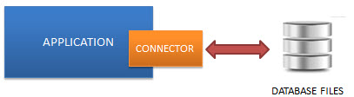
1. Principle
SQLite: Ultra-lightweight in setup, administration, and required resource.
PostgreSQL: The world’s most advanced open source database.
2. How it works
SQLite is an “embedded” database which means it’s server-less and can run within your app.

Slide 134
PostgreSQL on the other hand works based on a client-server model which requires a DB server to set up and run over the network.
3. Supported Data Types
SQLite supports only five types: BLOB, NULL, INTEGER, TEXT, REAL.
PostgreSQL supports almost everything that you can think of.
4. Storage
The SQLite library is less than 500kb while PostgreSQL is much larger in size.

Slide 135
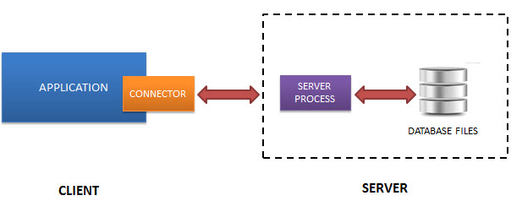

Slide 136
SQLite is highly useful for:
Standalone apps
Small apps that don’t require expansion.
Apps need to read or write files to disk directly.
The internet of things devices
Developing and even testing:
PostgreSQL is recommended when:
Data integrity and reliability is highly concerned.
Custom Procedures which is extensible to run the complex task.
Complexity with ease. PostgreSQL gives you the functionality to maintain such a complex database smoothly without limitations.

Slide 137
1. Connecting to a Data Base .
2. Creating Tables .
3. Insert Operation .
4. Update Operation .
5. Delete Operation .
6. Read Operation .
Fetch one ()
Fetch all ()
Row count ()

Slide 138
https://sqliteonline.com/
Made 2 programme –
1. Basic Python db .
2. Python full db .

Slide 139
7. Transaction Control . ( A C I D)
Atomicity - Ensure all the operations within the work unit are completed successfully ; otherwise the transactions is aborted at the point of failure , and previous operations are rolled back to the original state .
Consistency – Ensure that the database properly change states upon
a successfully committed transaction .
Isolation – Enable transaction to operate independently and transparent to each other .
Durability – Ensure that the result or effect of a committed transaction persist in case of a system failure .

Slide 140
Exception Handling in Databases :
Data base Error .
Data Error .
Integrity Error .
Interface Error .
Not Supported Error .
Etc

Slide 141
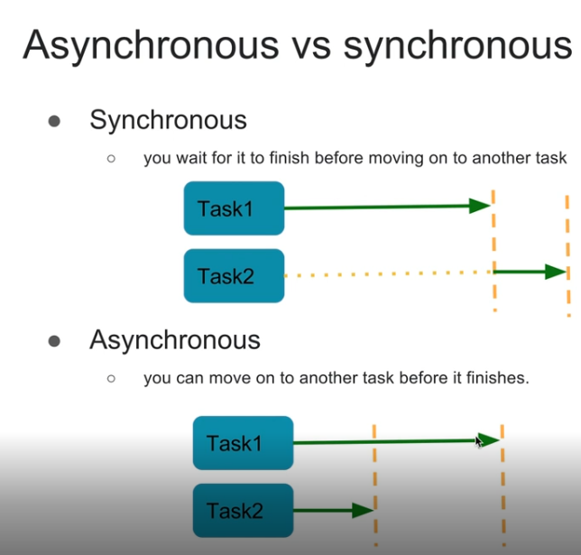
Multi Threading :-
Parallel Processing –

Slide 142
Modules :
Numpy .
Pandas .
Matplotlib ( Data Visualization )
Django Web Application python .
Data Science .

Slide 143
Django – Web Frame work .
MVT Patter –
Model – contain Data base .
View – The controller Regular HTML file .
Template – Pages which contain Dynamic element .
Template is a simple text file . It can create any text-based format like
XML , CSV etc .

Slide 144
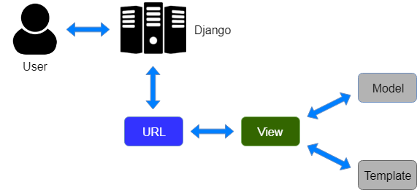

Slide 145
Machine Learning / Deep Learning .
Many Projects Based on Real Time Problem .
And Many More.

Slide 146
Thank You .

Slide 147
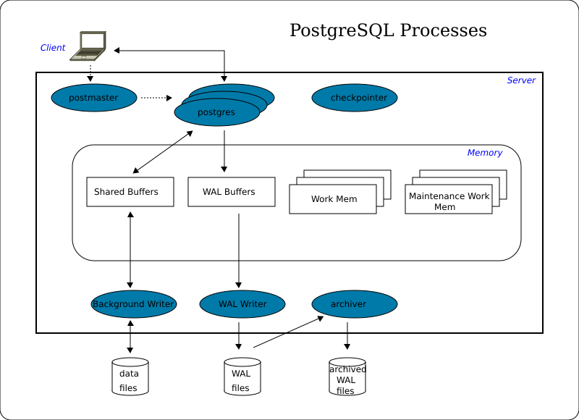
Slide – 131 Postgresql .

Slide 148
How Data is processed[edit]
Connecting to the Instance[edit]
Client applications, which run on a different server than the instance, use the IP protocol to connect to it. If client application and instance run on the same server, the same connection method is possible. But it is also possible to use a connection via a local socket.
In a first step the application connects to the postmaster process. The postmaster checks the application's rights and - if successful - starts a new postgres process and connects it with the client application.
Accessing Data[edit]
Client processes send and request data to and from the instance. For performance reasons, the instance doesn't write or read the requested data directly to or from disk files. Instead, it buffers them in a shared memory area which is called the shared buffers. The flushing to disc is done at a later stage.
To perform a client request, the corresponding postgres process acts on the shared buffers and WAL buffers and manipulates their contents. When the client requests a COMMIT, the WAL writer process writes and flushes all WAL records resulting from this transaction to the WAL file. As the WAL file - in contrast to the data files - is written strictly sequentially, this operation is relatively fast. After that, the client gets its COMMIT confirmation. At this point, the database is inconsistent, which means that there are differences between shared buffers and the corresponding data files.
Periodically the background writer process checks the shared buffers for 'dirty' pages and writes them to the appropriate data files. 'Dirty' pages are those whose content was modified by one of the postgres processes after their transfer from disk to memory.

Slide 149
The checkpointer process also runs periodically, but less frequently than the background writer. When it starts, it prevents further buffer modifications, forces the background writer process to write and flush all 'dirty' pages, and forces the WAL writer to write and flush a CHECKPOINT record to the WAL file after which the database is consistent, which means: a) the content of the shared buffers is the same as the data in the files, b) all modifications of WAL buffers are written to WAL files, and c) table data correlates with index data. This consistency is the purpose of checkpoints.
In essence the instance contains at least the three processes WAL writer, background writer, and checkpointer - and one postgres process per connection. In most cases there are some more processes running.
Optional Processes[edit]
The autovacuum launcher process starts a number of worker processes. They remove superflous row versions according to the MVCC architecture of PostgreSQL. This work is done in shared memory and the 'dirty' pages are written to disc in the same way as any other 'dirty' pages, such as the ones resulting from data modification by clients.
The logger process writes log, warning, and error messages to a log file (not to the WAL file!).
The archiver process copies WAL files, which are completely filled by the WAL writer, to a configurable location for mid-term storing.
The stats collector process continuously collects information about the number of accesses to tables and indices, total number of rows in tables, and works in coordination with VACUUM/ANALYZE and ANALYZE.
The WAL sender and WAL receiver processes are part of the Streaming Replication feature. They exchange data about changes in the master server bypassing the WAL files on disc.
Since version 9.6 it is possible to execute queries in parallel on several CPUs. In this case those parts of the execution plan, which shall run in parallel, are executed by additional background worker processes. They have access to the shared buffers in the same way as the original postgres processes and handle different buffer pages at the same time.

