Slide 1

Explainable Machine Learning Framework for Early Heart Disease Prediction
Under the esteemed guidance of – Dr. Swanthana
Section – 7
Group-8
2420030503-K. Anoop
2420030490 -V.Sree
2420030582-Sameera.M
2420030537-Souraja.M

Slide 2
Problem Statement
Heart disease is one of the leading causes of death worldwide. Many ML models predict it accurately but act as black boxes.
Doctors need transparent and interpretable prediction systems. The system should explain the medical factors behind each prediction.
An Explainable Machine Learning Framework is required. It provides accurate predictions with clear explanations for better clinical decisions.

Slide 3
Objectives
To develop an accurate machine learning model for early heart disease prediction.
To identify and select the most relevant clinical features influencing heart disease risk.
To evaluate and compare different machine learning models based on their prediction performance.
To integrate Explainable AI techniques such as SHAP and LIME for interpreting predictions.
To provide transparent and understandable insights that support early diagnosis and clinical decision-making.

Slide 4
Literature Survey
EXISTING PROJECTS | MODELS | OUTCOME | LIMITATION
Heart disease Prediction using Machine Learning | HDPM-01 | High prediction accuracy | No explainability
Explainable AI in Healthcare | XAIH-02 | Improved trust and interpretability | Limited Heart Disease Focus
XG-Boost based Heart Disease Prediction | XGHD-03 | High accuracy and fast prediction | No patient-level explanations

Slide 5
Research Gap Identification
Black-box ML models provide predictions without explaining the reasoning behind them.
Lack of transparency makes it difficult to understand the factors influencing predictions.
Low trust among doctors due to limited interpretability of AI-based decisions.
Limited Explainable AI and poor risk visualization reduce the effectiveness of clinical decision-making.
Fixed Research Gap: Develop a prediction model that is both accurate and interpretable.

Slide 6
Innovation, Creativity & Novelty
Innovation: Integrates Explainable AI (SHAP & LIME) with heart disease prediction to provide accurate and transparent results.
Creativity: Transforms complex machine learning predictions into simple, understandable insights for healthcare professionals.
Novelty: Combines SHAP and LIME to deliver patient-specific explanations, improving trust and interpretability in clinical decision-making.

Slide 7
Feasibility
Technical Feasibility
Python
Scikit-learn
XGBoost
SHAP
LIME
Google Colab/Jupyter Notebook
Dataset Availability
UCI Heart Disease Dataset
Cleveland Heart Disease Dataset
Kaggle Heart Disease Dataset
Cost
Open-source tools
Public datasets
No additional hardware required

Slide 8
Datasets
Dataset | URL Link
UCI Heart Disease Dataset | https://archive.ics.uci.edu/ml/datasets/heart+disease
Cleveland Heart Disease Dataset | https://www.kaggle.com/datasets/cherngs/heart-disease-cleveland-uci
Heart Disease Dataset | https://www.kaggle.com/datasets/johnsmith88/heart-disease-dataset
Key Features:
Age • Sex • Chest Pain • Blood Pressure • Cholesterol • Blood Sugar • ECG • Maximum Heart Rate • Exercise Angina • ST Depression

Slide 9
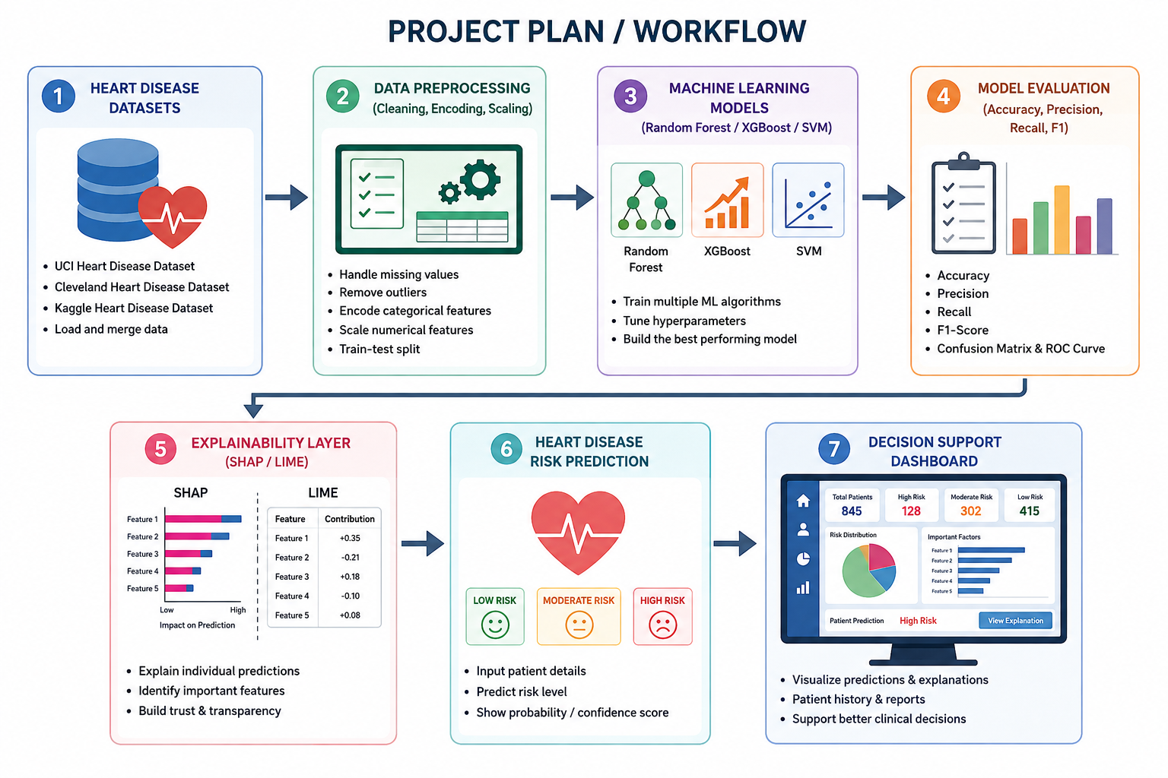
Project Plan:
┌──────────────────────────────┐
│ PHASE 1: DATA COLLECTION │
│ Heart Disease Dataset │
└──────────────┬──────────────┘
↓
┌──────────────────────────────┐
│ PHASE 2: DATA PREPROCESSING │
│ Cleaning • Encoding • Scaling│
└──────────────┬───────────────┘
↓
┌──────────────────────────────┐
│ PHASE 3: MODEL DEVELOPMENT │
│ Random Forest • XGBoost • SVM │
└──────────────┬───────────────┘
↓
┌──────────────────────────────┐
│ PHASE 4: MODEL EVALUATION │
│ Accuracy • Precision • Recall │
│ F1-Score │
└──────────────┬───────────────┘
↓
┌──────────────────────────────┐
│ PHASE 5: EXPLAINABLE │
│ PREDICTION │
│ SHAP • LIME → Risk Prediction │
└──────────────────────────────┘

Slide 10
Expected Outcomes
Accurate early heart disease prediction.
Transparent AI explanations.
Improved trust among healthcare professionals.
Better clinical decision support.
Easy-to-use prediction framework.

Slide 11
Conclusion
The proposed Explainable Machine Learning Framework for Early Heart Disease Prediction combines high prediction accuracy with transparent and interpretable explanations.
By integrating Explainable AI techniques such as SHAP and LIME, the system helps healthcare professionals understand the reasoning behind predictions, enabling informed clinical decisions and supporting early diagnosis to improve patient outcomes.

