Slide 1
Team code crafters
Sameera Ellanki
Varsha Jampala
Nikhil Kuchipudi
Naga Shivani Pinnamaraju
Jaswanth Sai Donepudi
Manogna Reddy Anugu
Atluri Varun Chowdary
Naga Bindu Kondaveeti

Slide 2
Inventory management system
Our inventory management system project is being developed to provide a streamlined stock management software to any retail shops, those who are typically handling stock manually or using any old software which is outdated.
On top of keeping track of stock flow our project mainly focuses on making the bin locations in a warehouse easy to manage and keep track of which item in what location.
Available stock information, separate items, customers, vendors, invoices, bills, warehouses modules and interlinking between them really makes out application shine in the competition.

Slide 3
Project objective
Inventory Tracking and Bin Location System: Develop a robust inventory tracking system with support for bin locations to enhance stock retrieval and management efficiency.
User Friendly Interface: Keeping the user interface simple elegant for the customer to use.
Modular design: Implement features as modular as possible this means keeping the features separate from one another, to make it easy on the user to use the features provided by each module independently.
Sales and Purchase Order Integration: Integrate modules for sales orders and purchase orders to streamline the invoicing process and maintain a history of stock purchases and sales.

Slide 4
PROJECT PLANING
Phase one:
Project objectives
Project scope
Research various existing projects
Phase two:
Develop Project Proposals
Finalize a project to work on
Get started with initial deliverables

Slide 5
PROJECT PLANING
Phase three:
Decide features to include
Competitor analysis
User need analysis
Phase four:
Set up development environment
Develop login system
Test user login

Slide 6
PROJECT PLANING
Phase five:
Add item, customer, vendor modules
Basic database integration to handle stock
Working prototype
Phase six:
Add sales order, purchase order, bills and invoices.
Integrate those with the previous modules.

Slide 7
PROJECT PLANING
Phase seven:
Develop and merge warehouse and bin locations with the previous modules
Unit testing
Acceptance testing
Test and fix production build
Phase eight:
Final project documentation
Final review

Slide 8
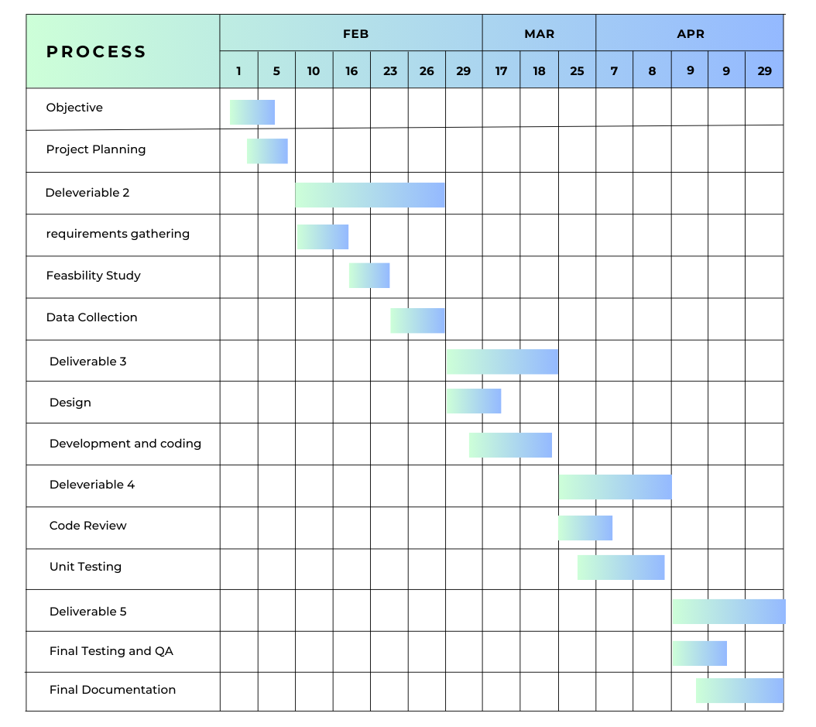
Project timeline

Slide 9
Development
Programming Languages and libraries
JavaScript – It’s the most widely supported language by browsers for rendering websites
HTML5 – The usual language for basic Dom elements
CSS – Provides styling for the Dom elements
Server Environment - NodeJS
Node JS is selected to be our server because it can execute and make Api calls with server side rendered JavaScript, so by having the power of JavaScript we combine it with express's to fulfil our Api calls.

Slide 10
Development
Database: SQLite – lightweight SQL technology for stability
Version Control: GIT This is a wisely used version control toll for case of collaboration between a large team
IDE : Visual Studio code
It's simple Ui and helpful extensions make it an amazing tool to work in .
Extensions used: ESLint, React snippets, Prettier
Hosting: web

Slide 11
ROLES of TEAM MEMEBERS
Sameera - Project Management; and demo and presentation lead
Varsha - Implementation for backend and System Administrator lead
Nikhil - Requirements lead and helps in system administration
Shivani - Implementation lead for front end
Jaswanth - Configuration management lead and helps in design of the project
Manogna – Documentation lead and helps in testing of our project model
Varun – Testing lead and helps in documentation
Bindu – Design lead and helps in configuration management

