Slide 1
RTC Parking Deck System
INFS – 622:System Analysis and Design
Dr. Larry Kerschberg
-Sameera Bammidi
-Divya Vajja
-Arvind Uppar
-Prinkle Lopes

Slide 2
Introduction
Reston Town Center offers unparalleled accessibility with seven parking garages.
ParkRTC is the easy way to pay for parking at all of Reston Town Center’s over 7,000 parking spaces.
The new ParkRTC app makes parking convenient so that you can enjoy everything Reston Town Center has to offer.

Slide 3
Primary goals
Protecting the parking rights of RTC tenants and visitors who patronize the Center.
Enhancing the parking experience of those tenants, visitors and patrons.
Augmenting the Boston Properties revenue dedicated to reinvestment in the Reston community through improved facilities for the general public, family-oriented events, best-in-class retail, innovative technologies and nonprofit donations.

Slide 4
Existing System
There are 7,000 parking spaces distributed across 6 garages.
Additionally there is street parking.
Parking is free for all users always.

Slide 5
New system
Create an account for mobile payment
Download the App
Register with Phone or Email
Once verified, you’re ready to start parking
Start parking
Enter Garage Zone located on signage where you are parking
Choose method of payment
Confirm parking session details
Manage parking session
See remaining session time
Extend parking session remotely
Track all your parking history

Slide 6
New system
Parking rates
0-2 hour $0.00
2-4 hours $2.00
4-6 Hours $6.00
.
.
12-24 Hours $12.00
Street Rates (2 hr. max)
0-1 Hour $2.00
1-2 Hours $5.00
Allow users to reserve before one day.
Cancel the reservation without cancellation fee until before 1 hour.
Show garage map to reserve a desired spot.
Free parking on weekdays for the first two hours. Billing starts from the third hour.
All day parking for $12.
Send garage map picture with the user’s parked spot highlighted in green.
Special category reservation option: handicapped people, employees of ParkRTC, Electric car owners, Security people.

Slide 7
Functional Requirements
The system shall allow the user to complete one-time registration process.
The system shall provide the links for the user to download the app through Google pay or App store.
The system shall not allow reservation if the maximum number of parking spaces are filled.
The system shall provide the user the information of available parking spots in respective zones.
The system shall notify the user when their parking time is about to expire.
The system shall allow the user to extend their parking time remotely.
The system shall detect the presence of a parked vehicle.
The system shall not charge the user until the parking session is initiated.
The system display an interactive garage map which displays all the available spots at a selected time of the day.

Slide 8
Non-functional Requirements
The system shall run on Android and Apple phone for the user to use.
The system shall be updated with available parking spots every 2 minutes.
The system shall notify the user 10 minutes before the parking time expires.
The system shall allow direct and discreet two-way communication with your community safety officials using text, picture, video and audio.
The system shall not allow user to cancel the reserved ticket less than one hour before the parking time.
The monthly pass should be available for the purchase for $70.00
The system shall send shopping related discounts or validation from retailers.
The system shall secure the license plate information.
The system shall secure the payment information.
The system shall wait until half hour after the parking session started and cancel the reservation if the user does not arrive.

Slide 9
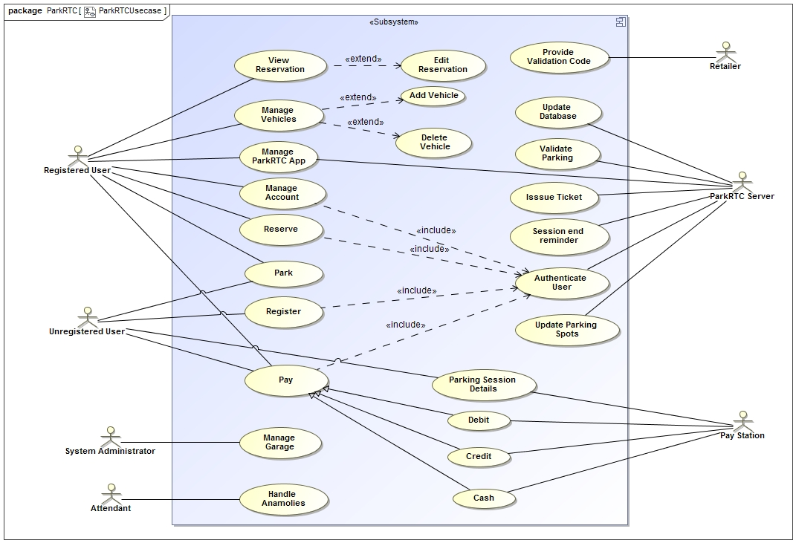
Use Case Diagram

Slide 10
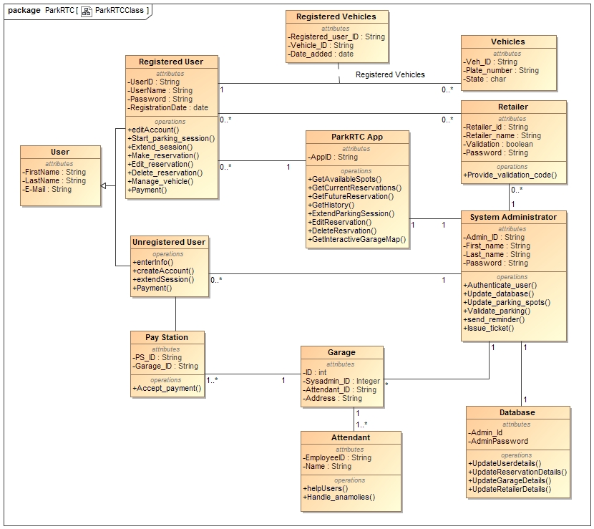

Slide 11
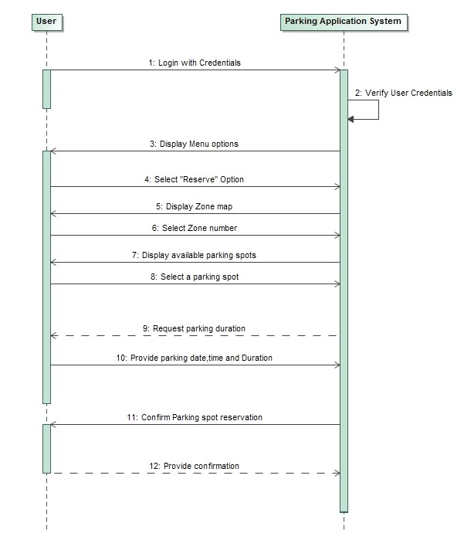
Sequence Diagram 1)Reserve

Slide 12
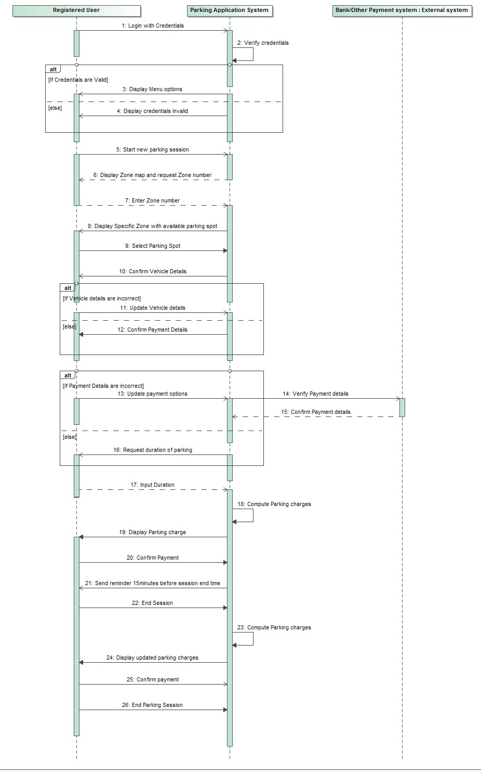
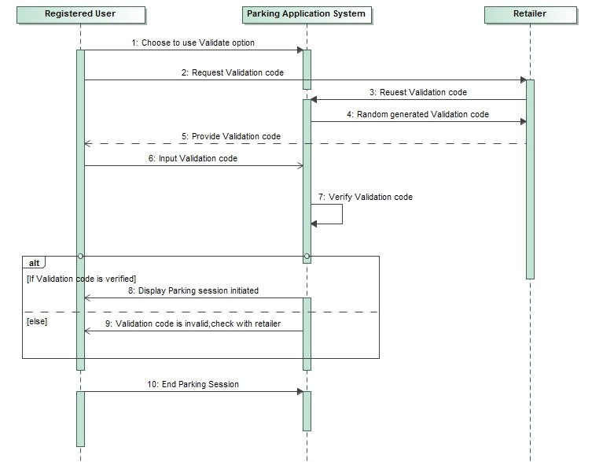
2)Initiate Parking Session
3)Validate Parking

Slide 13
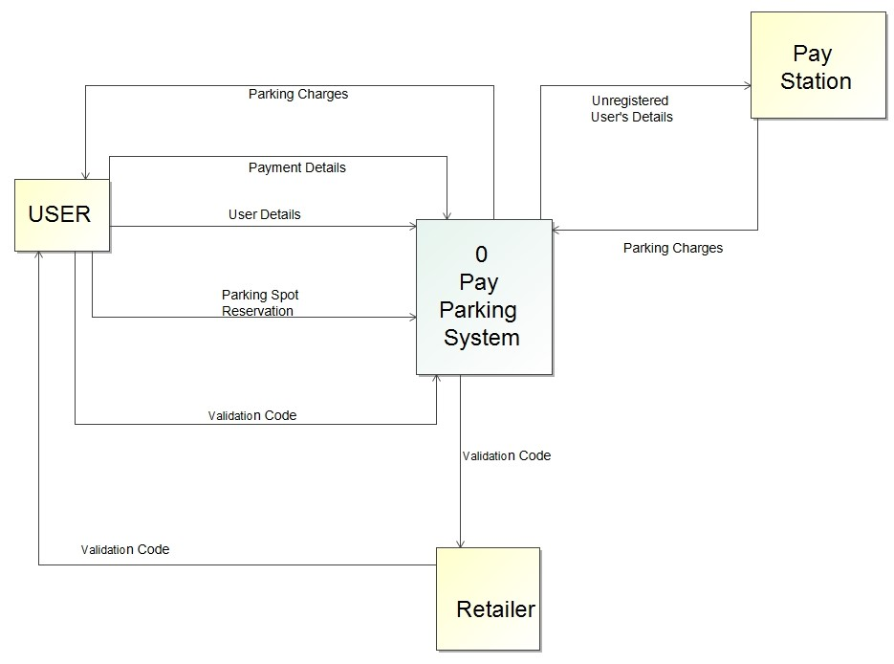
Data Flow Diagrams Context Diagram

Slide 14
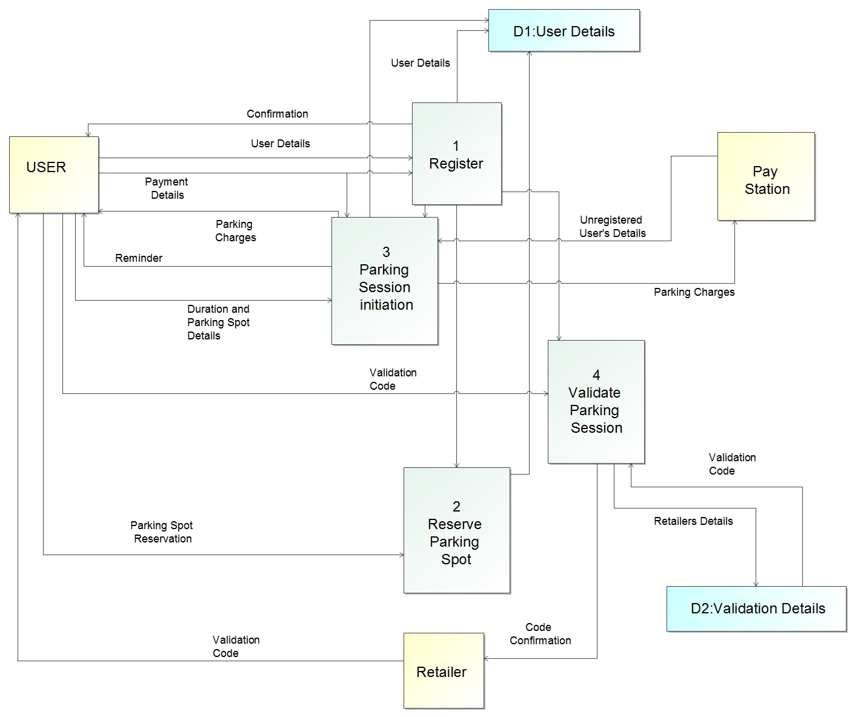
Level 0 Diagram

Slide 15
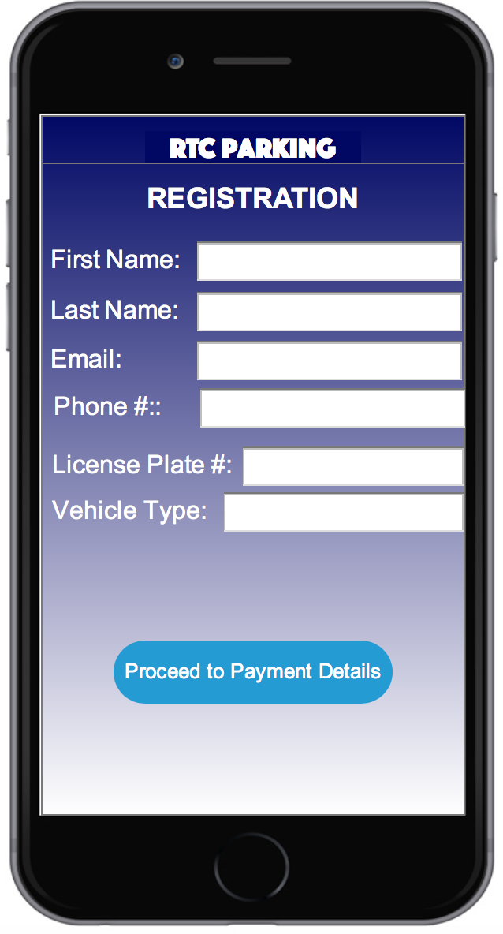
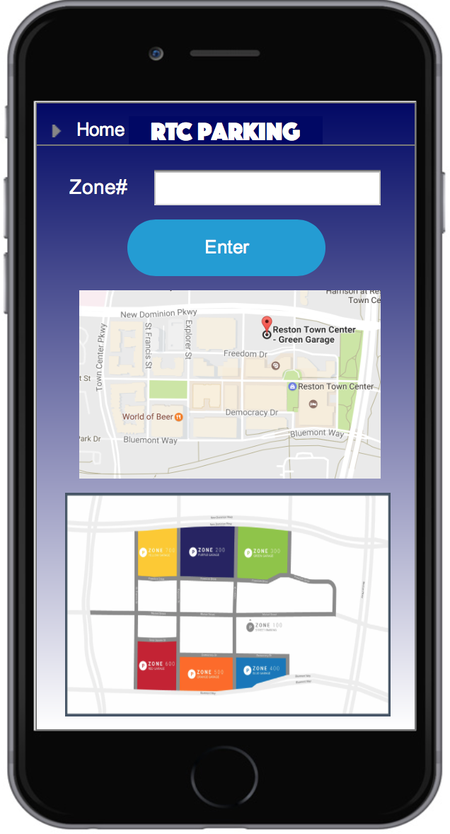
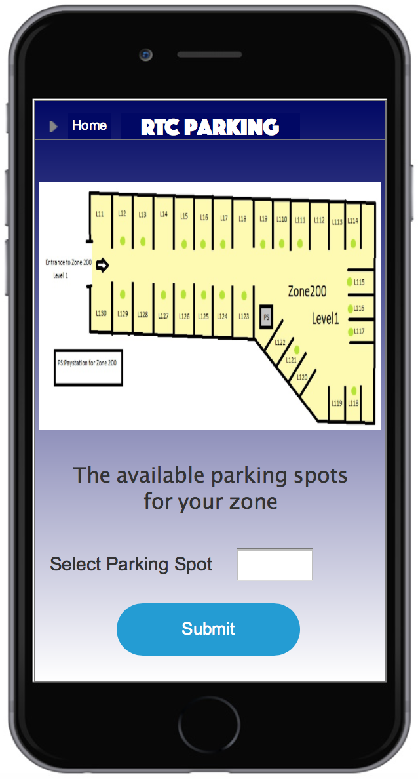

Slide 16
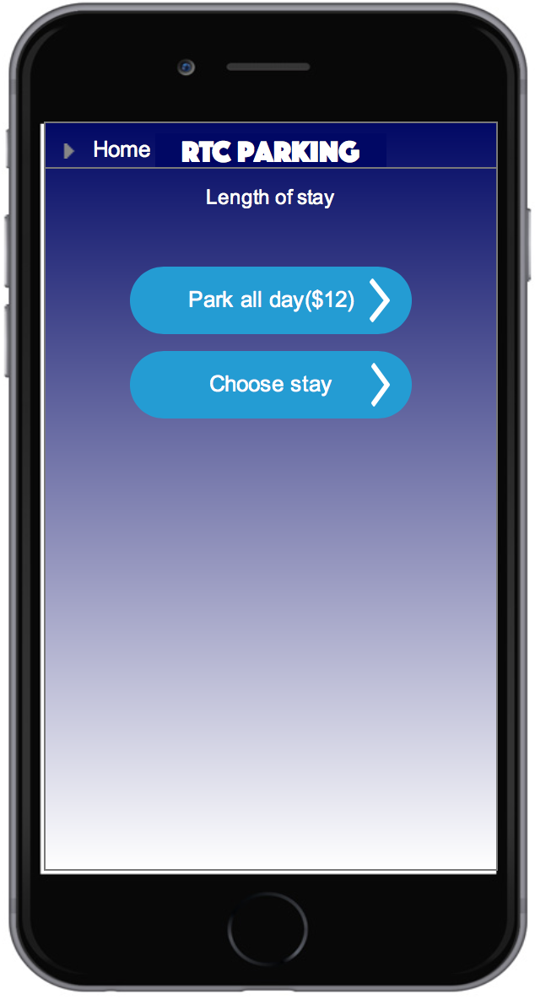
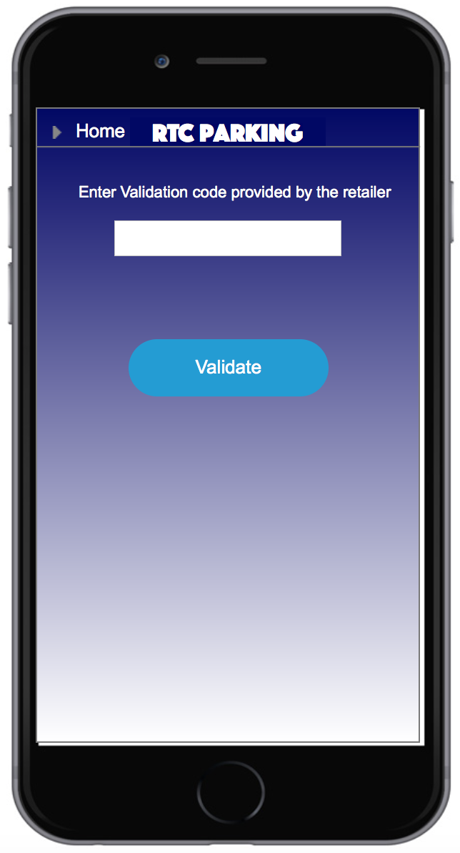
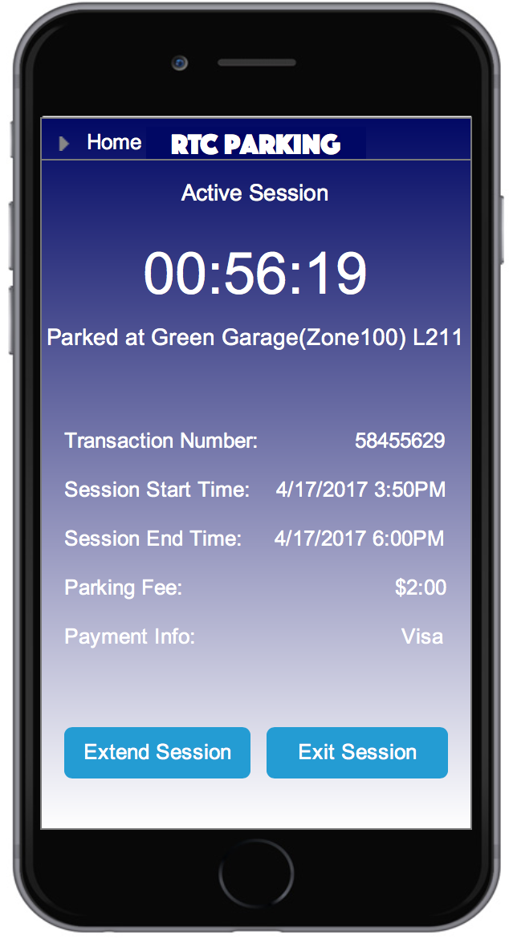

Slide 17
Recommended System Acquisition Strategy
The system made use of already existing systems to step up the development process.
We decided that a custom development project using the company’s standard Web development tools would be the best choice for Park RTC
For development, we used already existing system to create new system, using development resources from Parking RTC.
Developers with experience were hired for the System development.
The Interface was made customizable so that changes could be made after evaluation and can be incorporated later in the interface.
The system Development time is also another crucial factor in the development process. The System should be developed in optimal time, and time periods were set to see out each phase of development.

Slide 18
Hardware and Software Specification
 | Standard Client | Standard web server | Standard Application Server | Standard database Server
Operating system | IOS ,Android, Windows and Linux | Linux | Linux | Amazon RDS(MySQL)
Special Software | 1. Software That says Cars have overstayed and to extend their Parking period and Recurring Reservations. 2. Software To keep Track of Incoming And outgoing of vehicles. 3. System shall have Google maps Plug-in to facilitate the user to track the parking spot. This Plug-in is also used to locate a parking spot while making the reservation using interactive garage map. | Apache tomcat | Java | Amazon RDS(MYSQL)
Hardware | 1.Camera sensors are used to resolve the Number in the number plate to a string. 2. LED based Special Indicators which change color to red or green to reflect the status of the parking space. I5 Dual Core Processor, Xeon processor. | 500-GB disk drive Dual-core Xeon processor, I5 Dual Core processor, Quad Core processor | 160-GB disk drive Dual- Xeon processor, I5- Dual Core processor | 10-TB disk drive, RAID
Network | 1.Broadband Preferred 2. Dial-up at 1.5mbps, possible with some performance loss. | Dual 100 Mbps Ethernet | Dual 100 Mbps Ethernet | Dual 100 Mbps Ethernet

Slide 19
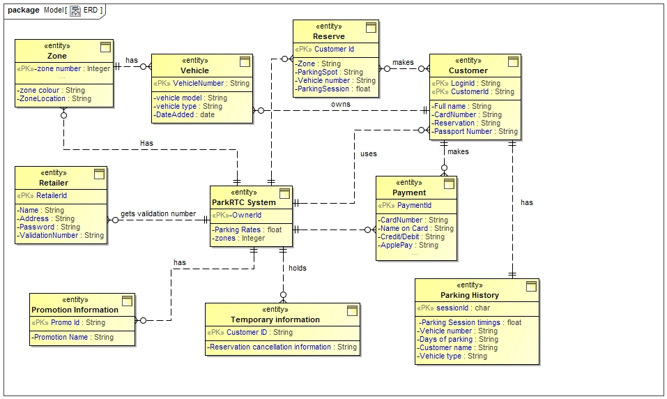
ER Diagram

Slide 20
Risk Analysis
Risk #1: Acceptance by customers
Likelihood of risk: High probability of risk.
Risk #2: Theft
Likelihood of risk: Low probability of risk.

Slide 21
 | Year 0 | Year 1 | Year 2 | Year 3 | Total
Benefits
Payment From Garage Parking |  | 550,000 | 602,000 | 845,000 | 1997000
Payment From Street Parking |  | 58,050 | 80,000 | 96,000 | 234050
Total Benefits |  | 608,050 | 682,000 | 941,000 | 2,231,050
Development costs
Labor: Analysis and design | 40,000 | 0 | 0 | 0 | 40,000
Labor: Application Development | 140,000 | 0 | 0 | 0 | 140,000
Consultant fees | 35,000 | 0 | 0 | 0 | 35,000
Software | 20,000 | 0 | 0 | 0 | 20,000
Hardware Equipment | 13,000 | 0 | 0 | 0 | 13,000
Total Development Costs | 248,000 | 0 | 0 | 0 | 248,000
Operational Costs
Labor: Business manager |  | 50,000 | 51,500 | 53,000 | 154,500
Labor: Computer operations |  | 40,000 | 41,500 | 42,000 | 123,500
Labor: Staff |  | 60,000 | 63,000 | 65,000 | 188,000
Software upgrades |  | 1,500 | 1,500 | 1,500 | 4,500
Hardware Maintenance |  | 2,500 | 2,500 | 3,000 | 8,000
Total Operational Costs |  | 154,000 | 160,000 | 164500 | 478,500
Total Costs | 248,000 | 154,000 | 160,000 | 164500 | 726,500
Total Benefits - Total Costs | -248,000 | 454,050 | 522,000 | 776,500 | 1,983,050
Cumulative Net Cash Flow | -248,000 | 206,050 | 728,050 | 1,504,550
Return on Investment (ROI) | 2.070957
Break-Even Point | 0.062395
Intangible Benefits: | Improved customer satisfaction
 | Lower emissions and reduce fuel consumption due to decreased time looking for spots
Economic
Feasibility

Slide 22
Other considerations and Future work
Monitor and update the mobile application.
Targeted advertisements to the customers.
Voice activation to the software.
A device like EZ-Pass for customer convenience.

Slide 23
THANK YOU.

