Slide 1

Lailisa
We Promise Joy…..

Slide 2

What is Event Management?
Event management is a process of analysing ,planning,marketing,producing and evaluating an event.It is a different way of promoting a product or service or idea.
If an event is managed effectively and efficiently,it can be used as a powerfull tool for provinding services.
Objective:
The objective of our project is to provide an event managing service to the customers needs.Our web application gets information about the event and plans them accordingly.The organiser work with the managing team to implement an evolutionary event management.

Slide 3

Introduction
Lailisa Event Management is an application which includes registration of customers, storing their details into the database. This application is based on an Event Management agency to provide planning of events. Our software has the facility to give a better event managing service for the customers. Every customer is provided a schedule once the details of schedule automatically when they have registered.The customer can view the different scheduled events and choose them according to their needs.

Slide 4

Events Planning -with 5 W’s concepts.
Why
- Why we want to organise the event.(event objective)
When
-When to oraganise the event.(date and time)
Where
-where to organise the event.(venue)
Who
-Who will be the organisers, sponsors,partners, target audience etc.
What
-What will be done in the event.

Slide 5
Who
Who will be the organisers, sponsors,partners, target audience etc.
What
What will be done in the event.

Slide 6

Overview
Lailisa Event Management software providesthe tools to manage all of your events online.Using Lailisa , our clients have increased their event attendance while saving time and money in the process. Allow invitees to register
through an easy-to-use online process, whether your event is a simple seminar for a small group or a multi-day conference with thousands of attendees.Quickly and securely process event fees directly into your bank account. Early-bird rates, discounts, coupons, and refunds are easy.

Slide 7

Features
Our application Lailisa is characterised by various elements coordinated together for a perioid of time .When Lailisa undertakes an event contract for a client,it usually is characterised by
Objective of the event
Target Audience visiting the event.
Period of the event
Manner of inviting the audience
Type of event
Dates of the evnt
Venues of the event
Hospitality
Performance

Slide 8

Modules
Administration Module
The administrative module includes the Xampp, Mysql and Php which enables the overall website to create a server-side database. This data base enables the server to gain informations about the customer who has been looking for an effective event planner.
User Module
The user modules contains the first name,last name,contact,event name,type of event ,name of fiancé(if wedding),name of honoree(if milestone event),name of corporation(if corporate event), address, e-mail address, password, date of event and what services are they looking for.

Slide 9

Tools Used:
XAMPP
Xampp stands for Cross-Platform (X), Apache (A), MariaDB (M), PHP (P) and Perl (P). It is a simple, lightweight Apache distribution that makes it extremely easy for developers to create a local web server for testing and deployment purposes.
Apache Flex Open Source Community
Get involved with an active open source project. Flex is now being developed at the Apache Software Foundation so you can participate in the project and directly contribute to the next version of the framework.
MySQL
MySQL is a popular choice of database for use in web applications, and is a central component of the widely used LAMP open-source web application software stack (and other "AMP" stacks). LAMP is an acronym for "Linux, Apache,MySQL, PHP/Python". Free-software open-source projects that require a full-featured database management system often use MySQL.
HTML
Lailisa has been built a admirable stylesheet with the HTML\CSS code that makes the web page look more vibrant than any other event planning websites.
PHP
The PHP Hypertext Pre-processor (PHP) is a programming language that allows web developers to create dynamic content that interacts with multiple databases like MySQL, PostgreSQL, Oracle, and Microsoft SQL-server. It is a server side scripting language that is embedded in HTML

Slide 10
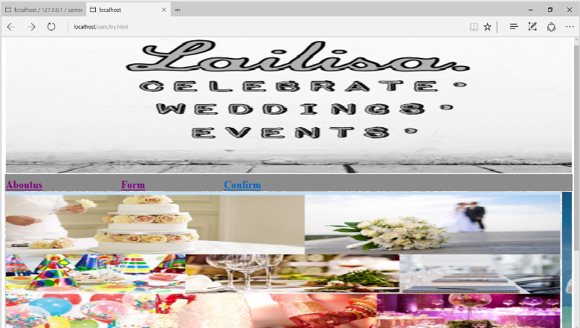

Slide 11

Conclusion
The customers can register attendees online on a customized registration form, send invitations, and send registration confirmation emails with barcodes. Then you can export your guest data for Event Track, which lets you register attendees on-site.Dealer meets, Conferences, Exhibitions, Customer Meet, Product launches and Product Promotions, Accommodation management, Logistics management, Entertainment shows, Fashion shows, Cultural shows, Award night are planned and organised by our Lailisa.

