Slide 1
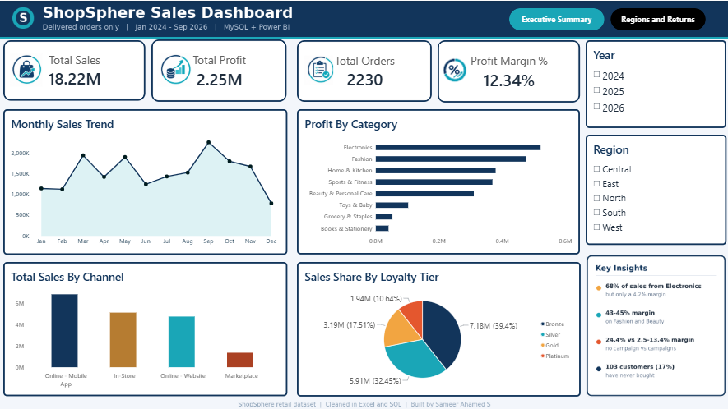
DATA ANALYTICS PROJECT | MYSQL + POWER BI
ShopSphere Retail Sales Analytics
Where profit is earned, and where it leaks
₹18.22M
₹2.25M
2,230
12.3%
Net sales
Profit
Delivered orders
Profit margin
Sameer Ahamed S | Anudip Foundation | DBA_AI

Slide 2
BUSINESS PROBLEM
ShopSphere sells on four channels but has no single view of profit
ShopSphere sells through a website, a mobile app, physical stores and marketplaces. Sales data sits in four separate tables, so leadership cannot see where money is made or lost.
Five questions we answer
1
How do sales and profit change over time?
2
Which categories, regions and channels earn most?
3
Do discount campaigns make money?
Business rule
"Sales" means Delivered orders only. Cancelled, returned and in-transit orders are not revenue.
4
How much do returns cost?
5
Who are our best customers?
ShopSphere Retail Sales Analytics | Sameer Ahamed S

Slide 3
APPROACH
Four stages took the raw files to an interactive dashboard
1 Clean
2 Store
3 Analyse
4 Visualise
Excel
MySQL
SQL
Power BI
Duplicates, spaces, blanks and labels fixed
Star-schema database loaded with clean tables
15 business questions answered with joins
Power Query, DAX measures, 2-page dashboard
Tools used
Excel
MySQL 8
SQL
Power Query
DAX
Power BI
GitHub
ShopSphere Retail Sales Analytics | Sameer Ahamed S

Slide 4
DATA MODEL
A star schema connects four tables through ID columns
Dates
1,004 days
Order Date
Sales (fact)
Products
Product ID
Customer ID
Customers
2,600 order lines
sales, profit, status
35 products
620 customers
Many to one
One source of truth
Fast and clear
Each sale points to one customer, product and date
Descriptions live only in the dimension tables
Filters flow from the small tables to the sales table
ShopSphere Retail Sales Analytics | Sameer Ahamed S

Slide 5
DATA CLEANING
Nine data issues were fixed before any analysis
18
21 / 6
11
Duplicate order lines
Extra spaces in name / city
Payment methods spelled differently
Removed, one copy kept
Trimmed
Standardised
781
2,460
19
Campaign written as "None"
Blank return reason
Missing discount %
Renamed "No Campaign"
Set to "Not Returned"
Calculated from amounts
17
10
13
Missing delivery days
Category labels "and" vs "&"
City in capital letters
Delivery date minus order date
Matched to products table
Matched to customers table
Blanks kept on purpose: 370 delivery dates and ratings do not exist for returned, cancelled or in-transit orders.
ShopSphere Retail Sales Analytics | Sameer Ahamed S

Slide 6
SQL BUSINESS QUESTIONS
Eight questions on time, regions, products and campaigns
How do sales and profit change each year?
Which category makes the most profit?
1
2
Which region sells the most?
Which months sell the most in 2025?
3
4
Who are our top 10 customers?
Do weekends sell more than weekdays?
5
6
Which category gets the most returns?
Do campaigns make money?
7
8
ShopSphere Retail Sales Analytics | Sameer Ahamed S

Slide 7
SQL BUSINESS QUESTIONS
Seven questions on customers, products, delivery and returns
Which loyalty tier spends the most?
Which 5 products make the most profit?
9
10
How many customers never bought?
How long does delivery take in each region?
11
12
Which category gets the best ratings?
Which 5 sales reps earn the most profit?
13
14
How much do returns cost, and why?
Skills used
15
JOIN, GROUP BY, SUM / COUNT / AVG, subquery
ShopSphere Retail Sales Analytics | Sameer Ahamed S

Slide 8
PERFORMANCE
Sales fell in 2025, but profit held steady as margin rose
Net sales (₹ million)
Profit margin (%)
Profit: ₹827K in 2024, ₹833K in 2025, ₹588K in 2026. *2026 data runs to September.
ShopSphere Retail Sales Analytics | Sameer Ahamed S

Slide 9
PRODUCTS
Electronics gives 68% of sales but keeps only 4.2% margin
Profit margin by category (%)
₹12.35M
Electronics sales, but only ₹521K profit
₹474K
Fashion profit from 1.11M of sales
₹310K
Beauty profit from 0.69M of sales
ShopSphere Retail Sales Analytics | Sameer Ahamed S

Slide 10
PROFIT LEAKS
Campaigns and returns are where profit leaks
Profit margin by campaign (%)
Sales lost to returns (₹ thousand)
157 returned orders cost ₹1.68M in sales and ₹276K in profit.
ShopSphere Retail Sales Analytics | Sameer Ahamed S

Slide 11
POWER BI DASHBOARD
Page 1, Executive Summary: sales, profit and trends
KPI cards
Sales, profit, orders and margin
Charts
Trend, category, channel and loyalty tier
Key Insights
Four findings in one card
ShopSphere Retail Sales Analytics | Sameer Ahamed S

Slide 12
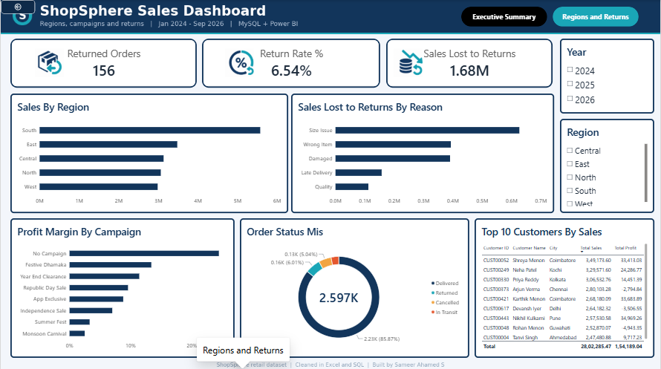
POWER BI DASHBOARD
Page 2, Regions and Returns: where profit leaks
Returns
Orders, return rate and sales lost
Campaigns and regions
Margin by campaign, sales by region
Top 10 customers
Ranked by sales and profit
ShopSphere Retail Sales Analytics | Sameer Ahamed S

Slide 13
RECOMMENDATIONS
Four actions would protect profit and win back customers
Review electronics pricing
Promote higher-margin Fashion and Beauty
Reduce campaign discount depth
Monsoon Carnival earns only 2.5% margin
Cut returns
Add size guides and a packing check
Win back 103 customers
They have never placed an order
Limits: one product per order, no sales targets, 2026 data ends in September, customer names are not unique.
ShopSphere Retail Sales Analytics | Sameer Ahamed S

