Slide 1

Elibrary
Sameer & Akhtar Haider

Slide 2

Agenda
Introduction
Pages
Picture
Summary

Slide 3
Introduction

Slide 4

Home Page

Slide 5
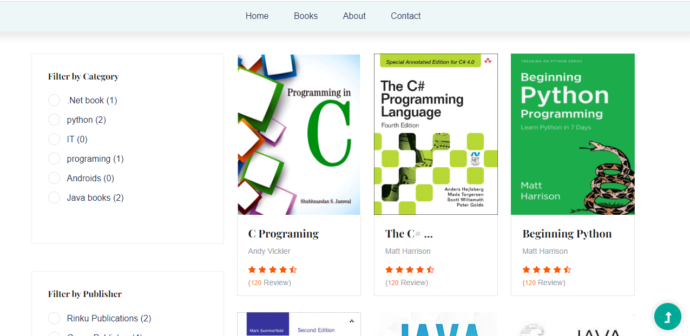
Book Page

Slide 6
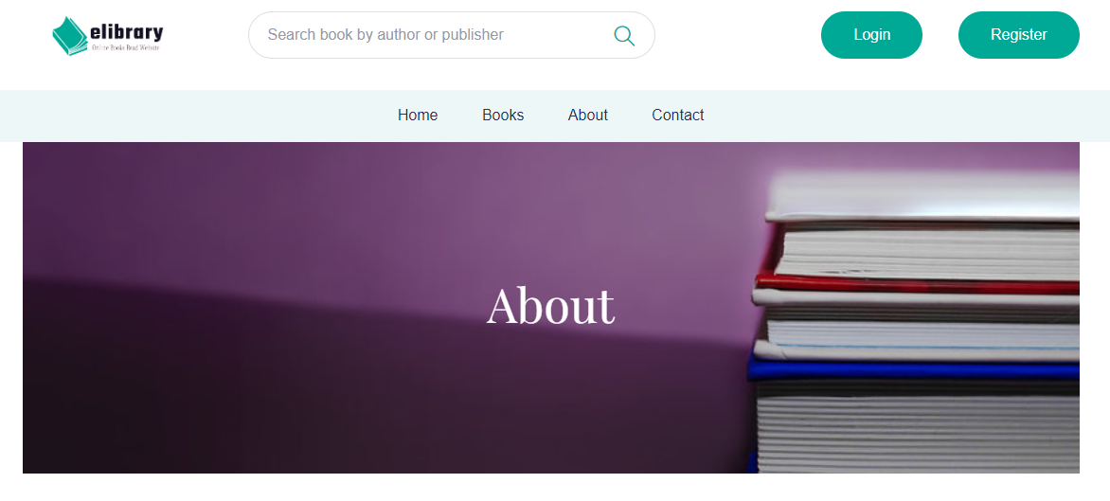
About Page

Slide 7
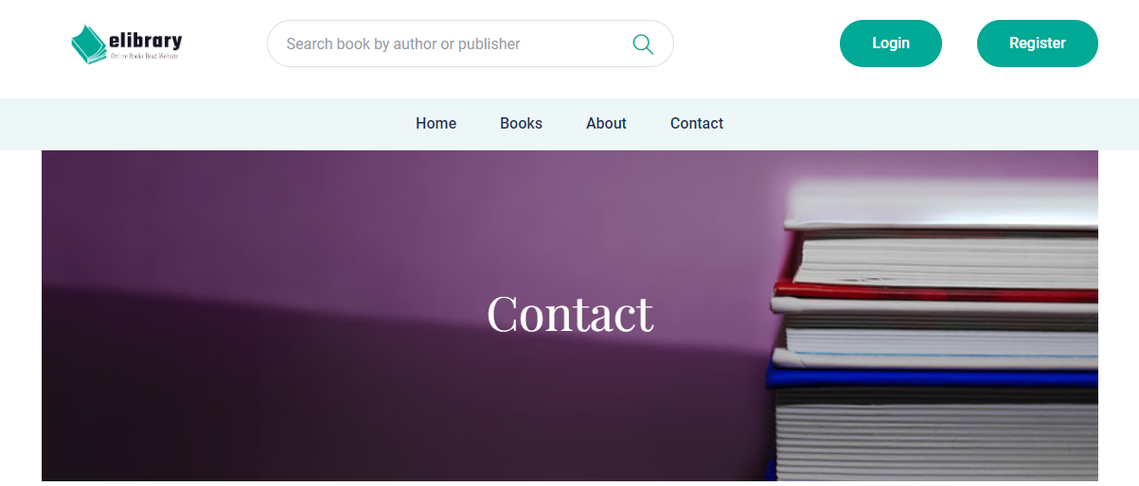
Contact Page

Slide 8
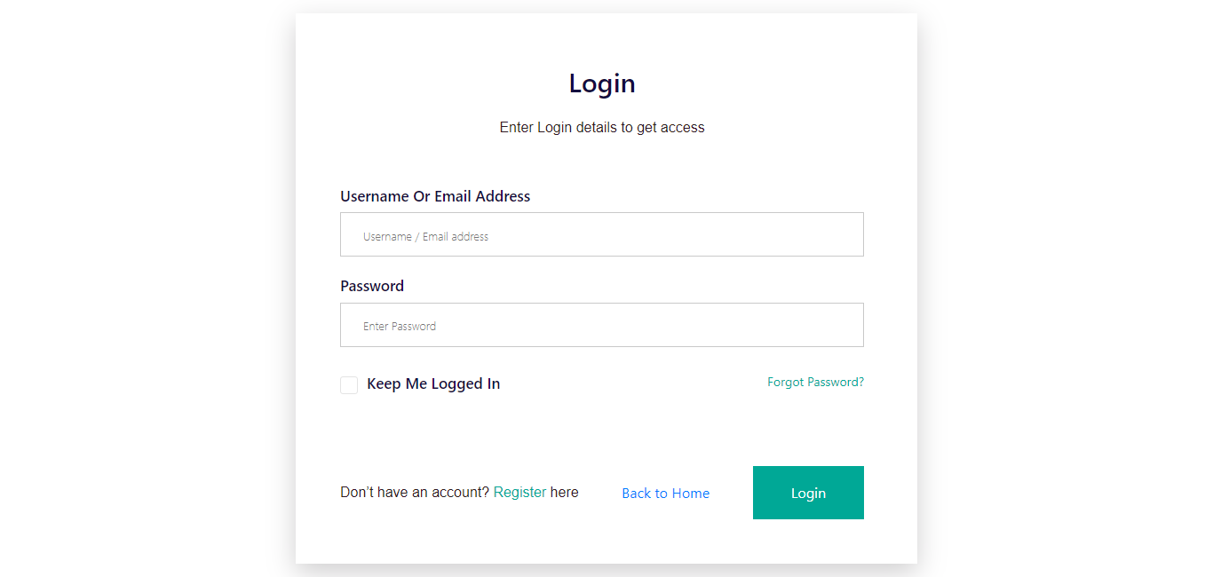
Login Page

Slide 9
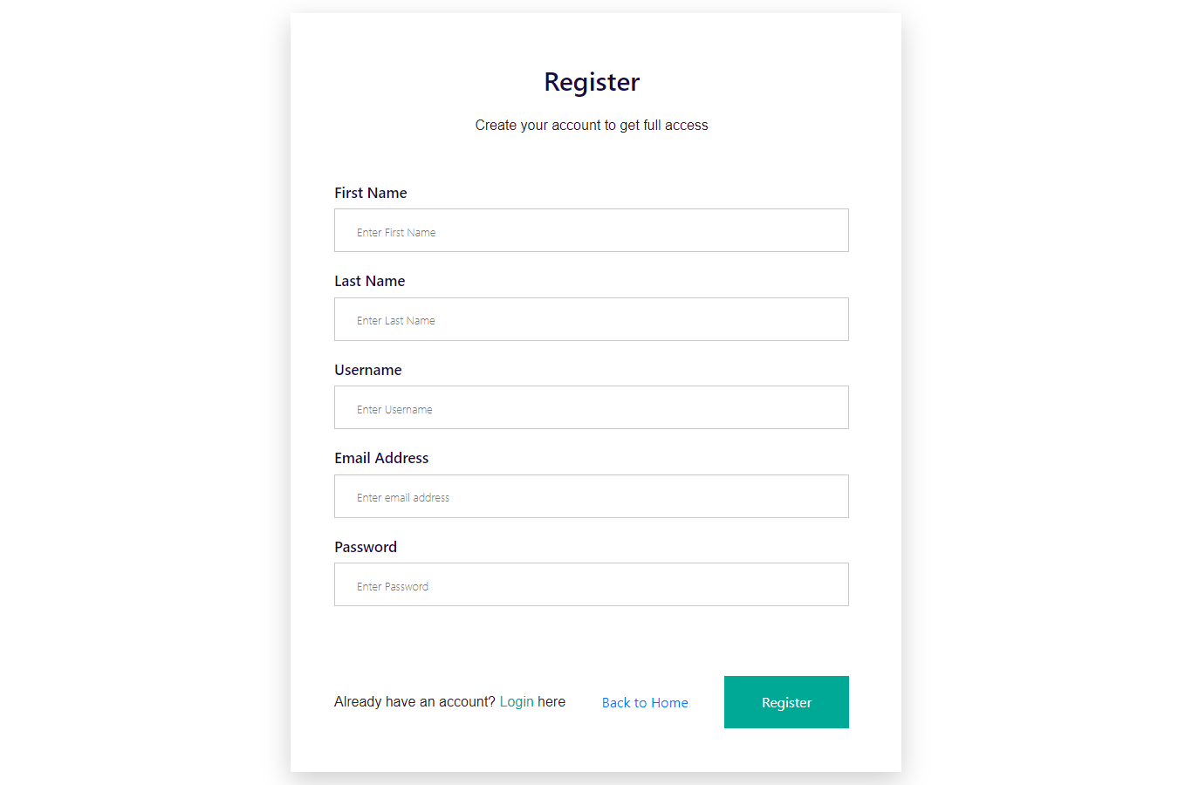
Register Page

Slide 10
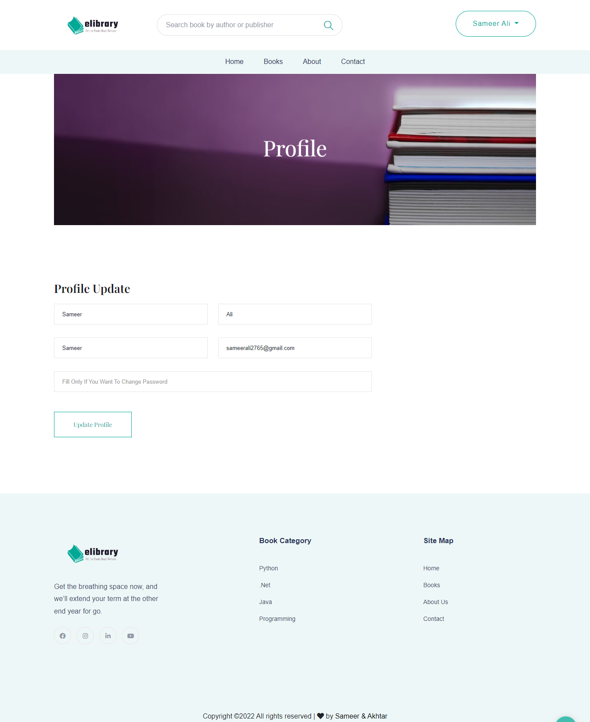
Profile Page

Slide 11
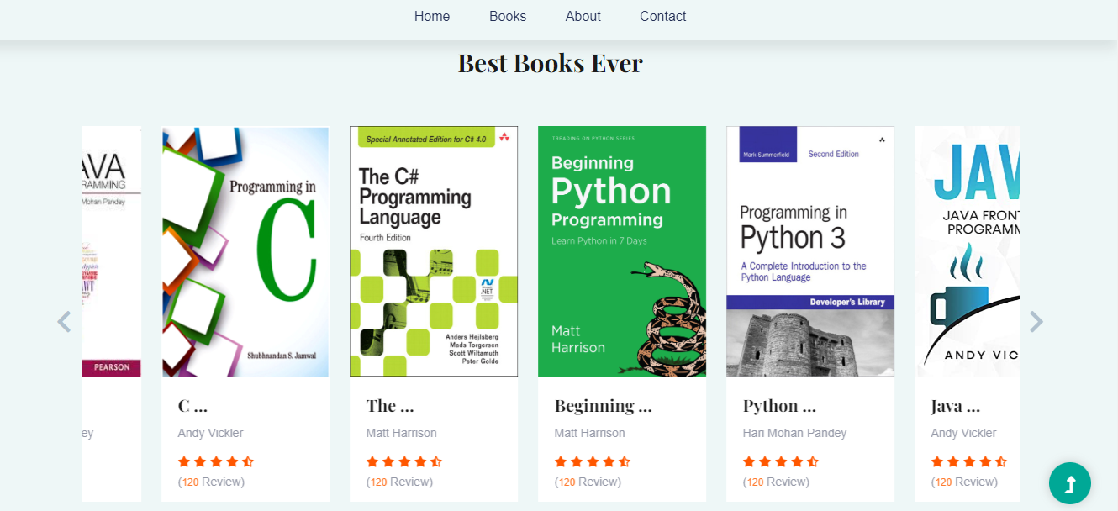
Book Slider Section

Slide 12
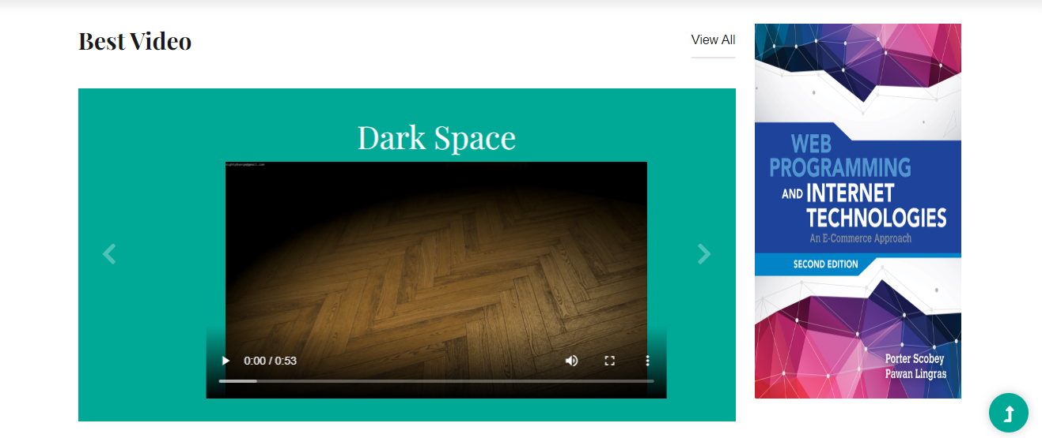
Videos Section

Slide 13
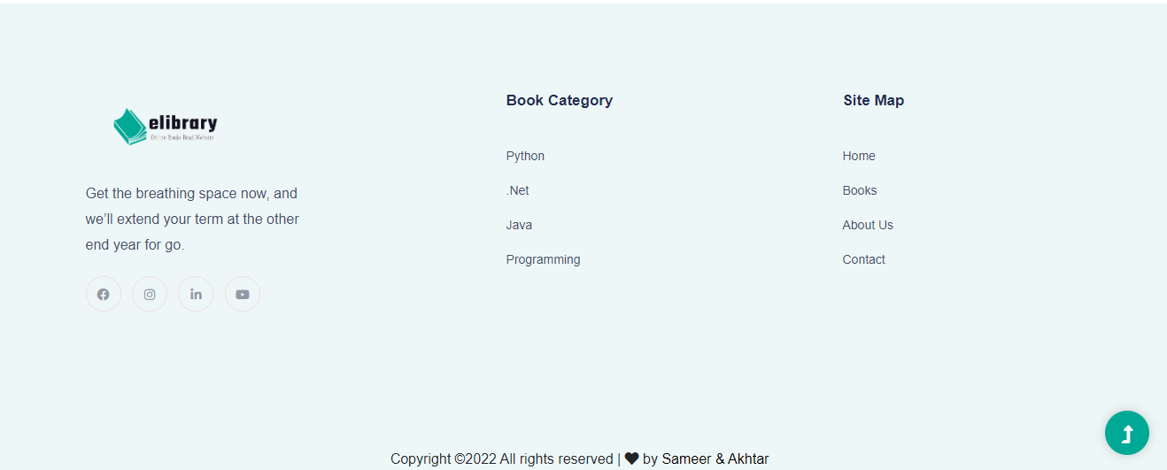
Footer Section

Slide 14
Summary
At Contoso, we believe in giving 110%. By using our next-generation data architecture, we help organizations virtually manage agile workflows. We thrive because of our market knowledge and great team behind our product. As our CEO says, "Efficiencies will come from proactively transforming how we do business."

Slide 15
Thank you
Sameer & Akhtar Haider
sameerali2765#@gmail.com
www.elibrary.com

