Slide 1
Online Classes: Yay or Nay?
Sameer Anees, Tasneem Adnan, Ahsan Ahmed

Slide 2
Introduction
The survey tries to find out the issues that students are facing and how their emotional and physical well-being is being affected, during the current crisis.

Slide 3
Objectives
1. Is coronavirus contributing to the stress levels of the university going students? Are all
the students getting affected equally or are there students of specific majors that are
getting affected due to the prevailing lock-down condition?
2. Are the university managements doing anything for the well-being of their students like
providing them with adequate resources and adjusting the curriculum according to the
mental capacities of their students?
3. Is the shift to online classes and the workload that they bring along contributing to the
already stressed students or are they helping them by providing them a distraction from
the continuously increasing counter of the number of cases?

Slide 4
Methodology
1. Gathering Questions (Mainly Yes/No, and rating questions)
2. Google form questionnaires
3. Sending to target audience using FB and Whatsapp groups.
4. Analyzing Responses

Slide 5
Expected Outcomes
1. Understand correlation between the stress levels of university students taking online classes and the students who are not taking online classes.
2. Comparison in stress levels between students of different majors.
3. Role of the university in providing the basic resources.
4. Explore the struggles which the students are facing during their online sessions.
5. Performance of students before and during the pandemic.
6. Effects on health.

Slide 6
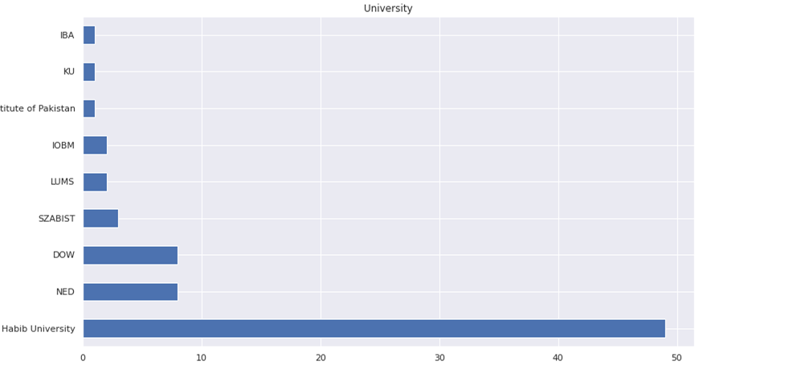
Our Analysis
The majority of the students that participated were from Habib University

Slide 7
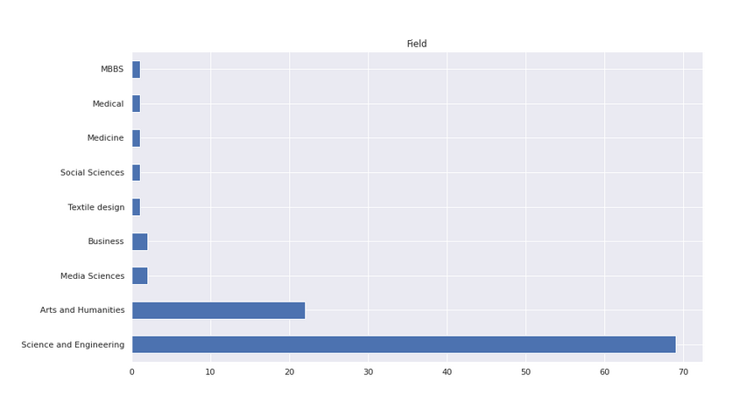
Our Analysis
The majority of the students that participated were from the Science and Engineering Field. About 20 students were from the Arts and Humanities Batch.

Slide 8
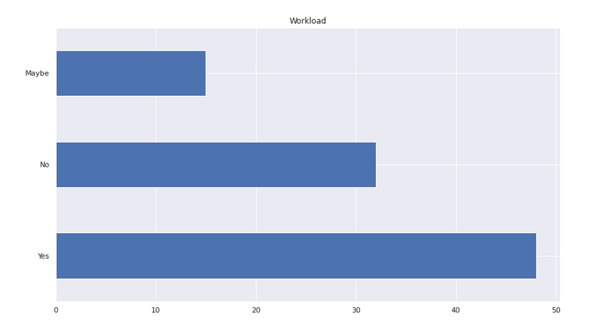
Our Analysis
The majority of the students that participated mentioned that their workload increased during the pandemic. Some people were unsure about it.

Slide 9
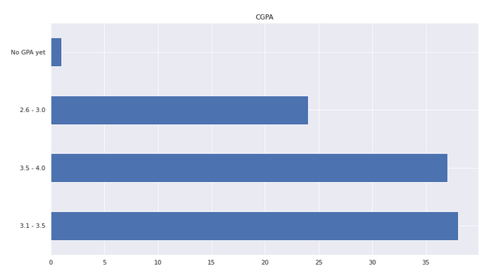
Our Analysis
The Data above shows that CGPA of students is comparatively spread out. However, majority of the students had GPA between 3.1-3.5.

Slide 10
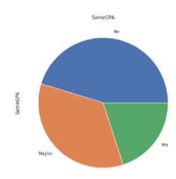
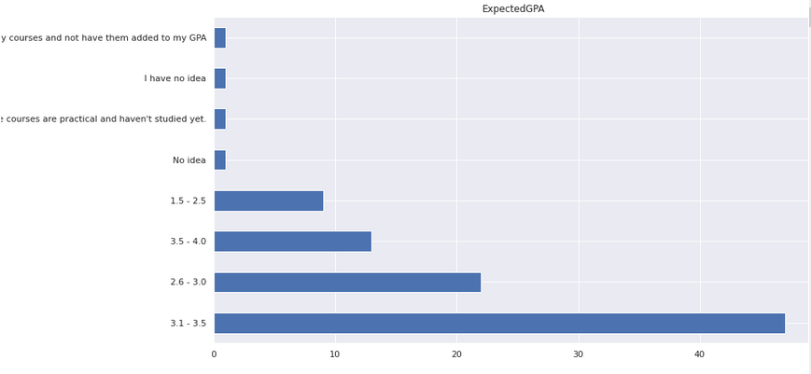
Our Analysis
The majority of the students are expecting a GPA between 3.1-3.5. Over here there is a spread of data between the other 3 ranges of GPA. This means that students are expecting their GPA to fall down.

Slide 11
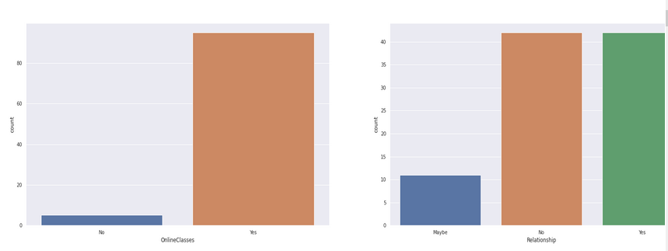
Our Analysis
The Data on the left shows that a majority of students had online classes during the pandemic. On the right the graph shows relations between students and their families. Unfortunately, the results obtained are inconclusive.

Slide 12
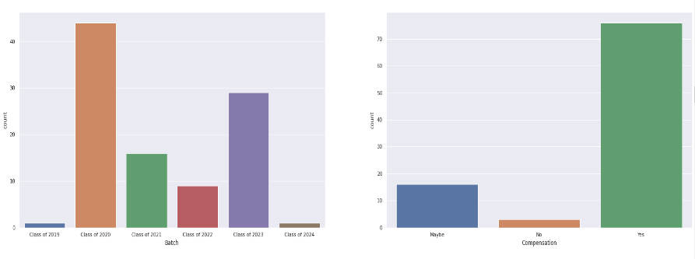
Our Analysis
The Data on the left shows that a majority of the students were from the Batch of 2020, seniors. By this we can say for sure that they might be worried about their future, due to the pandemic. The data on the left shows that students received some kind of compensation for their online studies during the pandemic.

Slide 13
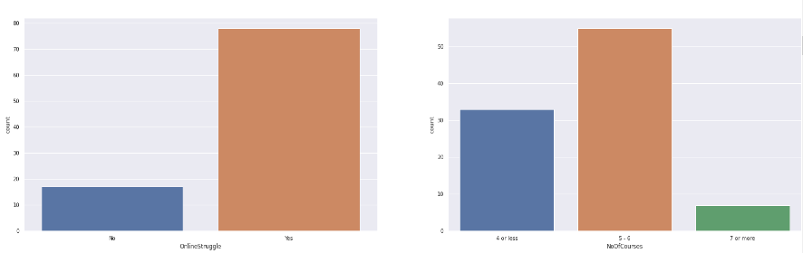
Our Analysis
The Data on the left shows that a majority of the students were struggling with their online studies. While, the data on the right shows that the majority of the students had between 5-6 courses. This shows why the majority of the students believed they had a high workload because of the pandemic.

Slide 14
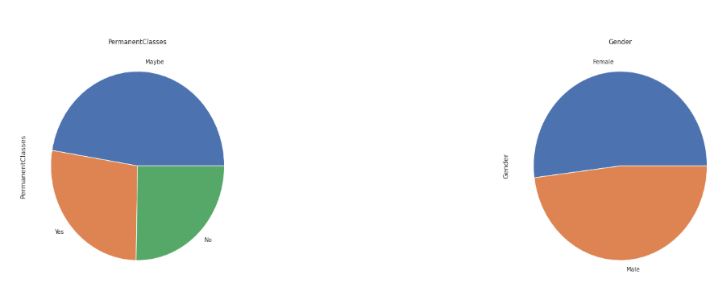
Our Analysis
The Data on the left shows that the majority of the students were unsure about whether the online classes would become permanent in the future. The data on the right shows that the majority of the students that participated in the survey were Female.

Slide 15
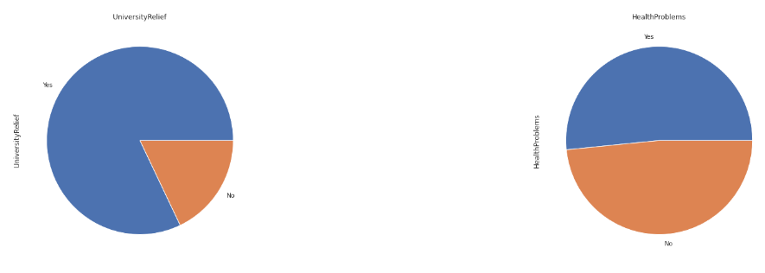
Our Analysis
The data on the left shows that the majority of the students believed that universities were giving them some kind of academic relief during the pandemic. However, the data on the right shows that majority students were suffering from Health Problems because of their online classes.

Slide 16
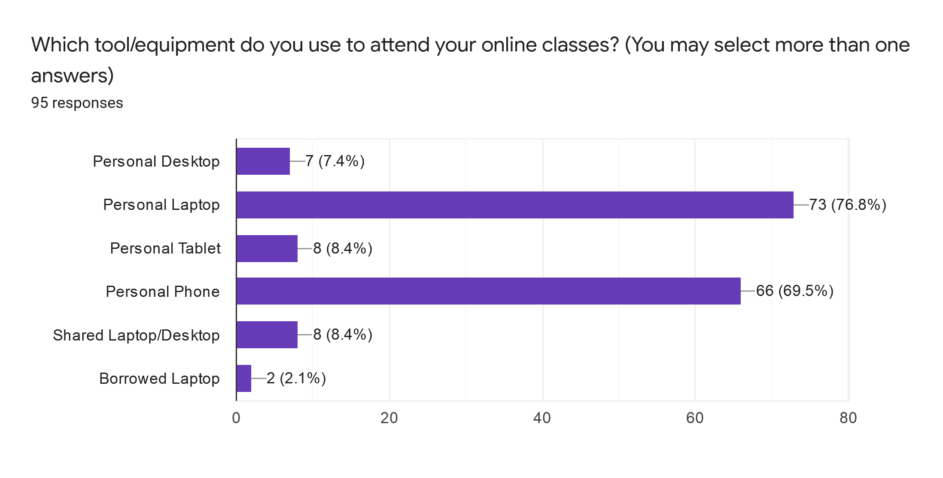
Our Analysis
The chart above shows that the majority of the students use their phones and laptops for their online classes. It also shows that a minority of students do share and borrow devices in order to attend these classes.

Slide 17
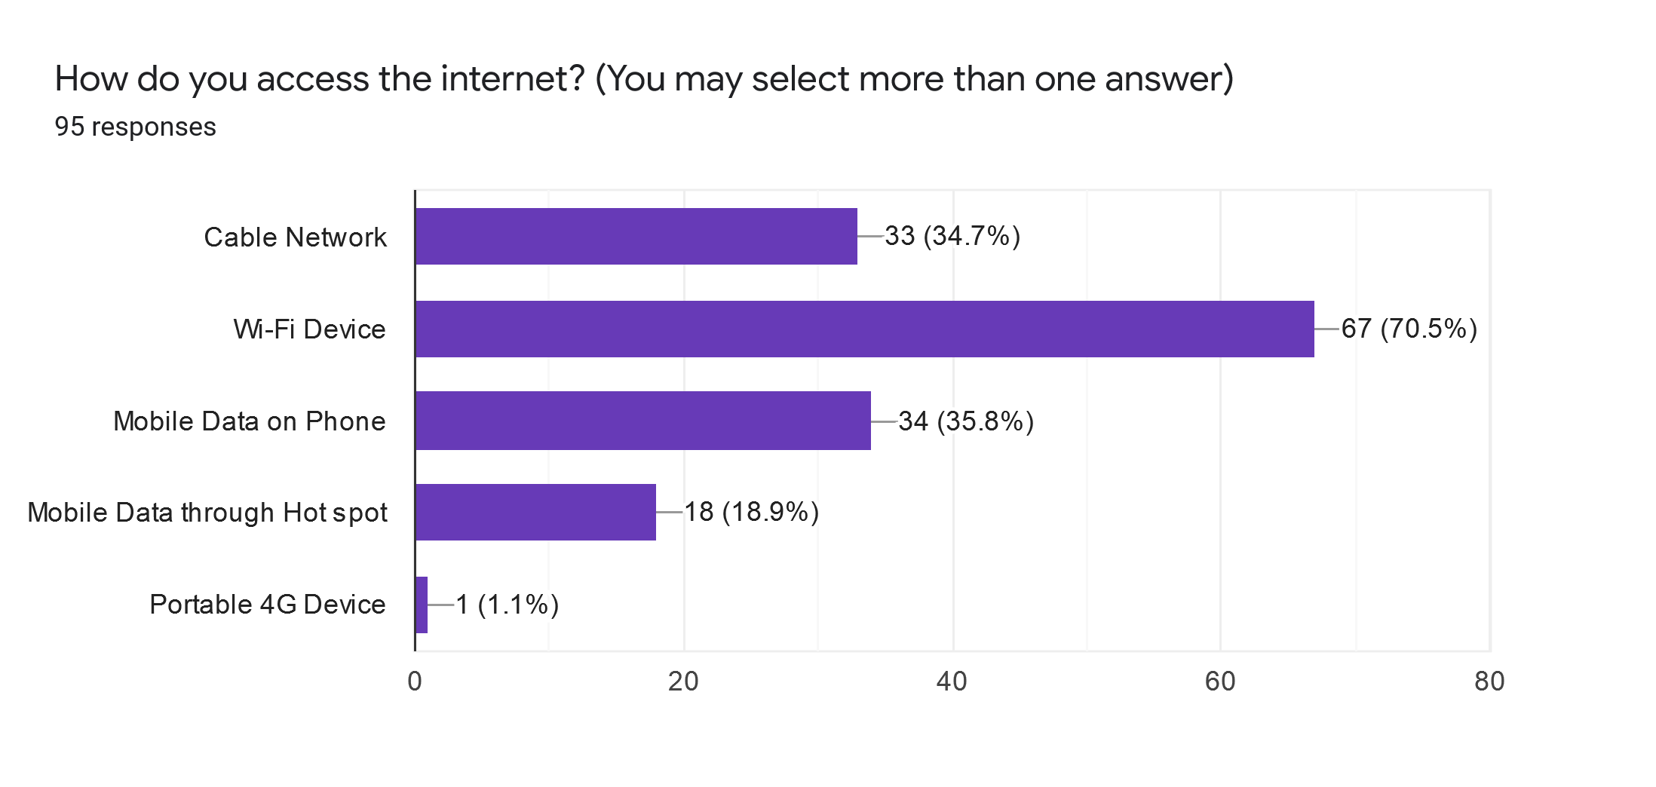
Our Analysis
The chart above shows that the majority of the students use a Wifi device to access the internet. However, some students also use cable network and mobile data to access the internet.

Slide 18
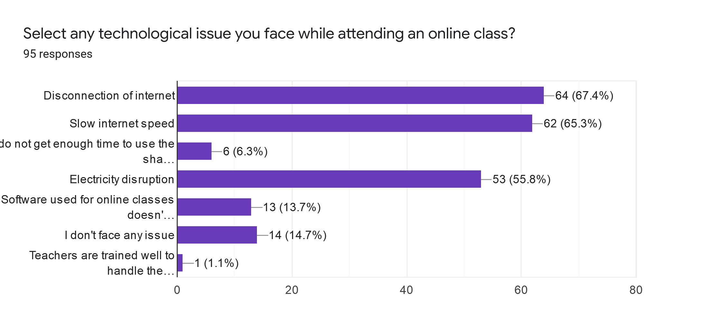
Our Analysis
Majority of the students have issues of occasional or severe disconnection of the internet, slow internet speed and electricity disruption.

Slide 19
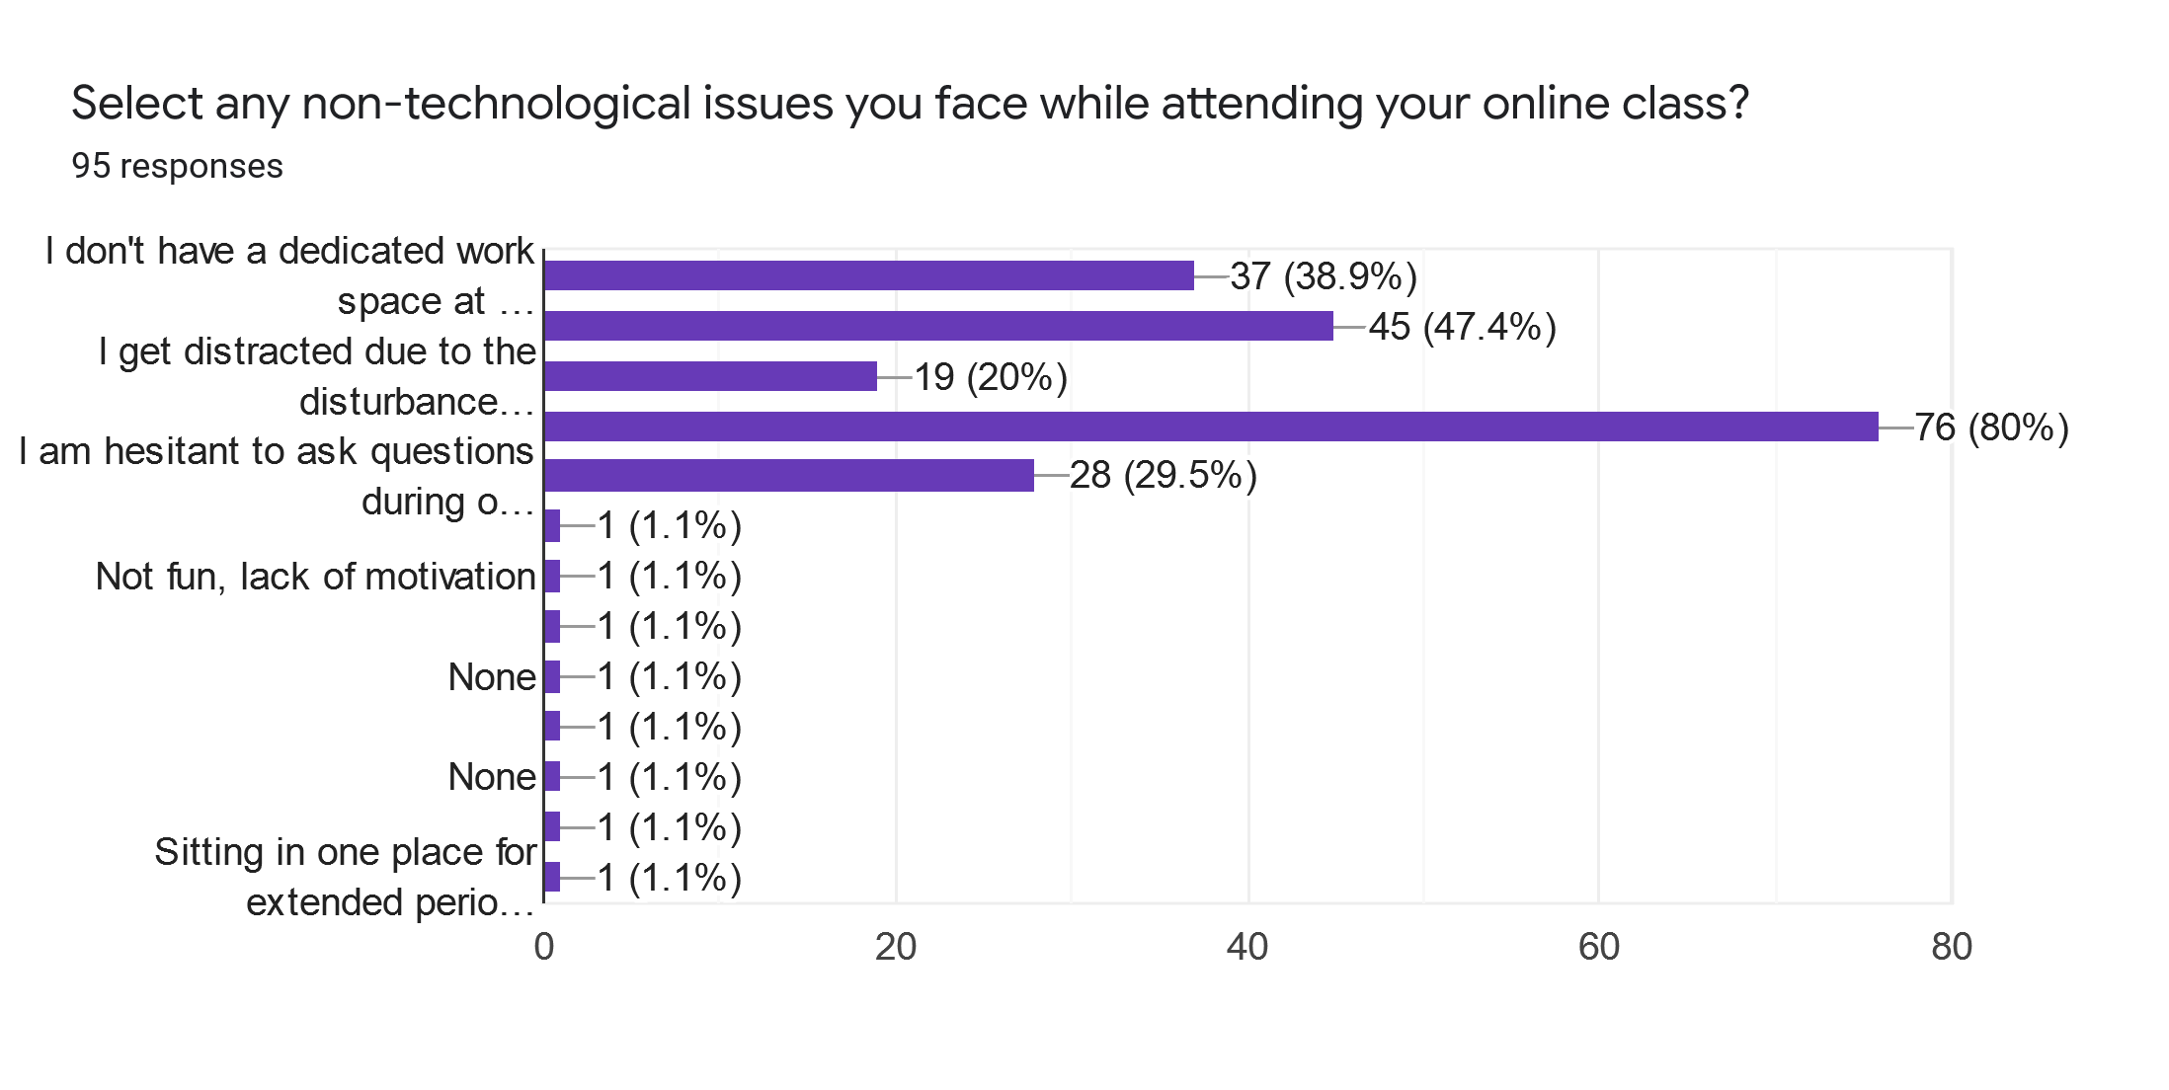
Our Analysis
Majority of the students are hesitant to ask questions during lectures and get distracted. Some students also say that they don’t have a dedicated work space at home.

Slide 20
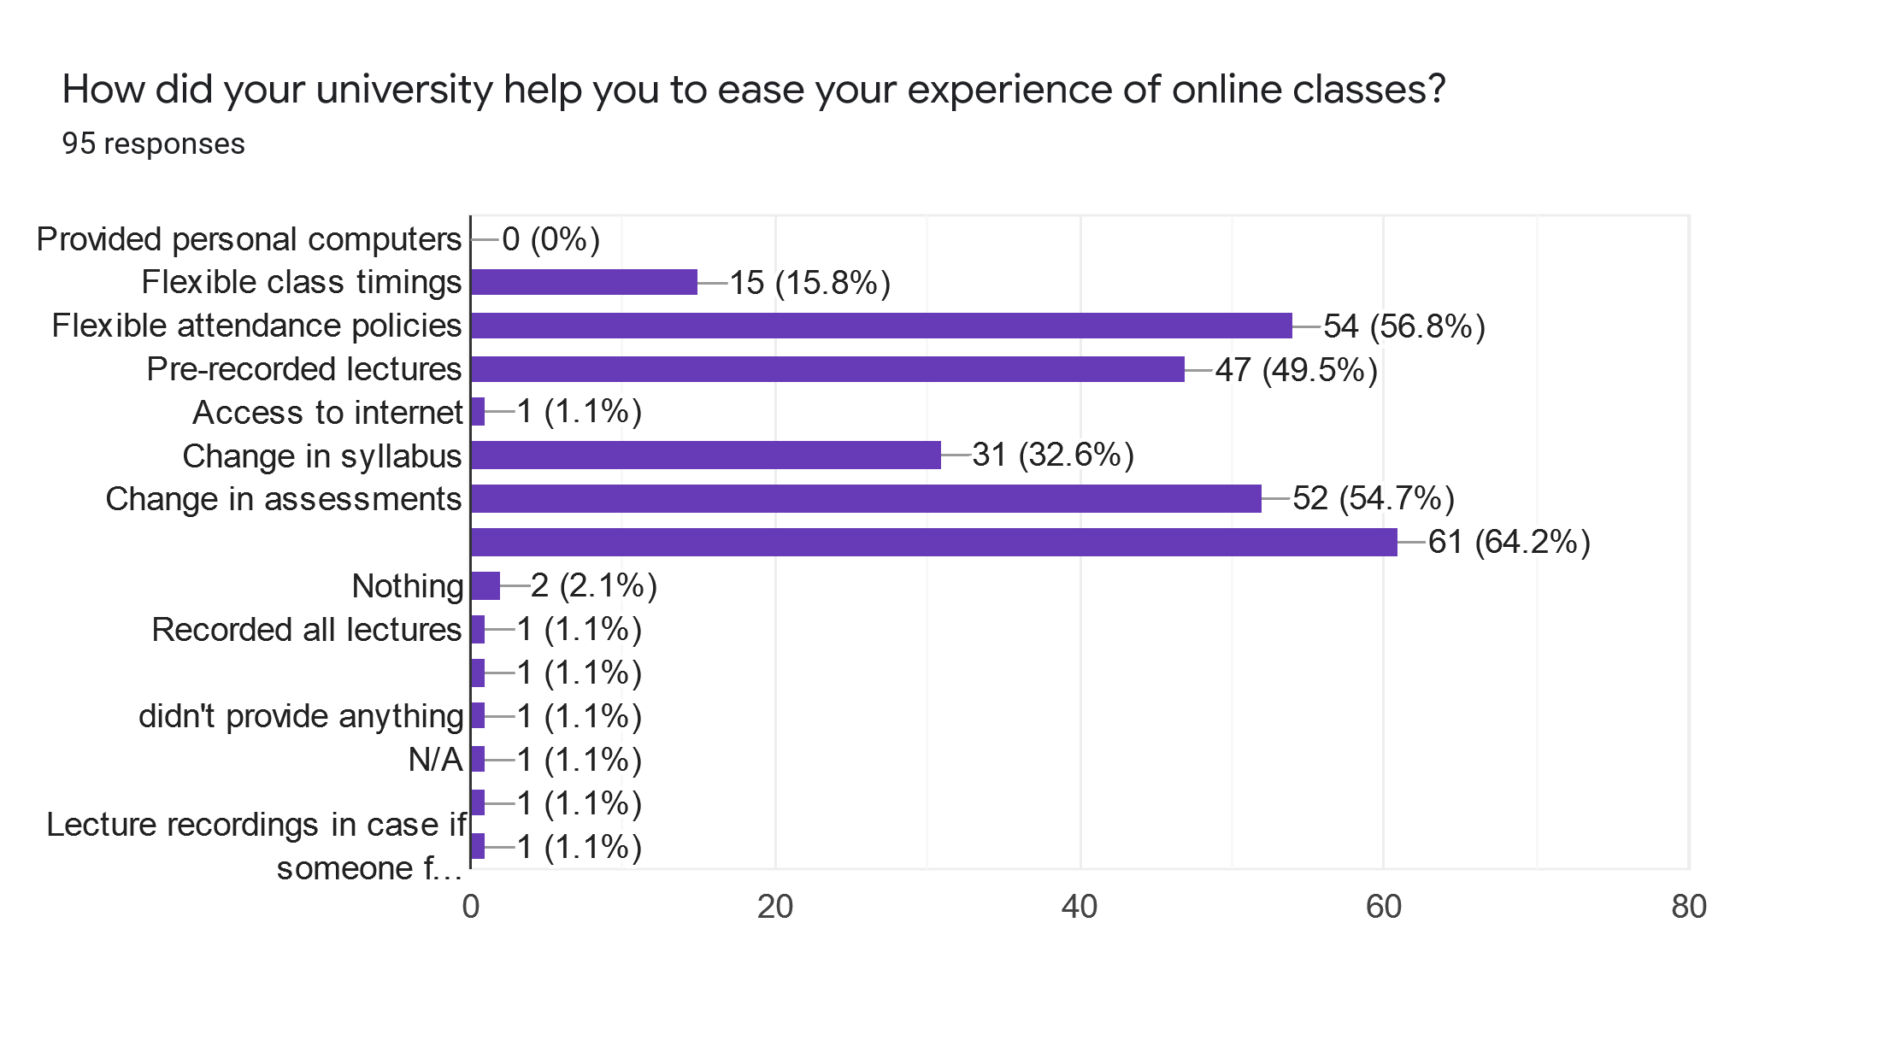
Our Analysis
According to students, most universities are helping out their students by changing the criteria in assessment and syllabus. They have also changed the attendance policy and started recording lectures of professors. Some even say that they did nothing to help them out!

Slide 21
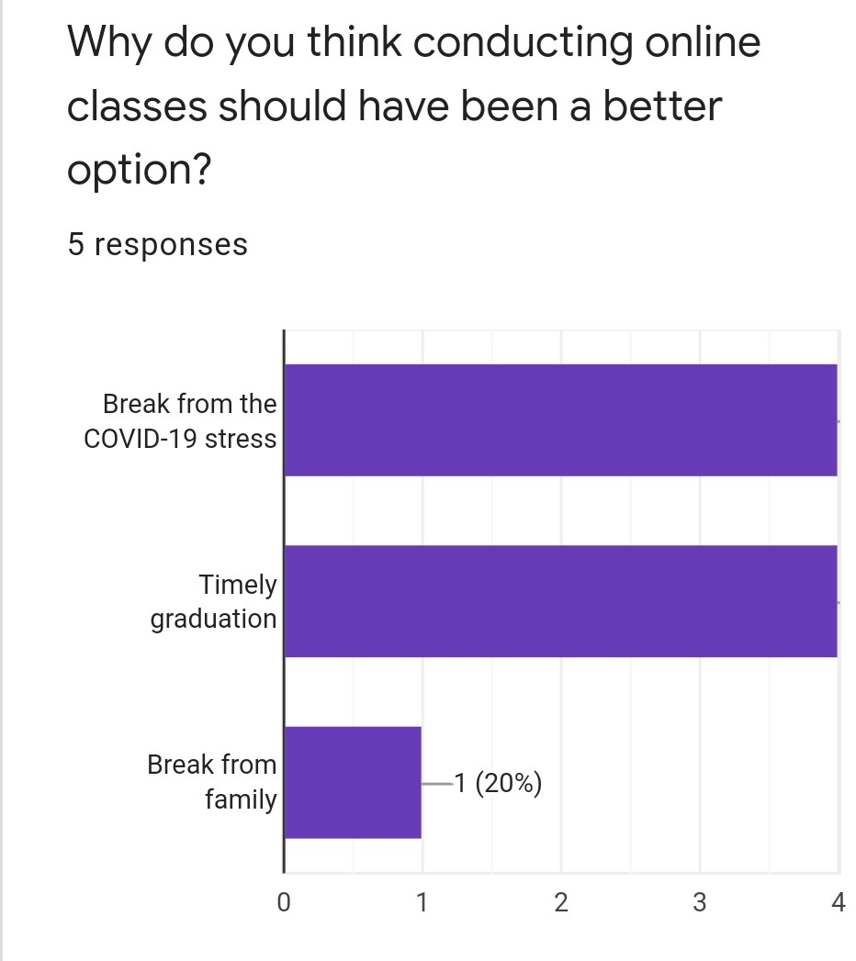
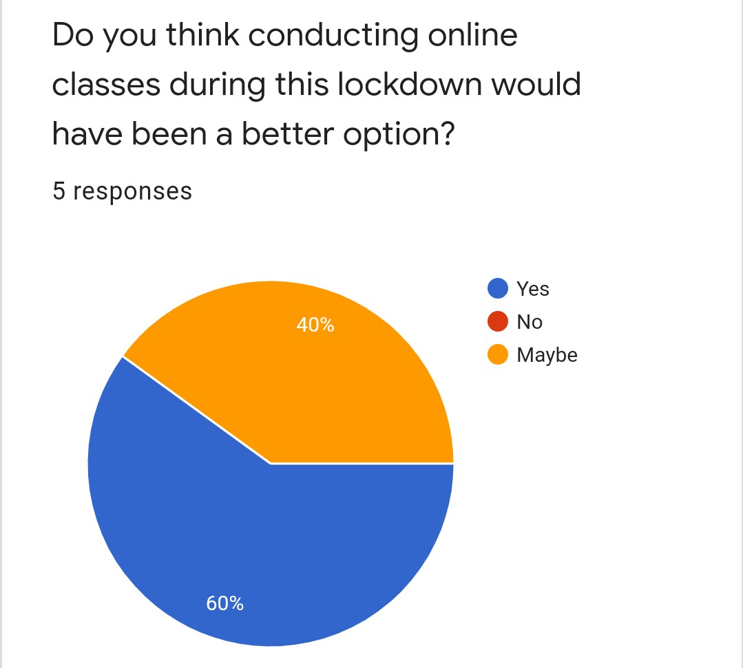
Our analysis

Slide 22
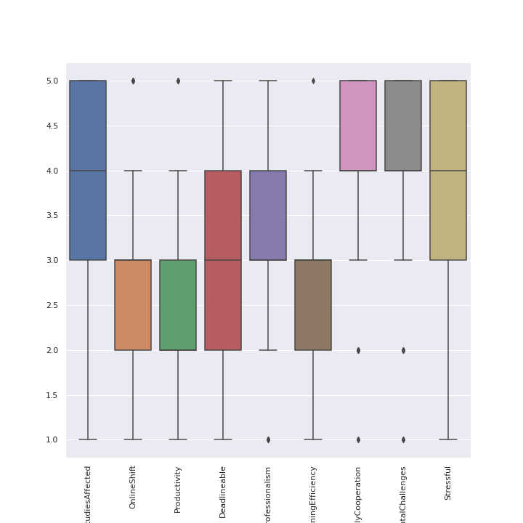
Our Analysis
The variables represent the questions where the surveyee was asked to rate between 1- 5. For example, the variable StudiesAffected represents the question: “On a scale of 1 to 5, how much do you think your studies have been affected by the pandemic?”. The boxplots give us information about the mean, maximum, minimum, interquartile range and also if there are any outliers within the dataset. For example, the interquartile range( where 50%+ of the data exists) of the variable studies affected is between 3 and 5, with the average rating being 4. This tells us that the average number of people felt that their studies had been affected by a great amount. The OnlineShift variable tells us that the majority of the people feel not good or average about their studies being shifted online; that is why the interquartile range is between 2 and 3. The Productivity variable shows us similar results, as students feel that they haven’t really been productive. The average number of assignments, projects and other tasks that students were able to complete on time is 3, but it shows us that the data is scattered as the interquartile range is between 2 and 4. However, most of the students believe that their studies have been productive. Furthermore, the learning efficiency of the students haven’t been great throughout the pandemic and most of the students are really stressful due to the situation, which is alarming. Most people believe that their family is cooperative during the online classes, but they are still going through some extreme mental challenges during the current phase.

Slide 23
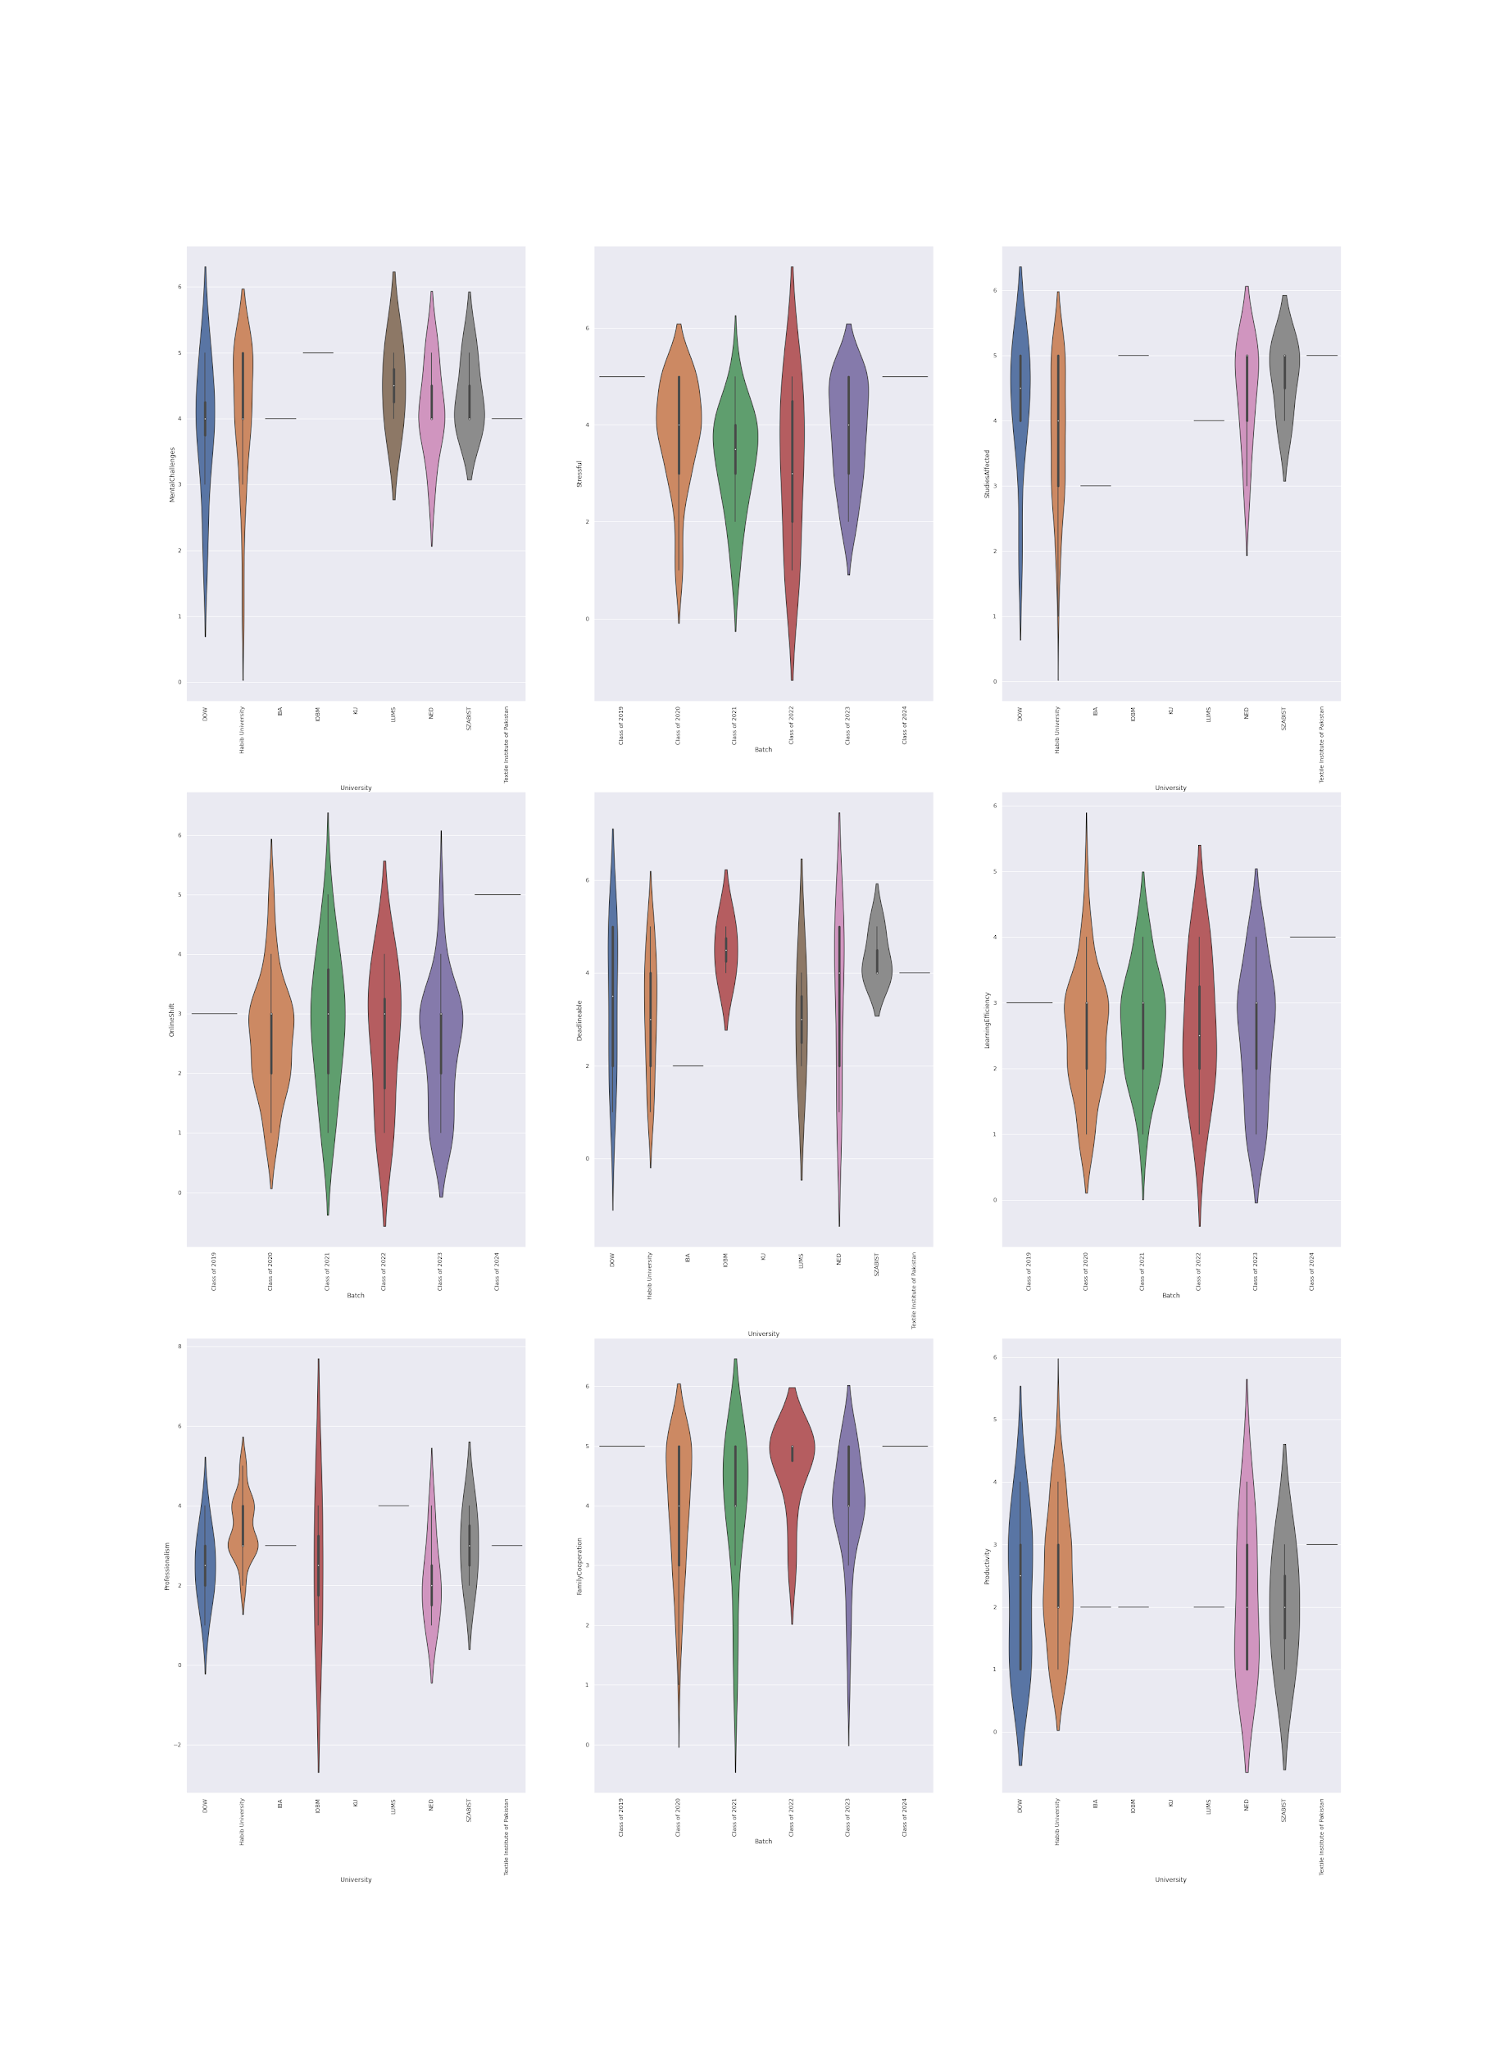
Our Analysis
A Comparison of Mental challenges faced by different university students.

Slide 24
Our Analysis
Stress levels of different Batches in all universities

Slide 25
Our Analysis
A Comparison of Students Affected by coronavirus in different universities.

Slide 26
Our Analysis
A comparison of how students feel about the shift to online classes wrt Batches.

Slide 27
Our Analysis
A comparison of how many deadlines the students can follow during the pandemic wrt Universities

Slide 28
Our Analysis
A Comparison of Learning Efficiency in different batches.

Slide 29
Our Analysis
A Comparison of Professionalism of teachers (teaching online) in different universities.

Slide 30
Our Analysis
A Comparison of Family cooperation wrt to various batches.

Slide 31
Our Analysis
A Comparison of Productivity in different university students.

Slide 32
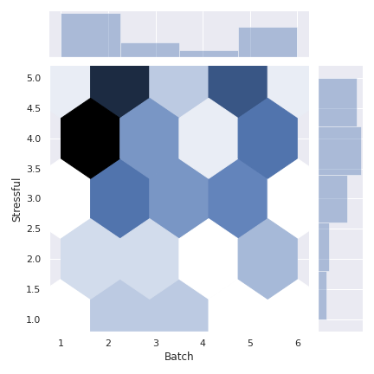
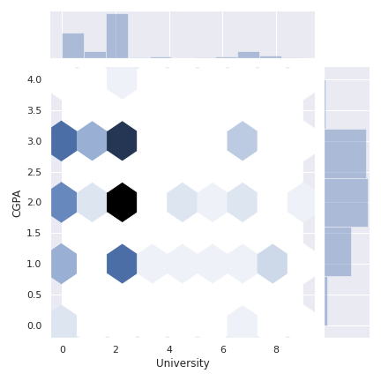
Our Analysis
The plot above shows us that the CGPA and University are not really correlated except when the CGPA is 2 or 3. The darker the color is the more correlated the variables are.
The above plot shows us that Batch and Stress is actually correlated to some extent. Which means the stress of the students actually does depend on the student’s batch.

Slide 33
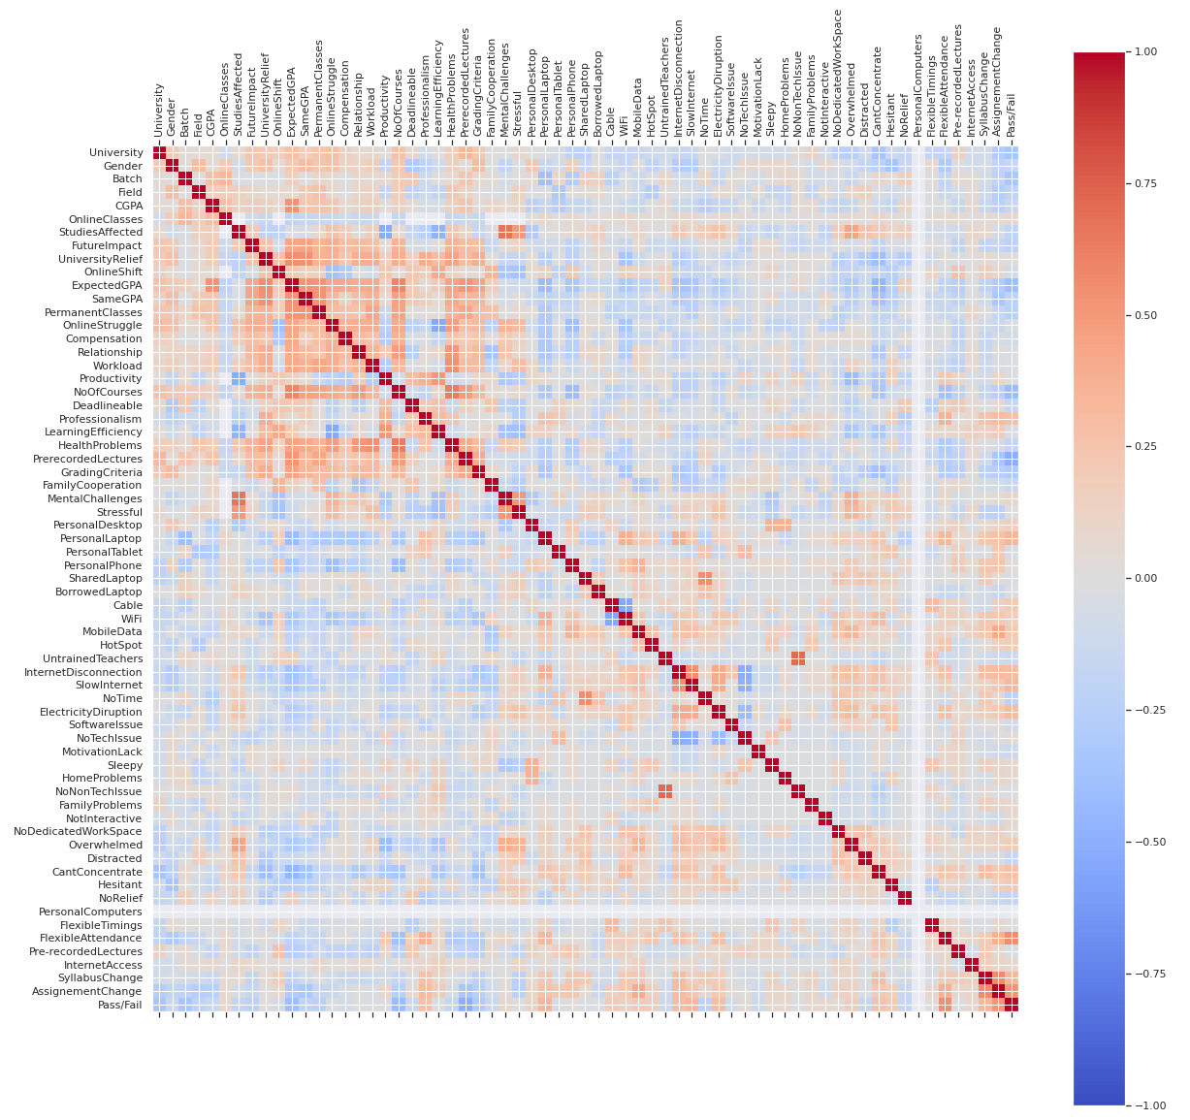
Our Analysis

Slide 34
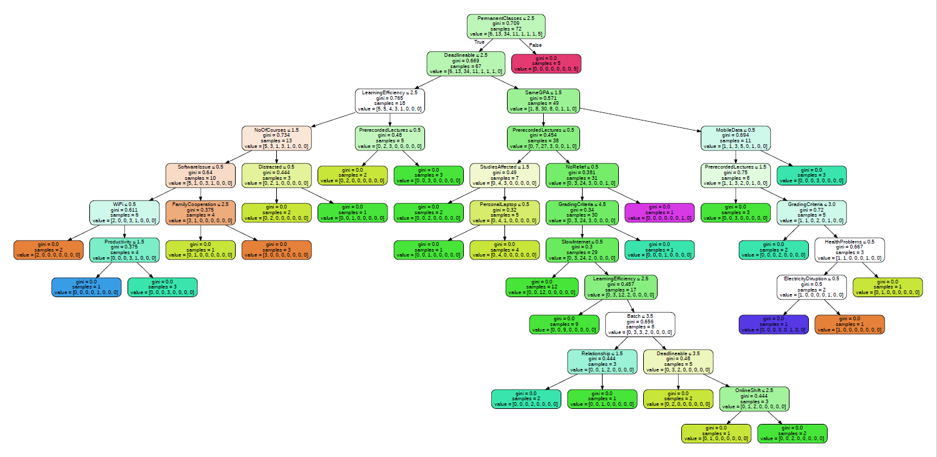
Decision Tree

Slide 35
Outcomes and conclusions
From our survey, it is concluded that:
Even though all the students feels stressed about the pandemic and having to attend online classes, the class of 2020 has an additional stress of their future which is shared equally by the students of all the universities.
Internet and electricity are among the major technological issues that hinders learning.
It is also concluded that online classes are adding to stress levels of the students those who are having them but at the same time, students who are not having classes want to have them because they believe that this will be a good distraction.

Slide 36
Thank you

