Slide 1
The Model Selection Problem
Amazon Bedrock offers 70+ models across 14 families. Picking the right one for each request is a manual, static decision that leaves money and performance on the table.
💸
Overspending
Using Opus for "What is S3?" costs 50× more than needed. No automatic downgrade for simple tasks.
🐌
Unnecessary Latency
Large models add seconds of latency for tasks a smaller model handles in milliseconds.
💀
No Resilience
Hardcoded model IDs mean throttling = downtime. No retry, no fallback, no circuit breakers.
🔒
Single Family Lock-in
Bedrock's native router only routes within one family. Can't leverage Nova for cost + Claude for quality.
👥
No Multi-Tenant Control
Free and enterprise users hit the same model. No per-tenant budgets, no cost attribution.
📊
Blind Decisions
No visibility into why a model was chosen. No quality tracking. No A/B testing for new models.

Slide 2
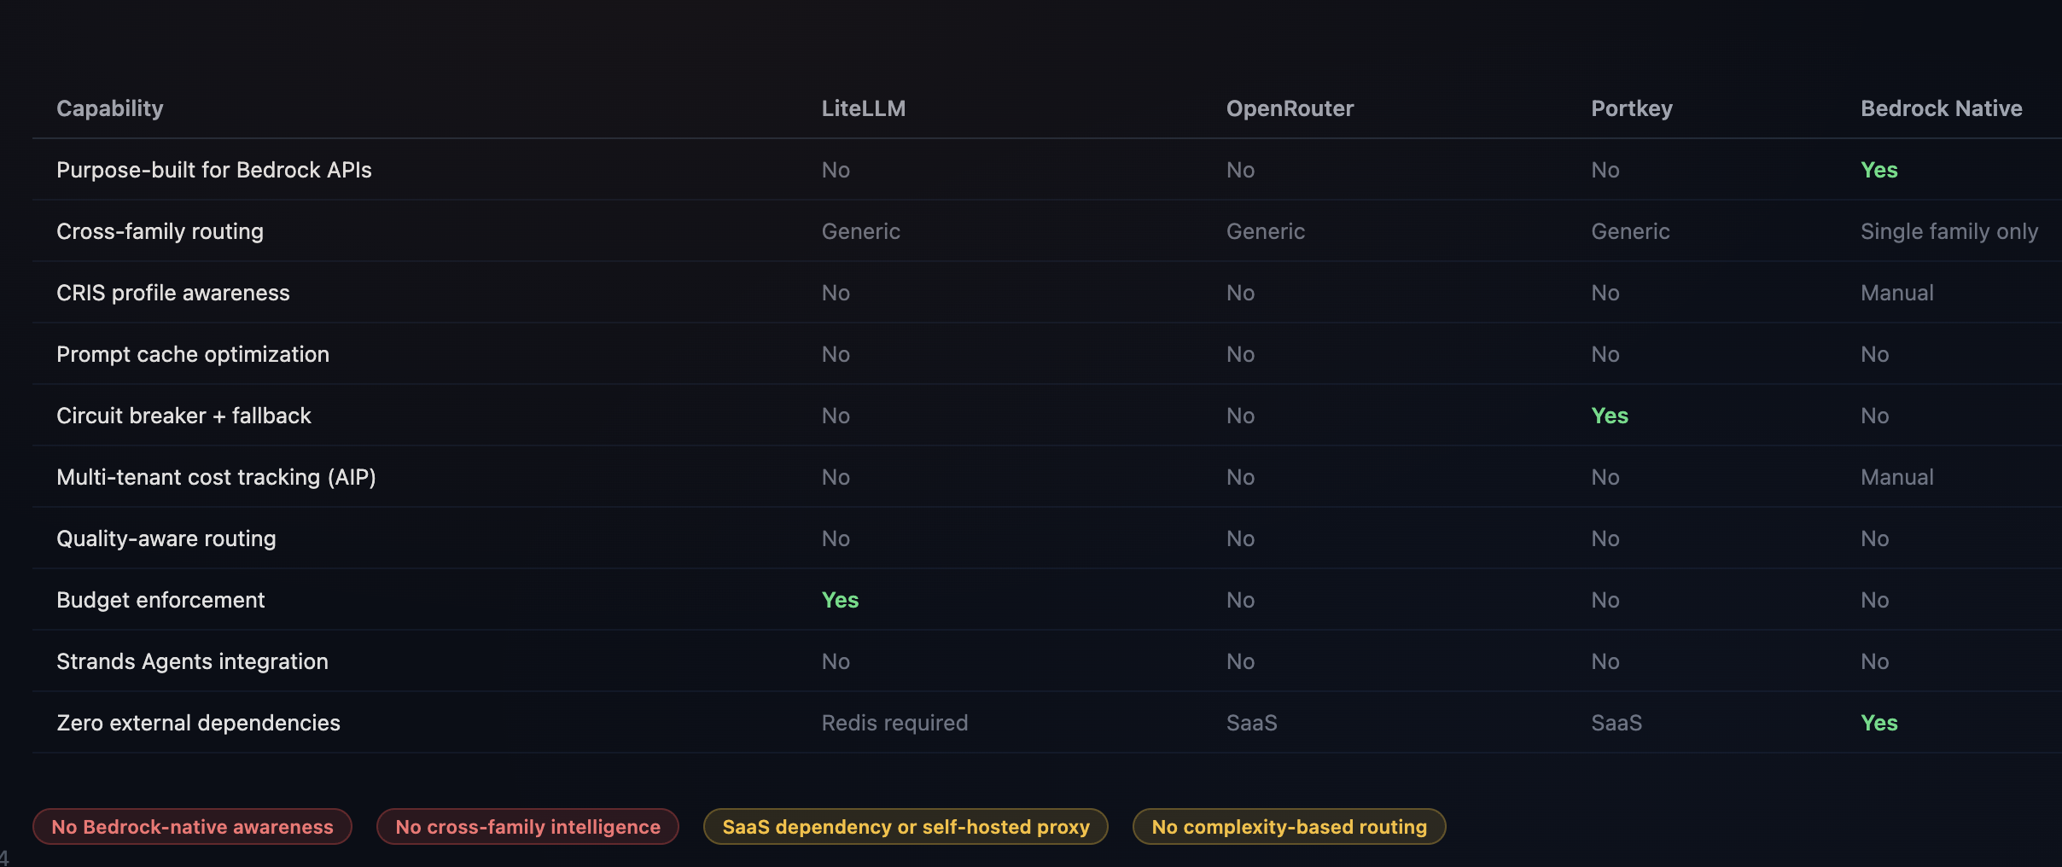
Existing Solutions Fall Short
Generic LLM gateways and Bedrock's native router each solve part of the problem — none address Bedrock-specific needs holistically.

Slide 3
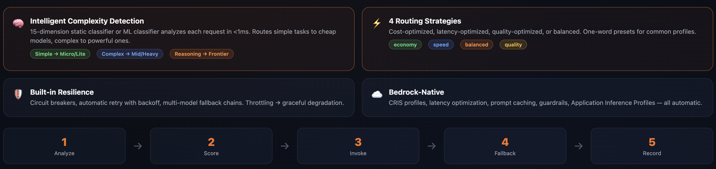
Bedrock Smart Router
A lightweight Python/JS Library that sits between your app and Bedrock. Drop-in replacement for converse & chat completion APIs with support for Strands Agents SDK.

Slide 4
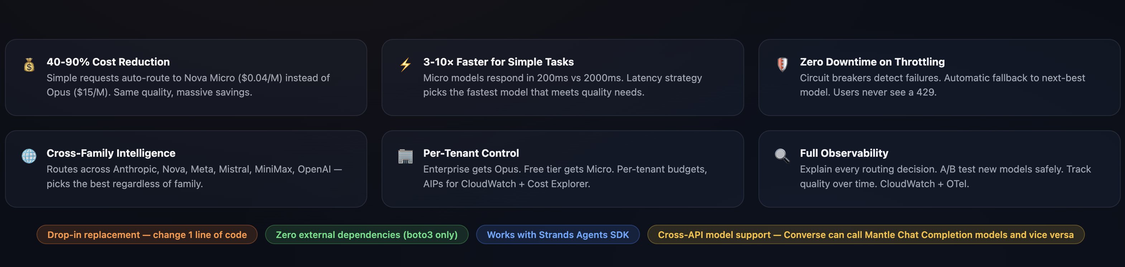
Problem → Solved
Analyzes each request's complexity in real-time and routes to the optimal model — balancing cost, latency, and quality automatically.
📧 Sameer Battoo (sbattoo@amazon.com)
🔗 GITLAB: https://gitlab.aws.dev/sbattoo/bedrock_smart_router

