Slide 1


Buds

Slide 2
PROBLEM STATEMENTS
TRADITIONAL EDUCATION SYSTEM
Our education system is not helping to develop persona of a child.
GRIEVANCE IGNORED
In many Schools, Educational Institutes, Colleges the complaint is either ignored, or the person is not allowed to drop any complaint.

Slide 3



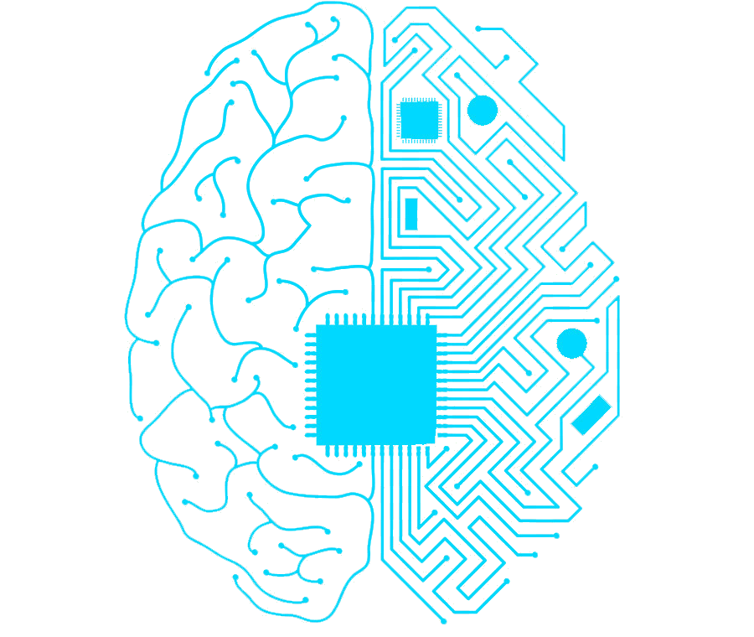

CATEGORIZATION OF STUDENTS
Test/Quiz
Prediction
Machine
Learning
Will help you
Learn better.
Games

Slide 4
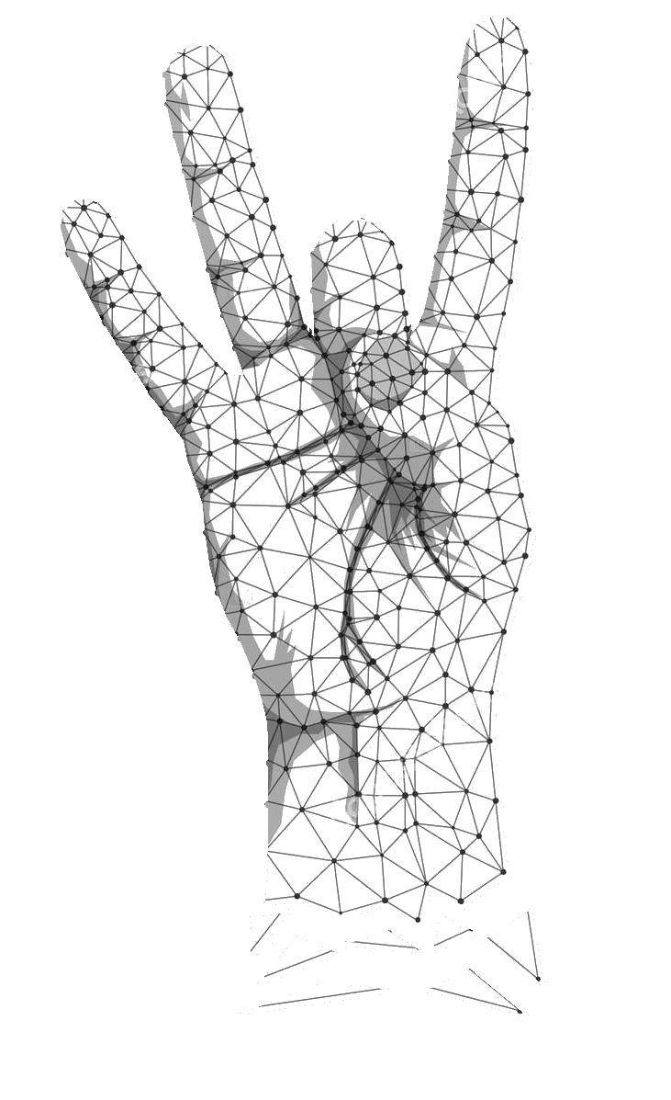

GUESTURE BASED TEST
Algorithm to detect the
Sign language.
B

Slide 5



VOICE BASED TEST
Specially prepared question set.
Prediction

Slide 6



GRIEVANCE SYSTEM WORK FLOW
Grievance
Submission
Higher Authority
Students
*All the complaints submission, approval & progress will be visible
to a valid Supervisor.
- Ignored
- Forced not
to submit.
Transparency
*Students *Management
*Employee *Staff

Slide 7
THANK
YOU

