Slide 1

BUDS
Presented By :
Sameer Kumar Dutta
1601227810
CSE-2
Under the guidance of :Subhashish Das Mohapatra
C.V. Raman College of Engineering ,Bhubaneshwar

Slide 2
Introduction
In the modern world where the women are walking beside men, and therefore both mother and father are working, due to which the children are becoming naughtier due to lack of attention. In this situation we are proposing our BUDS app which will keep your kids concentrated on one place. In the app you get both things at one place – learning and entertainment both.

Slide 3
Problem Statement
Audio / Visual learning.
Learn anytime, anywhere.
Keep your kids engaged in learning atmosphere.
Allow them to explore and get more knowledge out of the box.

Slide 4
Brief Description
Buds contains of 4 parts:
  Learn
  Quiz
  Game
  Rhymes

Slide 5
Brief Description
Learn :
  English Alphabets
  Hindi Alphabets
  Animals
  Numbers
  Shapes
  Colors

Slide 6
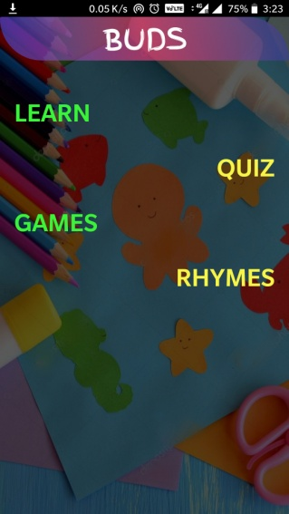
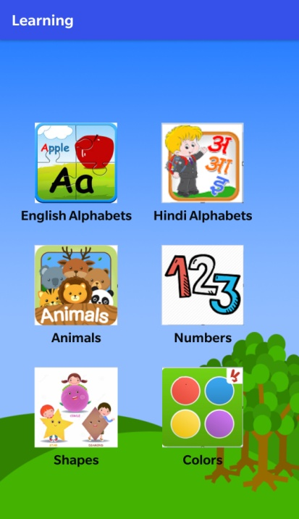
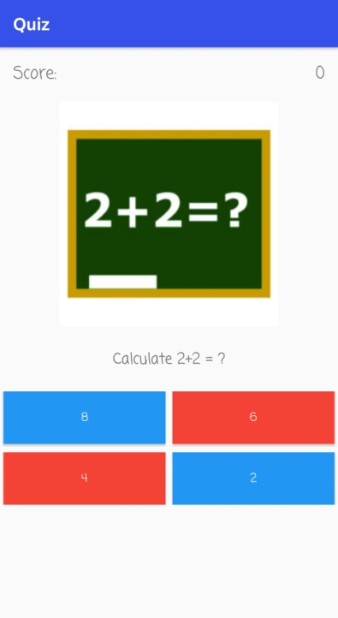

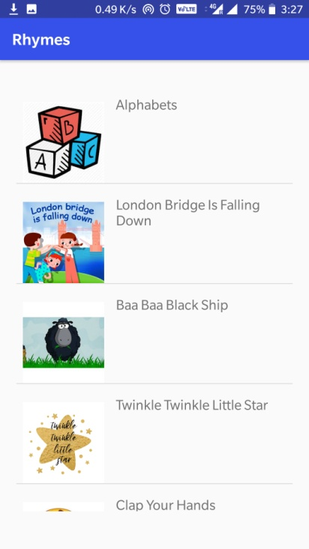
Activity Flow
Home
Learn
Quiz
Games
Rhymes

Slide 7
Activity Flow
Learn
English Alphabets
Hindi Alphabets
Animals
Numbers
Shapes
Colors

Slide 8
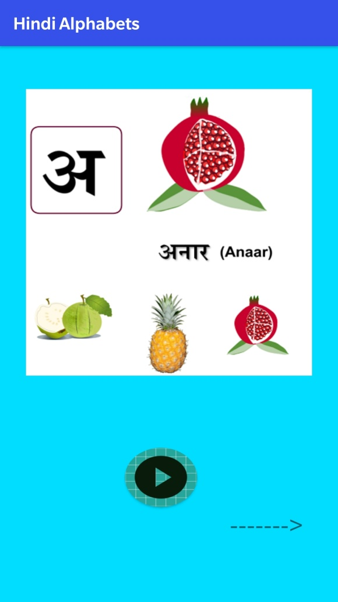
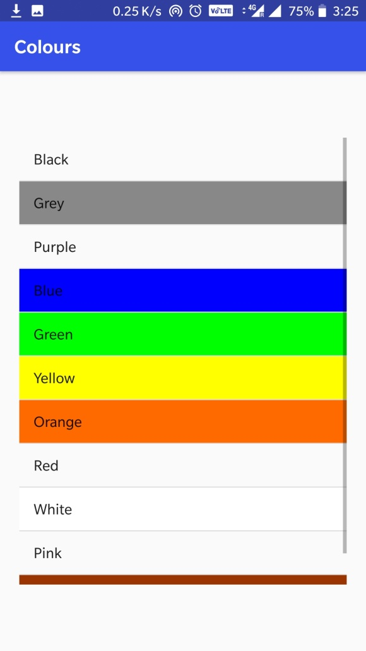
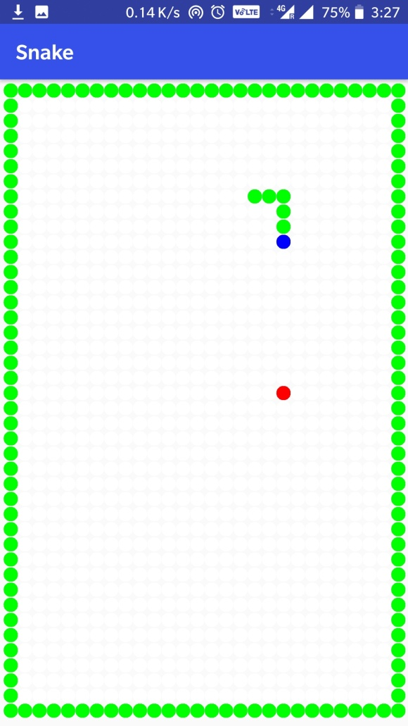
Previews

Slide 9
Advantages
Everything in a single application.
No network connectivity required.
Easy and simple to use.
Integrated with good audio and visuals.

Slide 10
Future Enhancement
We will give separate sections for kids of different age group.
We will include more sections for a kid’s basic knowledge.
We will give link to videos for better understanding.
We will incorporate more games.

Slide 11
THANK YOU !

