Slide 1

BUDS
Presented By :
Pratik Prakash
Sameer Kumar Dutta
Adarsh Pratik
Under the guidance of :Subhashish Das Mohapatra
C.V. Raman College of Engineering ,Bhubaneshwar

Slide 2
Problem Statement
Audio / Visual learning.
Learn anytime, anywhere.
Keep your kids engaged in learning atmosphere.
Allow them to explore and get more knowledge out of the box.

Slide 3
Brief Description
Buds contains of 4 parts:
  Learn
  Quiz
  Game
  Rhymes

Slide 4
Brief Description
Learn :
  English Alphabets
  Hindi Alphabets
  Animals
  Numbers
  Shapes
  Colors

Slide 5
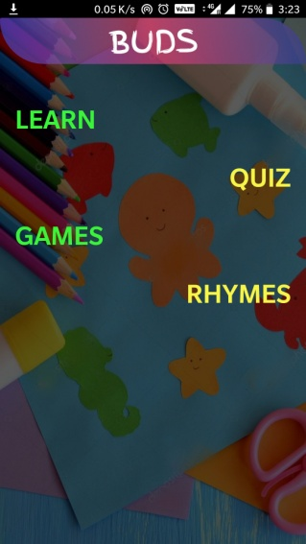
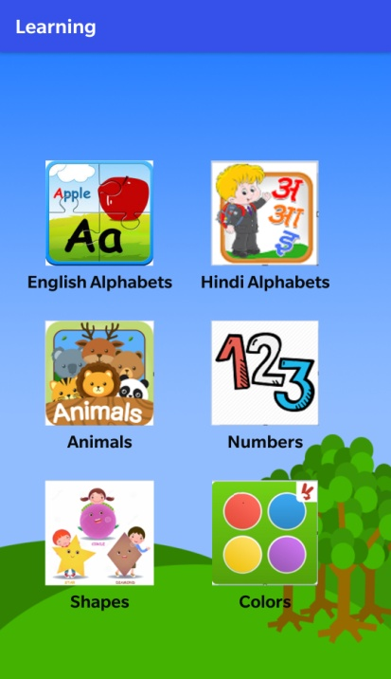
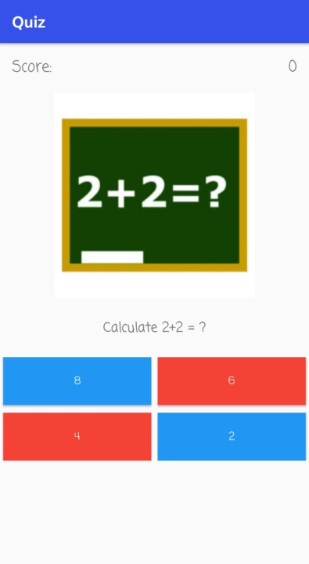
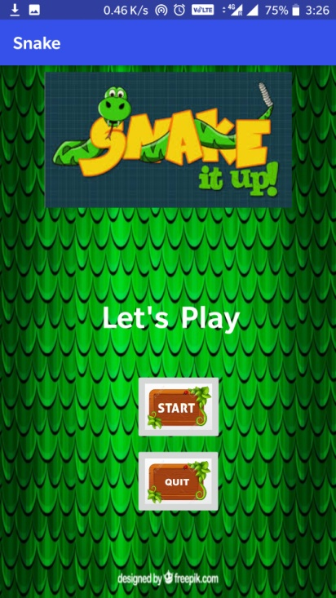
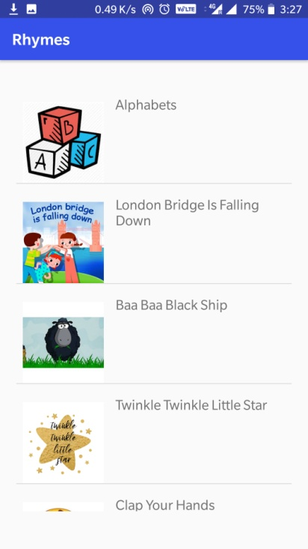
Activity Flow
Home
Learn
Quiz
Games
Rhymes

Slide 6
Activity Flow
Learn
English Alphabets
Hindi Alphabets
Animals
Numbers
Shapes
Colors

Slide 7
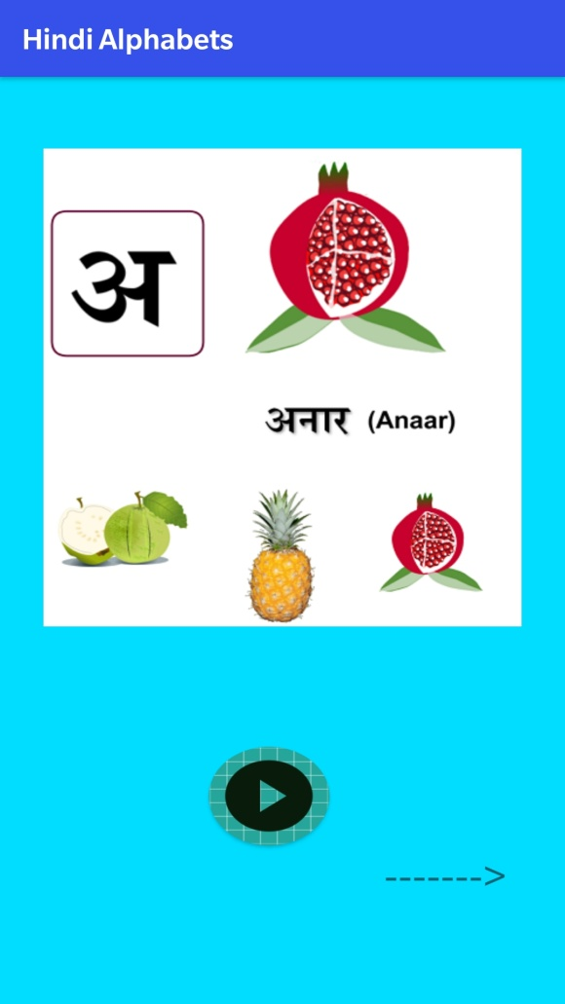
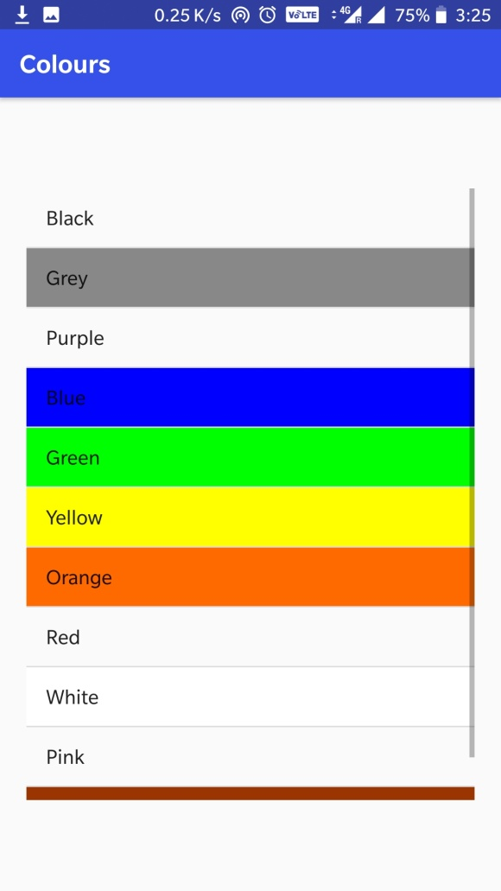
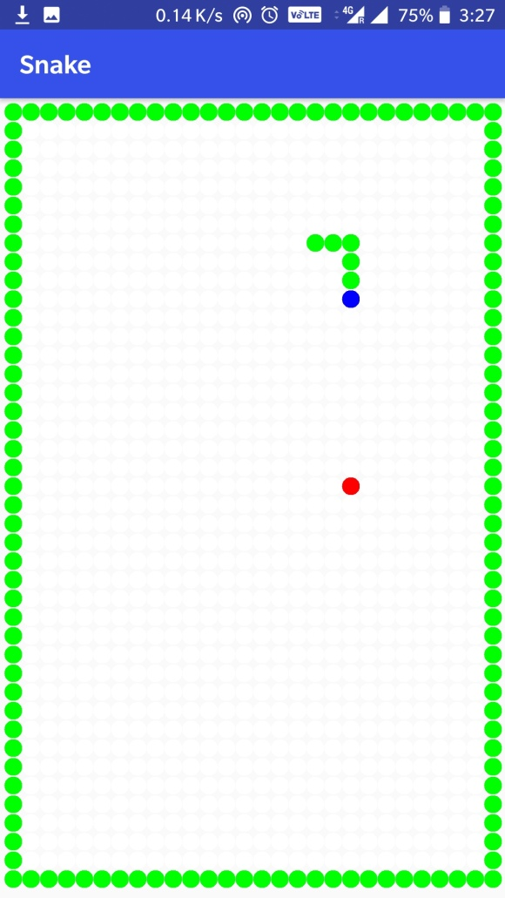
Previews

Slide 8
Advantages
Everything in a single application.
No network connectivity required.
Easy and simple to use.
Integrated with good audio and visuals.

Slide 9
Future Enhancement
We will give separate sections for kids of different age group.
We will include more sections for a kid’s basic knowledge.
We will give link to videos for better understanding.
We will incorporate more games.

Slide 10
THANK YOU !

