Slide 1
Find Your Way (An Indoor Navigation System)
Presented By :-
Sameer Kr Dutta
Pratik Ghose
Nikita Agarwalla

Slide 2
Problem Statement
On every single day we require to move around multiple places in and out of our office, to help in the outside world we got the maps proposed by Google.
But in here, at the office just to find a different department or an un-heard conference room where we haven't visited before cost us a ton of time.
On the other hand as being an evolving and rapid growing company, multiple newly built workspaces would also be accommodated and finding new regions and departments could a difficult thing.
2

Slide 3
Ease yourself to find the way to your destination with a single click …

Slide 4
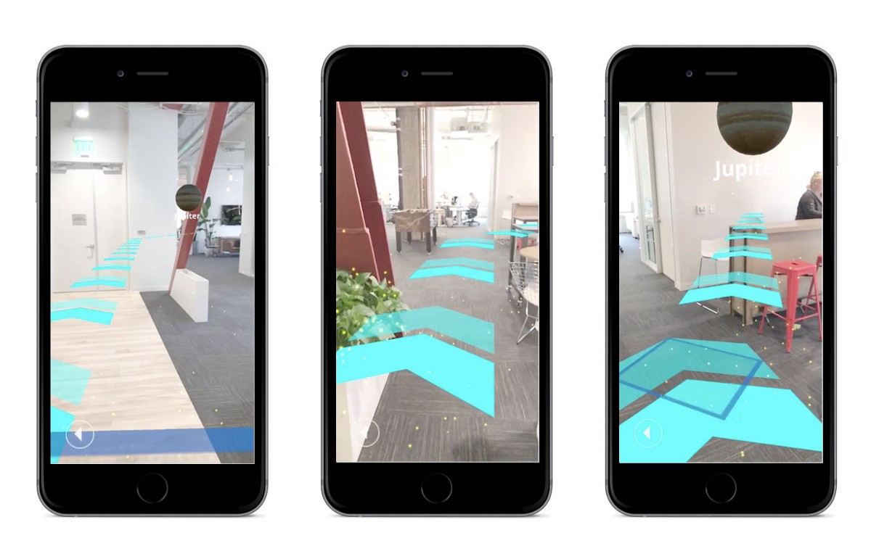
Proposed Solution
“Find Your Way” is an applications that will help you to look for your path in an augmented reality. The app will show virtual arrows on the camera’s live feed, to show the directions towards your destination in real time. This app will help a lot of people to find their way inside of the office irrespective of them being a fresher or experienced one.

Slide 5
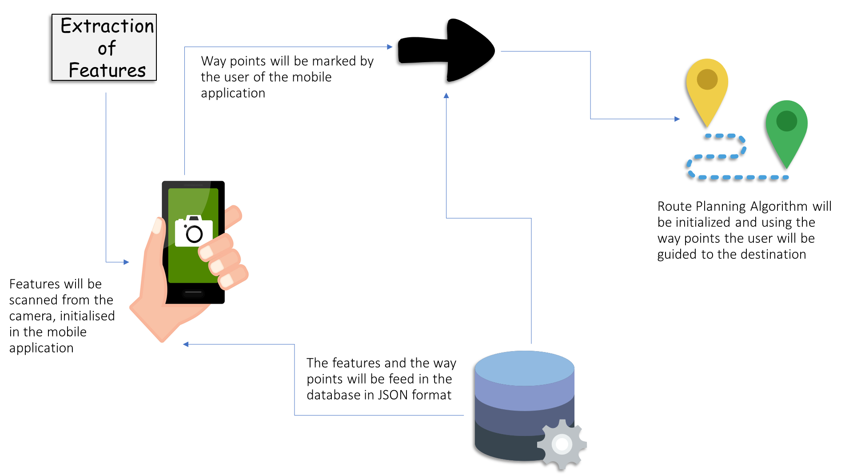

Slide 6
Proposed Technologies,
Front End
Android Studio with Java : To develop the application.
Unity and AR Core : To develop the AR arrows on the live feed.
Intermediate Tools
WFPS using RSSI Fingerprinting : To track the live location of the user.
Tensor flow and other Machine Learning libraries : To process live feeds.
Back End
Firebase : For real time database.

Slide 7

Thanks!

