Slide 1
INVESTMENT ASSIGNMENT SUBMISSION
Name: Gadicherla Sameer
Batch – March 31’ 2021

Slide 2
SparkFunds Investment Assist - Abstract
SparkFunds is a company which is looking to invest into few companies
It wants to invest in companies where most of the other funding agencies/companies are investing.
It wants to invest in countries where English is accepted as an official language
SparkFunds wants to even invest in one of the most happening type of investments amongst seed, angel, venture and private_equity types.
It has a budget limit which it can invest. 5 million USD to 15 million USD
We have data of all the investments done companies which fall into different primary sectors.
These primary sectors are mapped to a single major sector. Data for this is also given.
Our task is to suggest the country, funding type, major sector and potential investment amount.

Slide 3
Methodology
Data Arrangement & Cleaning
Fund Type
Analysis
Country Analysis
Sector Analysis
Merge the companies and rounds dataframes
Drop unnecessary columns
Remove missing data and impute values
Focusing on major 4 types
Getting the median values across all investments
Choose the most chosen type(FT) which falls under our budget
Within the selected FT and budget Range , get the top9 countries where most investments are done
Select the top three countries , English Spoken
Match primary sectors with one of the 8 main sectors
Map sectors manually for missing mappings
Find top 3 sectors in these 3 countries based on the investment counts

Slide 4
Data Cleaning
There are 66368 unique company permalinks in companies dataframe.
There are 90247 unique permalinks out of 114949 in the rounds dataframe.
There are 7 companies which are there in rounds df but not companies dataframe
We have 114942 entries in master_frame after performing inner join on rounds and companies df.
Dropped around 8720 rows which had rounds happening on closed companies.
There are 17.246%(~18.3K records) approx. missing values in the raised_amount_usd column.
There are around 5.263%(4.26K records) missing the country code.
There are around 431 records which are missing the primary sector field.
Dropping all the records in the above three points.
Records not falling in the major 4 FTs were dropped.
44780 records (38.95%) were dropped out of 114,942.

Slide 5
Fund Type Analysis
Fund Type | Median Value
Seed | 313837 USD
Angel | 418856 USD
Venture | 5M USD
Private Equity | 21M USD
We see that private equity is beyond 15M
We also see that seed and angel type are way too below our budget border which is 5M
Venture is the best suited Investment Fund type.
Fund Type | No of investments
Seed | 19731
Angel | 3960
Venture | 44748
Private Equity | 1723
Based on no of investments done as well we see Venture FT is the best
Note: These values were analysed from Dataset which includes records below 5M and above 15M as well
There are 44748 records left after keeping only venture type data

Slide 6
Country Analysis
Country Code | Funded Amount Sum
USA | 398324586390.000
CHN | 38642273502.000
GBR | 18142285645.000
IND | 13920253718.000
CAN | 8747167598.000
FRA | 6742608637.000
ISR | 6484356814.000
DEU | 6021103078.000
JPN | 3156202471.000
Since Spark Funds wants to invest in countries which have most funded amount, we will analyse the top three countries
English is not an official language in CHN
So we focussed on USA,GBR and IND
Based on count of investments USA is way too high in count compared to any other country.

Slide 7
Sector Analysis
After extracting the primary sector we create a new derived variable called main_sector given a primary sector
We observed that there are few missing mappings in the mappings.csv
Dropped all the rows which had primary sector NOT mapped to any main sector and being less than 100
For all the primary sectors with more than 100 records not having a mapping, we manually mapped them.
Eg: Analytics was one such primary sector which was not mapped to any main sector.
After dropping the above records, we were only left with 38.54% of data
Further created three dataframes with USA,GBR and IND and investment between 5M and 15M
We did not observe more outliers in this range of 5M and 15M
Based on Count -
Others, Social-Finance-Analytics-Advertising and CleanTech/SemiConductors are Top sectors in USA
Others, Social-Finance-Analytics-Advertising and CleanTech/SemiConductors are Top sectors in GBR(UK)
Others, Social-Finance-Analytics-Advertising and News-Search-Messaging are Top sectors in India

Slide 8
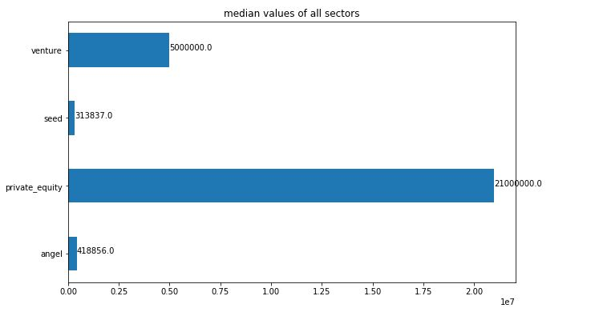
Funding Type with Representative Value

Slide 9
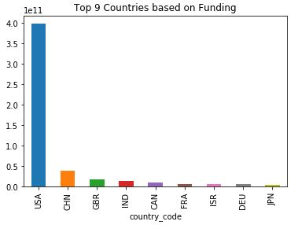
Top 9 Countries based on Funding Sum
Country Code | Funded Amount Sum
USA | 398324586390.000
CHN | 38642273502.000
GBR | 18142285645.000
IND | 13920253718.000
CAN | 8747167598.000
FRA | 6742608637.000
ISR | 6484356814.000
DEU | 6021103078.000
JPN | 3156202471.000

Slide 10
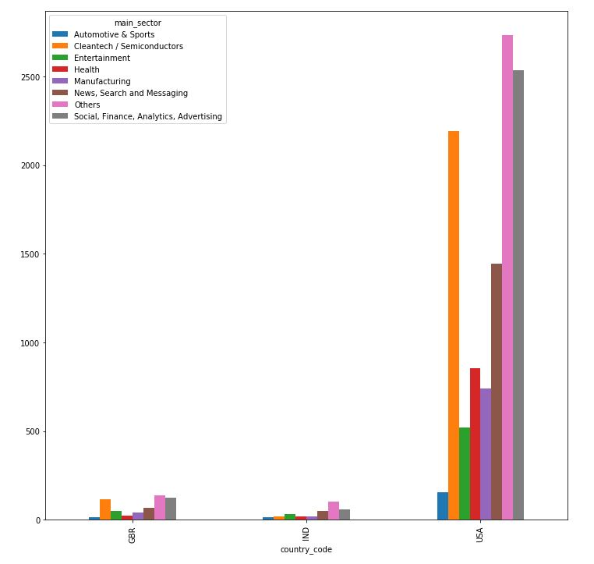
Sectors based on Counts in Top3 Countries

Slide 11
Conclusions
There are more than one companies receiving the top fund in USA , GBR and IND under the top sector and the second top sector
Since SparkFunds wants to invest in a funding type where most companies do, we have selected venture as the best one.
Since SparkFunds wants to invest in a top English speaking country , we can invest in USA as it has the highest number of investments done among the top three countries including GBR and IND.
Since SparkFunds wants to invest in a sector which has the highest number of investments, Others is the one which is highly contributed sector.
But this sector has a little uncertainty because this sector is not focused on Prime Area of Knowledge. Instead if we can invest in the second highest sector in USA i.e., Social-Finance-Analytics-Advertising , it is kind of a better investment as the domain here is fixed and 2535 investments are done here which are close to 2732 investments done in Others.
ShotsPotter is the highest fund receiving company in USA under Social-Finance-Analytics-Advertising with the total sum of 67.93M dollars
VirtuStream is the highest fund receiving company in USA under Others Category with the total sum of 64.3M dollars.
Both the companies are close by in terms of investment.

