Slide 1
LENDING CLUB – CASE STUDY SUBMISSION
Name: Omkar Joshi , Gadicherla Sameer
Batch – March 31’ 2021

Slide 2
Problem statement
You work for a consumer finance company which specializes in lending various types of loans to urban customers. When the company receives a loan application, the company has to make a decision for loan approval based on the applicant’s profile.
Like most other lending companies, lending loans to ‘risky’ applicants is the largest source of financial loss (called credit loss). The credit loss is the amount of money lost by the lender when the borrower refuses to pay or runs away with the money owed. In other words, borrowers who default cause the largest amount of loss to the lenders. In this case, the customers labelled as 'charged-off' are the 'defaulters’.
If one is able to identify these risky loan applicants, then such loans can be reduced thereby cutting down the amount of credit loss. Identification of such applicants using EDA is the aim of this case study.
In other words, the company wants to understand the driving factors (or driver variables) behind loan default, i.e. the variables which are strong indicators of default. The company can utilize this knowledge for its portfolio and risk assessment.

Slide 3
Methodology
Data Arrangement & Cleaning
Univariate
Analysis
Bivariate
Analysis
Recommendation
Drop all the rows with missing values
Drop all the columns with single values and high missing percentages
Impute values to necessary columns
Perform segmented univariate analysis and check the defaulting nature.
Analysing the spread of each numeric variable
Considering the major categories, work with other variables to get better insight.
Checking average defaulting rate in each of the main category given a sub-category
Note down the spread in default percentage for each variable analysis and at the end, decide based on the variance of this percentage that who are the strong indicators.

Slide 4
Data Cleaning
Total dataset contains 39717 rows and 111 columns.
We found 54 such columns where all the values were null and removed those columns.
Removed all the rows with missing last payment due
Removed columns with single value throughout rows.
dropped rows for "current" loan_status as they would not add much value to defaulting behaviour. Marked "charged off" as 1 and "Fully Paid" as 0 for simplifying our analysis.
'inq_last_6mths', 'initial_list_status', 'out_prncp_inv', 'total_pymnt_inv', 'recoveries', 'collection_recovery_fee', 'last_pymnt_amnt', 'last_credit_pull_d', 'policy_code', 'application_type', 'member_id', 'funded_amnt_inv', 'pymnt_plan', 'url', 'title', 'zip_code', 'acc_now_delinq', 'delinq_amnt', 'funded_amnt', 'total_rec_prncp’ are the droped columns.
- Number of rows dropped: 1388(3.4%)
- Number of columns dropped: 82(73.8%)

Slide 5
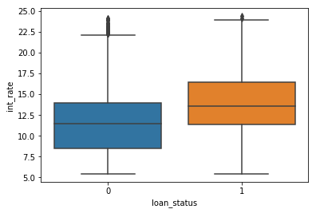
Univariate Analysis
For univariate analysis we have used different types of plots which gave some meaningful insights.
There are many plots drawn. We will show only unique plots in this ppt.
From this boxplot we can see that defaulters have high interest rates compared to non-defaulters

Slide 6
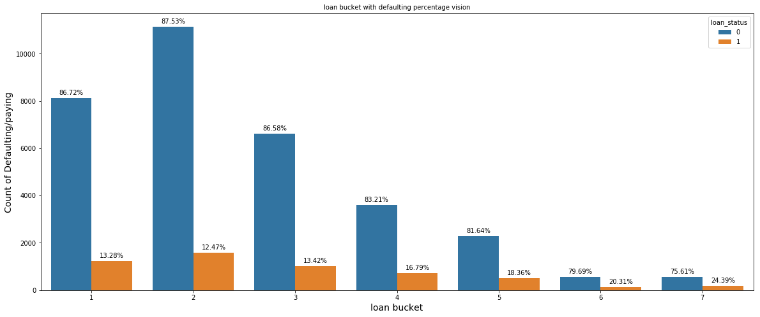
Unviariate Analysis
From this countplot we can see that defaulting rate increases with increase in loan amount

Slide 7
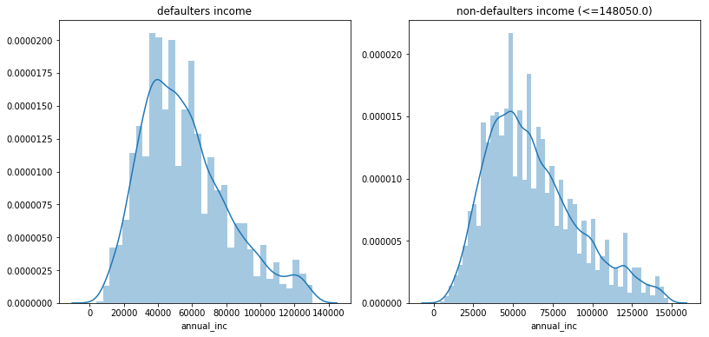
Univariate Analysis
From this histogram we can see there is normal distribution in income of defaulters and non-defaulters

Slide 8
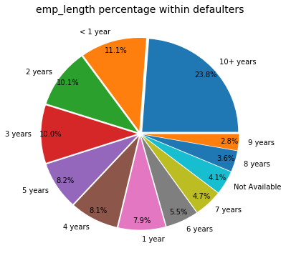
Univariate Analysis
From this pie chart we can see there are maximum defaulters over 10 years of experience

Slide 9
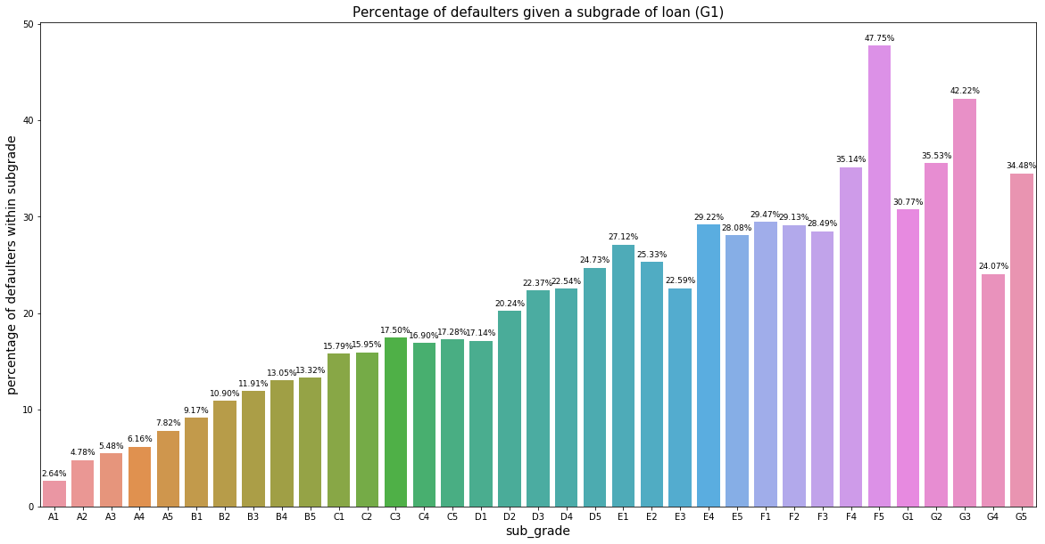
Univariate Analysis
From this bar chart we can see defaulting rate increases as grade increases. Within grade defaulting increases from 1-5 subgrade.

Slide 10
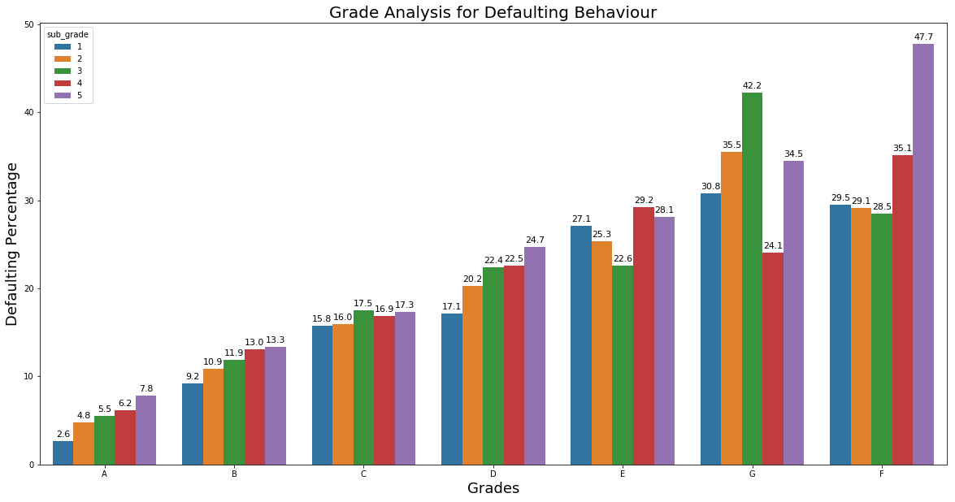
Bivariate Analysis
From this bar chart we can see defaulting rate increases as grade increases. Within grade defaulting increases from 1-5 subgrade.

Slide 11
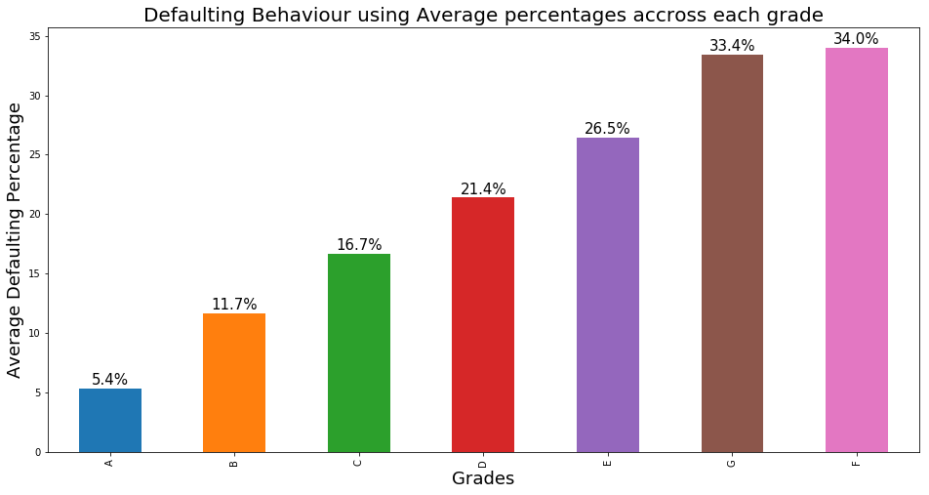
Bivariate Analysis
From this bar chart we can see average defaulting rate increases a grade increases. Within grade defaulting increases from 1-5 subgrade.

Slide 12
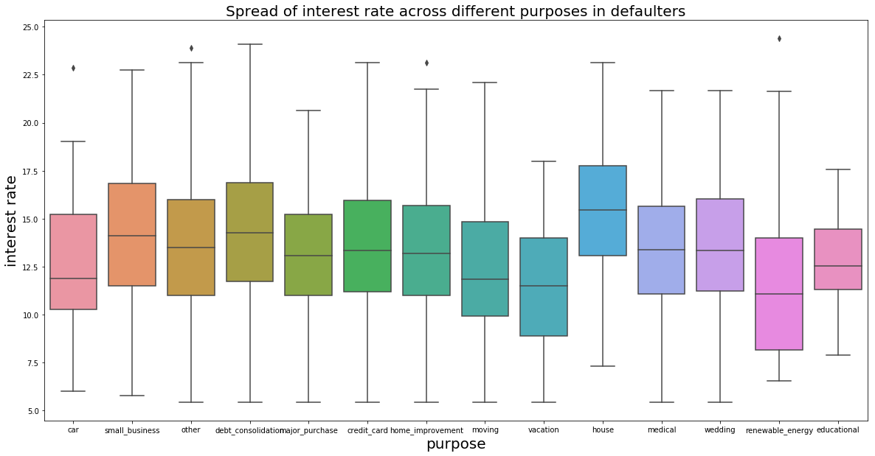
Bivariate Analysis
From this boxplot we can see defaulters who buy house loans have higher interest rates. Defaulters buying renewable_energy loans have very less interest rates.

Slide 13
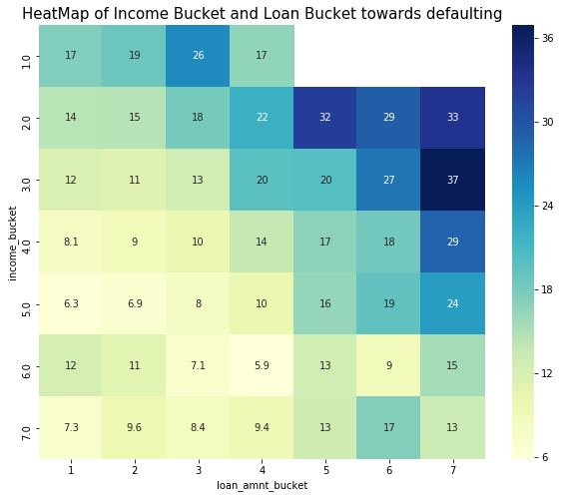
Bivariate Analysis
From this heatmap we can see defaulters whose incomelies between 50K to 75K and who purchase loan above 150K have highest defaulting rate.

Slide 14
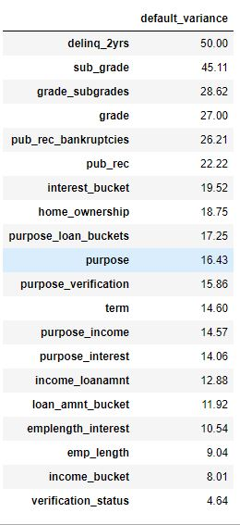
Feature Importance
Based on these percentages, we get the top indicators of the analysis..
These are the difference between max and min defaulting percentages in a particular category
For bivariate, these are the average differences across the sub-categories.

Slide 15
Recommendations
Grade and Subgrade:
These have shown a lot of variation in the defaulting percentages, thereby being a strong indicator.
We can recommend to go with any subgrade within lower grades like A and B as we have seen the trend that as the grade increases,
the defaulting percentage also increases. - Within a grade, we can go for lower subgrade number for less defaulting percentage. A1 instead of A5 etc..
Interest Rate:
When grouped into three categories, we have observed that the higher the interest rate, more the defaulters. - So its better to give loans in the normal or lower range. - recommended to keep the interest rate below 15% - Higher the interest , more the defaulting across all employment lengths.
Home Ownership:
Though we see a variation of 18% in this, actually its because there are 0% defaulters in NONE category which has only 3 records. - If we ignore that we see a similar range of 14-18% defaulting in other categories like rental, mortgage, individual. - This is NOT a strong indicator
Purpose:
- We have received a lot of good insight with this particular column - When seen alone, - we saw that borrowers taking loans for small businesses end up defaulting around 25% of the times. - Where as giving loans in categories like marriage, major_purchase, car and credit_card have very less risk. - When looked along with some other categories: - Verification-status: small businesses tend to default more, so not recommended to give to them. - Interest-Rate : Lower the interest rate, less the defaulting percentage across all the categories. - Loan-amnt : We see that avg default rate in major purchase across all the loan buckets is very less. Small businesses tend to have more avg default rate. So avoiding small_business loans is better. - Income-bucket : car loans have less default rates. Small business end up defaulting more across all income buckets.

Slide 16
Recommendations
Term:
It's recommended to give loan for 3 years instead of 5 years , as we see a default spike from 10% to 25% between these two.
Loan Amnt :
We can observe more defaulting in 30000-35000 loan bracket(7) across all emp_length, recommended to give loans below 30000
If the loan amount is below 15000, then we see less defaulting.
As the loan amount increases the defaulting rate is also increasing.
Employment length:
defaulting percentage in 10 out of 12 categories is almost near to 13%
When looked at only defaulter, we see that 10+ years had 23% of them.
Income Bucket:
We see less defaulting in between 75000 to 150000 i.e., buckets 4-5-6, good to give loans in this range.
Higher the salary, lesser the default rate.
Borrowers with income 5000-10000 are having the highest defaulting percentage of 23.4%, so better avoid loans in this range.\

