Slide 1
Music Genre Classification based on Lyrics
Presented by :
Raghav arora
Sameer gupta

Slide 2
Problem Statement
Lot of research has been carried for “genre classification” problem
Is there something new that we do ?
Most of the previous research is based on audio features
Our project is focused on “only lyrics” based genre classification
We also classify songs according to the decade in which the song released
Add new features to make classification more accurate using other non-vocal attributes of the song

Slide 3
Objective
Genre Classification
Classify song into six different genres :
Country, Jazz, Metal, Alternative, Electronic, Folk
Predicting time of release
Given a song, we try to predict if the song belongs to one of three given time frame :
1950-1970 ; 1971-1990 ; 1991-2010
Analyze if there is change in topical words with time

Slide 4
Dataset
The dataset was collected in three different stages
Stage I
Used Million Song Dataset provided by Columbia University researchers
Uses many third party datasets like musixmatch, lastFm, The Echo Nest,
Preprocessed the data from different files into 3 different databases
Fields | Type
Track_id | Varchar
Song_id | Varchar
Artist_id | Varchar
Artist_name | Varchar
Year | Int
Duration | Int
Title | Varchar
Fields | Type
Words | Varchar
Fields | Type
Track_id | Varchar
Fields | Type
Tag | String
Track_id | Varchar
Fields | Type
Track_id | Varchar
Word | Varchar
Count | Int
Fields | Type
Tag | String
Songs Table
Words Table ; Lyrics Table
TID ; TAG ; TID_TAG Table

Slide 5
Stage II
MSD has limitations since in contains on bag of words and not complete lyrics
Requested for CAL10k dataset
Contains song name, artist name, genre, and track id (to connect to MSD)
Provides details of 10k songs and used to extract lyrics in next phase
Stage III
To extract lyrics, we created our own crawler
Used multiple APIs like ChartLyrics, Lyrics Wikia, EchoNest
Written .net program to extract lyrics that was later saved in MySql Database
Final dataset contains two tables with relevant information
Fields | No. of rows
Artist_detail_id | 1800
Artist_name | 1800
Song_name | 1800
Genre | 300 (per genre)
Lyrics | 1800
Track_id | 1800
Year | 1800
Fields | No. of rows
Year_id | 900
Artist_name | 900
Song_name | 900
Genre | 900
Lyrics | 900
Track_id | 900
Year | 300 (per time-frame)

Slide 6
Approach : Genre Classification
Selected 3000 songs from MSD (evenly distributed among all six genres)
Baseline should be 16.6% (chosen by randomly distributing songs in six genres)
Start with performing k-means clustering
Created a list of words appearing in more that 80 songs
Created a input vector, having set value as 1 if the word exists in the list else 0
Issues :
Sparse data – clustering most of the songs together
Further, we applied k-nearest neighbor techniques to classify the songs
Better results than k-means clustering

Slide 7
Naïve Bayes Classification Model
We started by applying Unigram Model using MSD since it count of occurrence of each of the words
Training data : 400 songs from each of the six genres
Test data : 100 songs from each genre
The list of words created earlier was used to construct feature vector
Next, we used Bigram Model on our dataset to measure the accuracy of this model
Further, we applied it on our final dataset that had 300 lyrics for each of the six genres
Training data : 240 songs from each of six genres
Test data : 60 songs from each genre

Slide 9
Creating Feature Vector
After analyzing the accuracy of our feature vector (frequency of words), we included certain features to further improve accuracy of our classifier
Created a list with words occurring in more than 50 songs
Included following features
Part of speech tagging
Average number of words in a line in a song
Average number of lines in song
Duration of a song
Number of repeating words in a song
Classifier Used
Multiclass Support Vector Machine (Cornell)
Maximum Entropy (Stanford Classifier)

Slide 10
POS Tagging
POS tagging shows the structure of the sentence
Reflects the writing style of the lyrics
We assume that POS should be similar across a genre
We NLTK in Python over “Penn Treebank Tag Set” to tag words
Example : Country music that is known for telling stories through song contains most no. of adjectives, electronic has maximum nouns and alternate has max pronouns.

Slide 11
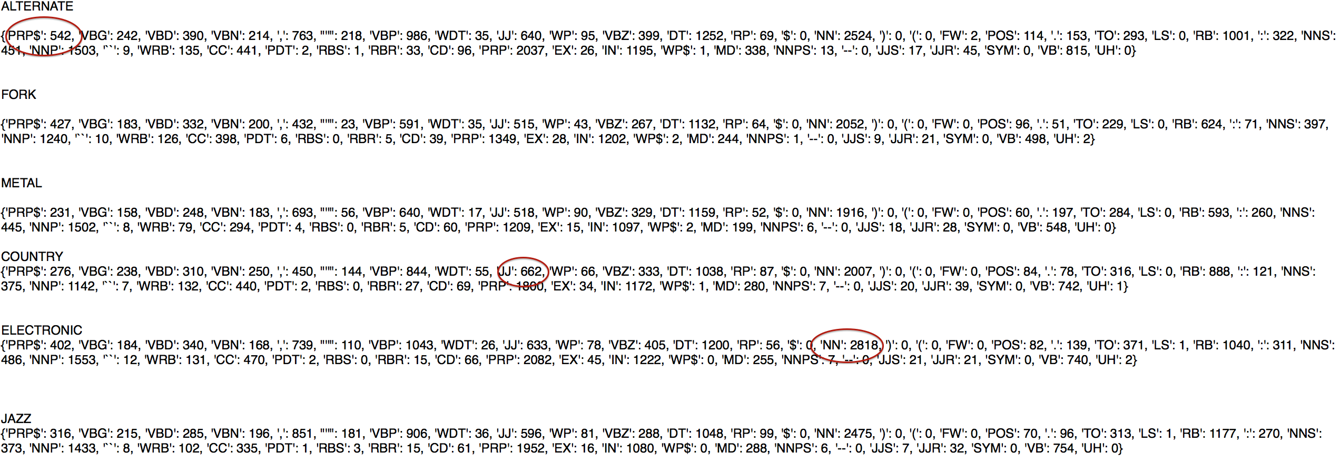
POS Tags

Slide 12
Average no. of words in line
The length of the line may indicate certain properties related to rhythm or flow of the song
Shorter length may mean broken flow along with stress on each word, whereas, longer length may signify a continuous flow.
SVM performs a little better with average number of words line.

Slide 13
Average no. of lines
It may also serve as an indicative of the style of the song
Shorter the lines, greater would be the probability of increase in no. of line in a song
Repetitions were excluded and mentioned as “Chorus” in the lyrics extracted
Example : Metal had a lowest 31 lines per song, as these are known for its fast paced songs. No. of lines in folk music were maximum while for jazz and electronic, it was same.

Slide 14
Duration and Repeating Words
Duration gives running length of the song
It includes the vocal and non-vocal part of the song
Example: Average Duration of Country is larger than Electronic
The no. of repeating words in a song indicates the writing style as it reflects tendency of a song to repeat the words or a line
If a word or a line was repeated more than once, we increased this count
Example: Repetition is more in Metal/Electric as compared to rest.

Slide 16
Combining Features
Finally, we combined all the features discussed earlier
For SVM , C parameter is set to 3*10³ with L1 regularization

Slide 17
Time Prediction
Similar set of steps were performed for Time Prediction
Dataset contains 300 songs from three time-periods (1950-70; 1971-90; 1991-10)
Training : 240 songs from each of 3 classes
Test : 60 songs from each of 3 classes
Analyzed different features vectors and observed some of the below characteristics
Bag of words (unigram and bigram)
Duration of song
Average lines in a song
POS tagging
Average duration of song is maximum in period 1971-90 and average lines per song is maximum in duration 1991-10.
Tags are more specific to genre rather than time period (as per our dataset)

Slide 18
Results

Slide 19
Change in topical words

Slide 20
Challenges and Issues
Data collection was the biggest challenge at the start of the project
Data limitation was one of the issues, since having larger dataset could have given us more accurate results
Maintaining the quality of dataset
Selecting attributes that may affect the accuracy of the classifier for creating feature vector

Slide 21
THANK YOU!!

