Slide 1

DOCTOR PATIENT APPOINTMENT
Project Presentation
Submitted by:
SAMEER AH AHANGER (1037)
Under the Supervision of
Asif Iqbal Kawoosa
Department of Computer Sciences
Govt boys degree college, pulwama

Slide 2
Contents
INTRODUCTION
NEED OF PROPOSAL/ PROBLEM DEFINITION
OBJECTIVES
REQUIREMENTS
SERVICES USED
DFD (DATA FLOW DIAGRAM)
LANGUAGES USED

Slide 3
INTRODUCTION
The project Doctor Patient Appointment system includes registration of patients, adding of doctors, booking appointments and storing the details into the reliable system. The user can book the appointment for any of the available doctors and the doctors can view all the booked appointments.
The purpose of the project entitled as “Doctor Patient Appointments SYSTEM” is to computerize the Front Office Management of Hospital/ Clinics to develop software which is user friendly, simple, fast, and cost–effective.
Traditionally, it was done manually. The chief function of the system is to register and store patient details and doctor details and retrieve these details as and when required, and also to manipulate these details meaningfully.

Slide 4
Need of proposed system/Problem Definition
Lack of immediate retrievals.
Lack of immediate information storage.
Lack of prompt updating.
Prone to human error.
Takes lots of time and resources
Information loss.

Slide 5
OBJECTIVES
The main aim is to reduce the manual work while managing the patient and doctor details.
Also, to develop a hassle free, reliable and user-friendly interface that can help the doctors and patients to do the day-to-day task with ease while taking up the least amount of resources and time.
By developing this website, we will enhance our skills which we have got during BCA.
We will add some more features in future for the better security and ease to use it by adding more user-friendly interface.

Slide 6
Module
Admin View
Can add Doctors
Doctor View
View all appointments
Patient View
Can book appointments
View all appointments
Can add Specialists
Can manage the database
Add comments to patients
Edit profile details
Can view doctors and patients
Login and Registration
Doctors, patient and Admin login page
Patient registration page

Slide 7
Requirements
SOFTWARE REQUIREMENTS
Operating System: Windows , Linux
Language: JAVA
Browser: Any of Mozilla, Opera, Chrome, etc
Web Server: Tomcat 10
Database: MySQL

Slide 8
Requirements (Conti….)
HARDWARE REQUIREMENTS
Processor: Pentium
RAM: 128 MB
Hard disk: 20 GB

Slide 9
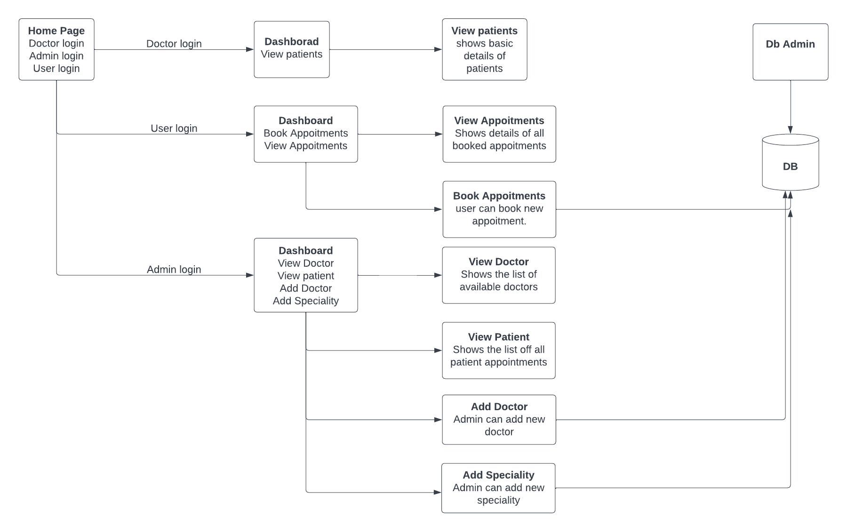
Design Methodology (DFD)

Slide 10
LANGUAGES USED:
JAVA
MYSQL
HTML
CSS
JAVASCRIPT
BOOTSTRAP

Slide 11
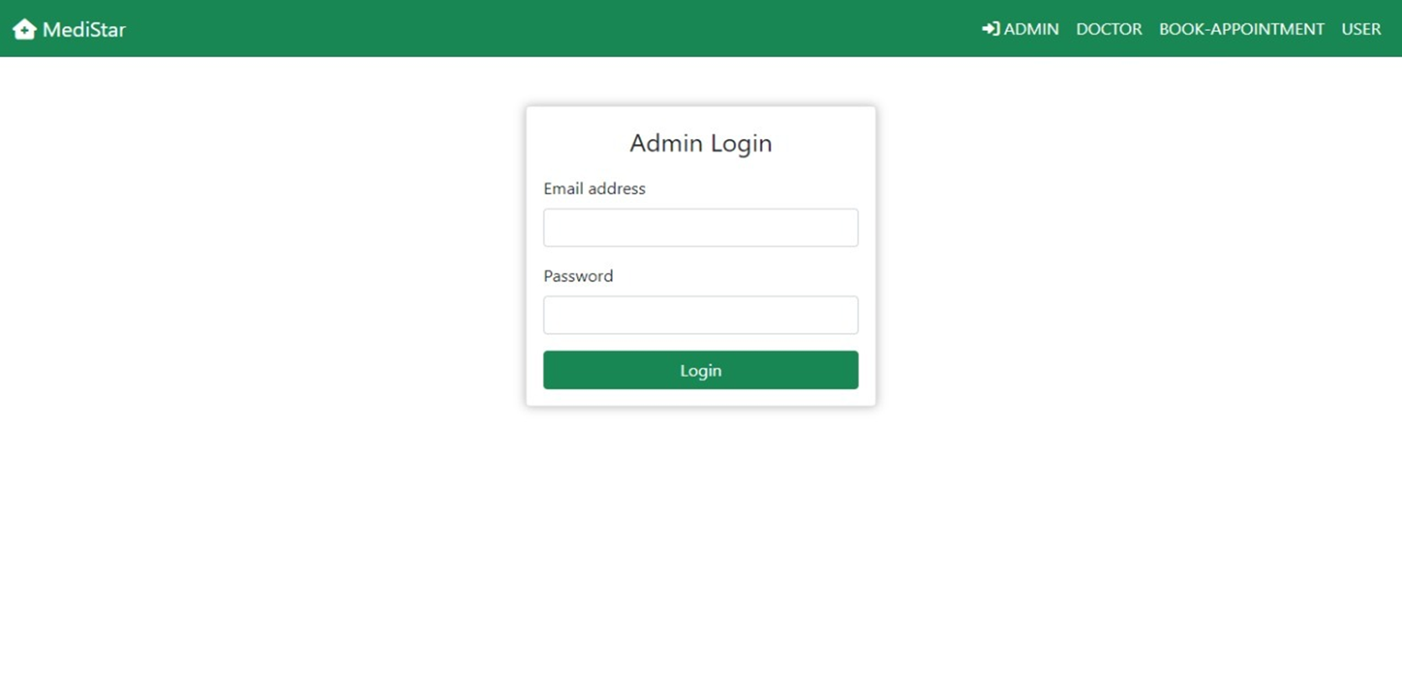
admin login

Slide 12
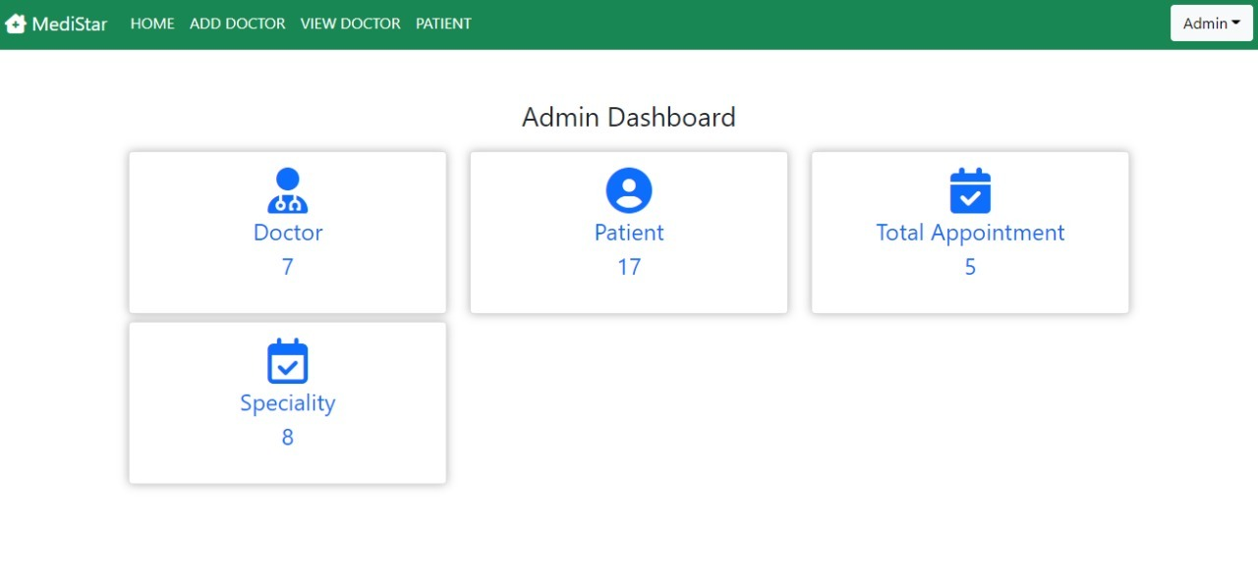
Admin Dashboard

Slide 13
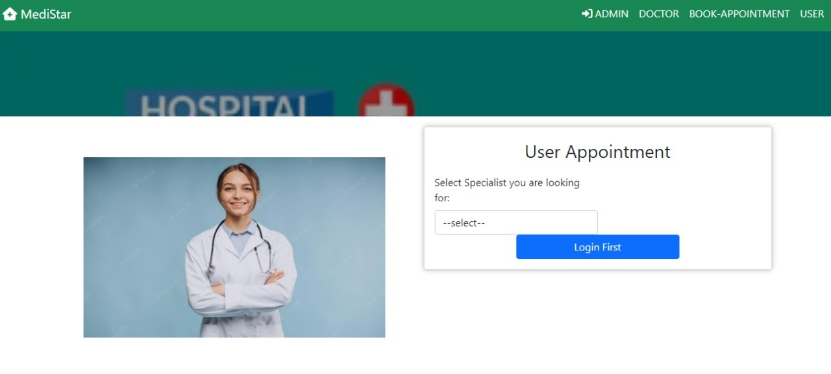
Appointment Dashboard

Slide 14
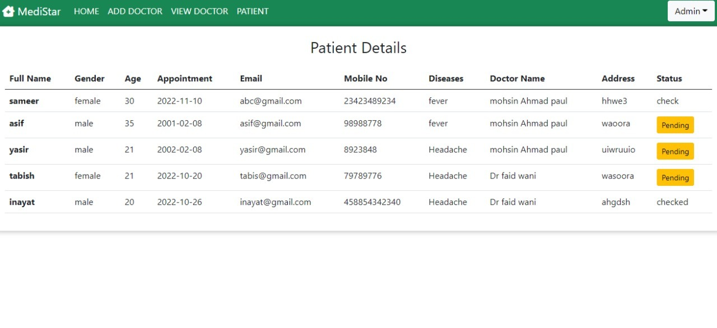
Patient Details

Slide 15
Thank You

