Slide 1
FOSS Case Study -Team 1

Slide 2
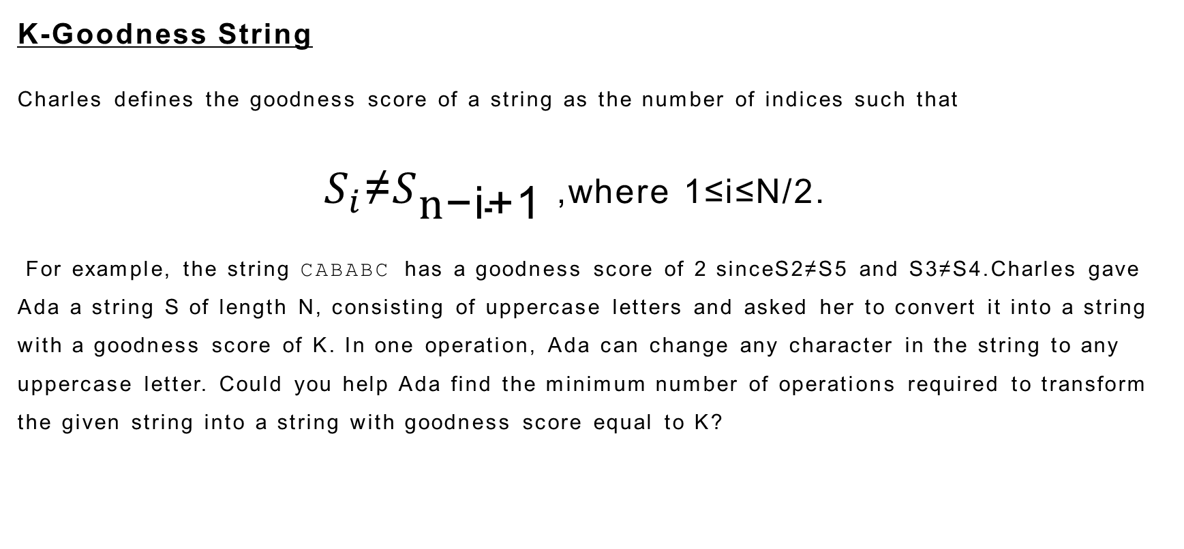
Problem statement:
K-Goodness String
Charles defines the goodness score of a string as the number of indices such that
$S_{i}$≠$S_{\text{n}\text{−}\text{i}\text{+1}}$ ,where 1≤i≤N/2.
For example, the string CABABC has a goodness score of 2 sinceS2≠S5 and S3≠S4.Charles gave Ada a string S of length N, consisting of uppercase letters and asked her to convert it into a string with a goodness score of K. In one operation, Ada can change any character in the string to any uppercase letter. Could you help Ada find the minimum number of operations required to transform the given string into a string with goodness score equal to K?

Slide 3

K-score Definition:
$S_{i}$≠$S_{\text{n}\text{−}\text{i}\text{+1}}$ ,where 1≤i≤N/2.
If the character from the first is not equal to the character from last increase the goodness score K by +1.
Example
K=0
K=1
K=2
1 2 3 4 5 6
C
A
B
A
B
C

Slide 4
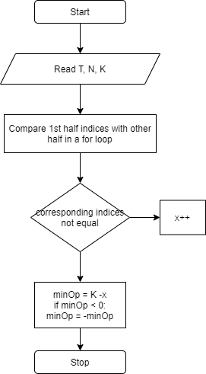
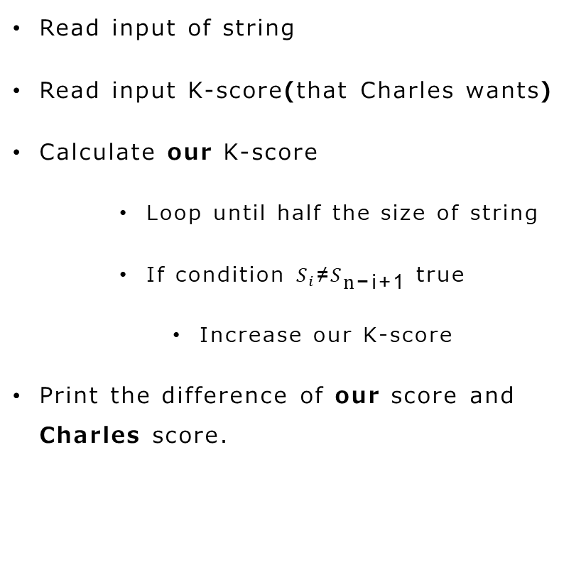
Algorithm:
Read input of string
Read input K-score(that Charles wants)
Calculate our K-score
Loop until half the size of string
If condition $S_{i}$≠$S_{\text{n}\text{−}\text{i}\text{+1}}$ true
Increase our K-score
Print the difference of our score and Charles score.
Flowchart:

Slide 5
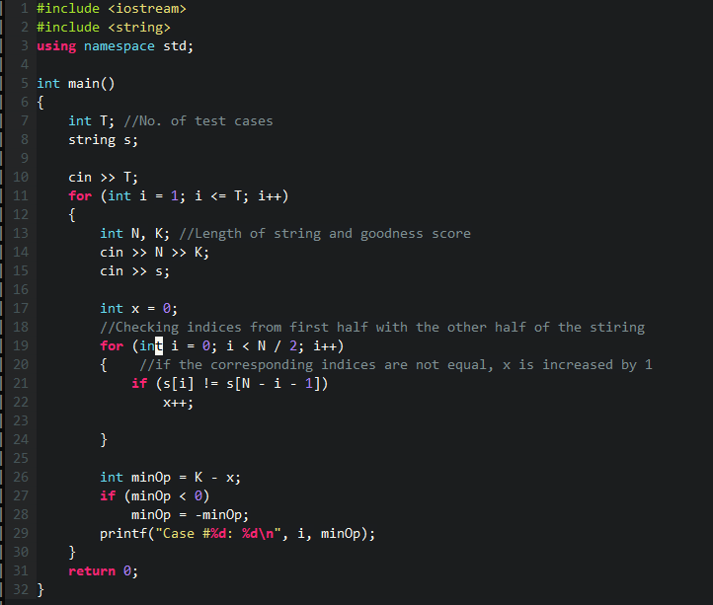
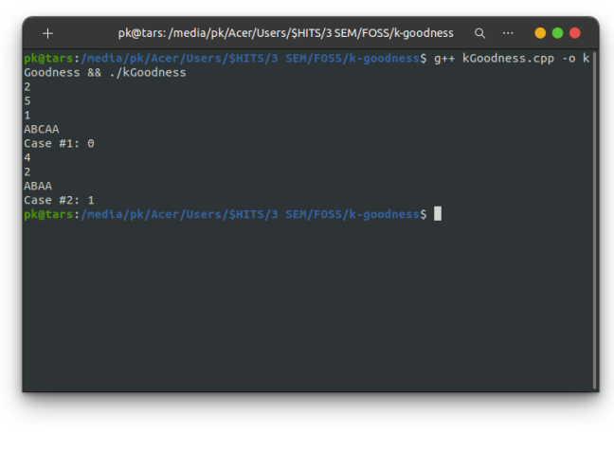
Code:
Output:

Slide 6

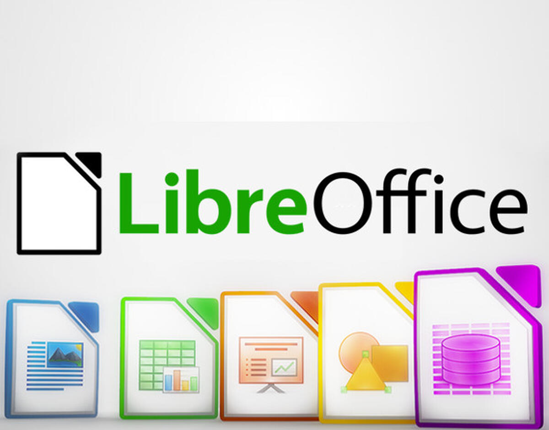
Tools Used
Vim or vi improved
Libre office
Linux based text editor which greatly focuses on speed.
Highly flexible in configuring
Extremely lightweight
Free and opensource office suite successor to open office.
As gold standard MSoffice is not supported on linux. OpenOffice can come in handy for linux users.

Slide 7
Disadvantages in open source:
Lack of tech support(left to debug on our own).
Missing exclusive features that proprietary apps provide.
Outdated UI ,which promotes hard learning curve.
Compatibility issues for enterprise/business customers.

Slide 8
Contributers List:
M1-Programming Jargula Hari Krishna
M2-Bundling the Work Ravi Kakarla
M3-Presentation Mohammed Sameer
M4-Coordinator Priyan Kishore MS
M5-Miscellneous Sandeep Kumar

Slide 9
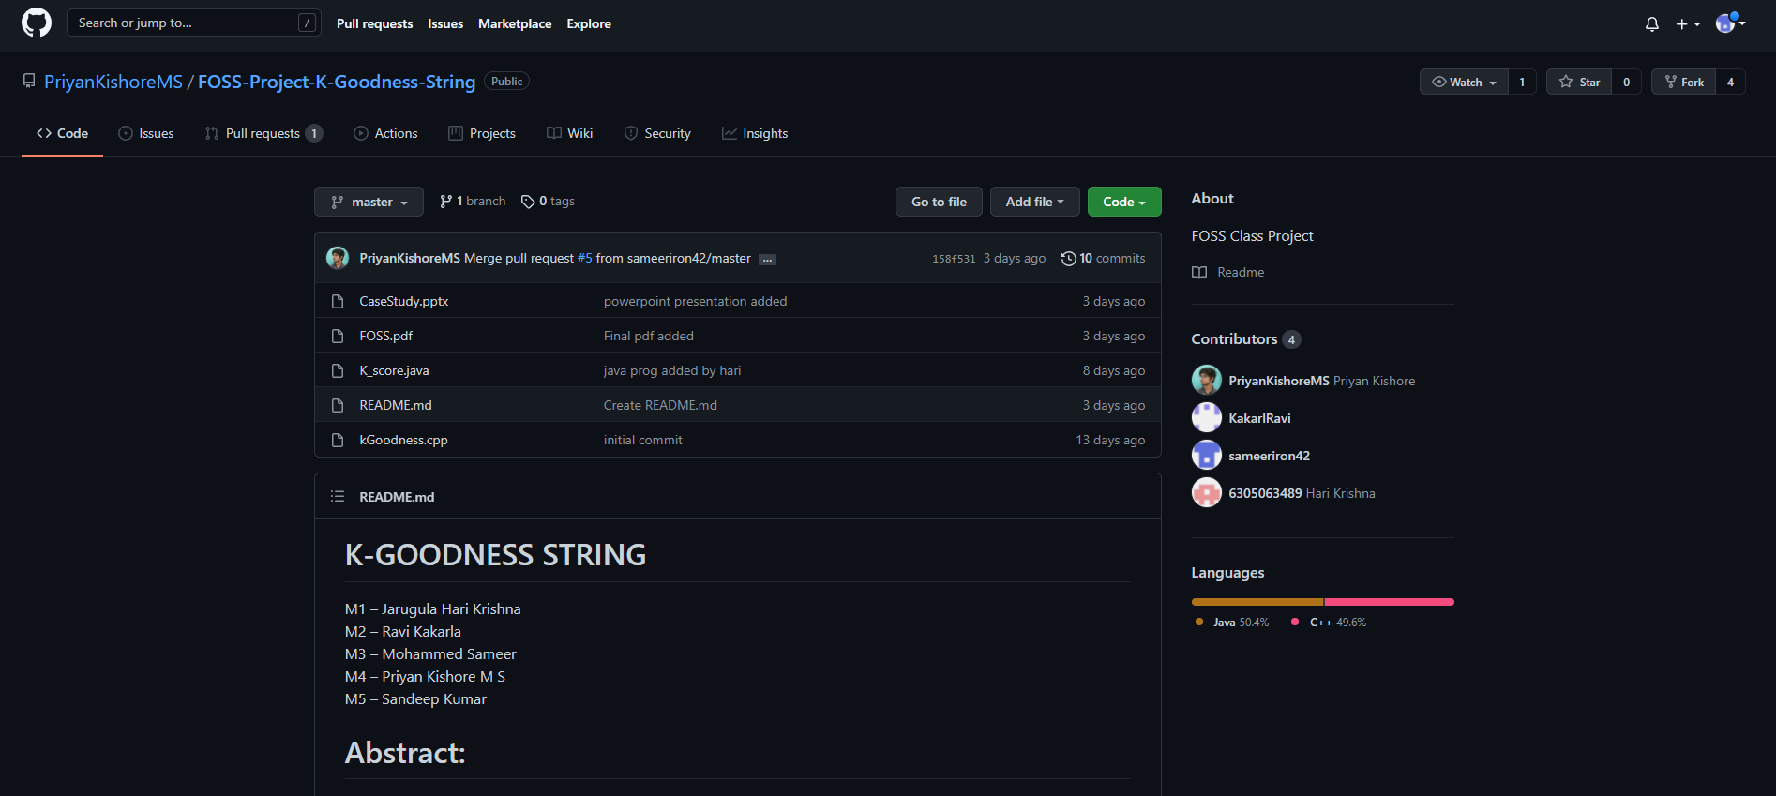
GitHub Repository Page

Slide 10
GitHub pull Request

Slide 11
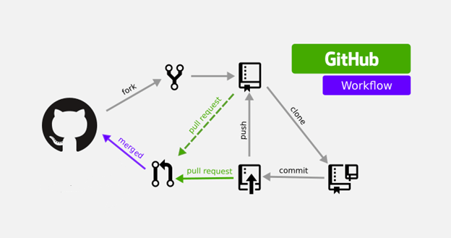
New repo under their account
Updated repo
Containing changes
Forked by team
members
Main repo under priyan
Main repo is updated
Offline copy of
Their repo
Verifying pull request
Adding their changes to repo

Slide 12
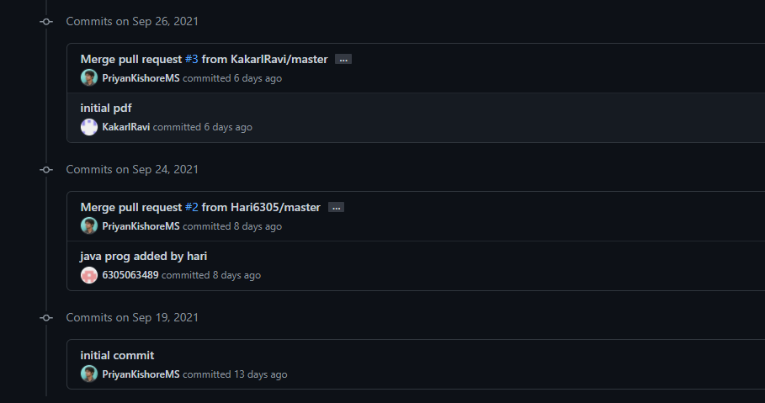
Commit History

Slide 13
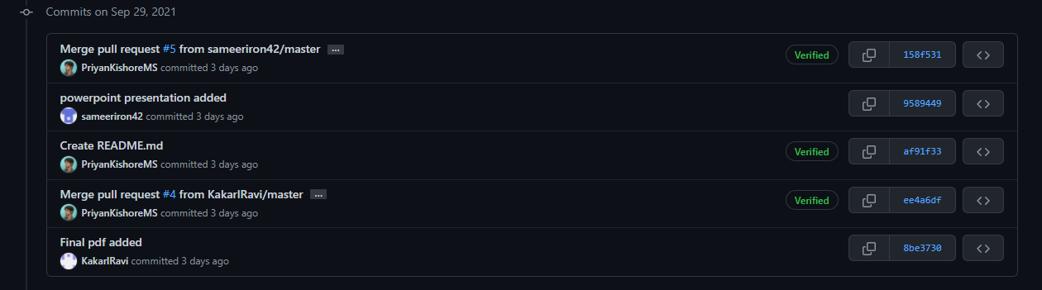
Commit History(cont.)

Slide 14

Title Slide 6

