Slide 1
HSC 509 Perspectives on Human Behaviour
Monsoon Semester 2022-23
Department of Humanities and Social Sciences
Indian Institute of Technology (ISM) Dhanbad

Slide 2
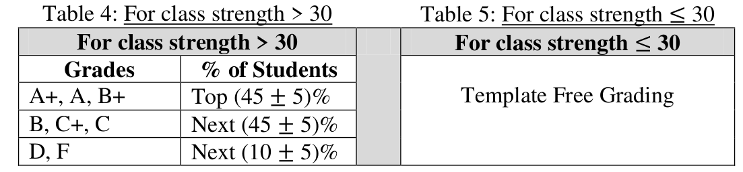
Attendance & Evaluation
Minimum Attendance Required: 75%
Evaluation:
For A+ : 90 and above

Slide 3
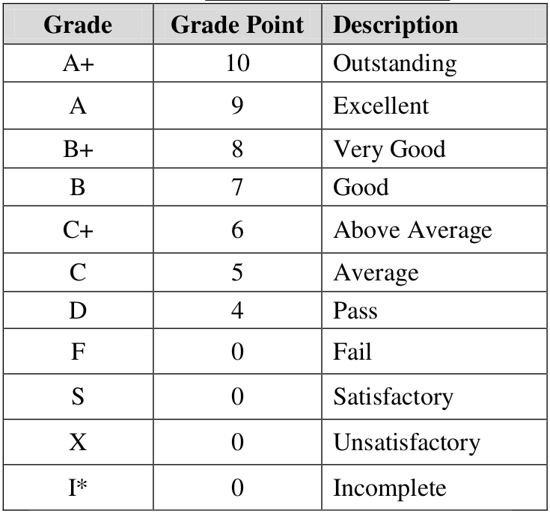
Grade Letters

Slide 4
Evaluation
Mid Semester Examination: 30
End Semester Examination: 50
Internal Assessment: 20

Slide 5

Primary Reading 1
Moghaddam, F.M. (2005). Great Ideas in Psychology: A Cultural and Historical Introduction. Oxford: Oneworld

Slide 6

Primary Reading 2
Gross. R.(2010). Psychology: The Science of Mind and Behaviour. Oxon: Hodder Education

Slide 7
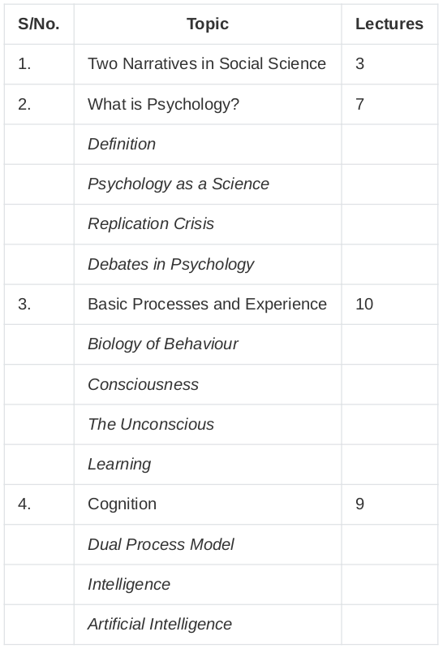

Slide 8
