Slide 1
OBEDIENCE
Presented by:
Rabiya Fatima

Slide 2
OVERVIEW
INTRODUCTION
CONFORMITY VS. OBEDIENCE
EXPERIMENTAL STUDIES ON OBEDIENCE
- MILGRAM’S RESEARCH
- ZIMBARDO’S RESEARCH
WHY DO PEOPLE OBEY?
EVALUATION
CONCLUSION

Slide 3
INTRODUCTION
Obedience – changing one’s behavior at the command of an authority figure.

Slide 4
CONFORMITY VS. OBEDIENCE
Both involve the ‘abdication of individual judgement in the face of some external social pressure’. (Milgram, 1992)
Conformity – No instructions
Obedience – Orders and instructions
Conformity – Influencer – Peers
Obedience – Influencer – Authority
Conformity – ‘Need’ to be accepted
Obedience – ‘Power’ of the authority

Slide 5
EXPERIMENTAL STUDIES ON OBEDIENCE
Stanley Milgram (1963)
Philip Zimbardo (1973)

Slide 6
MILGRAM’S RESEARCH
Designed to test the “Germans are different” hypothesis
https://www.youtube.com/watch?v=Kzd6Ew3TraA

Slide 7
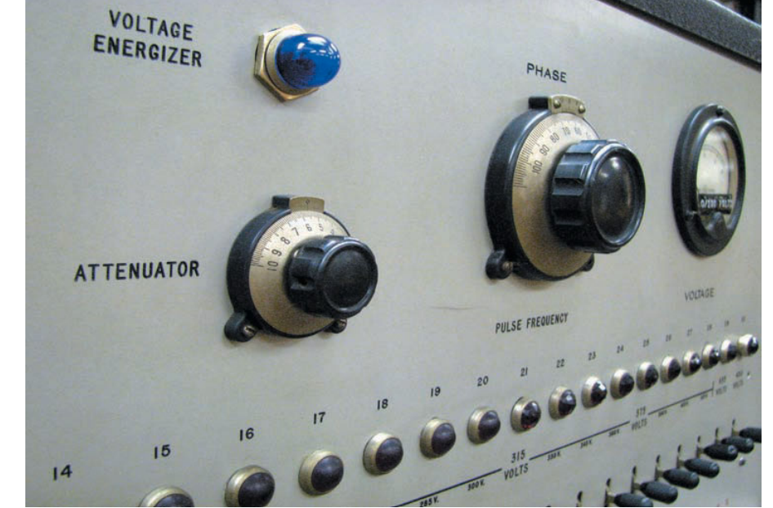

Slide 8
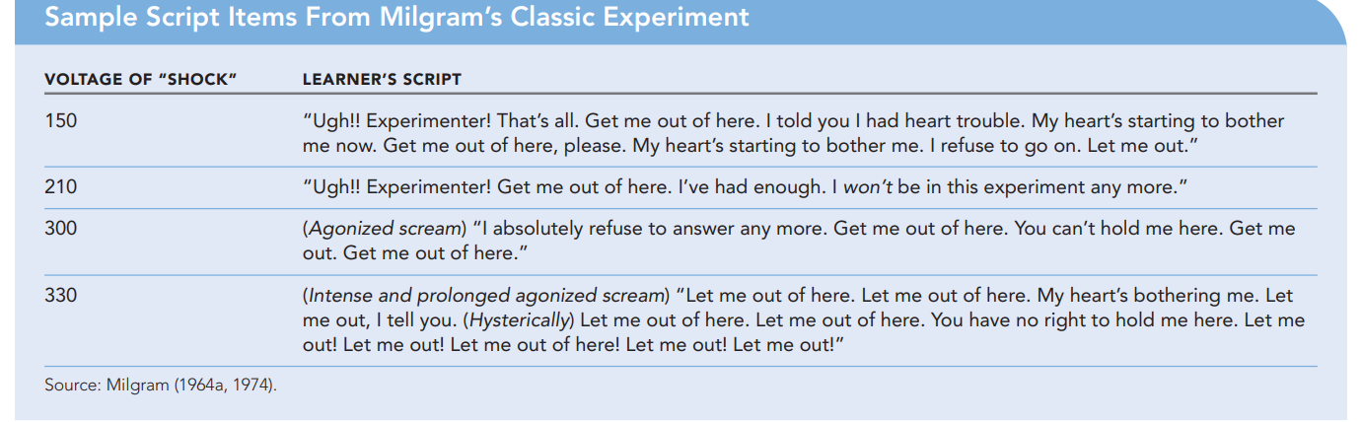

Slide 9
WHY DO PEOPLE OBEY?
According to Milgram (1974): “The most fundamental lesson of our study is that ordinary people simply doing their jobs, and without any particular hostility on their part, can become agents in a terrible destructive process.”
Diffusion of responsibility
The perception of legitimate authority
‘Entrapment’ – foot-in-the-door
Socialisation

Slide 10
CRITICAL EVALUATION
Ethical concerns
Unrepresentative sample
Lack of experimental realism
Lack of mundane realism Orne and Holland(1968)
(demand characteristics)
Cross-cultural replicability

Slide 11
ZIMBARDO’S RESEARCH
Stanford Prison Experiment (SPE) – Conducted by Zimbardo et al. to assess the power of social situations on people’s behaviour
https://www.youtube.com/watch?v=3XN2X72jrFk

Slide 12
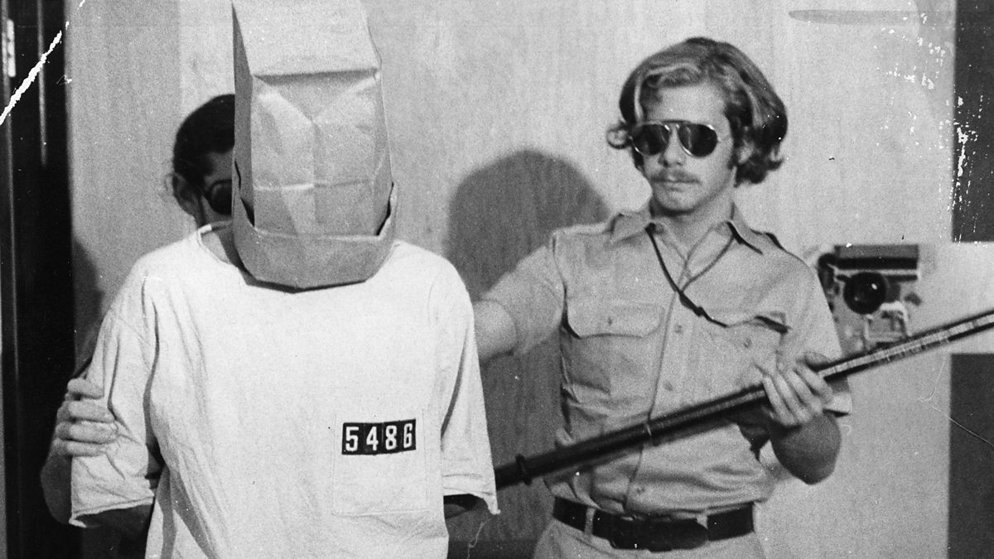
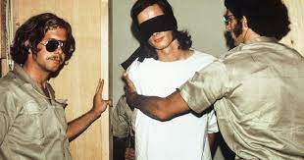
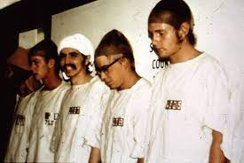

Slide 13
EVALUATION
Power of social and institutional forces
Role-playing vs real self
Ethical concerns

Slide 14
CONCLUSION
Milgram suggested following measure to reduce obedience: (3Es)
Educate – blind obedience
Encourage – question authority
Expose – disobedient models
According to Zimbardo (2007), the power of social situations isn’t limitless; ultimately, it’s individuals – not ‘the System’ – that’s responsible for individuals’ behaviour.

Slide 15
THANK YOU!!

