Slide 1
PYTHON PROJECT_TELEMARKETING_EDA
By Samir shankar jadhav

Slide 2
Understanding the dataset
Data uploading
Data cleaning
Fixing the rows and columns
Dropping unwanted columns
Splitting column into different category, example: splitting ‘jobedu’ column into ‘job’ and ‘education’ column.
Checking for missing values
Handling outliers

Slide 3
DESCRIPTIVE STATISTICS
# Calculate the mean of each numeric column
mean_values = bank.mean()
# Calculate the median of each numeric column
median_values = bank.median()
# Calculate the standard deviation of each numeric column
std_dev_values = bank.std()

Slide 4

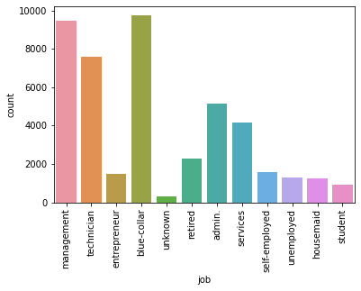
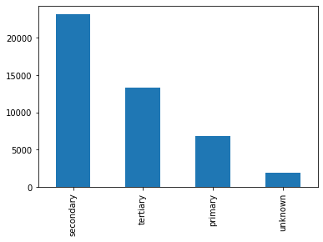
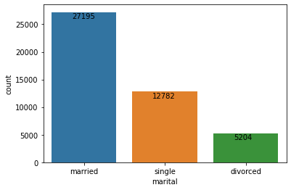
UNIVARIENT ANALYSIS
Married people were the highest with a count of 27195, followed by single and divorced.
People doing blue-collared job were the highest of the lot followed by people in management and technician. Student were the least.
Student with secondary education were the highest and primary education were the least.

Slide 5

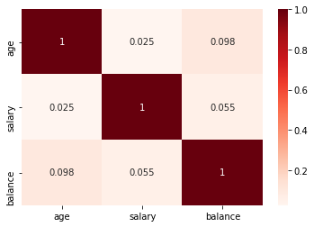
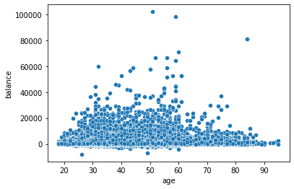
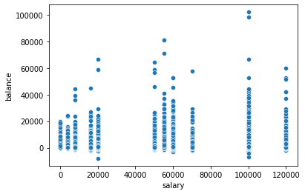
BIVARIENT ANALYSIS
A scatter plot between Age and Balance shows that a balance of 20,000 is normal between all age group.
There is a strong positive correlation that as salary increases the balance increases as well
This suggest that individuals with higher salaries tend to have higher account balances.
The heatmap shows that as age increases salary decreases leading to a lower balance. This might occur during retirement or career transitions.

Slide 6
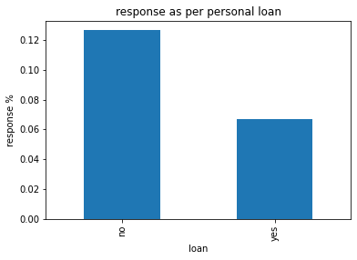

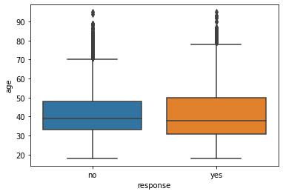
Categorical Variables Analysis
The amount of people not opting for personal loan is less as compared to those opting for the loan.
Similarly, the amount of people not opting for housing loan is less as compared to those opting for the housing loan.
There is not much difference in the mean and median values for categorical variables in age vs response category.
There are lot many outliers above the age of 70 for ‘No’ responses and above the age 80 for ‘Yes’ responses.

Slide 7
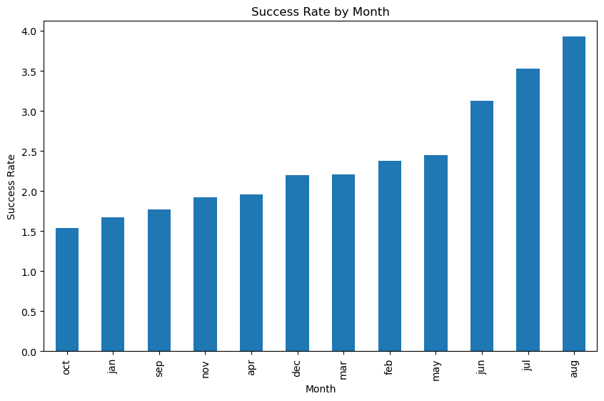
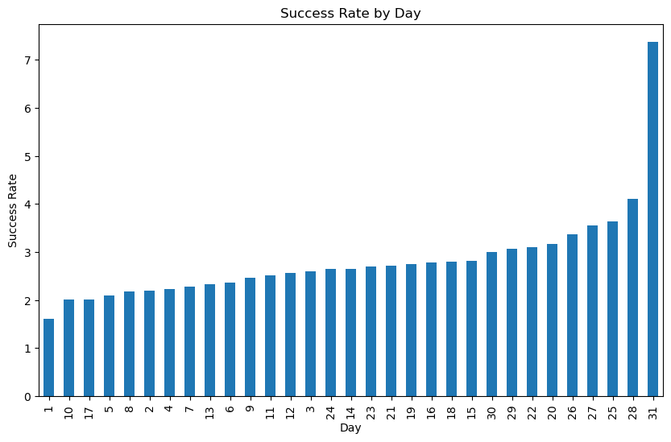
Temporal Analysis
The temporal patterns wrt the success of the campaign was demonstrated by certain trends in the Month and Day patterns.
August month showed highest success rate followed by July and June.
The success rate was highest on the 31st day of the month.

Slide 8
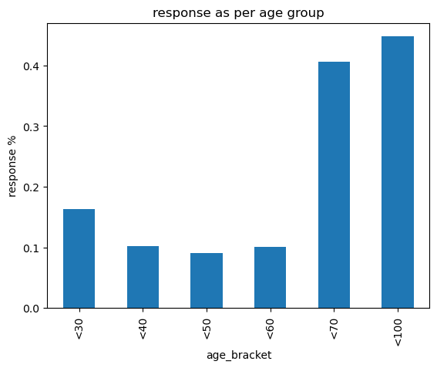
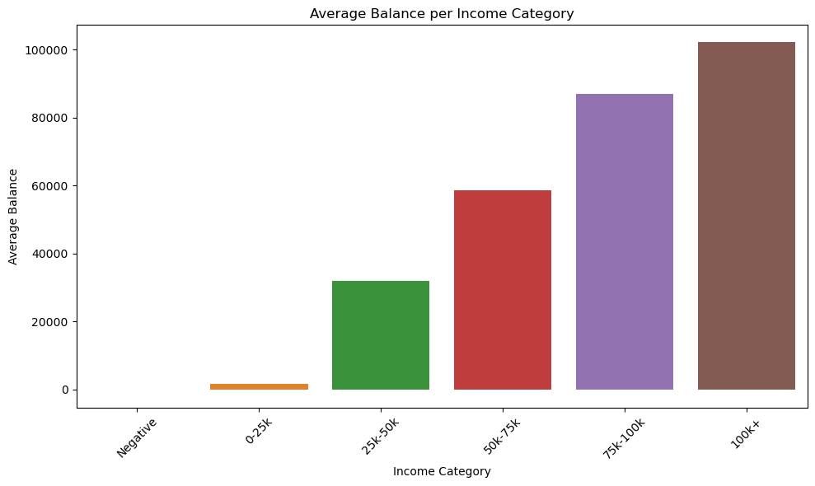
Feature Engineering
Two new categories namely age group and income category were introduced.
People who were <30 years showed good income stability.
Average balance was also goo din high income bracket category.

Slide 9
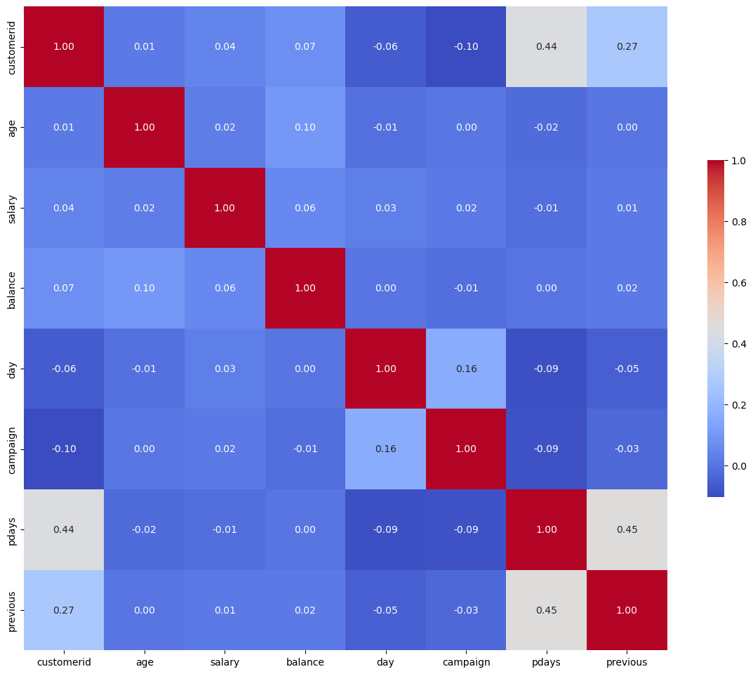
Correlation Analysis
There is no multicollinearity in any of the columns of the given dataset.

Slide 10
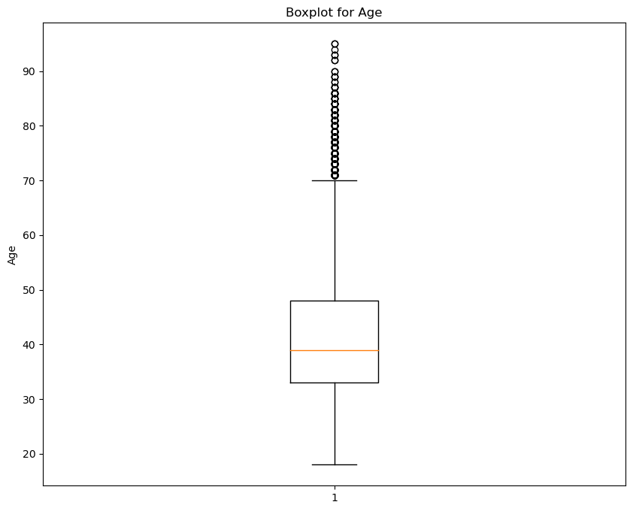
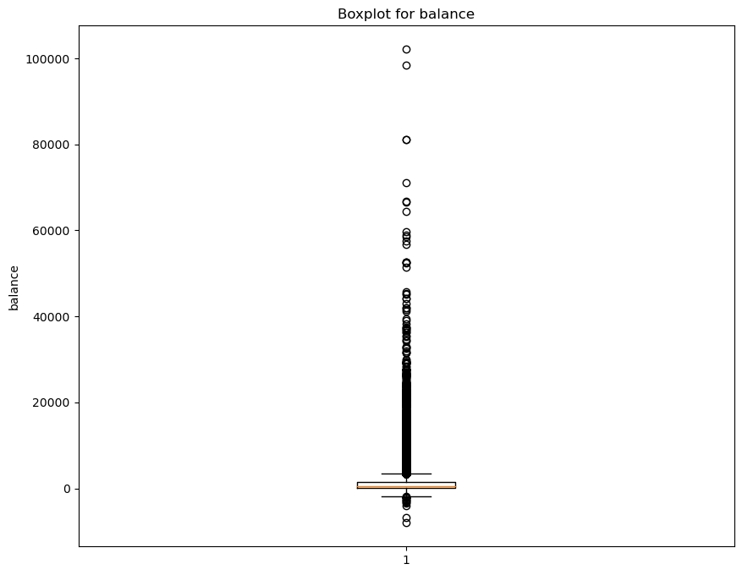
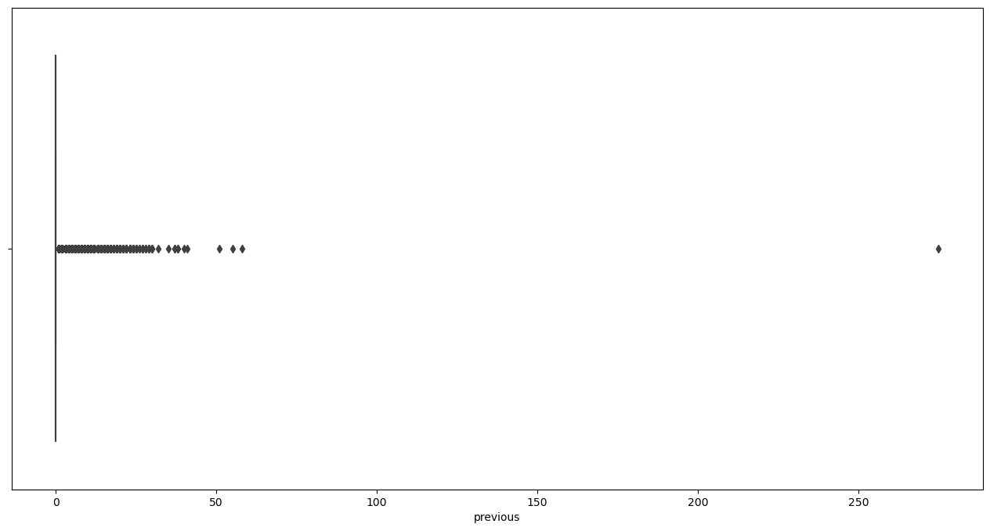
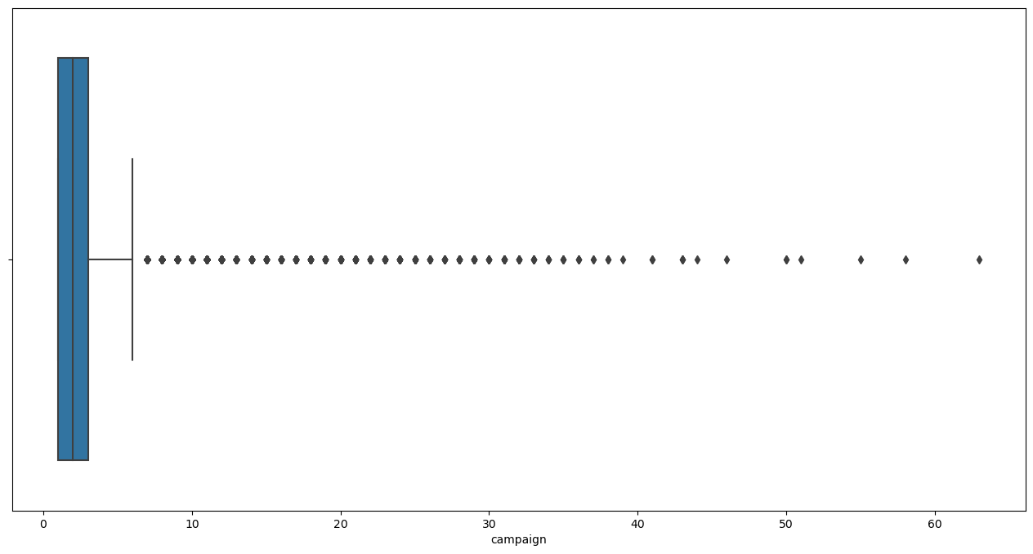
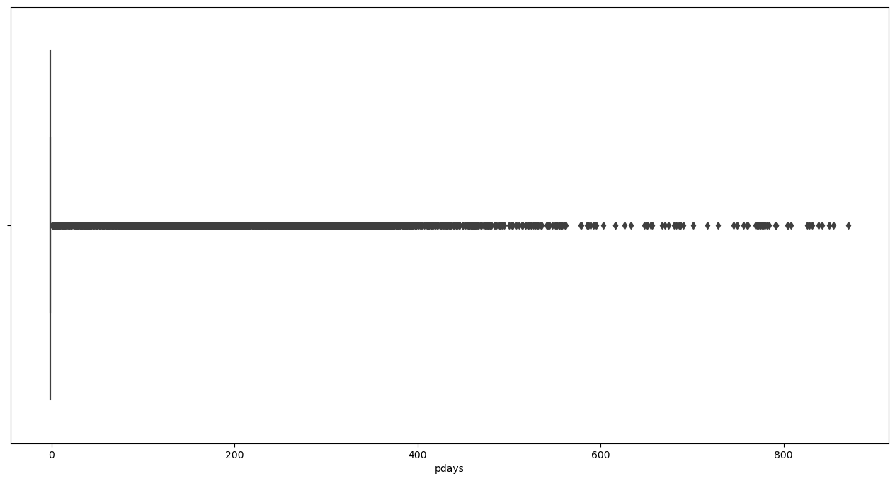
Outlier Detection and Handling

Slide 11
THANK YOU !!

