Slide 1
SQL Data Analysis and Visualization with Power BI for FDA
By Samir shankar jadhav

Slide 2
BUSINESS AND DATA UNDERSTANDING:
The U.S. Food and Drug Administration (FDA) is a federal agency responsible for safeguarding public health in the United States.
i-Vision is collaborating with FDA to perform Data analysis on FDA’s dataset.
FDA has provided i-Vision with SQL script of their dataset.
As an analyst at i-Vision THE role is to create informative reports by conducting a thorough analysis of the data using powerful tools like MySQL and Power BI.

Slide 3
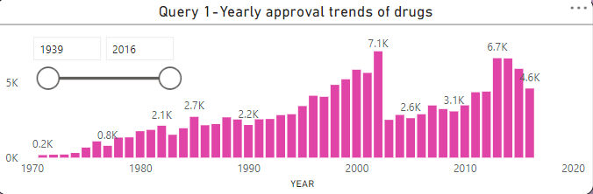
QUERY 1-Visualize the yearly approval trends of drugs. Highlight any significant patterns and/or fluctuations, if any.
VALUABLE INSIGHTS:
THE APPROVAL FOR DRUGS WAS HIGHEST IN 2002 AND WAS 7.1 K WHICH WAS CLOSELY FOLLOWED BY 2013 WITH A COUNT OF 6.7 K.
THE APPROVAL OF DRUGS PRIOR TO THE YEAR 1970 WAS THE LEAST.

Slide 4
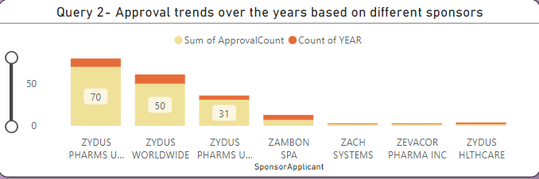
QUERY 2- Explore approval trends over the years based on different sponsors. Uncover patterns and changes in approval rates among sponsors.
VALUABLE INSIGHTS:
THE APPROVAL RATE WAS HIGHEST FOR ZYDUS PHARMA USA INC FOLLWED CLOSELY BY ZYDUS WORLDWIDE AND ZYDUS PHARMS USA
THE APPROVAL RATE WAS LEAST FOR ZACH SYSTEMS AND ZEVACOR PHARMA INC

Slide 5
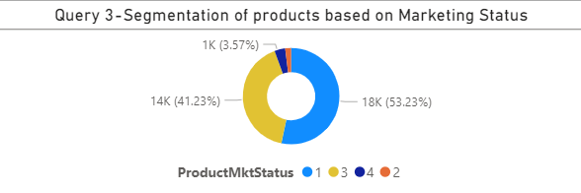
QUERY 3- visualize the segmentation of products based on Marketing Status
VALUABLE INSIGHTS:
THE PRODUCTS WITH HIGHEST SEGMENTATION OF 53.23% WAS FOR MARKETING STATUS 1
THE PRODUCTS WITH LEAST SEGMENTATION OF 1.98 % WAS FOR MARKETING STATUS 2

Slide 6
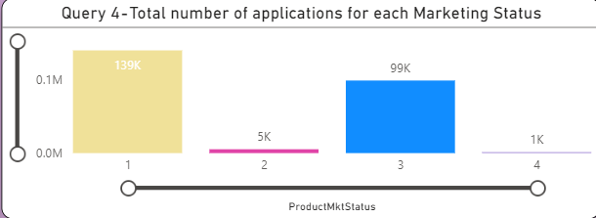
QUERY 4- show the total number of applications for each Marketing Status. Enable users to filter by years and Marketing Status for detailed analysis.
VALUABLE INSIGHTS:
THE TOTAL NUMBER OF APPLICATIONS WAS HIGHEST FOR MARKETING STATUS 1 WITH 139 K AND WAS LEAST FOR MARKETING STATUS 4 WITH 1K.

Slide 7
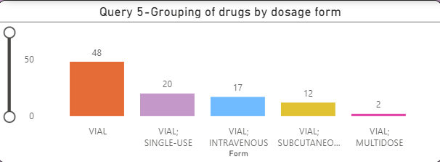
QUERY 5- analyze the grouping of drugs by dosage form. Visualize the distribution of approvals across different forms. Identify the most successful dosage form.
VALUABLE INSIGHTS:
THE MOST SUCCESSFUL DOSAGE FORM WAS VIAL AND THE LEAST SUCCESSFUL WAS VIAL;MULTIDOSE.

Slide 8
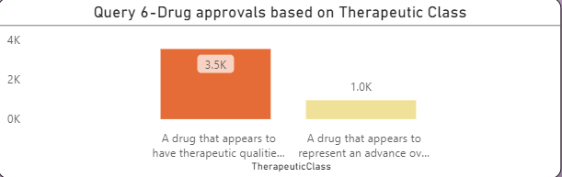
QUERY 6-visualize drug approvals based on therapeutic classes. Identify classes with the highest number of approvals.
VALUABLE INSIGHTS:
THE CLASS WITH HIGHEST NUMBER OF APPROVALS OF 3.5 K WAS FOR THE CLASS “ A DRUG THAT APPEARS TO HAVE THERAPEUTIC QUALITIES SIMILAR TO THOSE OF AN ALREADY MARKETED DRUG”.

Slide 9
THANK YOU !!

