Slide 1
Agile Development

Slide 2
What is Agile?
S/w Development methodology to develop s/w incrementally.
The duration would be in the intervals of 2 to 4 weeks.
Development happens in phased manner.
Changes will be made based on the business changes recommended by the client.

Slide 3
How is it different?
The software is delivered incrementally instead of all at once in the end.
U will break down the project into little bits of user functionality called as USER STORIES.
U prioritize the User stories and the continuously develop them and deliver in the span of 3 to 4 weeks called as SPRINTS.
Agile adapts for development of frequent feed backs by delivering the workable products on time to time.

Slide 4
Traditional Methods
Design→Code→Integrate→Test→Deliver.
Issues:
Long duration.
Success is known only after the final product is developed.
No intermediate feed backs.
Customers have no clue how their product is being shaped.
Client requirements would have changed since the initial documentation is done.

Slide 5
Agile methodology
Development is divided into small deliverable
Each Deliverable is called as User story.
Design→Code→Test→Delivery.
Customer gives feedback about the delivery.
Next cycle refines the previous deliverable.
It would add or remove certain features.

Slide 6
Agile Methodology
Each such iteration is called as SPRINT.
Each Sprint will enhance the s/w with new features, implementations and growth towards the completeness of the product.

Slide 7
Advantages of Agile
Customers continuously get the look and feel of the product progress at each Sprint.
Sprint is developed to satisfy the client requirements.
Teams would be responsive to the changing requirements and can make the changes even in the advanced stages of development.

Slide 8
Advantages
Two-way communication that keep the customers and the development team involved at all levels.
All stake holders: Business and the technical team do have a clear visibility on the product’s progress
The design of the product will be efficient as they are short term goals and will fulfill the business needs of the customer.

Slide 9
Ways of practicing Agile
SCRUM
KANBAN
EXTREME PROGRAMMING(XP).

Slide 10
SCRUM
The most popular Agile Framework.
Empowered with self- managed development teams with clear and specific roles.
Scrum Master(SM)
Product Owner(PO)
Functional Team(FT)

Slide 11
Components of SCRUM
Roles: PO, SM, FT
Artifacts: Product Backlog, Spring Backlog, Product Increment
Events: Sprint, planning, Daily Scrum, Sprint Review and Sprint retrospective.

Slide 12
Sprint?
Sprint is a predefined interval or a time frame in which work has to be completed and made ready to review or deploy for production.
Time bound to 2 to 4 weeks.

Slide 13
User Story
Requirements or features that need to be implemented.
Can be considered like a module which performs a certain user requirement.
In a Banking App, the User registration is a user story. Account operation is a user story.
Each story is further cut into tasks called Sprints.
User story does not have huge requirements and business rules: An abstract requirement in a single paragraph.
Notes:
As a <User>
I want to <add new customer>
I wish to search for existing Customers
I wish to update Customer details
Send SMS to customers.

Slide 14
Roles in Agile Development
Scrum Master
Facilitator of the team to help in following the Agile methods and practices in the course of meeting their commitments
Product Owner:
Like internal customer, responsible for driving the product towards its business prospective.
Functional Team or Development Team:
Self Sufficient team of 5 to 9 members with an avg. experience of 3 to 5 years.
4 to 5 developers, 1 Tester, 1 Tech lead.

Slide 15
Scrum Master
Facilitates the team about its deliverable and requirements
Enable cross cooperation b/w the roles and functions.
Clearing any obstacles
Creating the Environment where the team can be effective.
Addressing team dynamics.
Protecting the team from outside interruptions and distractions.
Other terms used: Iteration Manager, Agile Coach or Team Coach.
Notes:
Scrum Master need not be one person. It could be rotative, Each member do share the responsibility based on sprint level or part of it.
Rare occurrence of having full time Scrum Master

Slide 16
Product Owner
Like Internal Customer, responsible to ensure that the product is shaped as per the client requirement.
Responsibilities:
Define the requirements and prioritize the values.
Determine the content and its release dates.
Active role in internal planning, release plan meetings.
Decide on priorities of the user stories on which should be completed before the other.
Represents the voice of the Customer.

Slide 17
Agile Daily Standups
Daily status meetings among the members of the team.
Common Forum for the updates of the sprint.
Problems should be brought into focus so that it will be quickly addressed.
It is a MUST-DO Practice no matter how an agile team is created or residing in multiple office locations.
Roughly held for 15 to 20 min.
What I did yesterday?
What will I do today?
Any backlogs I am facing../Not able to do because of?
Daily Standups even happen in cafeteria.

Slide 18
Project backlogs
Kind of Bucket where all the user stories are kept.
Maintained by the PO.
Contains the list of Prioritized features.
Provides the estimates of each feature or user story.
It helps in planning the product’s road map.
Determines the priority of the product. First team works on high priority task and then the lower ones.
Notes:
Each Product must have a product backlog that contain info about large to very large features.
Multiple teams can work on single backlog
Ranking of features is based on the business urgency and the performance impact on other modules.
Highest ranking items are further divided into smaller items and make it more abstract.

Slide 19
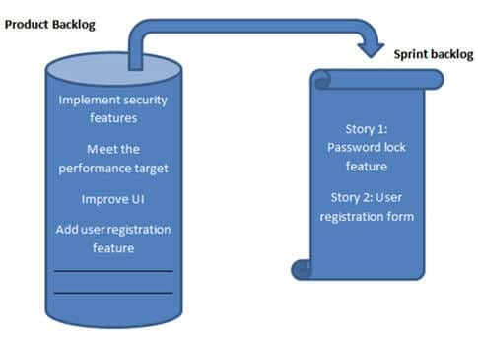
Sprint Backlog
Collective list of all the user stories which the team works on a particular iteration is called as Sprint Backlog.
The Scrum team works out the feasibility of the user story and cuts the story into multiple tasks and the list of the operations that need to be done on a single sprint would the way on how the Sprint back log is created.

Slide 20
Agile Definition of DONE
User Story:
All the related code has been checked in
All the unit tests have passed
All the acceptance tests have passed
Help Text is written
PO has approved the story.
Iteration:
Product backup is complete
Performance testing is done.
User stories have moved to the next iteration.
Issues have been fixed or postponed to the next iteration.
Release
Final Delivery of the Sprint.
System is well tested
Performance tuning is completed.
Security and validations are completed.

Slide 21
Final Example
Team has 9 members comprising of 1 PO, 1 SM, 2 Testers, 4 developers and 1 DBA.
Team decides to follow a 4 week cycle. We have 1 month Sprint starting from 24th Nov 2019.
PO will set the list of User stories in the product backlog.
Team decides to meet on 25th of Nov(Next day) for pre-planning.
PO takes 1 story from the backlog, describes it and leaves it to the team for brainstorming sessions.
Entire team discusses and communicates to the PO to have clearly understood the story and its requirements.
Other stories could also be taken if there are any interlinking.
Notes:
Team decides the total no of hours needed to work:
Total no of working hrs: 9 hrs.
1 Hr break, 1 Hour meetings, 1 Hour emails, discussions, trouble shooting.
Total work: 6 hrs.
Total working days: 21 days.
Total hours available : 21 x 6 = 126 hrs.
Member takes a leave for 2 days: 126 – 12 = 114 hrs.
Each member spends 114 hrs of billing cycle for each Sprint.
Each member wishes to spend the total hrs for the span of 21 days including his leaves.

Slide 22
Planning meeting:
The final verdict is taken and noted to the customer.
Each member decides the tasks that he or she would do on a given date..
SM can resize the date duration depending on the task.
Team enter their individual tasks along with their working hours for each story into a Agile Tool.(JIRA).
All the stories are completed and SM formally starts the Sprint.

Slide 23
Once the sprint has started, based on the tasks each member works in his respective work station.
The team meets daily for 15 min and discusses
What was done yesterday?
What they plan to do today?
Any impediments(blocks)?
SM tracks the progress on daily basis with the help of a ‘BURN DOWN CHART’

Slide 24
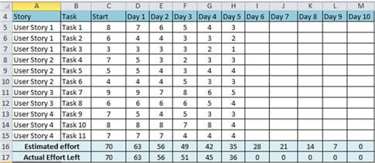
Excel Sheet of Task and performance entries

Slide 25
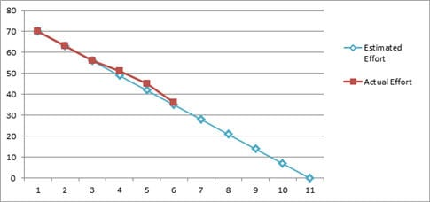
BURN DOWN CHART
Notes:
Enter all the stories
Enter all the tasks
Enter the no of days
Enter the starting effort
Apply a formula to calculate Estimated efforts for each day.
Each day, enter the actual efforts.
Finally select all the cells and generate the Chart….

Slide 26
In case of any flaws(Impediments) the SM follows it and resolves it ASAP.
On 25th of Dec 2019, the team has a final meeting.
Each member demonstrates his/her task to the PO.
PO sets whether the Story is done or not.
On 26th Dec 2019, RETROSPECTIVE Meeting:
What went well?
What went wrong?
Action Items
Next Iteration discussion.

Slide 27
Atlassian JIRA
Software testing tool developed by an Aus Company Atlassian. It was initially a bug tracking tool which reported issues related to the software or apps that were tested upon.
Later versions of JIRA started to provide project management support using various methodologies including Agile.

Slide 28
Components of JIRA
Projects : Manage the s/w projects in an effective manner.
Issues: Manage the units of the software development which is called as Issue. An issue can be a bug or a new part that is planned to be developed.
Workflow: Processes the progress of any issue. Implements business requirement including design, development, test cases.
Search
Dashboards: display Area of the tool that contain info related to Ur projects and its components which can further be organized.

Slide 29
Installation process
Download the Jira Software Server from the Atlassian website.
Choose the appropriate version based on the OS that U wish to install.
Install the exe package into the preferred location. U must have admin rights to install the software.
The installation wizard will help in the progress of the installation.

Slide 30
Creating a Project
Create a SCRUM Project from the JIRA Tool.
Once U create and log in to the account, U can create project.
In project Template, U should select SCRUM.
Create User Stories or Tasks
User stories describe work in a non technical manner and from the user’s prospective.
As a {type of User}, I want to {goal} so that I could get some {benefit}.
Creating a Website is also a User Story.

