Slide 1
Brazil Housing Data Analysis

Slide 2
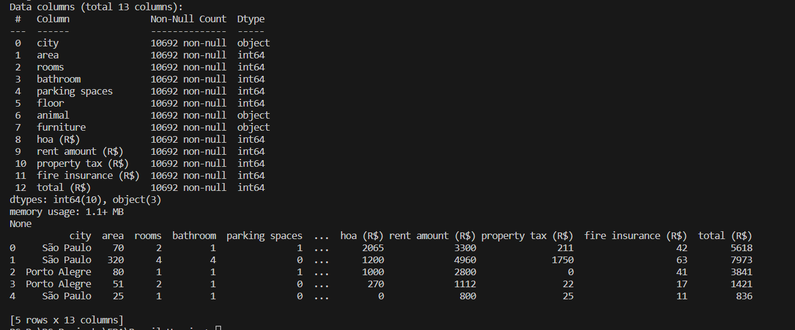
Data Loading and Initial Exploration:
Start by loading your data into a pandas Data Frame and perform initial exploratory analysis to understand the structure of the dataset.

Slide 3
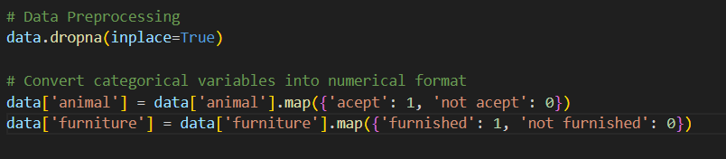
Data Pre-processing:
Clean the data by handling missing values, converting categorical variables, and creating new features if needed.

Slide 4
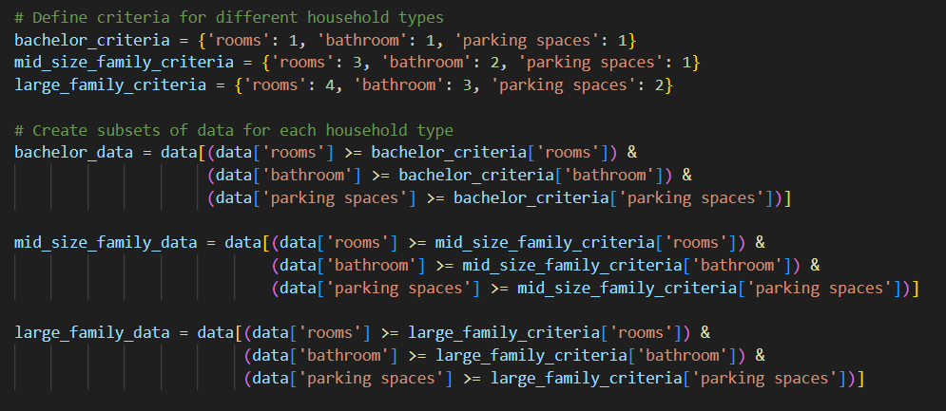
Feature Selection and Engineering:
Identify the features that are relevant for each household type and create subsets of the data.

Slide 5
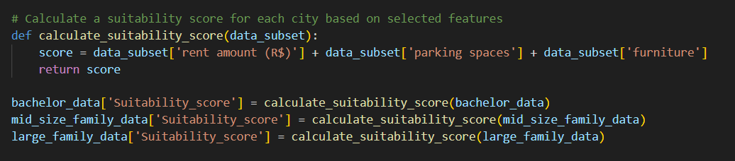
Suitability Evaluation:
Rank or score each city based on relevant criteria for each household type.

Slide 6
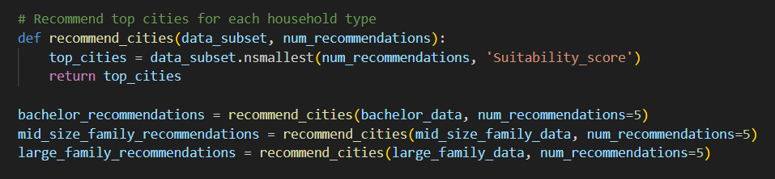
Recommendations:
Provide recommendations based on the suitability scores.

Slide 7
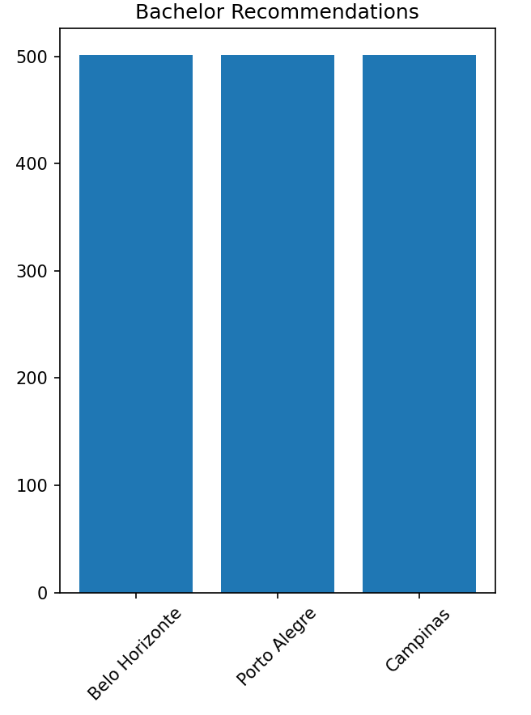
Bachelor Recommendations

Slide 8
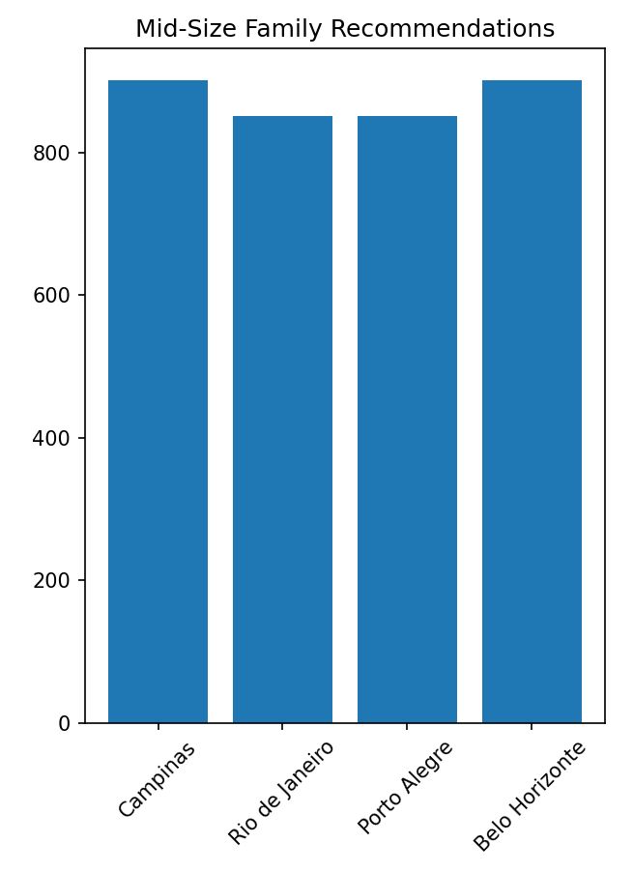
Mid size family recommendations

Slide 9
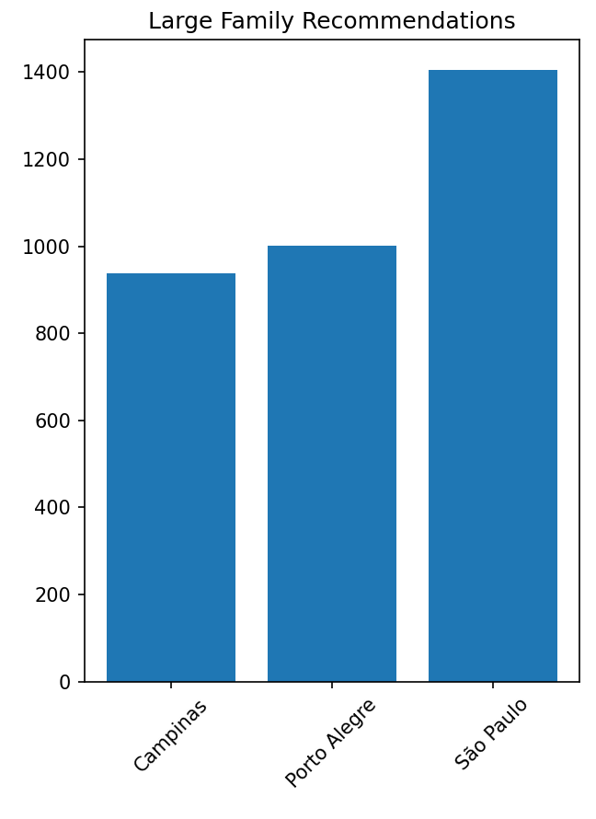
Large family recommendations

Slide 10
Thank you
By:- Sameer Karur

