Slide 1


Predicting low weight birth of a baby
Sameer Nepal
DSC 630 Course Project
Bellevue University
16 Nov 2022

Slide 2
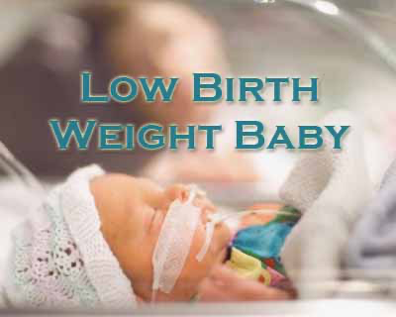
Problem Statement
A birthweight less than 5 pounds, 8 ounces, is diagnosed as low birthweight
Major causes of low birth weight are weight of the mother under 100 pounds, poor prenatal nutrition, use of alcohol, cigarettes or drugs
People will have the ability to see if their baby is going to be underweight because of different factors out of which smoking is one
Low birth weight is associated with long-term neurologic disability, impaired language development, impaired academic achievement, and increased risk of chronic diseases including cardiovascular disease and diabetes.
The model will help heath care provider and parents know if their baby is going to be low birth weight and helps prevent different kind of health-related issues

Slide 3
Source for Dataset
Finding the data was very difficult for me and after hours of searching I came to find the data in the openintro website.
This data is subset of the data present in CDC.gov website. I tried to export the data multiple times directly from CDC but got an error
Openintro is opensource website for people who can’t afford books and this data is from one of those books.
US releases large data every year to the public which contains the information about the birth recorded in the country
The dataset that I am working with has 1000 cases with 13 different variables and is from 2014.
The data is useful to solve the problem because we have many factors that is related to childbirth like the age of mother, smoking habit of mother, weight gained during pregnancy, length of pregnancy and many more. Since these data are related to the birth of baby the data available to us is very useful in studying the problem

Slide 4
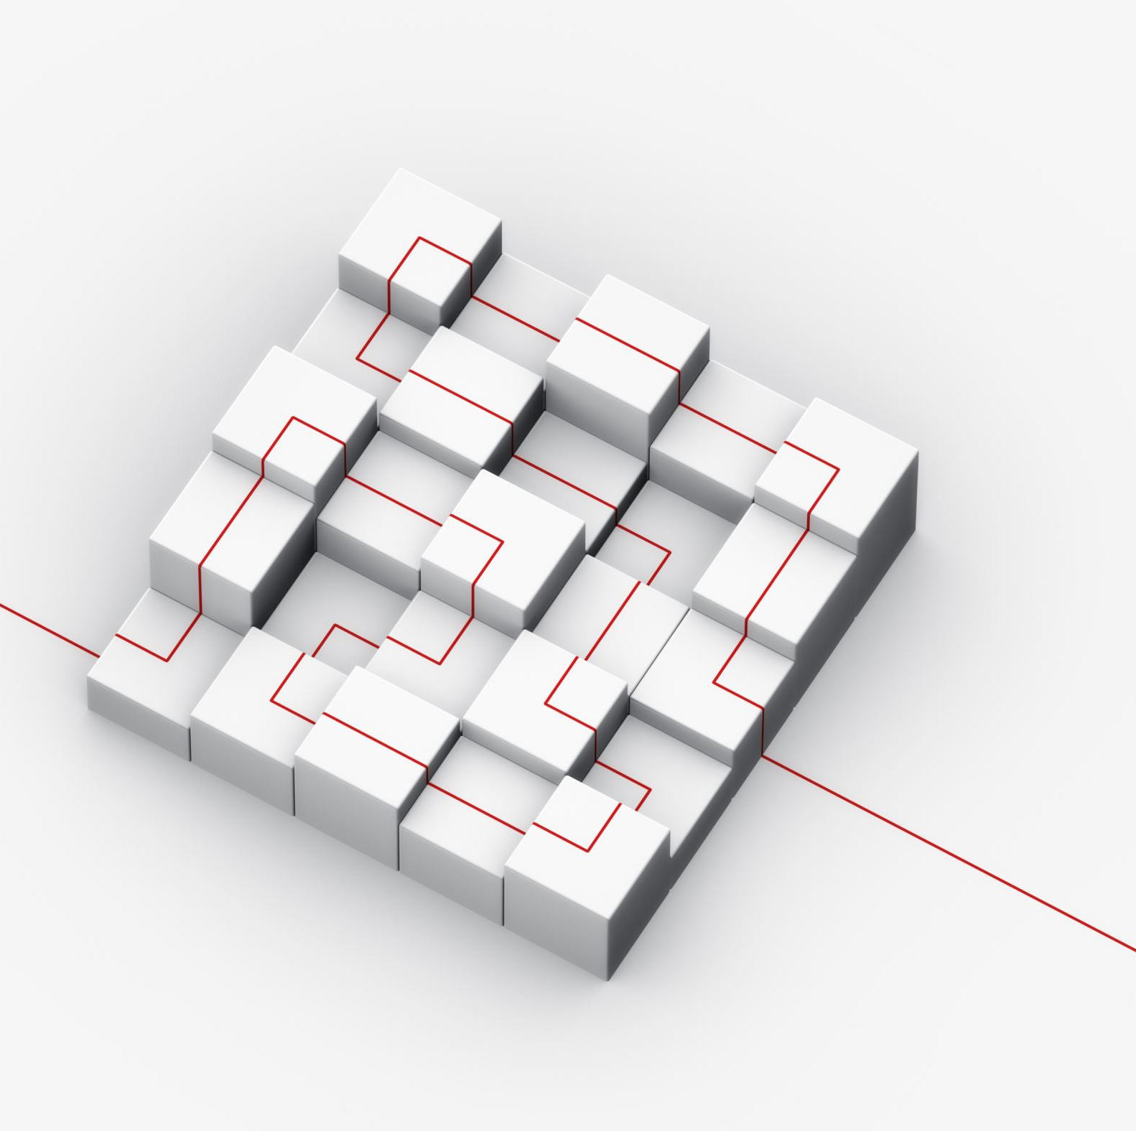
Steps for completion of Project
Exploratory Data Analysis
Feature Selection
Model Selection

Slide 5
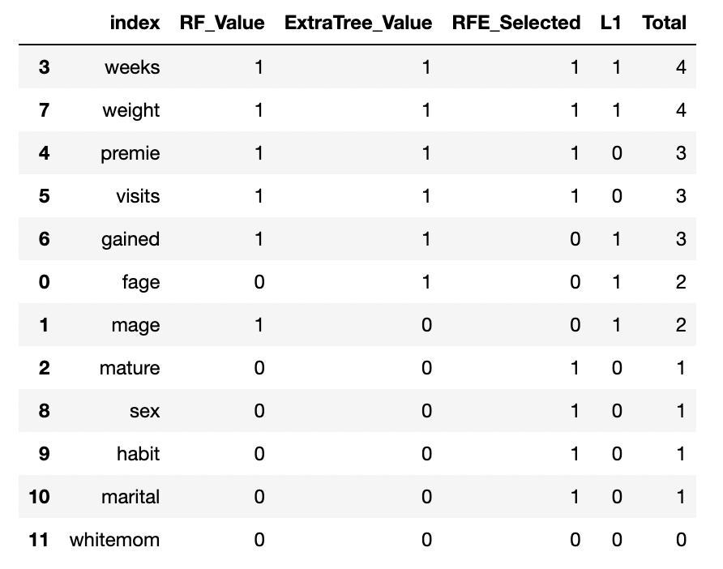
Feature Selection
Techniques used
Random Forest Classifier
Recursive Feature Elimination
Extra Tree Classifier
Lasso Regression
The result from these algorithms were combined to find the features that has the best prediction scores

Slide 6
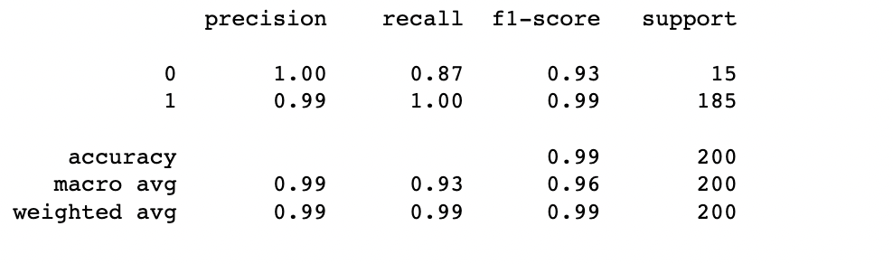
Modeling the data using Logistic Regression
Logistic Regression is a classification technique used in machine learning. It uses a logistic function to model the dependent variable. The dependent variable is dichotomous in nature, i.e. there could only be two possible classes (eg: either the baby is low weight or not)
The accuracy for this model was 99%
Classification report for this model is shown in the figure

Slide 7
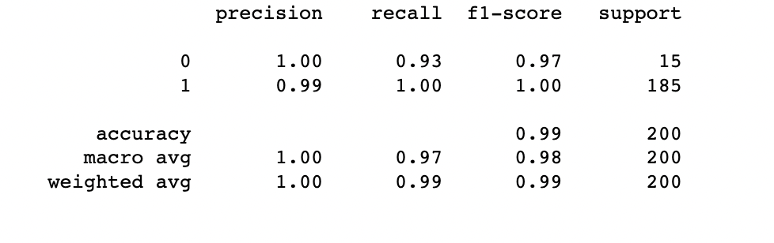
Modeling the data using Random Forest Classifier
Random Forest is a supervised learning algorithm which is used for both classification as well as regression. It is mainly used for classification problems. This method creates decision trees on data samples and then gets the prediction from each of them and finally selects the best solution by means of voting.
The accuracy for this model was 99.5%
Classification report for this model is shown in the figure

Slide 8
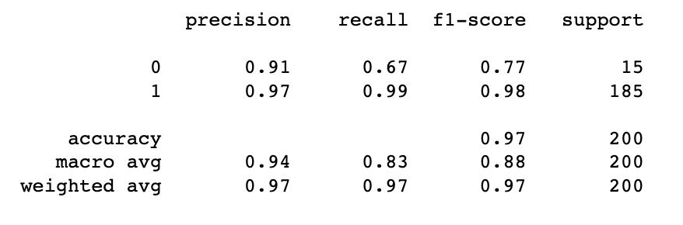
Modeling the data using KNN Classification
The k-nearest neighbors (KNN) algorithm is a data classification method for estimating the likelihood that a data point will become a member of one group, or another based on what group the data points nearest to it belong to.
The accuracy for this model was 97%
Classification report for this model is shown in the figure

Slide 9
Result/Conclusion
The accuracy for Random Forest Classifier model was the highest which came out to be 99.5% i.e. the predictions were very high for this model
Recommendation will be made to use this model
This model will help in predicting whether the baby will be low weight depending on different features selected
This will help the health care provider to determine if the baby will be in risk because of low birth weight

Slide 10

Learning
From this project, I learnt how the dataset can be useful to solve the problem in practical life
I also learnt that in data science you come up with one idea and start the project, but you might not be successful in completing the project
Got exposed to many tools and concepts related to data science
Data Science is vast and concentrating in one domain knowledge is helpful with different modeling strategy for that domain

