Slide 1
Data Set for the Analysis
Military Strength of a country
Sameer Nepal
DSC 530
Data Exploration and Analysis
03.04.2022

Slide 2
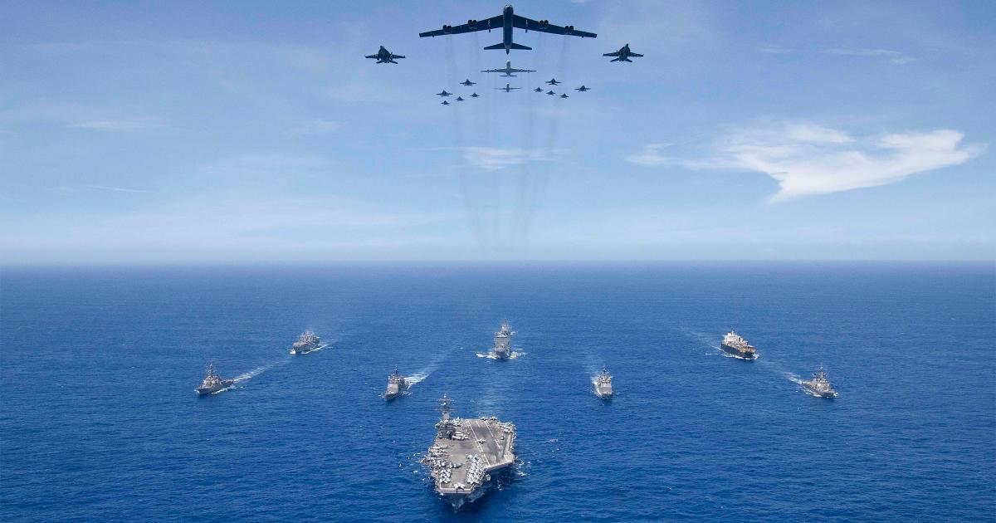
Statistical Question/Hypothesis
What is the relationship between the total number of military personnel of the country and its defense budget ? Does greater number of military personnel correspond to higher defense budget ?
Data Source: https://www.kaggle.com/maheshjs/military-strength-of-top-10-world-powers/data?select=GlobalFirePower.csv

Slide 3
Variables used in the Data Set
Country: Name of a country
Rank: Rank of country based on military strength
Total Military Personnel: Total military personnel for a country
Total Aircraft Strength: Total number of aircraft for a country
Total Naval Assets: Total number of naval asset for a country
Defense Budget: Defense budget of a country for specific fiscal year
Rocket Projectors: Total number of rocket projectors for a country
Submarines: Total number of submarine for a country

Slide 4
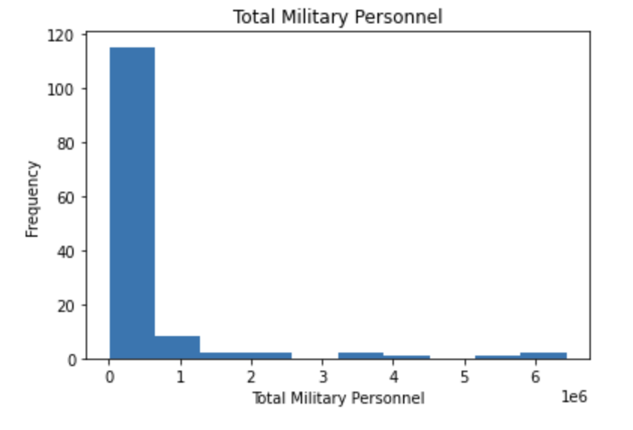
Mean: 449237 Mode: 15500 Variance: 1124107641813 Standard Deviation: 1060239 Tail extends to right
Histograms of variables

Slide 5
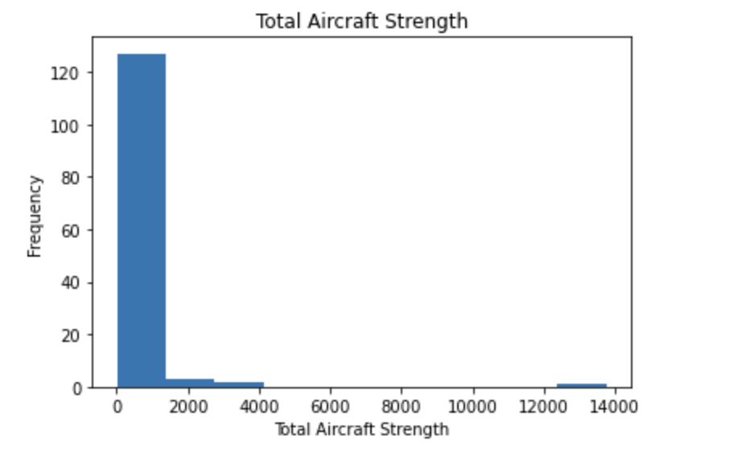
Mean: 395 Mode: 25 Variance: 1633522 Standard Deviation: 1278 Tail extends to right
Histograms of variables

Slide 6
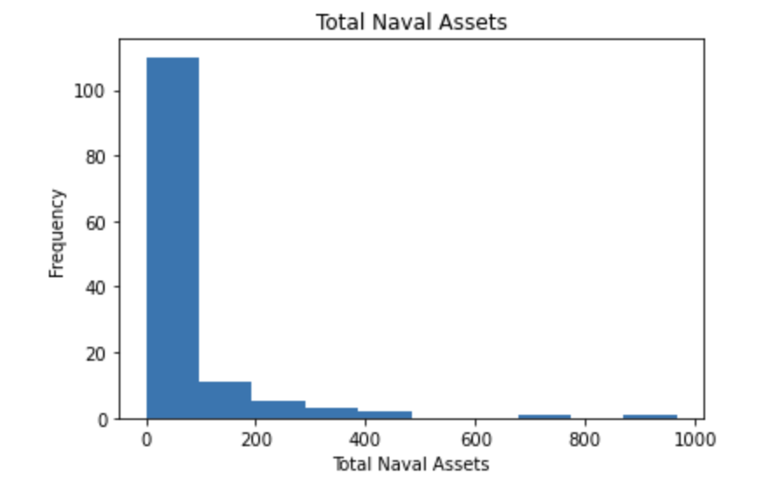
Mean: 69 Mode: 0 Variance: 15758 Standard Deviation: 125 Tail extends to right
Histograms of variables

Slide 7
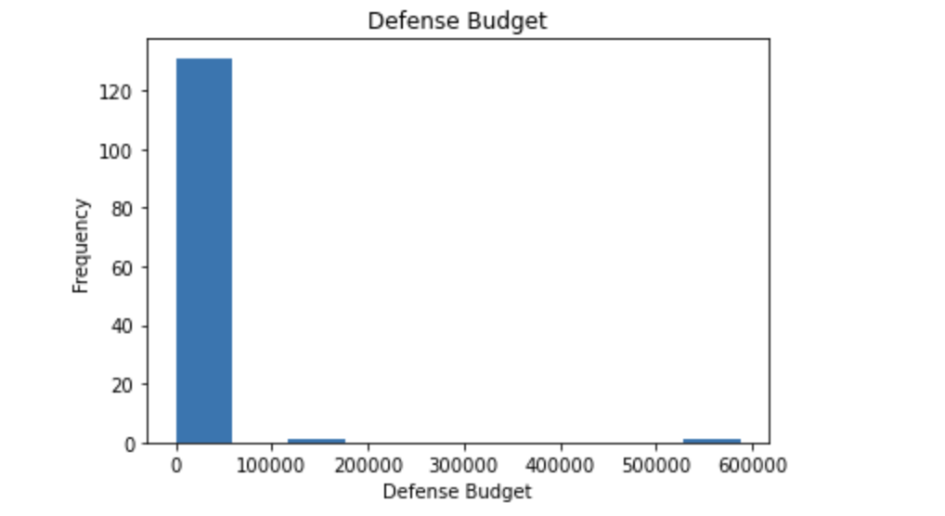
Mean: 11553 Mode: 1207000 Variance: 2843346736 Standard Deviation: 53323 Tail extends to right
Histograms of variables

Slide 8
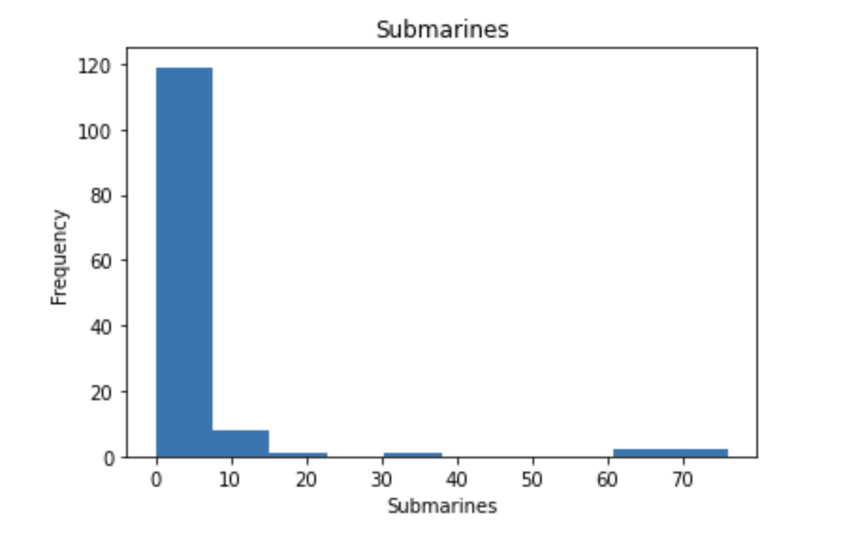
Mean: 4 Mode: 0 Variance: 152 Standard Deviation: 12 Tail extends to right
Histograms of variables

Slide 9
OUTLIERS
The dataset has the top ranked countries to have the value variables in very high range in all the variables. This includes around ten countries out of 133 so this might affect the model that we try to predict. I am not removing them to see how it affects the model and they also have most significant data that determines the military strength ranking of the country.

Slide 10
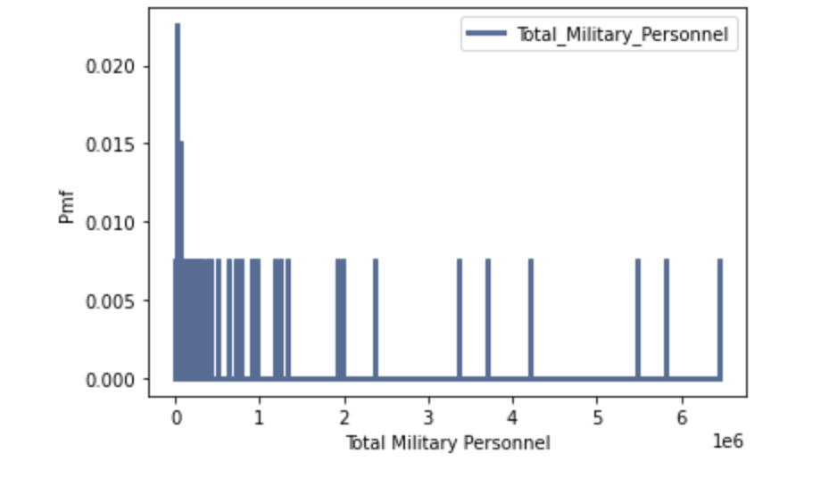
Probability mass function (PMF)
This PMF is for the number of military personnel of the country. Looking at the PMF we see that the there is more chance of seeing that most of the country has the total military which less than 0.5 million. There is a greater number of country that has a smaller number of military than the country that have high number of military personnel.

Slide 11
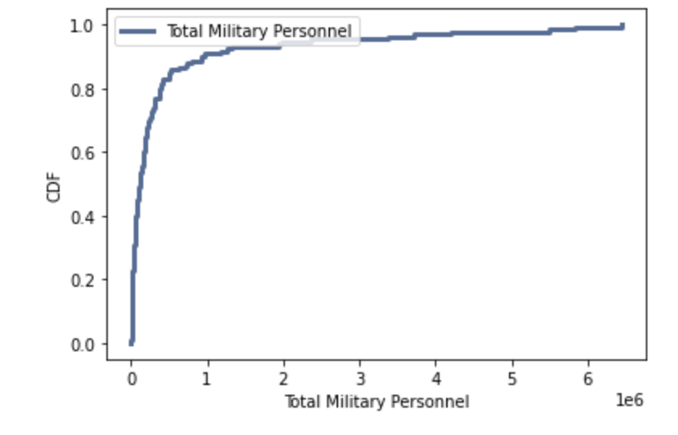
CUMULATIVE DISTRIBUTION FUNCTION (CDF)
The CDF for the Total_Military_Personnel variable shows that the most common number is around the left side of the graph. Most country has the value less than 0.25 million so I would say the common number is 0.25 million. The highest value is around 4-5 million.

Slide 12
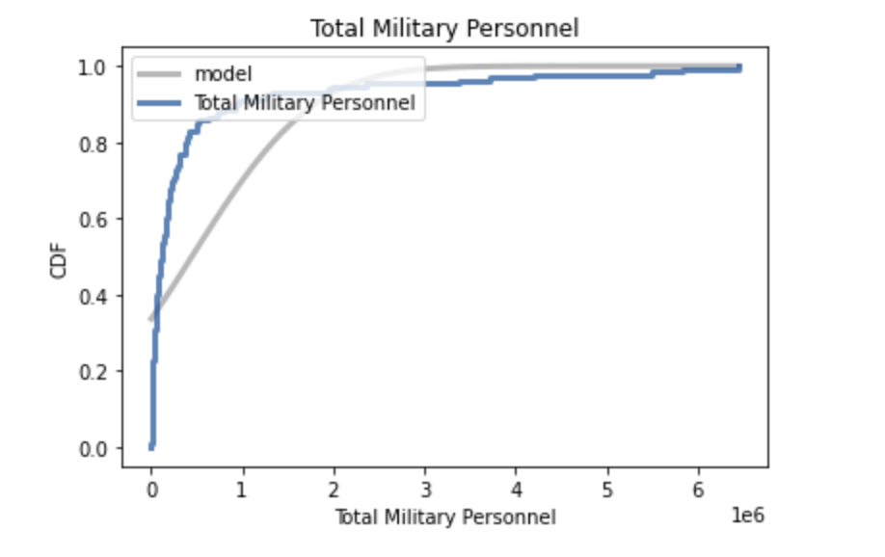
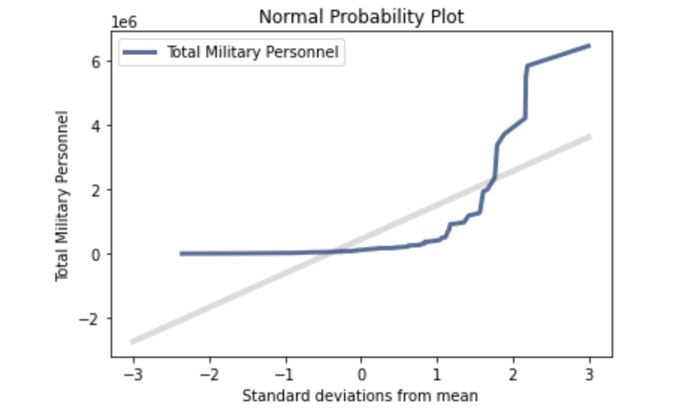
Analytical Distribution
The curve for the total military personnel deviates from the expected model because most of our data are concentrated in the left and there are very few countries in the right. Since we have very few record in the right the model and the actual curve are not lining together.
The normality probability plot shows us that the data lacks the normality where the tails are deviated very much from the model and the curve is not linear.

Slide 13
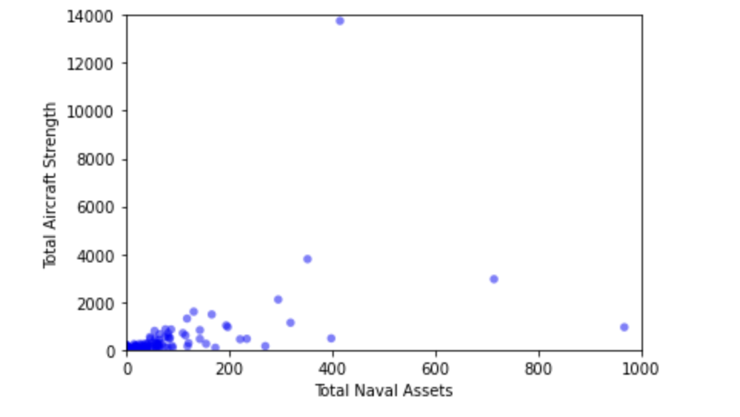
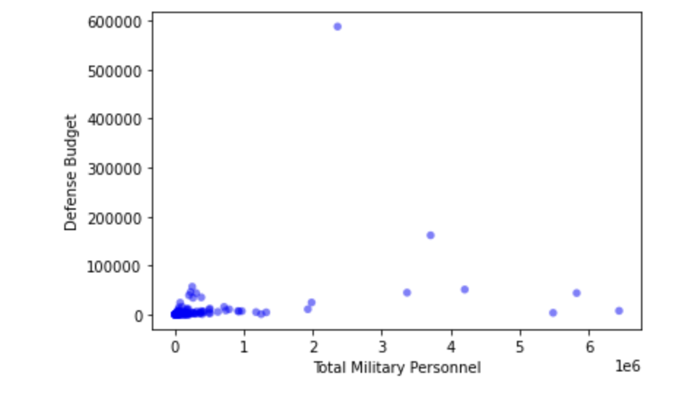
SCATTER PLOTS
The scatter plot shows that there are strong correlation between the Total Military Personnel Vs Defense Budget and between Total Naval Assets Vs Total Aircraft Strength.
Looking at the Pearson's coefficient and Spearman coefficient of correlation and we see that there is slightly positive correlation between the variable.
While these variables are correlated, we cannot tell if one of them is causing the another one to increase. We need more analysis to find the correlation and causation.

Slide 14
Hypothesis testing
Null hypothesis:
There is no relationship between defense budget and total military personnel for a country
A p-value less than 0.05 (typically ≤ 0.05) is statistically significant. The correlation calculated is 0.29 It indicates strong evidence against the null hypothesis, as there is less than a 5% probability the null is correct (and the results are random). Here we have p value equal to 0.03, that means we have strong evidence against the null hypothesis hence there is relationship between the total military personnel and the defense budget.

Slide 15
Regression analysis
The regression is analyzed between Defense Budget and Total Military Strength
R^2: ~ 0.09
Intercept: ~ 4778
Slope: ~ 0.04
Prob (F-statistic): 0.000454
The higher the R-squared, the better the model fits our data. R square indicate the percentage of the variance in the dependent variable that the independent variables explain collectively. Here we see that R squared value to be 0.09 that means 9% variance is done by total military personnel count towards the defense budget.
This means that military personnel count only count for 9% relation towards the defense budget, and we can tell that there are other factors that affects the defense budget like the military combat equipment, maintenance and mission.

