Slide 1
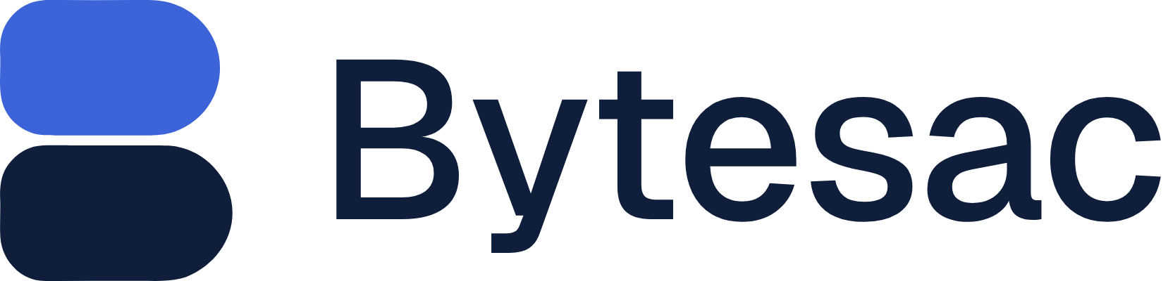
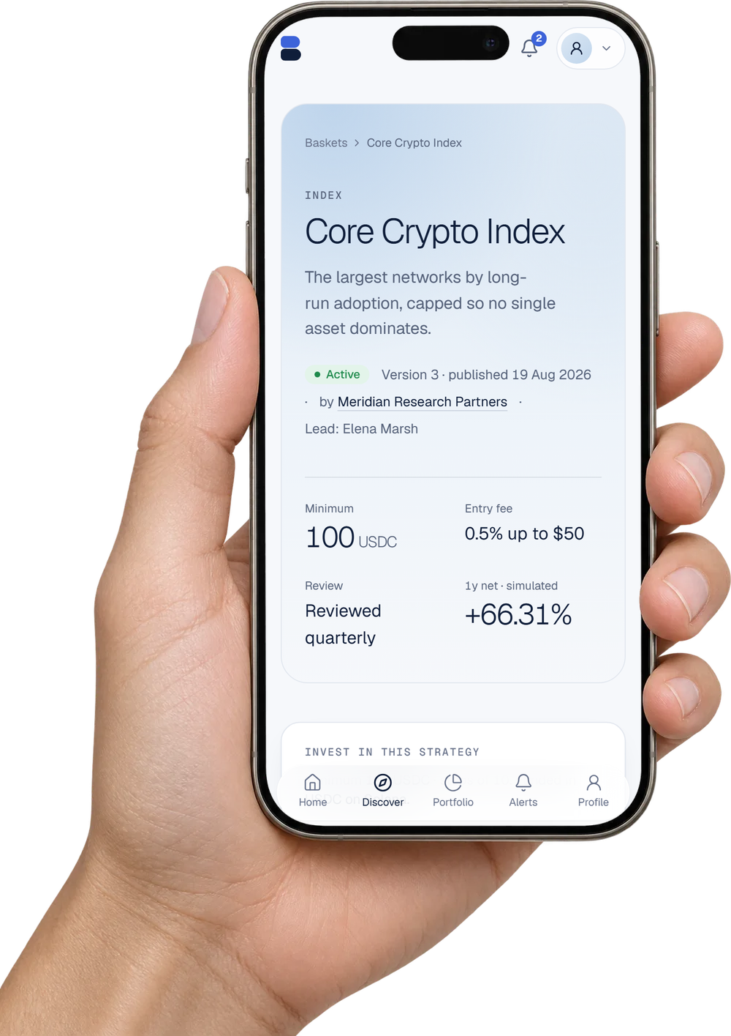
STRATEGY BASKETS · YOUR OWN WALLET · BUILT ON SOLANA
Expert-managed portfolios.
Held in your own wallet.
Vetted fund managers build multi-chain baskets of crypto and tokenized assets. You invest in USDC on Solana, approve every move, and keep the assets.
Self-custody
Verified managers
7 chains
USDC on Solana
Notes:
[0:00–0:14] We're [names]. Bytesac lets anyone invest with a verified fund manager across every major chain, without ever handing over their wallet. The phone shows the real basket screen from our app (demo data).

Slide 2
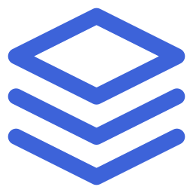
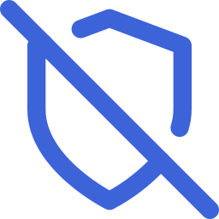
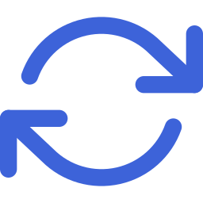
Three walls between people and a good portfolio
THE PROBLEM
62%
$17B
24/7
Doing it yourself is fragmented
Trusting an expert is risky
Staying on target is a chore
of crypto users juggle two or more wallets. Solana alone lists 3,000+ tokenized real-world assets.
in crypto scam proceeds in 2025; impersonation scams rose 1,400%. Following an expert today usually means giving up custody.
Prices drift the mix around the clock. Rebalancing across chains means many swaps, bridges and gas tokens.
Sources: Reown/Nansen wallet survey (2025) · Solana Foundation, Sep 2026 roundup · Chainalysis 2026 Crypto Crime Report
Notes:
[0:14–0:28] Building a portfolio across chains is a mess, trusting someone to do it for you has cost people billions, and keeping it balanced never stops.
Figures: 62% manage 2+ wallets (Reown/Nansen, May 2025). 3,000+ RWA assets on Solana (Solana Foundation, Sep 2026). ~$17B estimated scam proceeds in 2025, impersonation +1,400% (Chainalysis 2026). Re-verify before recording.

Slide 3
Every option makes you give something up
TODAY'S OPTIONS
Option | Assets in your wallet | Vetted managers | You approve changes | Multi-chain + BTC | Stocks, gold, RWAs | Where it falls short
smallcase (India) | ● | ● | ● | ○ | ○ | Proves demand (10M+ investors), but Indian equities only, off chain
eToro copy trading | ○ | ◐ | ○ | ○ | ◐ | Custodial; copied traders are users who meet thresholds
Symmetry baskets | ◐ | ○ | ○ | ○ | ◐ | You hold a basket token; anyone can create one; Solana only
Glider | ● | ○ | ○ | ◐ | ● | Self-built portfolios; automation runs on delegated permissions
Vaults (Enzyme, Kamino…) | ○ | ◐ | ○ | ○ | ◐ | Pooled custody under a manager or curator
xStocks, Ondo, Robinhood | ● | ○ | ○ | ◐ | ● | Single tokenized assets; no portfolio, no manager
Bytesac | ● | ● | ● | ● | ● | Self-custody, verified managers, consent on every move, 7 chains, RWAs
● yes ◐ partly ○ no
Sources: smallcase.com · eToro Q4 2025 results · symmetry.fi · Glider blog and ZeroDev case study · issuer sites. Full detail in appendix A6.
Notes:
[0:28–0:42] Today you choose: custody or convenience, an expert or your own keys. smallcase proves people pay for manager-led baskets they hold themselves, but only for Indian stocks. Crypto options either pool your money, give you a token instead of the assets, or have no accountable manager. Bytesac combines all five.
Check before publishing: smallcase rebalance consent and Glider's chain list.

Slide 4
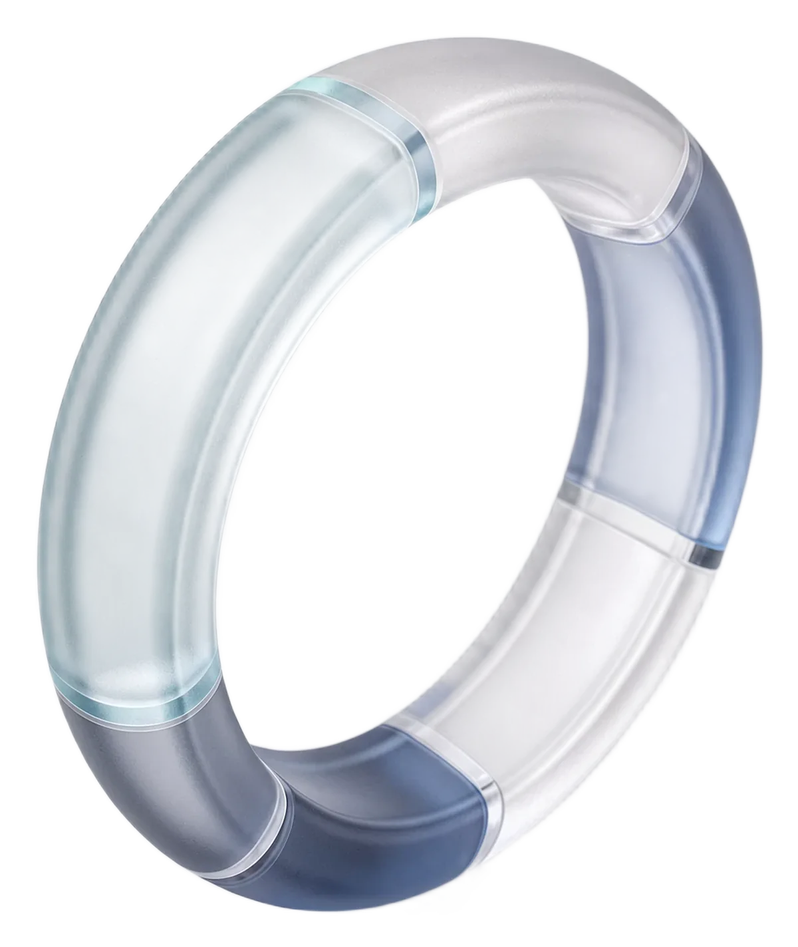




Managers set the strategy. You keep the wallet.
THE SOLUTION
Your keys, your assets
Strategy is not execution
Self-custody. Bytesac never holds your keys or your funds.
A manager update is a proposal. Nothing moves without your signature.
Verified managers
Proof over promises
Screened, organization-verified, every version reviewed before it goes live.
Holdings read from the chain. Every fee and step shown before you sign.
A marketplace where verified managers publish strategies and you execute them in your own wallet.
Notes:
[0:42–0:54] Managers decide the strategy. You hold the assets and sign every change. We verify the managers and show you everything before you sign.
Wording rule: say 'never holds your keys or funds', not 'never touches a transaction' — Bytesac co-signs Solana legs as fee payer and sends EVM gas drops.

Slide 5
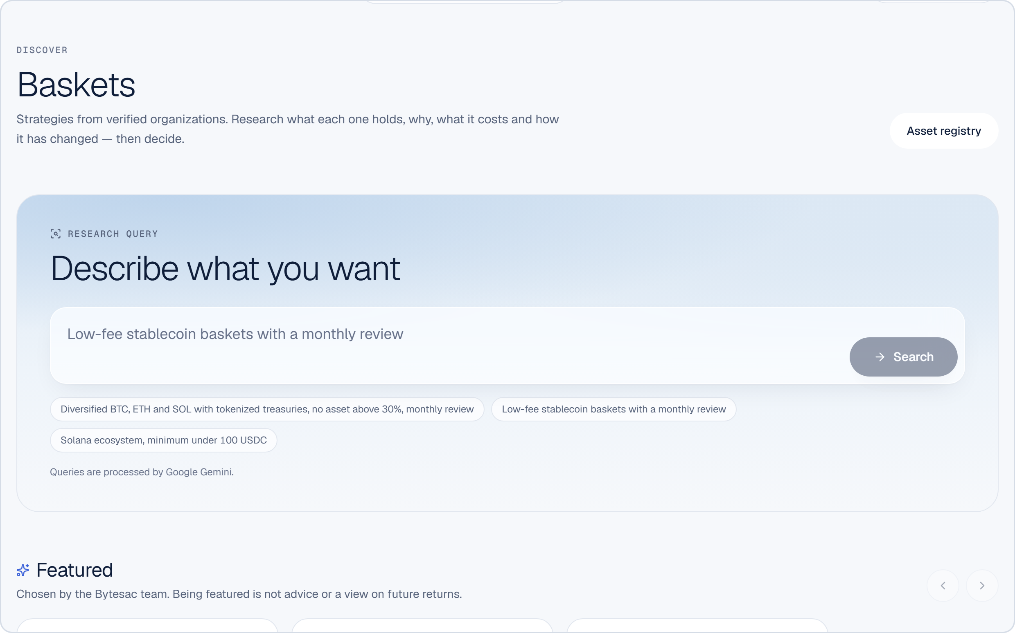
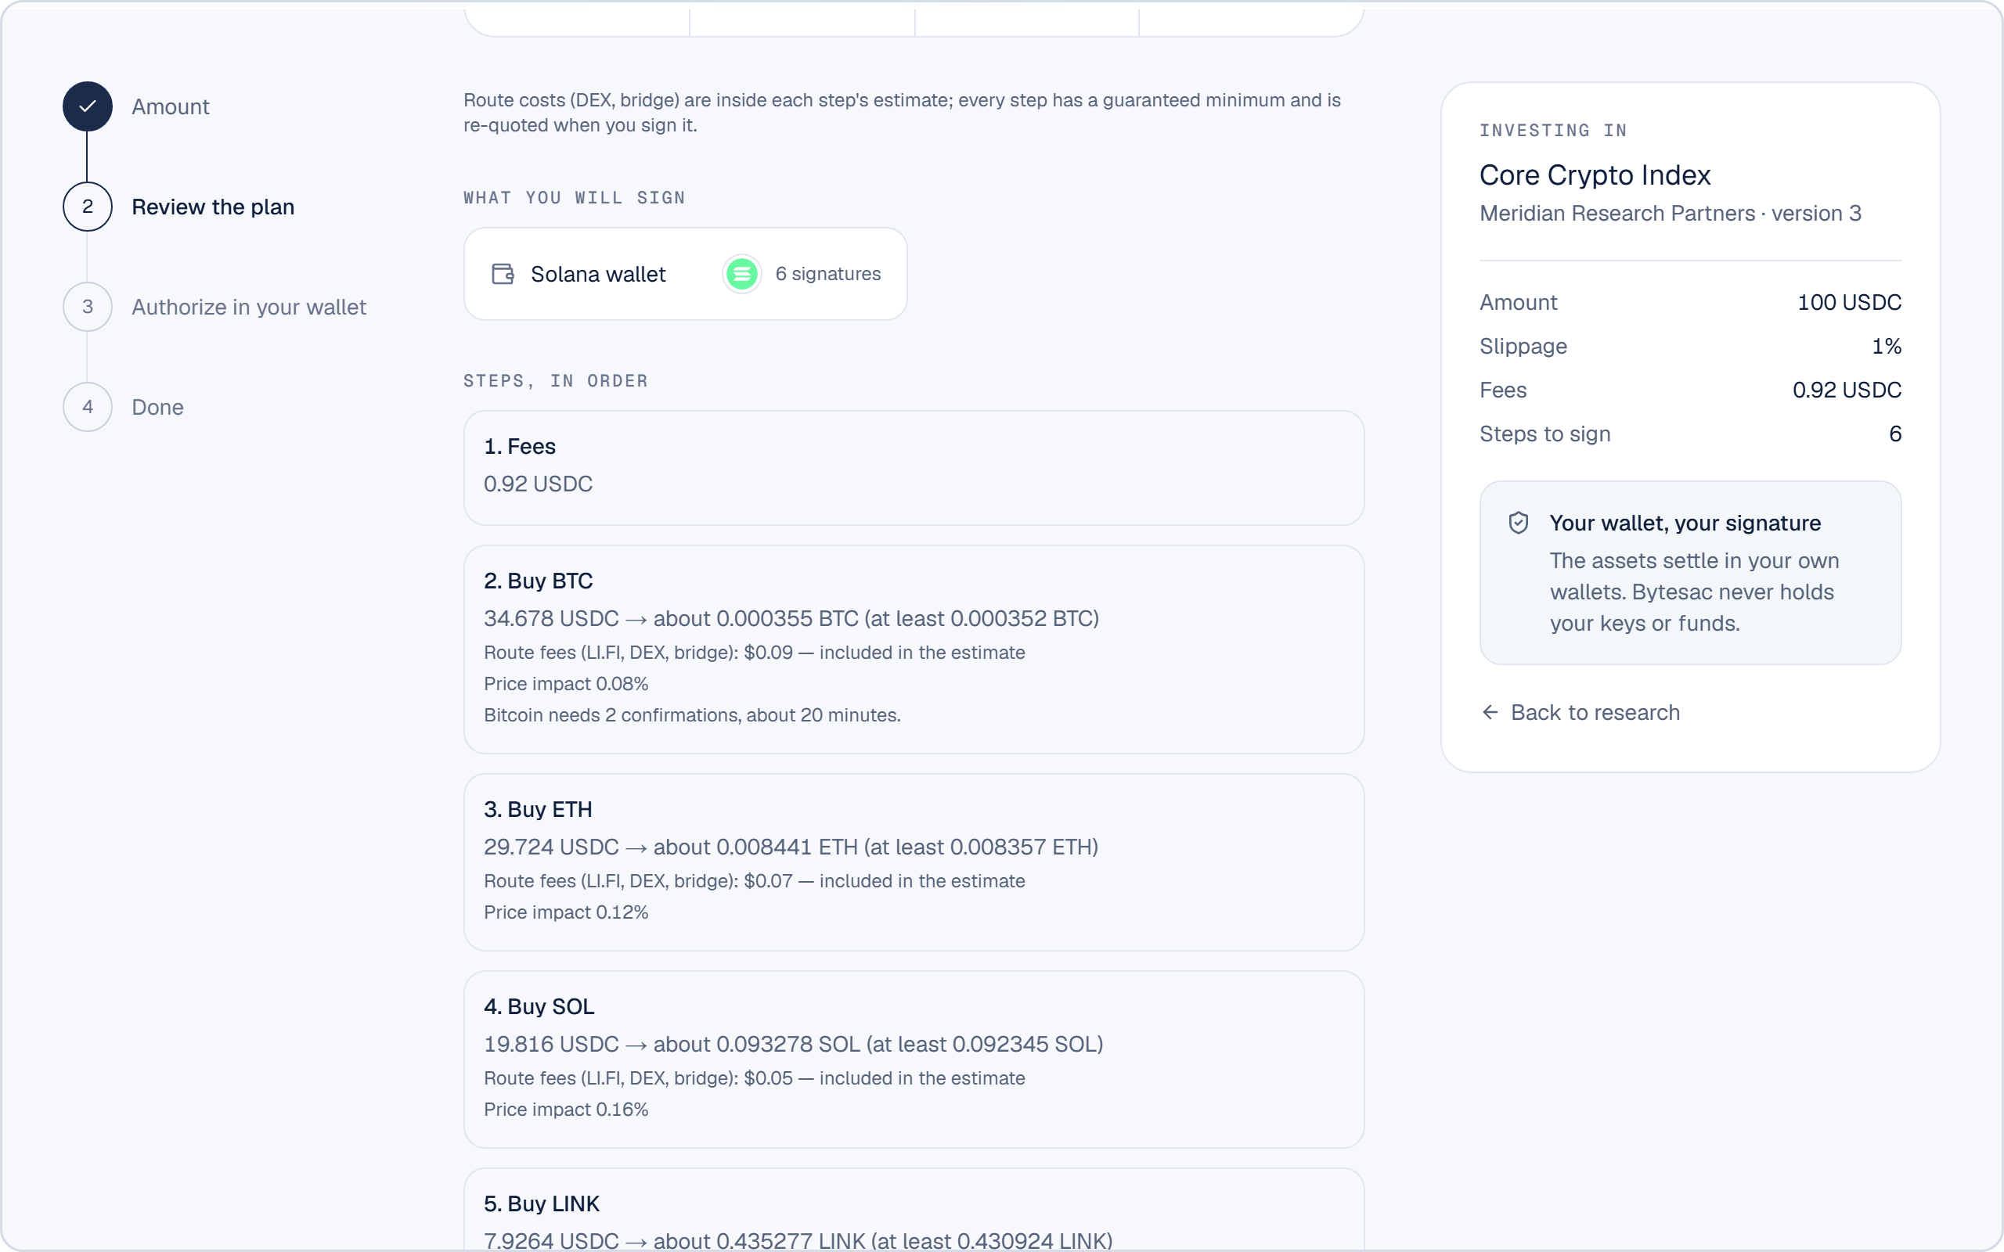
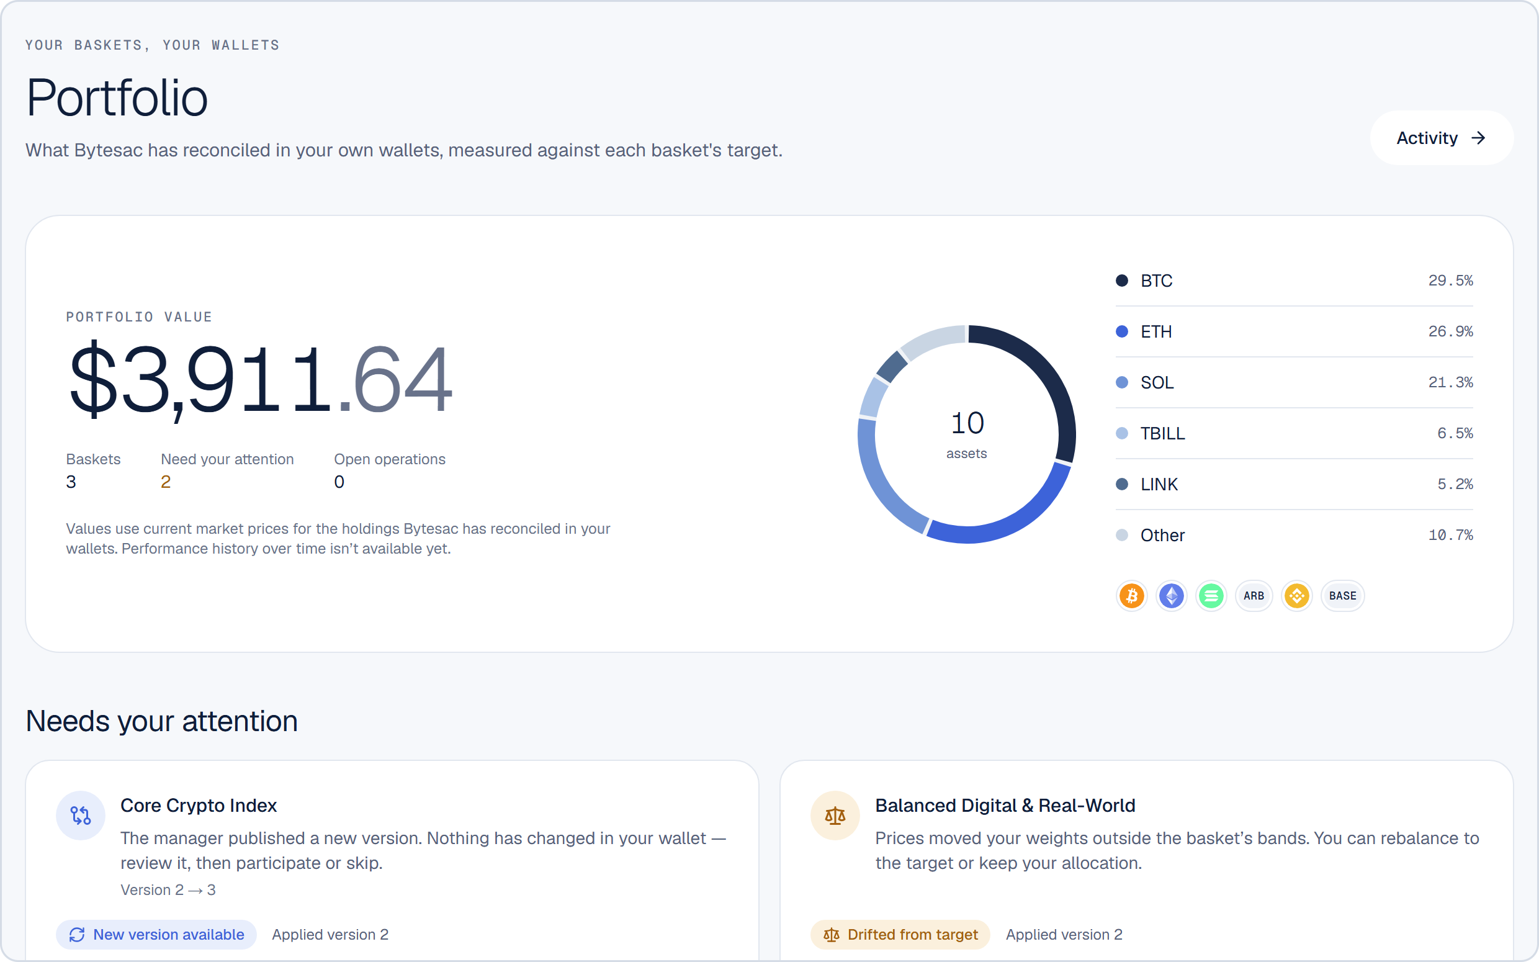
From discovery to owning the assets in five steps
FOR INVESTORS
1
Discover
2
Invest
3
Sign
4
Own
5
Stay or leave
Filters, AI search, manager profile, simulated performance
Enter a USDC amount; every step and fee previewed
Approve one step at a time in your own wallet
Assets land in your wallets on each chain
Apply or skip updates; sell or leave any time
Discover · AI search over verified baskets
Review the plan · every step and fee before signing
Portfolio · reconciled from your own wallets
Real Bytesac web app, shown with demo data. AI search: AI suggests filters; results come only from published baskets.
Notes:
[0:54–1:08] Pick a basket, enter USDC, approve each step in your wallet. The assets arrive in your own wallets on every chain, and you can leave whenever you want — no lock-in, no manager approval needed.
Features to mention if asked: AI search, plan preview with every fee, per-step tracking, drift alerts by inbox, email and push, eligibility checks for tokenized assets.

Slide 6
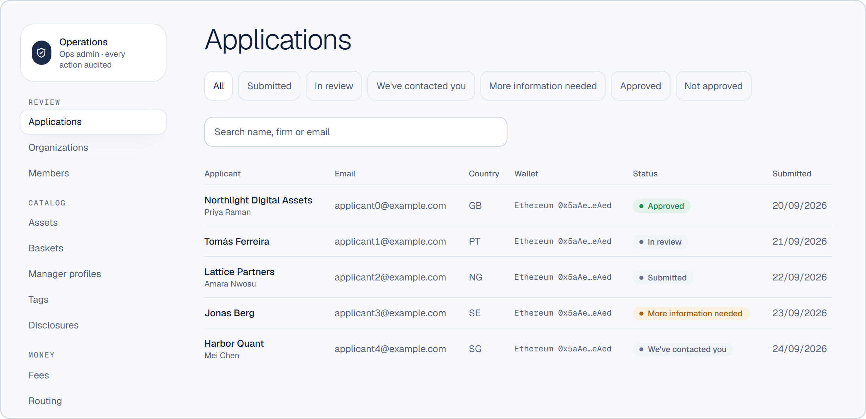

Managers steer. They never touch your money.
FOR FUND MANAGERS
Apply
Screening
Wallet proven
Org verified
Build basket
Ops review
Publish
Earn
Ops screening of every application
Wallet proven by signature before any rights
Organization documents verified per jurisdiction
Admins and managers pass their own ID review
Only ops-approved assets can go in a basket
Every version frozen, hashed and reviewed
Fee caps (max 1%) and mandatory disclosures
Every application is screened in the ops console before a manager gets any rights.
"Verified" badge only while verification is active
Real Bytesac ops console with demo applicants. Controls: ADR-007 to ADR-011 in the repository.
Notes:
[1:08–1:24] Managers are screened, verified and reviewed on every change. They publish a target with a written reason; they can't move a single dollar of yours. Their fees go straight to a payout wallet they proved they own.
Detail if asked: application states with email confirmation and ops screening; the submitted wallet must sign before rights are granted; organization documents per jurisdiction; member identity review for Admins and Managers; registry-only assets; immutable hashed versions with rationale and diff; fee caps 0–100 bps; disclosures managers cannot remove; adoption counts only, never individual investors; full audit trail.

Slide 7
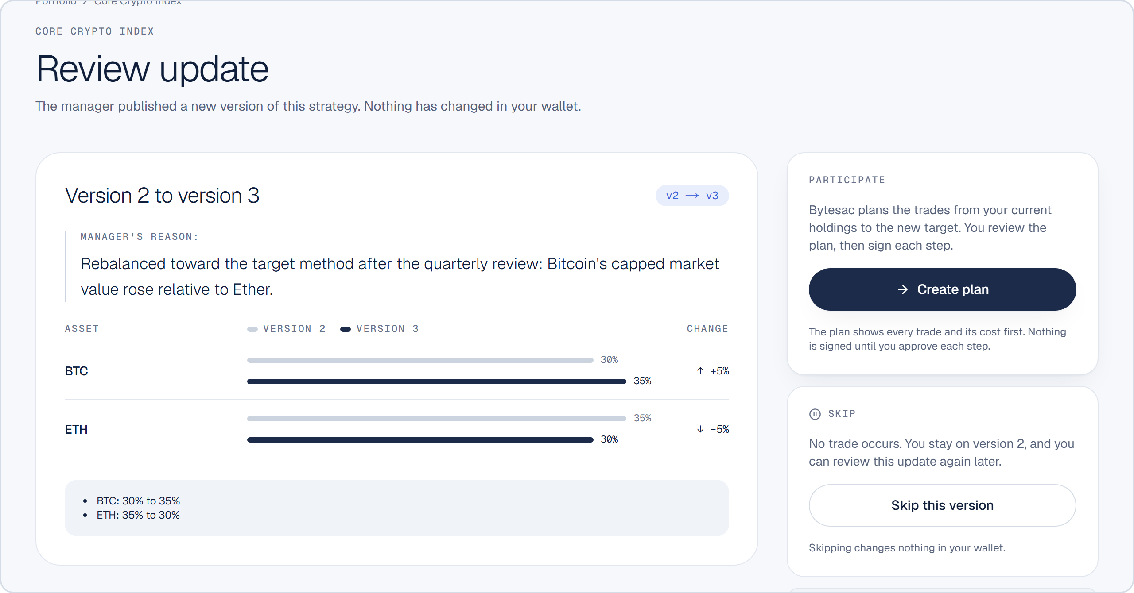
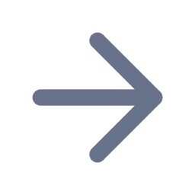
Drift or a manager update: you decide every move
REBALANCING AND DRIFT
Review update: the manager's reason, the diff, then Create plan or Skip.
Sell
USDC on Solana
Buy
Buys are sized to what the sells actually returned. Trades under 50 bps or $5 are skipped. Every step is tracked to settled, failed or unknown, and never blindly retried.
Rebalance to target
Keep custom
Drift past ±5% (default 500 bps) flags the position.
Chart data is illustrative. Screenshot: real Bytesac web app with demo data.
Notes:
[1:24–1:40] When prices drift or your manager publishes an update, you see why, what changes and what it costs. One tap to apply, one to skip. Skipped versions are never replayed.
Engine: reconcile holdings from the chain → apply thresholds (50 bps / $5) → sell to USDC on Solana → buy, scaled to the cash that actually arrived → leftover goes to basket cash → shortfalls are repaired with Buy back or Sync. Detail in appendix A3.

Slide 8

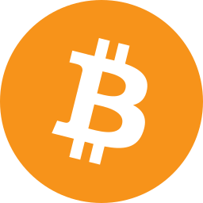
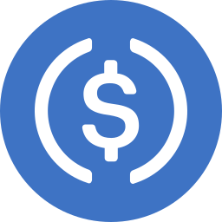
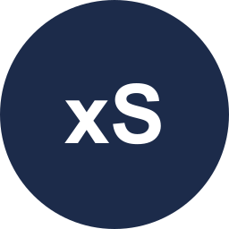

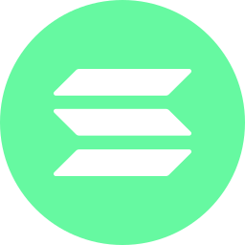
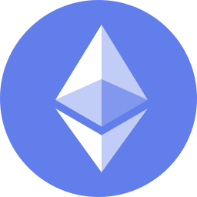
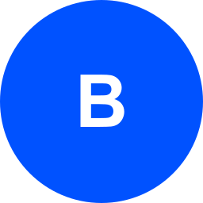
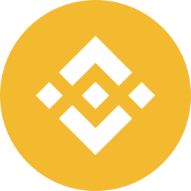
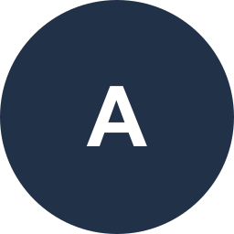
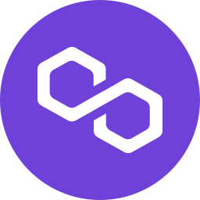
One USDC entry. Seven chains. Many asset classes.
MULTI-CHAIN AND ASSET CLASSES
LIVE IN RELEASE 1
Crypto
Stablecoins
BTC, ETH, SOL, L2s, DeFi
USDC is the settlement asset
Tokenized equities
Tokenized gold
Stocks and ETFs, e.g. xStocks
e.g. PAXG
NEXT
Treasury funds
US & global stocks, ETFs
Permissioned, after KYC
Broker-held; needs a custody decision
Solana
Ethereum
Base
BNB
Arbitrum
Polygon
Bitcoin
Commodities, indices, FX
Deposits & pre-IPO
Solana is the hub: you fund in USDC there, assets arrive on their own chain.
Tokenized and conventional
Fixed and recurring deposits, pre-IPO
Tokenized assets are checked per user (country and investor status); permissioned tokens are not offered in release 1. "Next" items are roadmap, not shipped.
Notes:
[1:40–1:52] You fund in USDC on Solana. A basket can hold Bitcoin, Ethereum assets, tokenized stocks like Nvidia, or tokenized gold, and each lands in your own wallet.
Keep live and next separate: release 1 = crypto, stablecoins and permissionless tokenized RWAs traded on chain through LI.FI, eligibility-checked per user. Next = permissioned RWAs and issuer subscription/redemption after a KYC vendor; conventional stocks/ETFs need a new custody decision; deposits, pre-IPO, commodities, indices, currencies.

Slide 9
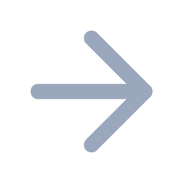
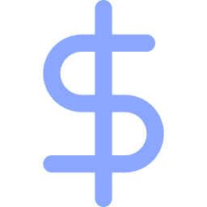



Solana is the settlement layer for every move
UNDER THE HOOD
Apps
Bytesac core
Providers
Your wallets
Web and mobile (Android, iOS)
Plans, steps, ledger, eligibility
LI.FI routes · Alchemy RPC · CoinMarketCap
Solana hub + 6 more chains
USDC on Solana
Sign-In with Solana
Fee-payer co-signing
One fee transaction
The single entry currency and the hub for every rebalance
Your wallet is your identity, never spending permission
Bytesac co-signs only byte-identical, quoted transactions
All fees in one USDC payment
$17.5B
13.07M
1M+
47%
stablecoins on Solana
stablecoin-holding wallets
tokenized-stock holder wallets
of on-chain RWA trades
Solana Foundation, Sep 2026 roundup · Allium via Hokanews (47%, 12 months to 18 Aug 2026)
Notes:
[1:52–2:06] Everything settles through USDC on Solana: sign-in, fees and every rebalance. Solana's speed and cost are what make approving every move practical.
Do not say 'gasless': release 1 still needs a little SOL in the wallet. Say 'network costs paid in USDC'. Full architecture and the step state machine are in appendix A1–A2 (use them in the technical demo video).

Slide 10
Tokenized assets are compounding, on Solana fastest
MARKET
10M+
smallcase investors in manager-led baskets
3.81M
eToro funded accounts; copy trading at a record high
13.07M
Solana stablecoin wallets: our first market
rwa.xyz via KuCoin (9 Oct 2026), Investax Q1 2026, Cryptobriefing · Solana Foundation; Dec 2025 Solana figure from secondary reports · smallcase.com · eToro Q4 2025.
Notes:
[2:06–2:20] Tokenized assets nearly doubled this year and grew about five times on Solana. Millions already pay for manager-led baskets off chain. We bring that model on chain.
Sizing (fill in before investor meetings): SAM = 13.07M Solana stablecoin wallets. SOM year 1 = wallets reached × conversion × average invested × fee rate — team assumptions needed; platform fee rates are still open (D-087). Forecasts for 2030 range from about $3T to $16T depending on the source: quote only as a labelled range. Re-pull rwa.xyz figures the day before recording.

Slide 11

Revenue on every operation. Managers paid on chain.
BUSINESS MODEL AND TRACTION
HOW MONEY FLOWS
GROWTH LOOP
TRACTION
One user-signed Solana transaction in USDC
Web and Android apps built end to end
Verified managers
Invest, rebalance, drift repair, exits
Network cost to the gas treasury
Fees paid on chain to managers
Fees + data
Their audiences
Manager fee to their verified payout wallet
Eligibility engine for tokenized assets
Platform fee to Bytesac revenue
ADD BEFORE SENDING
Waitlist size · manager letters of intent · user interviews · pilot numbers
Investors
Managers set entry and rebalance fees, capped at 1%. Bytesac never holds manager money. Later: management fees and subscriptions.
Managers bring their audiences; investor adoption and fees bring more managers.
Fee mechanics: ADR-016. Platform fee rates are set by ops and not final.
Notes:
[2:20–2:32] We earn a small fee on each operation; managers get paid instantly on Solana, straight to their own verified wallet. [Traction line: waitlist, managers signed, pilot.]
Colosseum explicitly asks for demand validation and go-to-market. Fill the yellow box with real numbers before recording; do not invent them.

Slide 12

TEAM · ROADMAP · ASK
We built it.
Now we launch it.
NOW
NEXT
LATER
Mainnet pilot with small amounts
Web and Android
First verified managers
One address per chain, several wallets
KYC and permissioned RWAs
Mobile push, one-tap repair
Stocks, ETFs, commodities
Deposits and pre-IPO
More settlement currencies
[Name]
[Role · one proof line]
[Name]
[Role · one proof line]
Raising [amount]
Security audit · legal and RWA licensing · launch managers · KYC vendor · team
Expert-managed portfolios. Held in your own wallet.
Notes:
[2:32–2:44] We've built it. Next is a mainnet pilot with our first verified managers. We're raising [amount] to get there. Thank you.
Fill in: team photos, names, roles and one proof line each; the raise amount, instrument and 18-month milestones. Team slide gets the most attention from investors — make the proof lines concrete.

Slide 13
A modular monolith with every provider behind an adapter
APPENDIX A1 · ARCHITECTURE
Clients
Bytesac API · Express 5, TypeScript
Providers
Web: Next.js 16 · Mobile: Expo 57 · wallets via Reown AppKit
Feature modules: auth, organizations, members, assets, baskets, discovery, operations, portfolio, rebalance, fees, eligibility, notifications. Every route authorized server-side; append-only ledgers.
LI.FI routing · Alchemy RPC for EVM, Solana and Bitcoin · CoinMarketCap prices · Gemini AI search · Resend email · Twilio SMS · FCM and Expo push
Data
PostgreSQL on Supabase (pg_cron, pgvector), app role without DELETE · Redis for queues, cache and rate limits · Cloudflare R2 for private documents
Worker · BullMQ
User wallets on 7 chains
Prices, performance, search index, step tracking, nightly reconciliation, gas checks, revenue reconciliation, notifications. Jobs never move money.
Source of truth: docs/architecture/ARCHITECTURE.md and the decision register (D-001 to D-121).
Notes:
Use in the technical demo video. One API process plus a worker process from the same codebase; providers live in providers/ behind adapters; the database is the source of truth and the runtime role cannot delete rows.

Slide 14
How one investment moves, step by step
APPENDIX A2 · SOLANA INTEGRATION
01
02
03
04
05
06
07
Sign in
Plan
Fee step
Quote
Sign
Co-sign
Track
Sign-In with Solana proof; session only
Steps built from reconciled holdings
One Solana tx, several USDC transfers
Fresh 60-second quote per step
You sign in your own wallet
Fee payer signs only byte-identical tx
Ledger written from chain evidence
EVERY STEP'S STATE
Planned
Submitted
Pending on chain
Settled
Failed
Unknown
Operations can end Partial. An unknown outcome is re-checked hourly for 7 days and never resubmitted.
Guards: price impact refused above 5%, slippage 1% by default (max 3%), exact-amount EVM approvals, Bitcoin PSBT checks.
Gas: Solana steps co-signed by the platform fee payer; EVM steps get one gas drop; costs recovered in USDC.
ADR-013, ADR-014, ADR-017; decisions D-067 to D-075, D-107.
Notes:
Technical demo: walk this slide, then show the invest flow live (amount → review the plan → authorize each step).

Slide 15
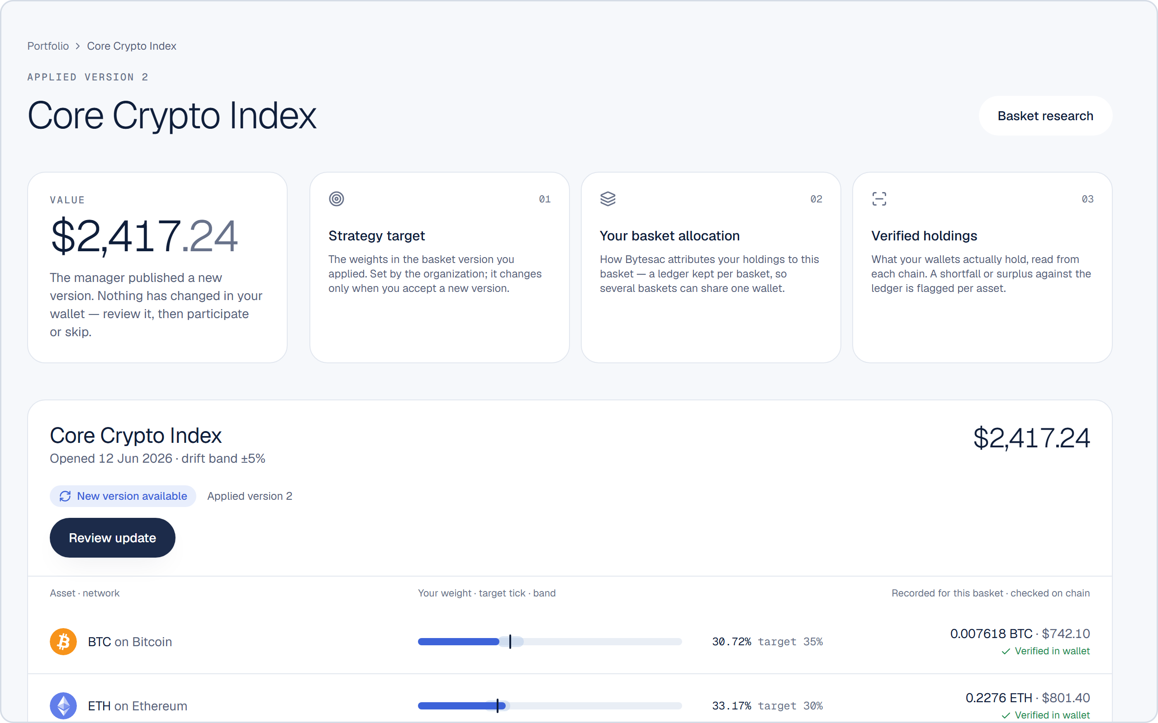
Reconcile first, then plan, then let the holder decide
APPENDIX A3 · REBALANCE ENGINE
1
Reconcile
Read holdings from the chain; shared assets split across baskets
2
Decide
Apply a new version, skip it, or keep a custom mix
3
Plan
Skip trades under 50 bps or $5; one open operation per user
4
Sell
Reduced assets sold to USDC on Solana
5
Buy
Sized to the cash that actually arrived
Position view: strategy target, basket allocation and verified holdings are separate layers, each with its own state.
6
Repair
Shortfalls fixed by Buy back or Sync, never guessed
ADR-015; D-076 to D-082. Screenshot: real Bytesac web app with demo data.
Notes:
States are separate: version, backing, allocation and execution, with one headline shown to the user (pending, repair required, incomplete, rebalance available, drifted, customized, aligned). A newer publish cancels untouched planned rebalances to an older version.

Slide 16
Four reviewed lifecycles before any basket goes live
APPENDIX A4 · MANAGER VERIFICATION
Application
Email confirmed
Submitted
Screening
Info requested
Approved
Organization
Draft
Submitted
Under review
Changes required
Verified
Team member
Invited
Wallet proven
Documents
Under review
Active
Basket version
Draft
Submitted, hashed
Ops review
Approved
Published
A typed wallet address never grants anything; the applicant must sign with it.
Self-approval is blocked, and reviewers who belong to an organization cannot act on it.
Payout wallet proven by its own signature; replacing it needs a new signature and ops approval. Every action is audited.
ADR-007, ADR-008, ADR-009, ADR-011.
Notes:
Key point for judges: manager legitimacy is enforced in code and by ops review at four points, and managers never control investor funds.

Slide 17
Tokenized assets are offered only where they are allowed
APPENDIX A5 · ELIGIBILITY AND ROADMAP
Declared country
Allowed
ROADMAP DETAIL
Investor status
Eligibility engine
per user, asset, route and action
Restricted
Next
Link a different address per chain and several wallets (D-120, D-121)
KYC vendor, permissioned RWAs, issuer subscription and redemption
One combined repair plan; instant drift alerts by webhook
Later
US and global stocks, ETFs (needs a custody decision)
Commodities, indices, currencies, deposits, pre-IPO
Management-fee collection, subscriptions, more settlement currencies
KYC required
Geo-IP signal
Review required
Asset and route rules
Declaration required
No rule means restricted; crypto and stablecoins are not affected.
Declarations are versioned and expire after 365 days.
Restricted holdings are never force-sold; they stay in the wallet.
Legal review per jurisdiction is still open.
ADR-018; D-025, D-100 to D-106; docs/domains/FUTURE-PLANS.md.
Notes:
If asked about compliance: release 1 relies on self-declared country and investor status plus a geo-IP signal, and blocks anything that needs KYC. A KYC vendor is on the roadmap. Legal review per jurisdiction is still open — say so plainly.

Slide 18
Every number in this deck, with its source
APPENDIX A6 · SOURCES
Tokenized RWAs $39.02B distributed, 9 Oct 2026: rwa.xyz via KuCoin blog
RWAs ~$21B Jan and ~$27.5B end Q1 2026: Investax Q1 2026 report
RWAs $38.29B mid-Aug 2026: Cryptobriefing
Solana RWAs $3.1B (Jun), $4.23B (5 Sep): Cryptobriefing, Memeburn
Solana RWAs $4.6B, $17.51B stablecoins, 13.07M stablecoin wallets, 1M+ tokenized-stock holders, 3,000+ assets: Solana Foundation Sep 2026 roundup
47% of on-chain RWA trades (12 months to 18 Aug 2026): Allium via Hokanews
~$17B scam proceeds 2025, impersonation +1,400%: Chainalysis 2026 via FastBull
62% of users manage 2+ wallets: Reown/Nansen 2025 via Benzinga
smallcase 10M+ investors: smallcase.com
eToro 3.81M funded accounts: Q4 2025 earnings call; copy trading record: Q1 2026 call
Symmetry basket tokens: symmetry.fi · Glider: Glider blog, ZeroDev case study
Pitch format: Colosseum hackathon page and submission workshop; Storydoc and DocSend deck studies
Retrieved 10–11 Oct 2026. Market figures change daily: re-check rwa.xyz and the Solana Foundation before presenting. Links: docs/pitch/PITCH-DECK-PLAN.md.
Notes:
Keep this slide in the investor version. Links for every source are in docs/pitch/PITCH-DECK-PLAN.md and the storyboard.

