Slide 1
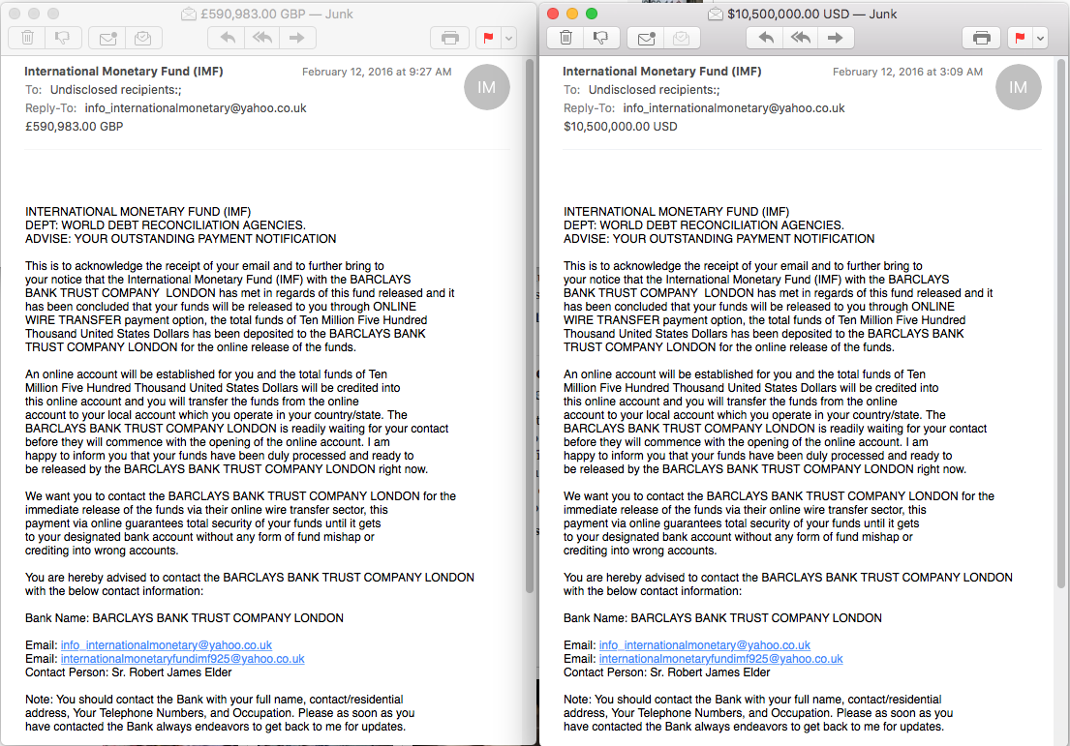
Sent at very different times
Different Amounts. Good to test (although might have kept currency constant)
Inconsistent with the headline. Bad.

