Slide 1



Well Log Facies Classification
Lithology Prediction in Sandy-Shaly Basins using Machine Learning
Intern
Sameer Modi · B.Tech 2nd Year, Geological Technology
Roll No
23410030
Supervisor
Prof. Ravi Sharma · Dept. of Earth Sciences
Mentor
Varun Dev Jamwal · Dept. of Earth Sciences
Organization
Rock & Fluid Multiphysics Lab · IIT Roorkee
Date
June 2025
Notes:
1

Slide 2
Project Objectives
PRIMARY OBJECTIVE
Develop and evaluate ML models that classify 6 sedimentary facies from 6 wireline logs across 4 Gondwana Basin wells — with cross-well generalization (Leave-One-Well-Out validation).
SECONDARY OBJECTIVES
Build a rule-based lithology classifier mapping raw log descriptions to 6 standardised facies classes.
Engineer 7 derived petrophysical features (log-ratios, products, anomaly indices) to improve model separability.
Evaluate 6 ML models (Random Forest, XGBoost, SVM×2, KNN, 1D CNN) under LOWO cross-validation.
Identify the most discriminating well logs and derived features via feature importance analysis.
Produce depth-track visualisations comparing actual vs. predicted facies for geological validation.
Notes:
3

Slide 3
Dataset Overview
4
162,829
6
13
Wells
Log Samples
Log Features
Total Features
Gondwana Basin
after cleaning
base inputs
incl. derived
Well | Basin | Sub-basin | State | Depth Range | Samples
Well 1 | Gondwana | Raniganj | West Bengal | 2.9 – 783.0 m | 39,008
Well 2 | Gondwana | Raniganj | West Bengal | 3.4 – 918.0 m | 45,731
Well 3 | Gondwana | Jharia | Jharkhand | 1.8 – 510.1 m | 25,413
Well 4 | Gondwana | Jharia | Jharkhand | 70.0 – 1197.5 m | 56,375
Notes:
4

Slide 4
Well Log Features
GAM[API]
Gamma Ray
DEN[G/CC]
Bulk Density
Unit: API | Range: 20 – 575
Unit: g/cc | Range: 0.83 – 3.5
Primary shale indicator. High GR → shale; Low GR → clean sandstone.
Differentiates coal (low ~2.14) from sandstone/shale (~2.4–2.6).
RES[OHM]
Deep Resistivity
RES(16N)
Shallow Resistivity
Unit: Ω·m | Range: 0.05 – 3527
Unit: Ω·m | Range: 0.03 – 3496
High resistivity → hydrocarbon-bearing sandstone or coal beds.
16-inch spacing tool. Combined with deep RES to detect invasion zones.
SP[MV]
Spontaneous Potential
CALIPER[CM]
Borehole Caliper
Unit: mV | Range: −314 – 143
Unit: cm | Range: 12 – 54.4
Most important feature (0.154 importance). Strongly separates facies.
Borehole diameter anomaly detects washouts. Converted from inches.
Notes:
5

Slide 5
Data Preprocessing
Sentinel Null Replacement
FINAL NULL RATES
1
−99999, −9999, −999, 9999, 99999 → NaN. LAS exporter leaves these as missing-data flags; pandas reads them as valid numbers without explicit replacement.
CALIPER[CM]
0.01%
Zero-Value Cleaning
DEN[G/CC]
0.31%
2
Zero is physically impossible for Caliper, GR, Density, Resistivity → replaced with NaN. SP excluded (0 mV is valid at shale baseline).
GAM[API]
0.00%
Physical Bounds Check
RES(16N)
0.05%
3
Values outside instrument range → NaN. E.g., Density > 3.5 or < 0.8 g/cc is instrument error. Well 3 had 506 density outliers (2.0%).
RES[OHM]
0.01%
4
Startup Row Removal
SP[MV]
0.00%
473 rows removed across 4 wells — logging tool stabilisation artifact at top/bottom of well. Cannot be imputed; no geological signal.
✓ Remaining nulls imputed by
per-well median (Phase 2)
Notes:
6

Slide 6
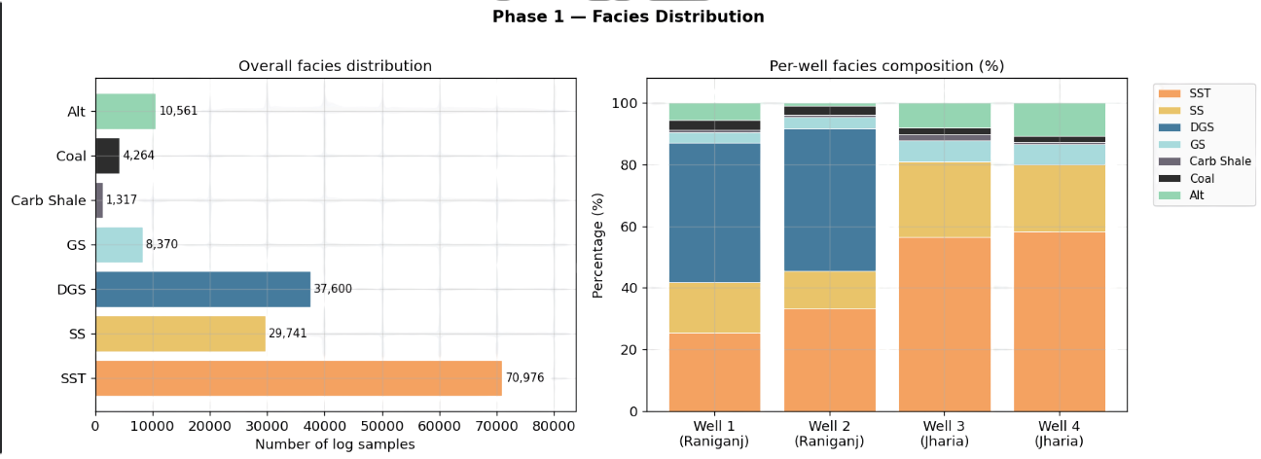
Exploratory Data Analysis

Slide 7
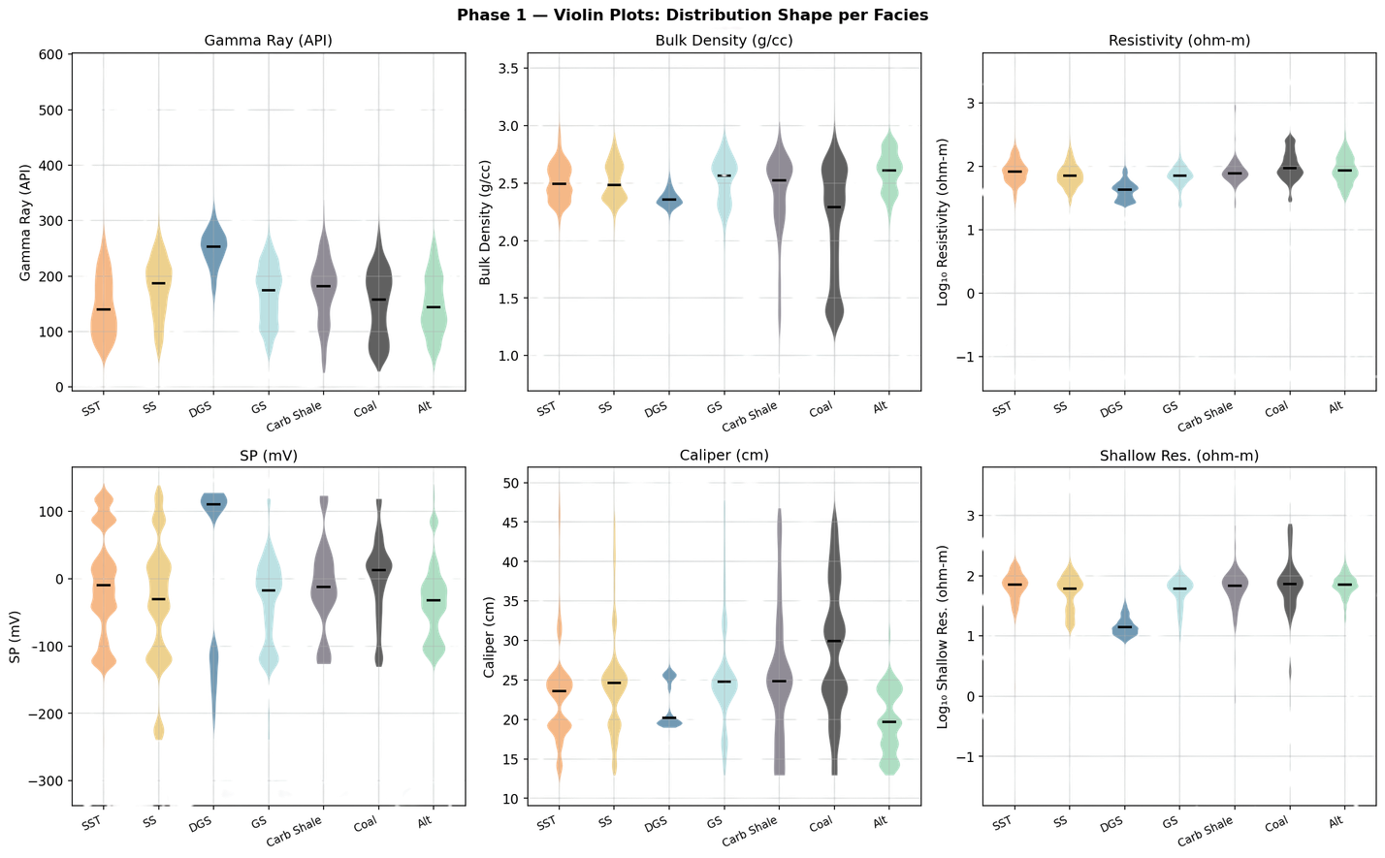
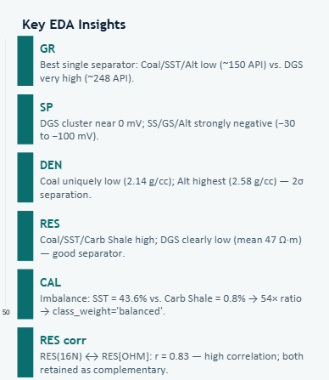
Exploratory Data Analysis

Slide 8
Feature Engineering
6 raw logs → 13 features via domain-informed petrophysical engineering
Feature | Formula | Petrophysical Rationale
GR_DEN_ratio | GR / DEN | Amplifies shale vs. dense-sandstone contrast.
log_RES | log₁₀(RES[OHM]) | Compresses wide resistivity range; linearises response.
log_RES16 | log₁₀(RES(16N)) | Same compression for shallow resistivity tool.
RES_ratio | RES[OHM] / RES(16N) | Invasion ratio — differentiates fluid-bearing vs. dry.
DEN_RES_product | DEN × log₁₀(RES) | Joint density-resistivity index for lithology typing.
GR_DEN_product | GR × DEN | Separates carbonaceous shale from clean formations.
CALP_anomaly | CALIPER − median(CALIPER) | Borehole enlargement anomaly; flags washout intervals.
Notes:
8

Slide 9
Machine Learning Workflow
Raw Well Logs
Cleaning
Feature Engineering
LOWO Split
Model Training
LOWO Validation
Best Model: RF
4 wells · 6 logs each
Null, bounds, startup removal
13 features (6 raw + 7 derived)
Wells 1–3 train, 1 test
RF · XGB · SVM · KNN · CNN
4-fold avg F1-weighted
Mean F1 = 53.5%
Leave-One-Well-Out (LOWO) Cross-Validation
FOLD SUMMARY
Train on 3 wells → Predict unseen 4th well. Repeated 4 times.
Fold
Test Well
Test Rows
Tests true cross-basin generalization (Raniganj ↔ Jharia basins).
1
Well 1 (Raniganj)
37,242
24,000 balanced training samples per fold (via class_weight='balanced').
2
Well 2 (Raniganj)
44,908
3
Well 3 (Jharia)
24,566
Final test set: Wells 3 & 4 (Jharia) — unseen during training.
4
Well 4 (Jharia)
56,113
Notes:
9

Slide 10
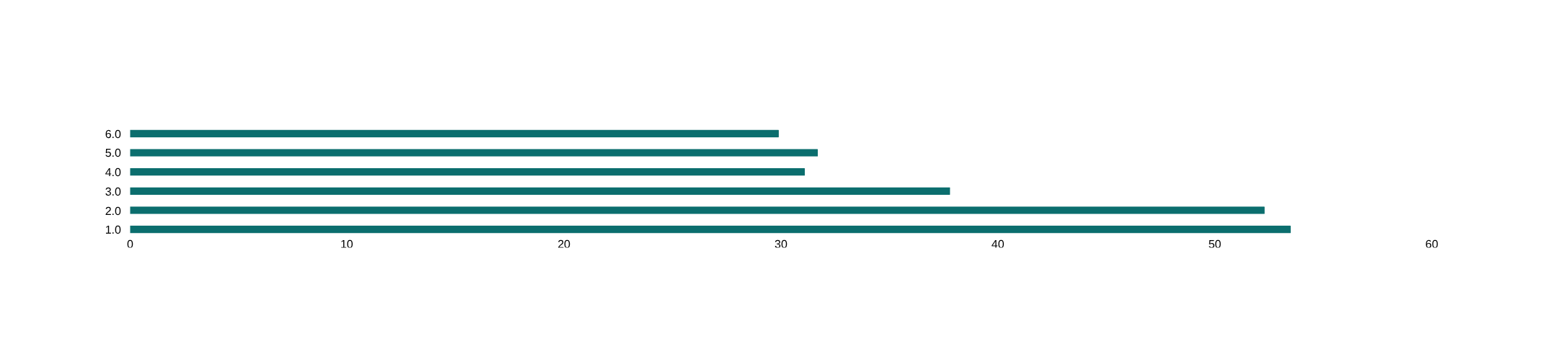
Models Evaluated — LOWO Results
Model | Well 1 F1 | Well 2 F1 | Well 3 F1 | Well 4 F1 | Mean F1 | Std
★ Random Forest | 50.3% | 74.8% | 45.5% | 43.2% | 53.5% | ±12.6%
SVM (Linear) | 59.6% | 67.9% | 38.5% | 43.1% | 52.3% | ±12%
XGBoost | 38.1% | 25.7% | 44.6% | 42.8% | 37.8% | ±7.4%
1D CNN | 25.2% | 22.2% | 38.8% | 38.2% | 31.1% | ±7.5%
SVM (RBF) | 25.1% | 25.2% | 39.8% | 36.9% | 31.7% | ±6.7%
KNN (k=5) | 21.1% | 22% | 35.3% | 41% | 29.9% | ±8.6%
Notes:
10

Slide 11
Best Model: Random Forest
53.5%
74.8%
53.5%
n=500
Mean F1-weighted
4-fold LOWO
Best Fold F1
Well 2 (Raniganj)
vs 52.3% SVM Lin.
+1.2 pts margin
Trees · Depth 20
class_weight balanced
Why Random Forest Outperforms
Why Others Fell Short
Handles class imbalance
XGBoost
37.8%
class_weight='balanced' directly upweights rare Coal and Carb Shale classes without synthetic oversampling.
Sensitive to feature scaling across basins
Robust to log scale variability
SVM RBF
31.7%
Ensemble averaging reduces sensitivity to the 2σ caliper unit difference between Raniganj and Jharia wells.
Kernel bandwidth poorly calibrated
Non-parametric
KNN
29.9%
No distributional assumptions — captures non-linear boundaries between facies in multidimensional log space.
Distance metric fails with 13D mixed-unit features
Interpretable
1D CNN
31.1%
Feature importance scores provide direct geological validation of which logs drive classification.
Insufficient data per fold; no depth context
Notes:
11

Slide 12
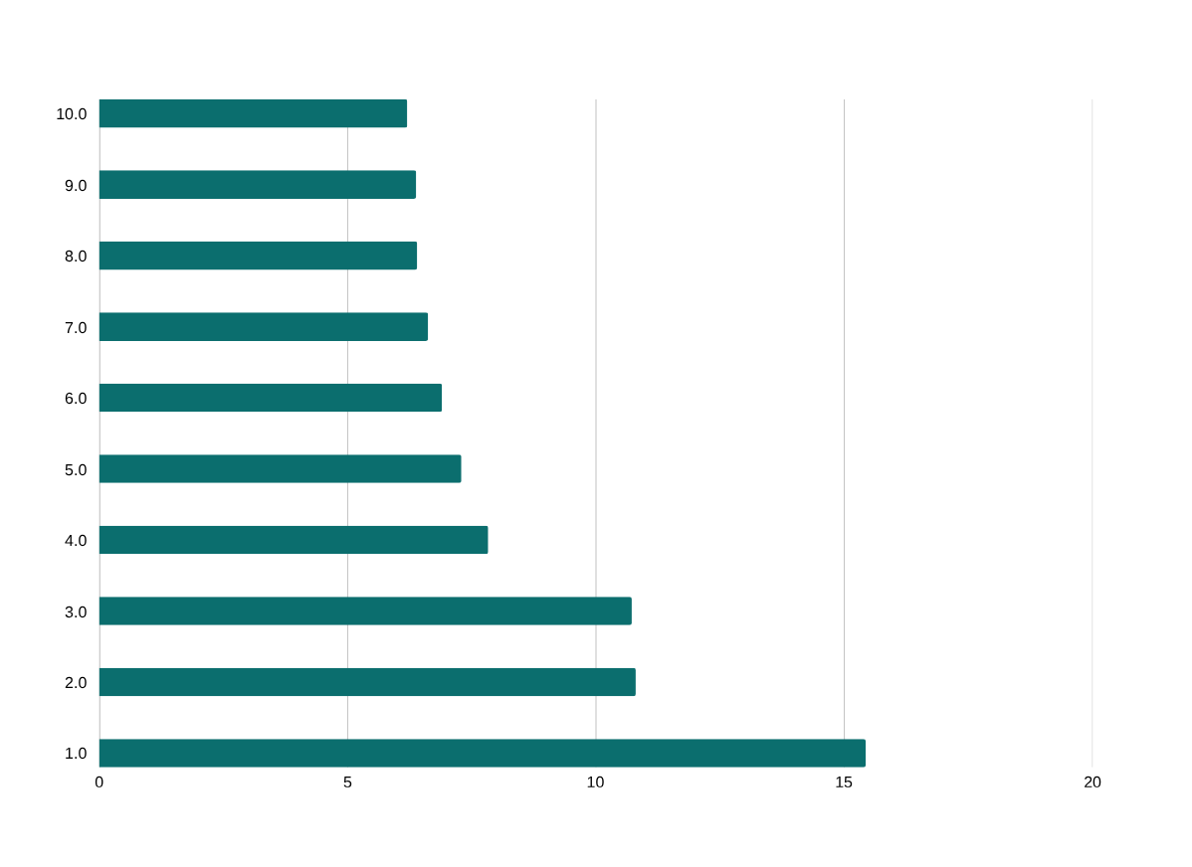
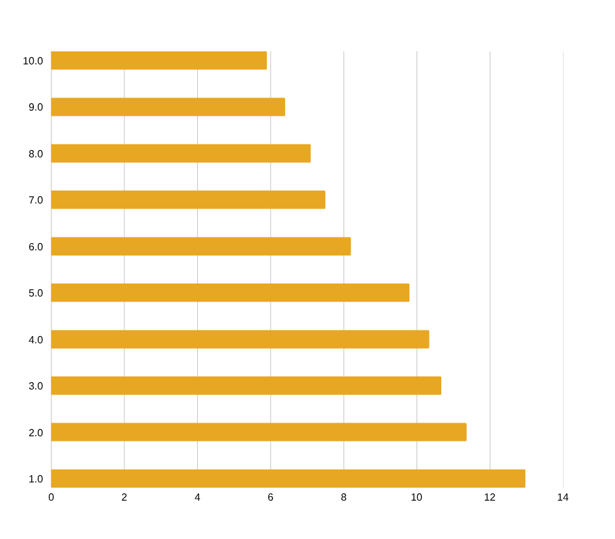
Feature Importance
Random Forest Feature Importance
XGBoost Feature Importance
SP[MV] is the top feature for RF (15.4%) — captures electro-chemical contrasts between facies.
CALP_anomaly (derived) outperforms raw Caliper — engineered features add discriminative power.
Both RF and XGBoost agree: SP + Caliper + log_RES16 form the core discriminating trio.
Notes:
12

Slide 13
Model Performance Metrics
Random Forest — Per-Class F1 Scores by Test Well
Facies | Well 1 F1 | Well 2 F1 | Well 3 F1 | Well 4 F1 | Observation
SST | 0.554 | 0.753 | 0.706 | 0.683 | Best predicted class — dominant in training set (43.6%)
GS | 0.589 | 0.886 | 0.000 | 0.062 | High in Raniganj; near-zero in Jharia — basin distribution shift
SS | 0.401 | 0.370 | 0.223 | 0.129 | Transitional class — confused with SST and GS at boundaries
Coal | 0.249 | 0.318 | 0.053 | 0.033 | Low support in test set; distinctive signature helps partly
Alt | 0.026 | 0.000 | 0.003 | 0.010 | Rare and heterogeneous — hardest class across all wells
Carb Shale | 0.000 | 0.099 | 0.000 | 0.000 | Rarest class (0.8%) — insufficient training support
Overall Accuracy & F1 per Test Well
Well 1
Well 2
Well 3
Well 4
Acc: 49.3% F1: 50.3%
Acc: 74.6% F1: 74.8%
Acc: 53.0% F1: 45.5%
Acc: 50.1% F1: 43.2%
Notes:
13

Slide 14
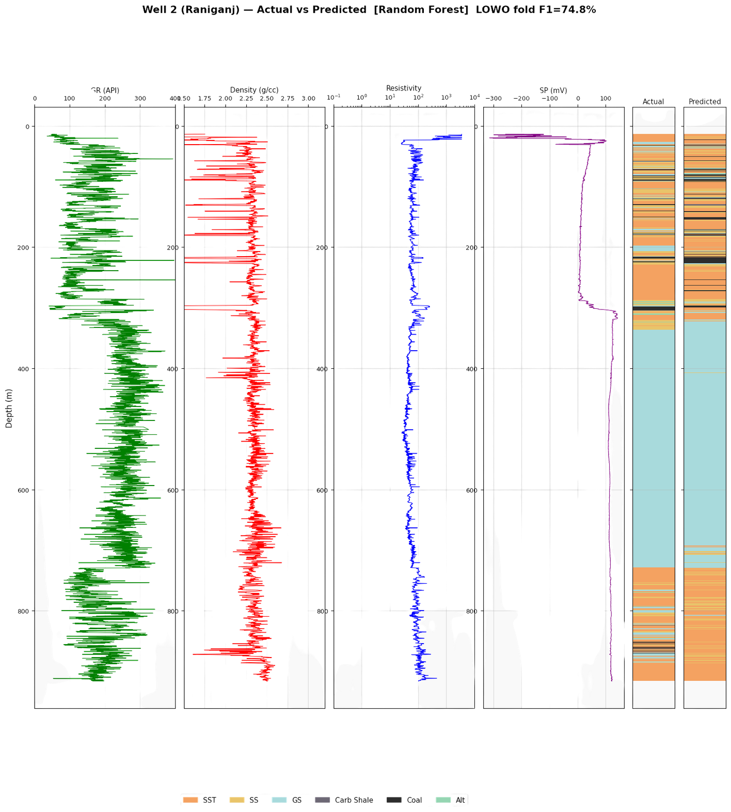
Well 2 (Raniganj) — Actual vs Predicted [Random Forest] LOWO fold F1=74.8%

Slide 15
Generalization Capability
🌍
Cross-Basin Transfer
📏
LOWO Validation Design
Model trained on Raniganj wells successfully predicts Jharia basin facies — log physics are transferable despite different depths and sub-basin geology.
Leave-One-Well-Out is the industry-standard test for cross-well prediction. Each fold is a true blind test on a well the model has never seen.
⚖️
Class Weighting Strategy
📁
Scalable Pipeline
class_weight='balanced' ensures the model doesn't ignore rare Coal (2.6%) and Carb Shale (0.8%) — critical for safety in resource estimation.
StandardScaler + feature engineering pipeline is serialised (best_scaler.pkl). Any new well's logs can be scored instantly without retraining.
Model file: best_model.pkl (154 MB) · Scaler: best_scaler.pkl (< 1 KB) · Pipeline: load → scale → predict · Latency: < 1 sec for full well
⚡ Production Deployment Note
Notes:
15

Slide 16
Key Insights
GEOLOGICAL INSIGHTS
ML INSIGHTS
SP[MV] alone drives 15.4% of classification — electro-chemical facies signature is dominant.
Derived features (CALP_anomaly, log_RES16) outperform raw logs in feature importance rankings.
DGS (Dark Grey Shale) and GS merge geologically — merging to 6 classes improved model stability.
54× class imbalance (SST vs. Carb Shale) requires explicit balancing — cannot be ignored.
Coal is distinguishable by its triple signature: low density, high resistivity, elevated GR.
Random Forest beats deep learning (1D CNN) due to limited per-fold training data (24,000 rows).
Caliper anomaly (washout) strongly correlates with shale and coal intervals.
Basin shift (Raniganj→Jharia) reduces F1 by ~15 points — well-to-well variability is real.
Notes:
16

Slide 17
Limitations
1
Severe Class Imbalance
Carb Shale (0.8%) and Coal (2.6%) are chronically underdetected. F1-macro averages as low as 0.15 reflect failure on minority classes despite class weighting.
2
Limited Training Data Per Fold
LOWO trains on 24,000 samples from 3 wells — capped to avoid imbalance. Real basin datasets have millions of depth samples; more data would dramatically improve minority-class recall.
Notes:
17

Slide 18
Conclusion
✅
Successfully built an end-to-end ML pipeline for facies classification across 4 Gondwana Basin wells spanning 2 sub-basins (Raniganj & Jharia).
✅
Random Forest achieved 74.8% F1-weighted on the best test well, with a mean of 53.5% over rigorous LOWO cross-validation.
✅
Engineered 7 domain-informed features — CALP_anomaly and log_RES16 rank among top-3 discriminators across both RF and XGBoost.
✅
SP[MV] identified as the single most important log (15.4% RF importance), confirming its petrophysical sensitivity to electro-chemical facies contrasts.
⚠️
Cross-basin generalization remains the core challenge: Carb Shale and Alt facies are underdetected, pointing to the need for sequential deep learning and more training data.
🚀
The serialised pipeline is deployment-ready — new well logs can be classified in under 1 second with no retraining required.
Rock & Fluid Multiphysics Lab · IIT Roorkee · Sameer Modi · June 2025
Notes:
19

