Slide 1
Deque

Slide 2
Deque => Doubly ended Queue
Queue are first In First Out.
pop
append

Slide 3
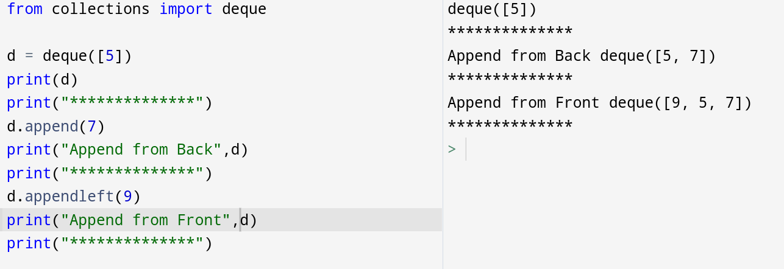
Deque => Doubly ended Queue

Slide 4
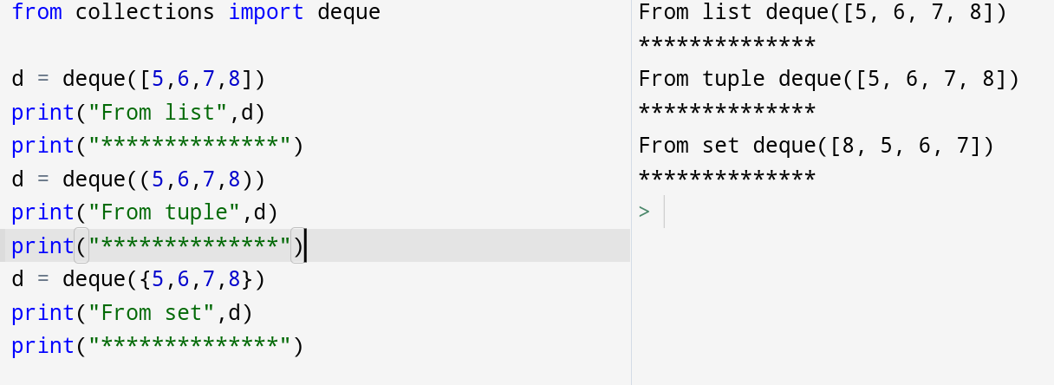
how to create Deque

Slide 5
Insertion into deque

Slide 6
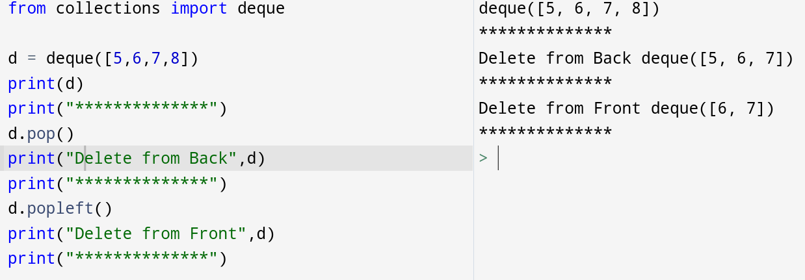
Deletion from deque

Slide 7
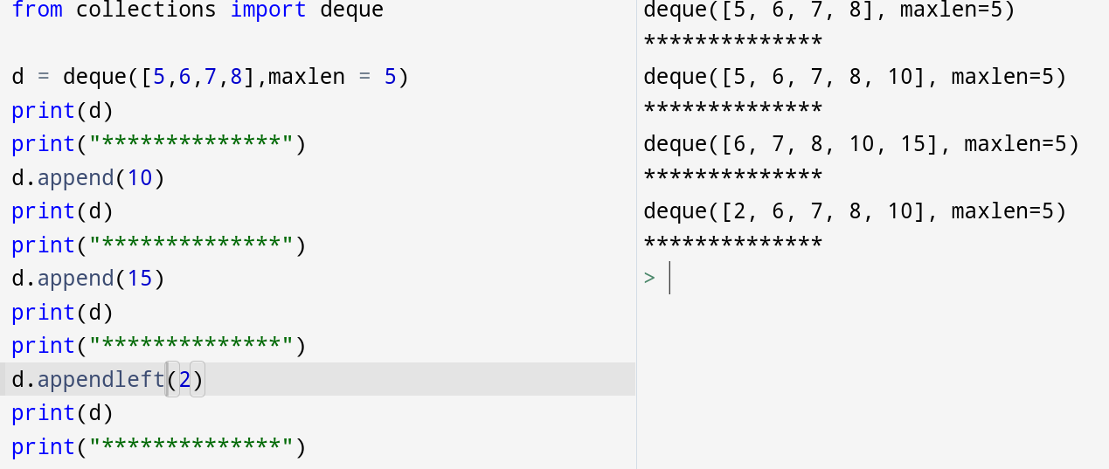
Maxlen of Deque

Slide 8
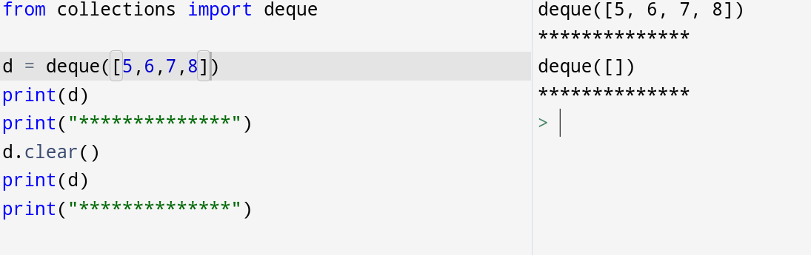
Clear

Slide 9
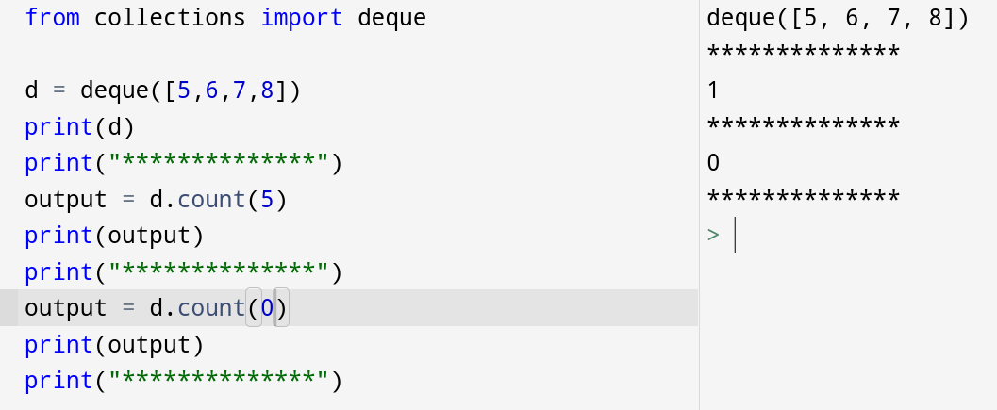
Count

Slide 10
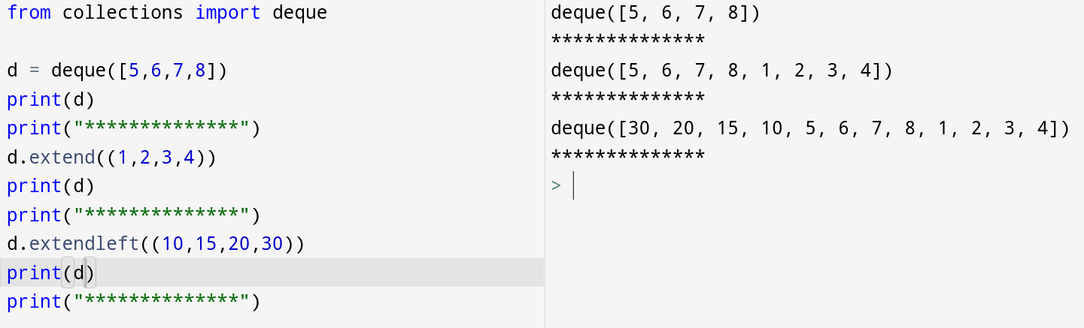
Extend and Extendleft

Slide 11
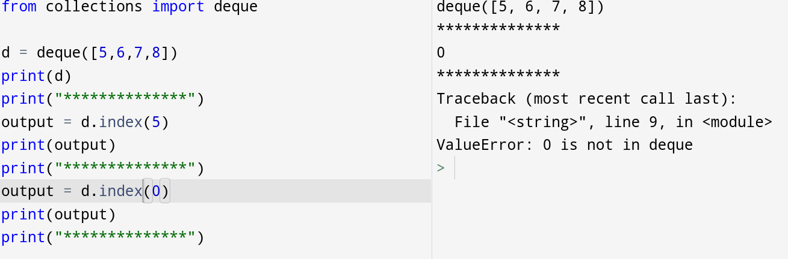
Index

Slide 12
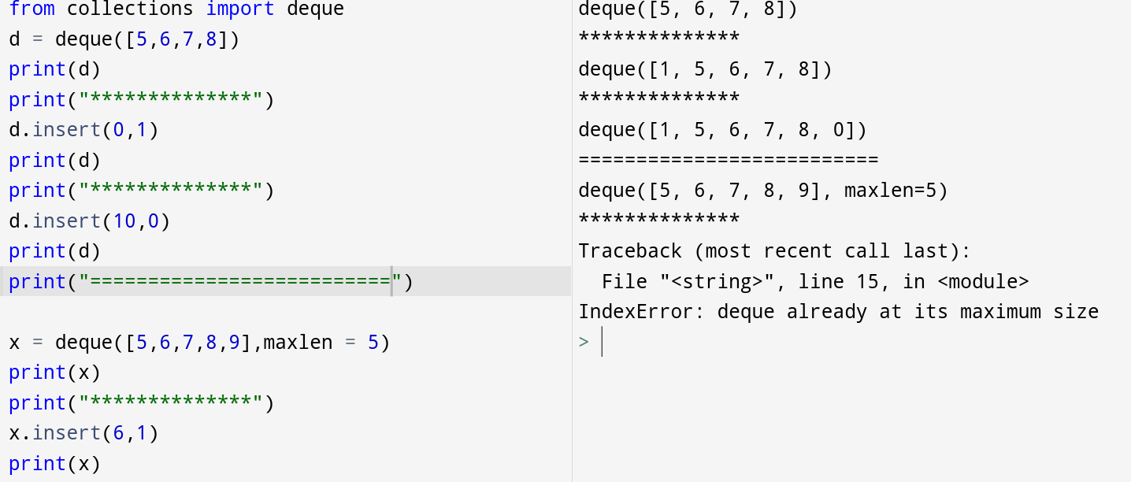
Insert

Slide 13
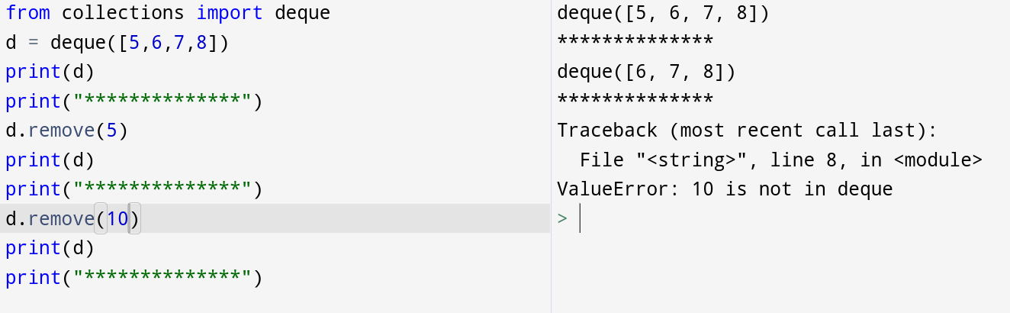
Remove

Slide 14
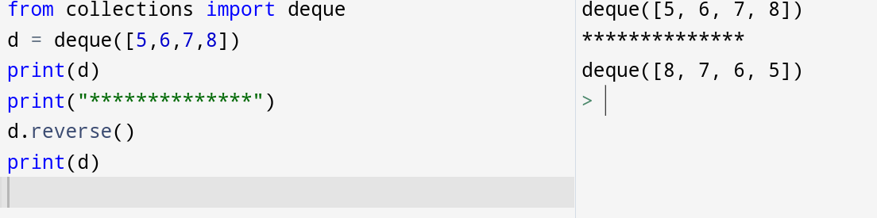
Reverse

Slide 15
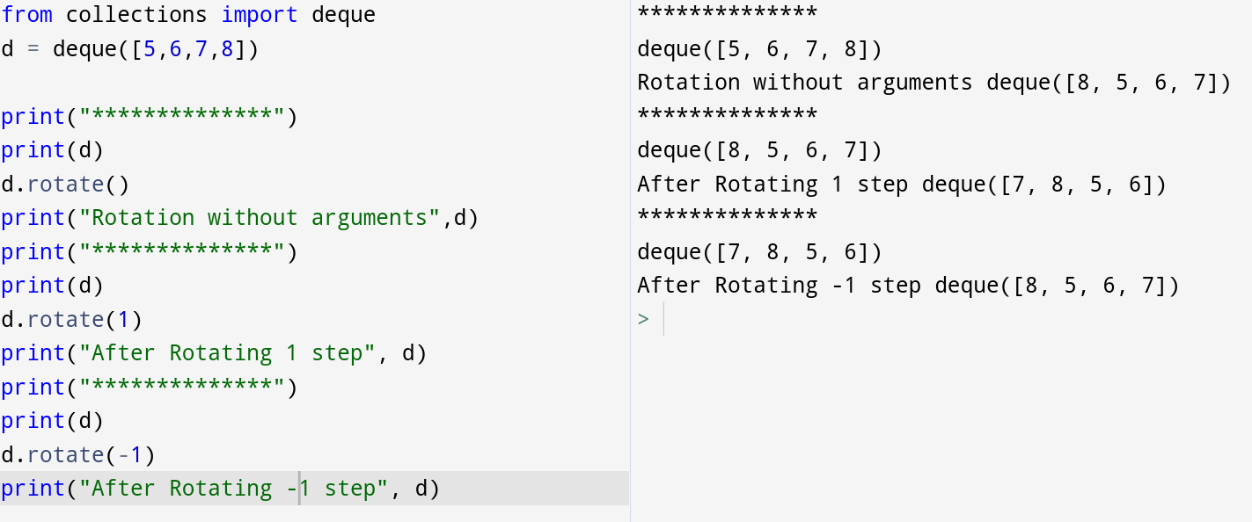
Rotate

Slide 16
Thank
You

