Slide 1

Bartr
Trade, Connect, Thrive

Slide 2
Understanding the Problem Statement
Problem: Lack of a dedicated platform for seniors to sell their unused items and juniors to access affordable resources.
Solution: An interactive e-commerce platform named "Bartr" that facilitates buying and selling among students.
Benefits: Empower seniors to declutter, provide affordable resources for juniors, promote sustainable consumption.

Slide 3
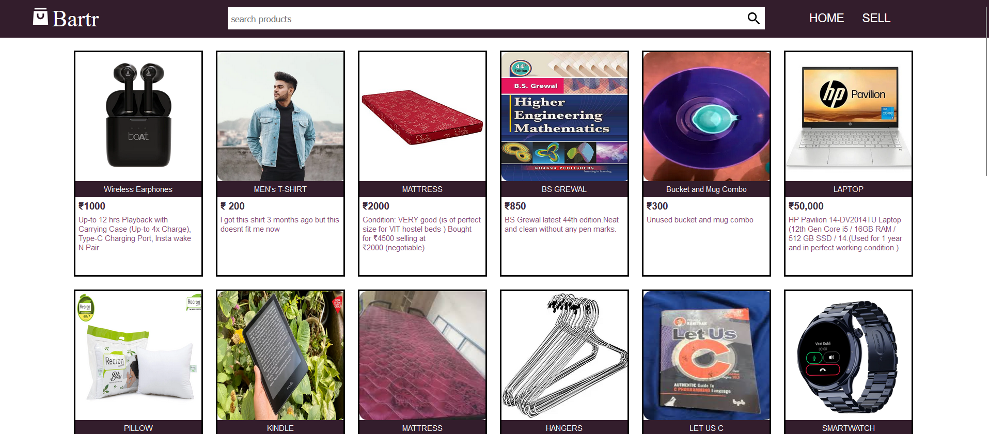
Platform Overview
Platform Name: Bartr
Features:
User-friendly interface
Interactive chatbot for real-time assistance
Safe and secure transactions
Bargaining feature to enhance engagement
Categories: Extensions, Hangers, Mattresses, Books, and more
User profiles with ratings and reviews
Option for doorstep delivery or local pickup
Integration with social media for wider reach

Slide 4
User Personas
Seniors: Individuals looking to declutter and earn from their unused items.
Juniors: Students seeking affordable resources to support their academic and personal needs.
Benefits: Seniors earn, juniors save, both contribute to sustainability.

Slide 5

Interactive Chatbot
Real-time assistance for navigation and support
Conversational negotiation for seamless bargaining
Intelligent suggestions based on user preferences
Problem-solving and dispute resolution

Slide 6
Seamless Interaction
Real-time assistance for navigation and support
Conversational negotiation for seamless bargaining
Intelligent suggestions based on user preferences
Problem-solving and dispute resolution

Slide 7
Sustainability & Social Impact
Promoting Sustainability:
Extending product lifecycle through reuse
Reducing waste and landfill contribution
Encouraging responsible consumption

Slide 8
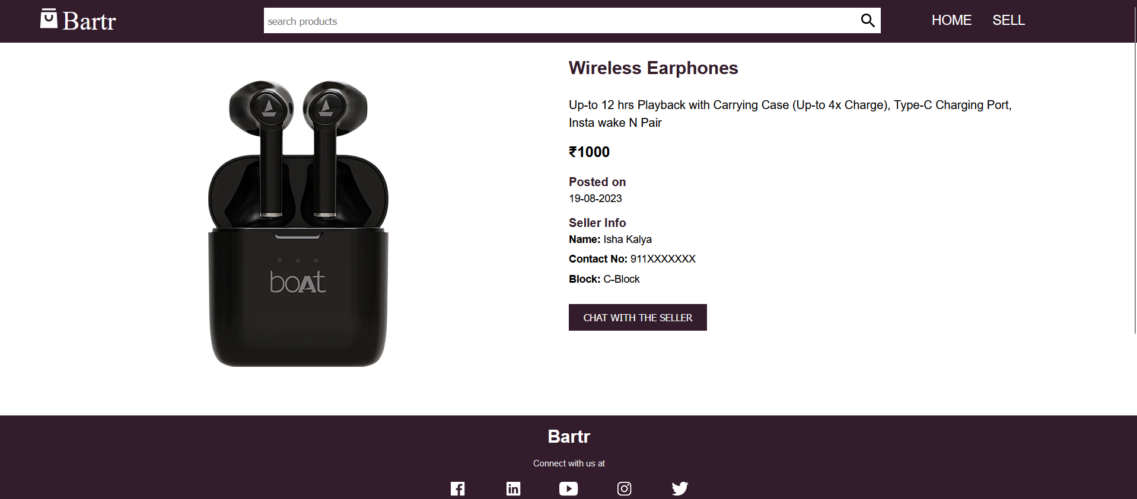
Market Potential
Target Audience: College and university students
Market Potential: Growing demand for affordable and sustainable solutions among students

Slide 9
Competitor Analysis
Analysis of Similar Platforms:
OLX, Facebook Marketplace, Letgo
Differentiating factors: Focus on student community, interactive chatbot, specific categories

Slide 10
Revenue Generation
Revenue Streams:
Commission on successful transactions
Premium listing options for sellers
Featured listings for greater visibility

Slide 11
Future Enhancements
Mobile app for enhanced user experience
Integration with campus communities
Expansion into other student-centric categories

Slide 12
Conclusion
Key Takeaways:
Addressing a real market need
Fostering intergenerational interaction
Promoting sustainability in student communities

Slide 13
Q&A

