Slide 1
BALL BALANCING TABLE USING PID CONTROLLER
By
SAMEER PURWAR(1401EE37)
SHAILESH KUMAR KASHYAP(1401EE39)
SHIVAM SHARMA(1401EE40)

Slide 2
INTRODUCTION
The goal of the project is to balance the ball on a platform and prevent it from falling in case of small perturbation about the given coordinate(set point) on the platform . The problem we have modeled here is a regulatory problem or a set point problem where in case of disturbance from a given set point the controller will behave in such a way as to bring the ball back to its desired states.
There exist several state of the art controller like –
Proportional Integral , Proportional Integral Derivative , Proportional Controller.
Balancing a ball on a platform is similar to an inverted pendulum problem. Both of these system are non-linear in nature and to mathematically model them, one has to linearize them around a nominal point.

Slide 3
Material Used
Raspberry pi
5 wire Resistive touch panel
Two position controlled Servo motors
MCP3008 Analog to Digital Convertor
12” by 12” Plexi Glass
Universal joint
Nuts and bolts

Slide 4
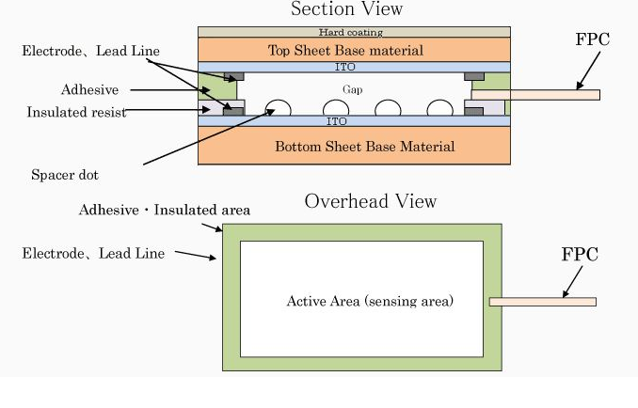
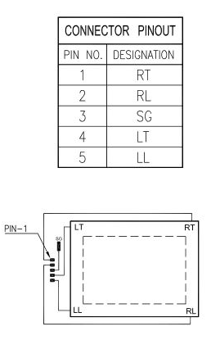
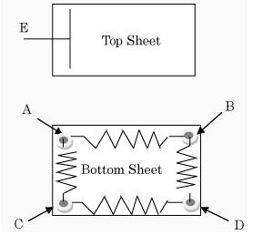
5 wire Resistive Touch Panel

Slide 5
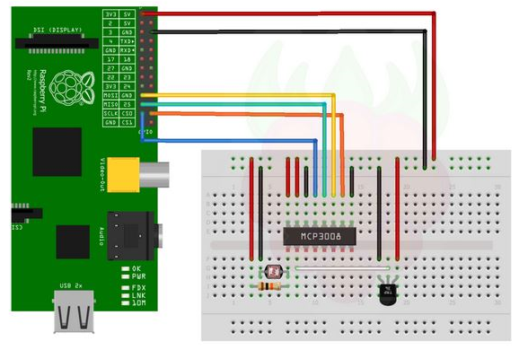
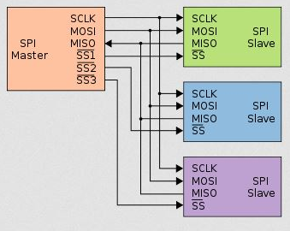
Analog To digital Interface
The MCP3008 is a 10 bit 8 channel ADC which makes use of SPI interface (full duplex) for data transfer. The frequency at which the analog signal is being sampled is 200 kilo samples per second.
The rate of data transfer depends upon the master which in this case is raspberry pi and the S_clock is 250 MHz or the core speed.

Slide 6
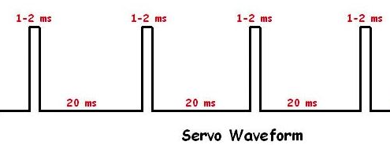
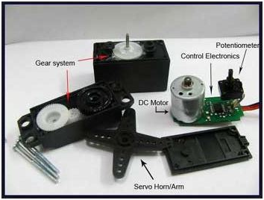
Position Controlled Servo Motor
Most servos rotate 180 degrees. Servos are controlled by a single digital pin. The way to tell a servo what to do is by sending them a high pulse for a certain duration. Most standard RC servos use a pulse of 1 millisecond to indicate zero degrees of rotation and 2 milliseconds for 180 degrees. This means that for 90 degrees is set via a 1.5 millisecond high signal.
One problem is that these servos cannot remember therefore we have to send the signal constantly.

Slide 7
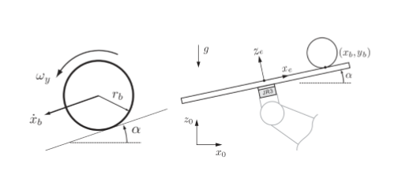


Working
Though the dynamics of the system is highly non-linear in nature, the equation has been linearized about the point
Xb = 0
Yb = 0
Q1 = 90
Q2 = 90
Also from the laplace transformed equation we can see that both the x and y equations are decoupled and the input q1 and q2 are the angles of the servo motor which will be controlling the states xb and yb .
Dynamics of System analysis

Slide 8
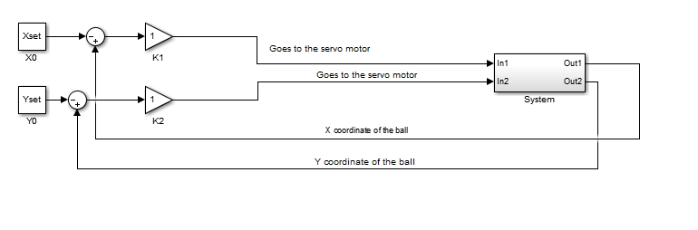
How do we plan to control
We plan to make a closed loop control with angle of the servo motor as the input to the system and states as the position of the ball on the touch screen.
The inputs are a function of the states of the system and proportionally related to the error in the states wrt. To set point

Slide 9
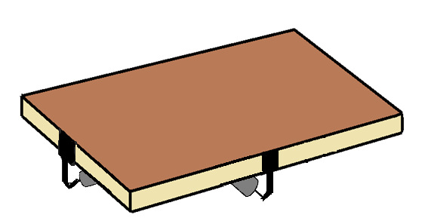
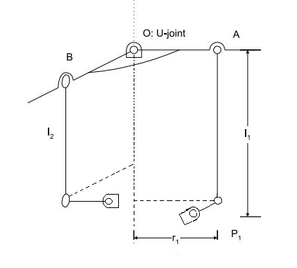
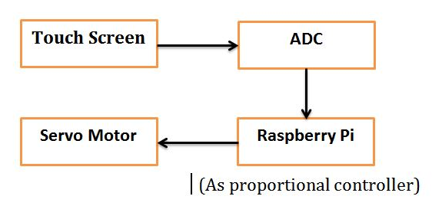
Physical model

Slide 10
Future Work
So far we have thought of a simple decoupled proportional controller for our controller design, though it difficult to build a stable controller just on the basis of a proportional controller.
Other controller design include decoupled PID controller, Linear Quadratic Controller. These controller are based on first principle model. We can also make use of black box models like Neural Network, where the model can be trained by itself.
We can further move from regulatory control to optimal tracking control using algorithms like State Dependent Ricatti Equation.

Slide 11
THANK YOU

