Slide 1
DELHI METRO ANALYSIS
Data Analysis & Power BI Dashboard Project
Presented by
Sameer Raj
Data Analyst Portfolio

Slide 2
Project Overview
End-to-end analysis using Python, Pandas and Power BI
PROJECT
• Objective: analyze Delhi Metro passenger movement, fare, revenue and profitability patterns.
• Dataset: 1,50,000 trip records covering 2022–2024.
• Key fields: stations, distance, fare, cost per passenger, passengers, ticket type, remarks, year, month and day.
• Workflow: data cleaning → exploratory analysis → DAX measures → interactive Power BI dashboard.
• Focus: business-style insights rather than machine learning.
Records
1,50,000
Years
2022–2024
Tools
Python + Power BI
Delhi Metro Analysis • Sameer Raj • Data Analyst Portfolio Project

Slide 3
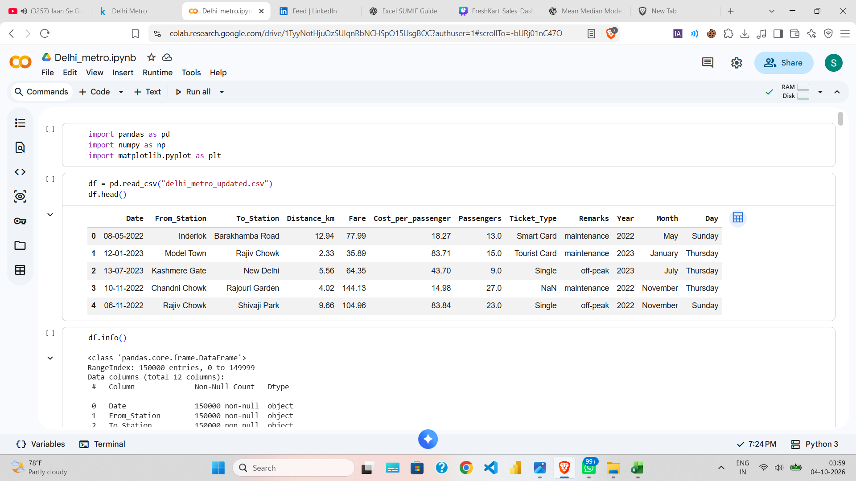
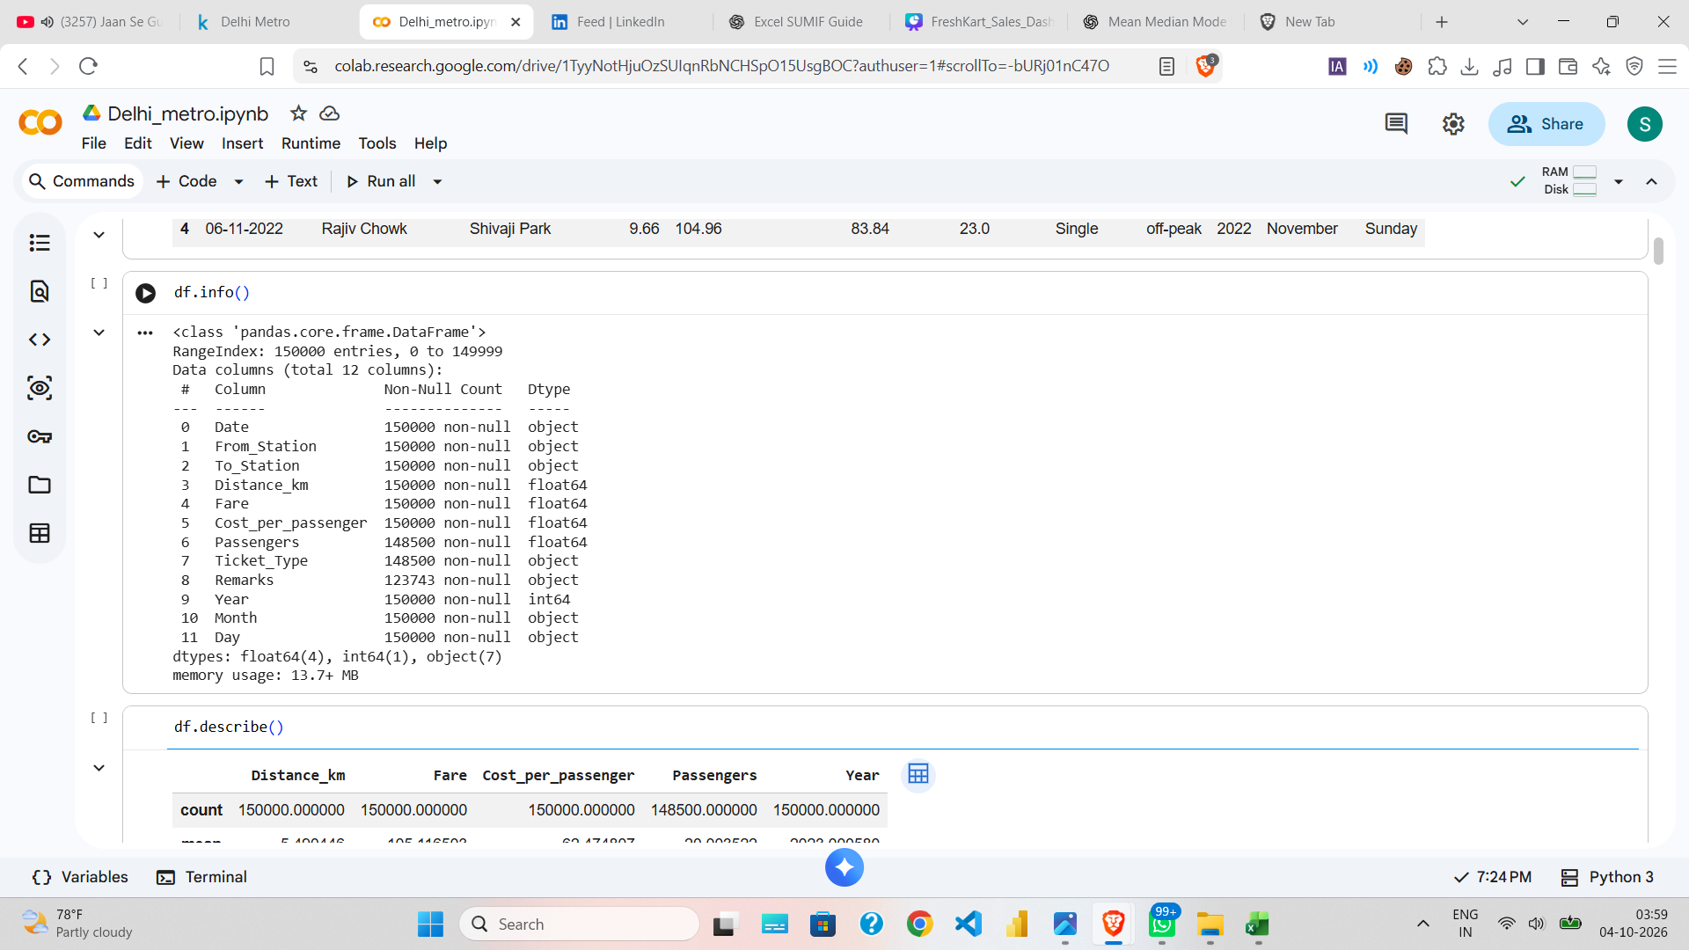
Data Loading & Structure
Initial inspection of the cleaned dataset
PYTHON EDA
Delhi Metro Analysis • Sameer Raj • Data Analyst Portfolio Project

Slide 4
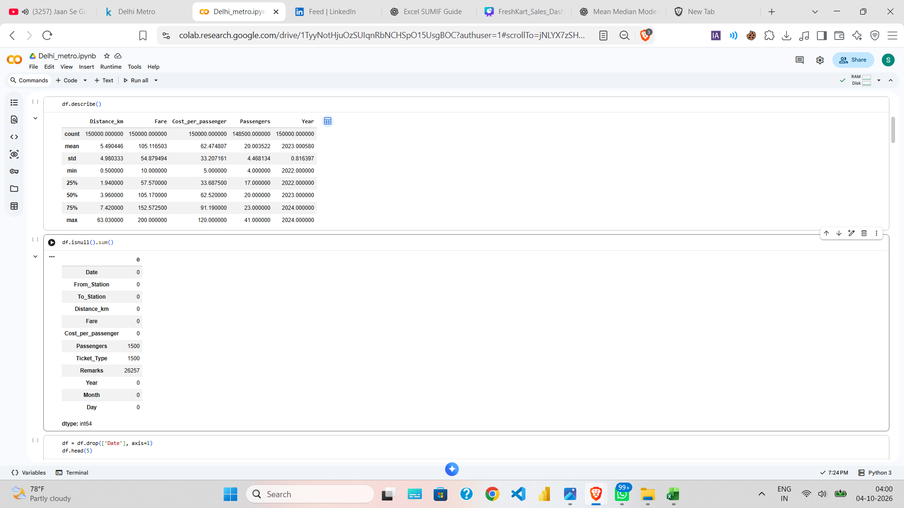
Data Cleaning & Quality Checks
Missing-value treatment before analysis
DATA QUALITY
• Passengers: 1,500 missing values filled using the column mean.
• Ticket Type: 1,500 missing values filled using the mode.
• Remarks: 26,257 missing values filled using the mode.
• Date removed after deriving Year, Month and Day.
Delhi Metro Analysis • Sameer Raj • Data Analyst Portfolio Project

Slide 5
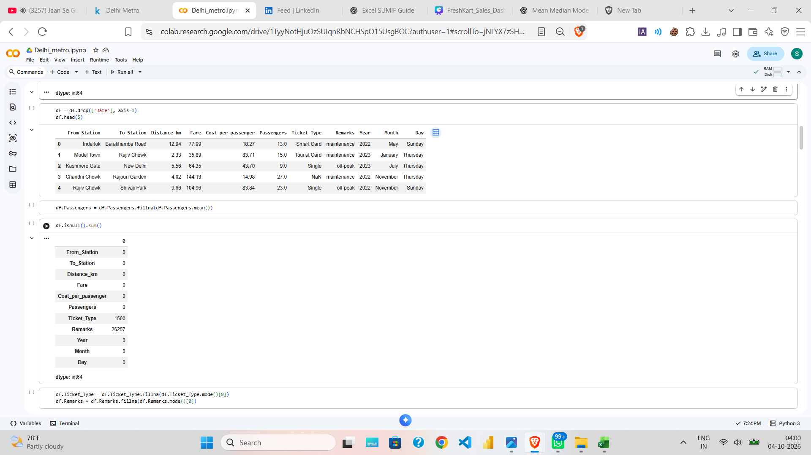
Ticket Type Distribution
Composition of ticket records
EDA INSIGHT
Tourist Card
60,693
Single
37,341
Smart Card
37,244
Return
14,722
Delhi Metro Analysis • Sameer Raj • Data Analyst Portfolio Project

Slide 6
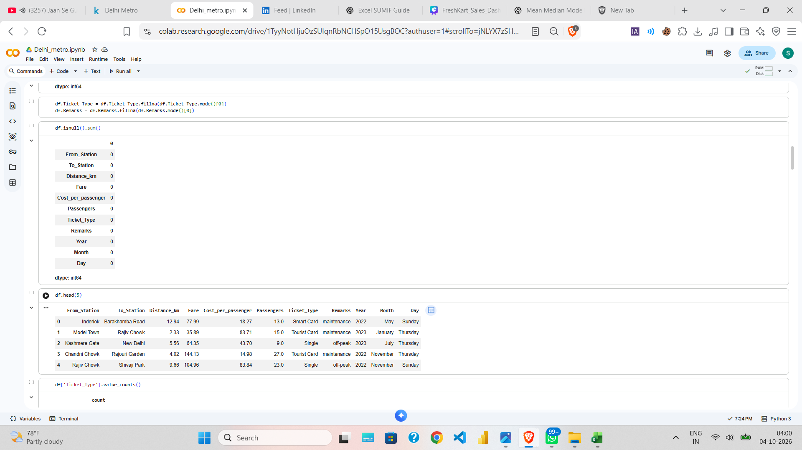
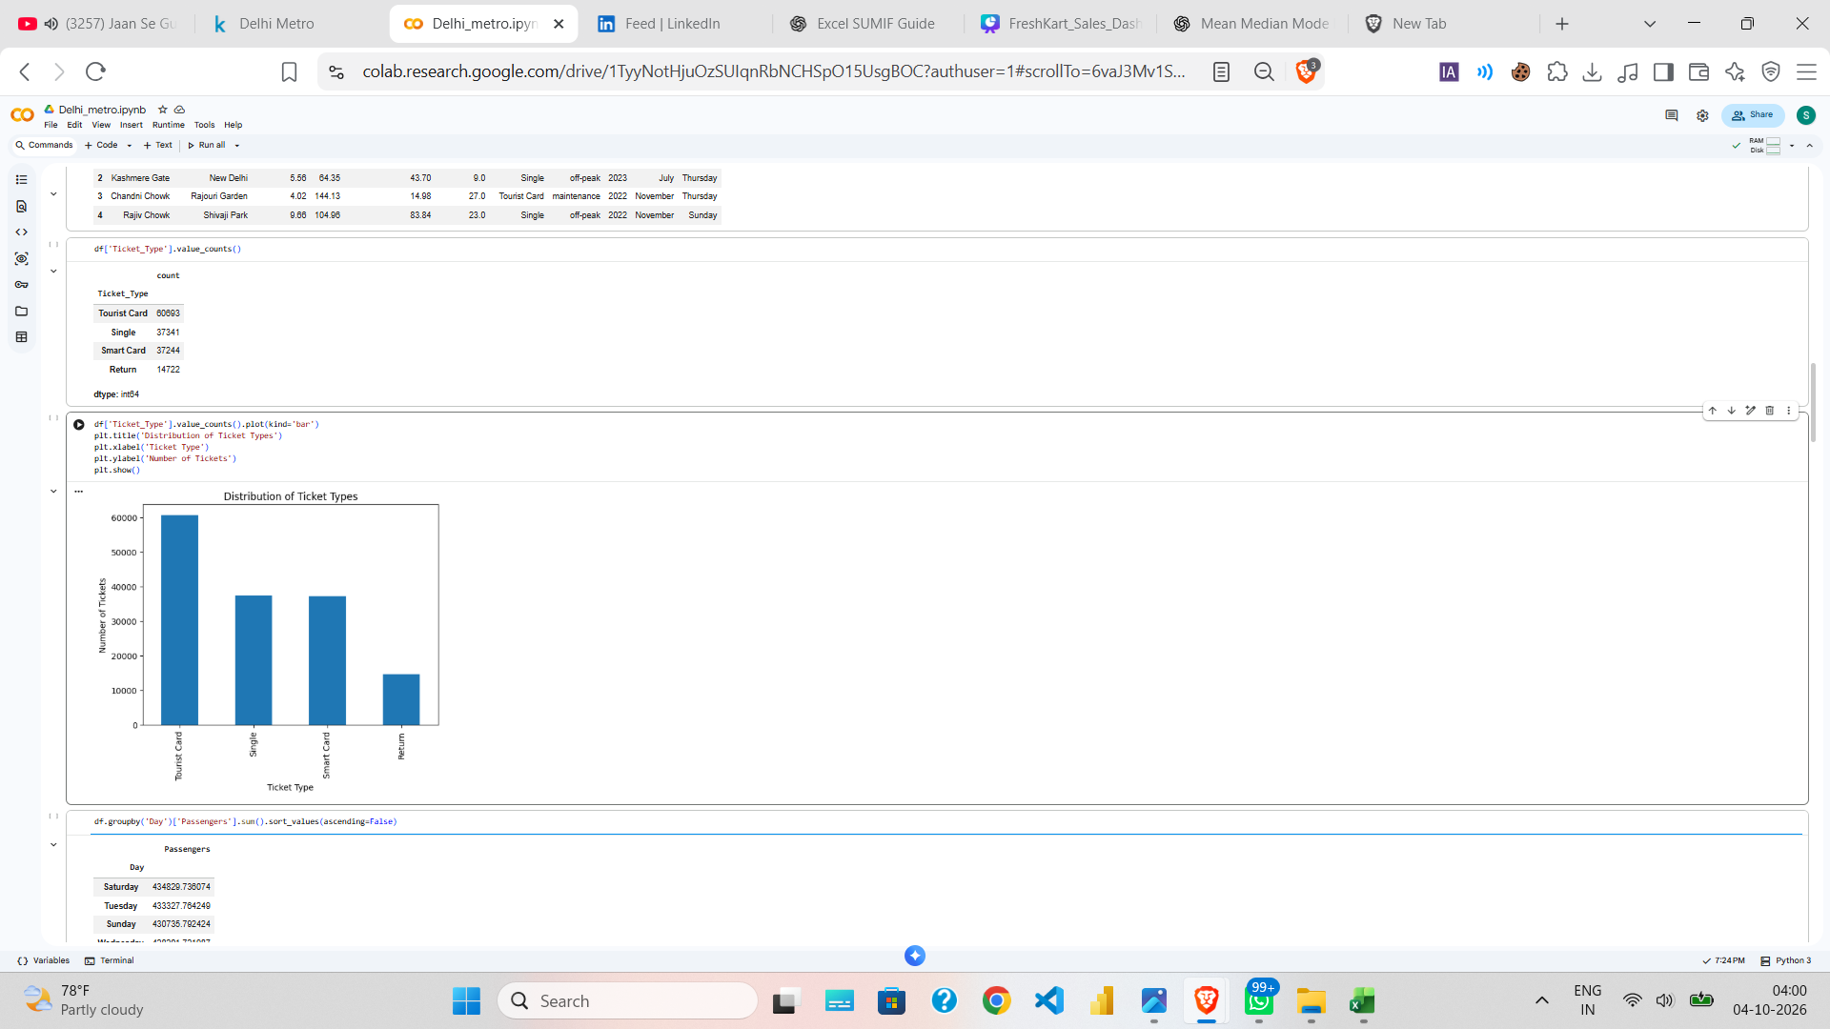
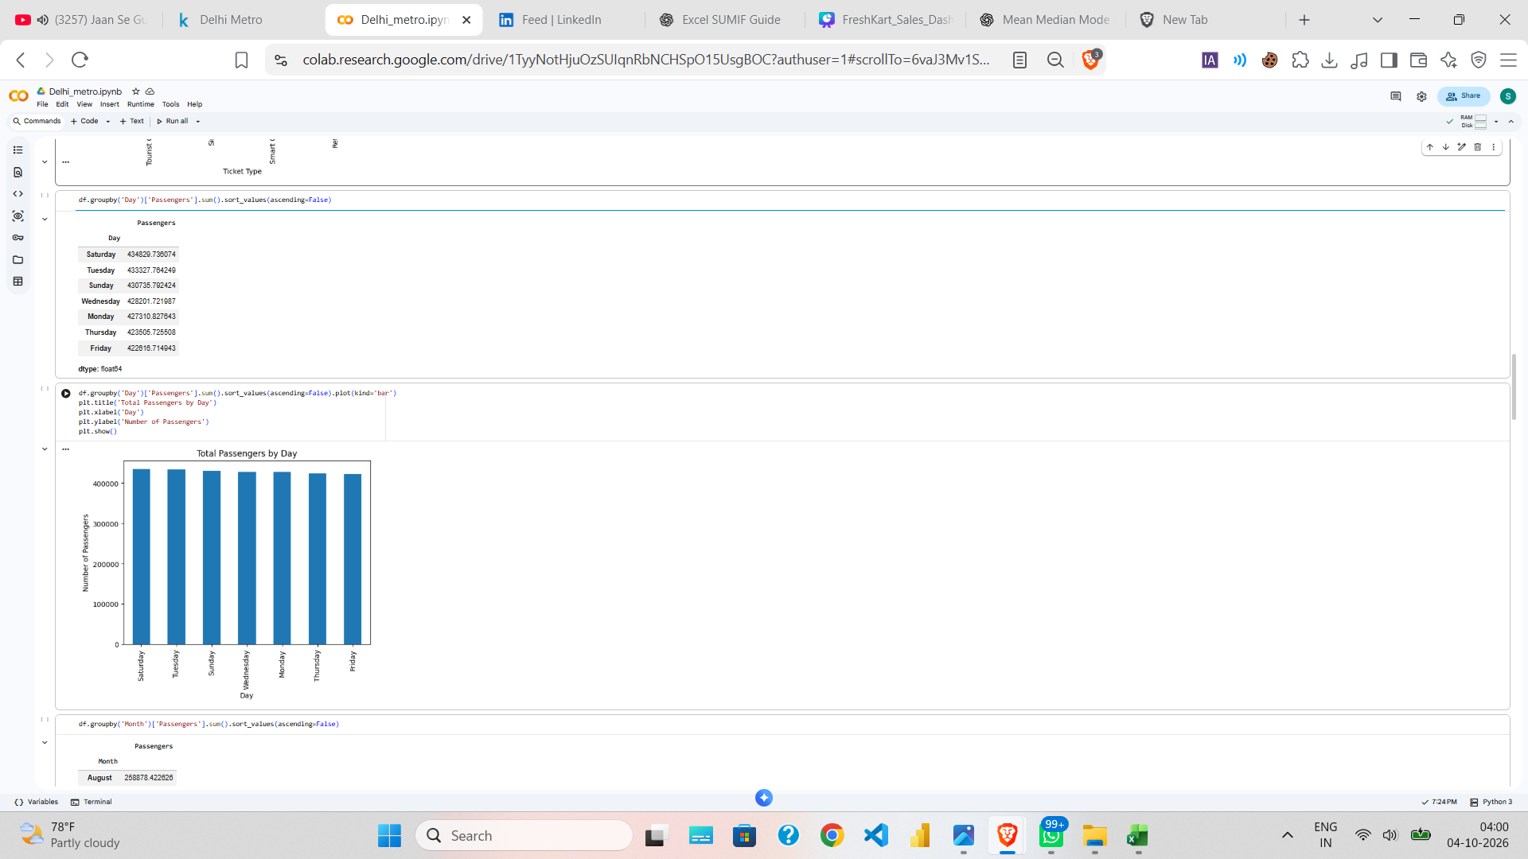
Passenger Trends by Day, Month & Year
Time-based aggregation from the cleaned dataset
TIME ANALYSIS
Delhi Metro Analysis • Sameer Raj • Data Analyst Portfolio Project

Slide 7
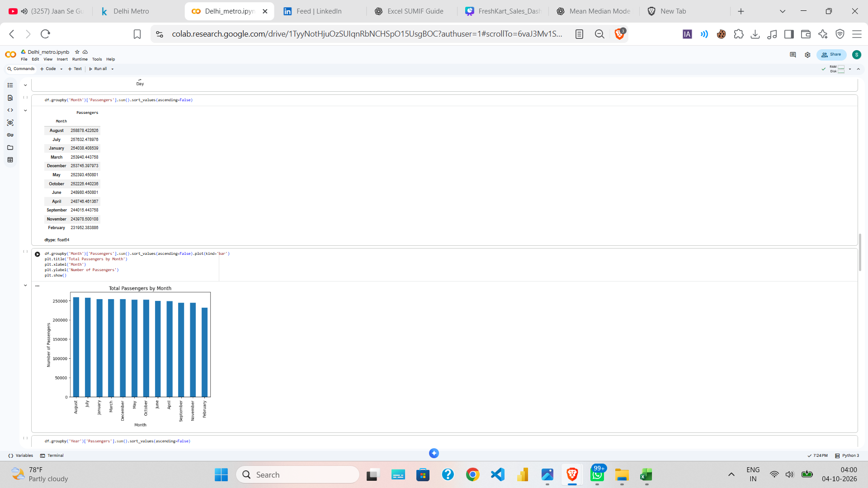
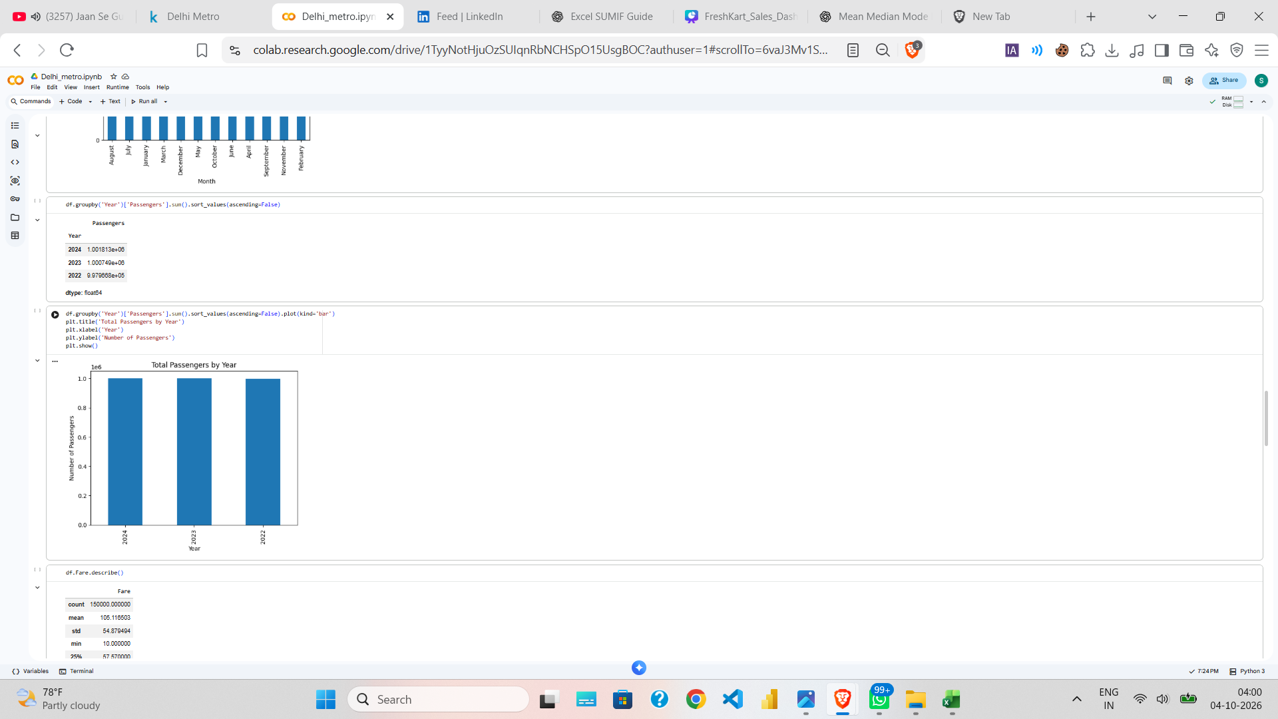
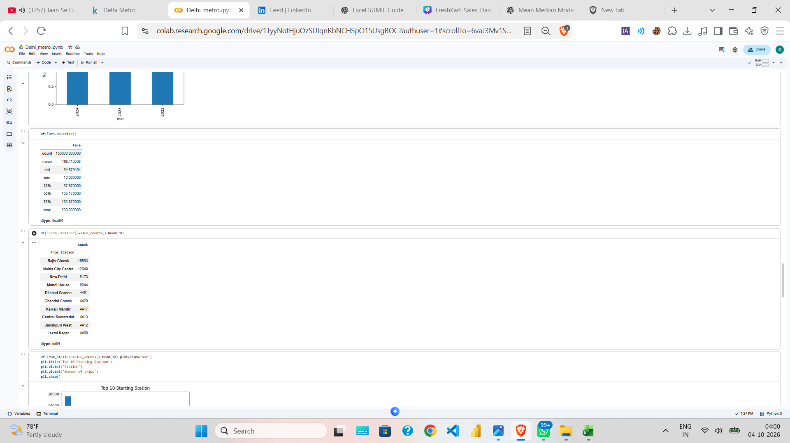
Station-Level Analysis
High-volume origin and destination stations
STATION ANALYSIS
Delhi Metro Analysis • Sameer Raj • Data Analyst Portfolio Project

Slide 8
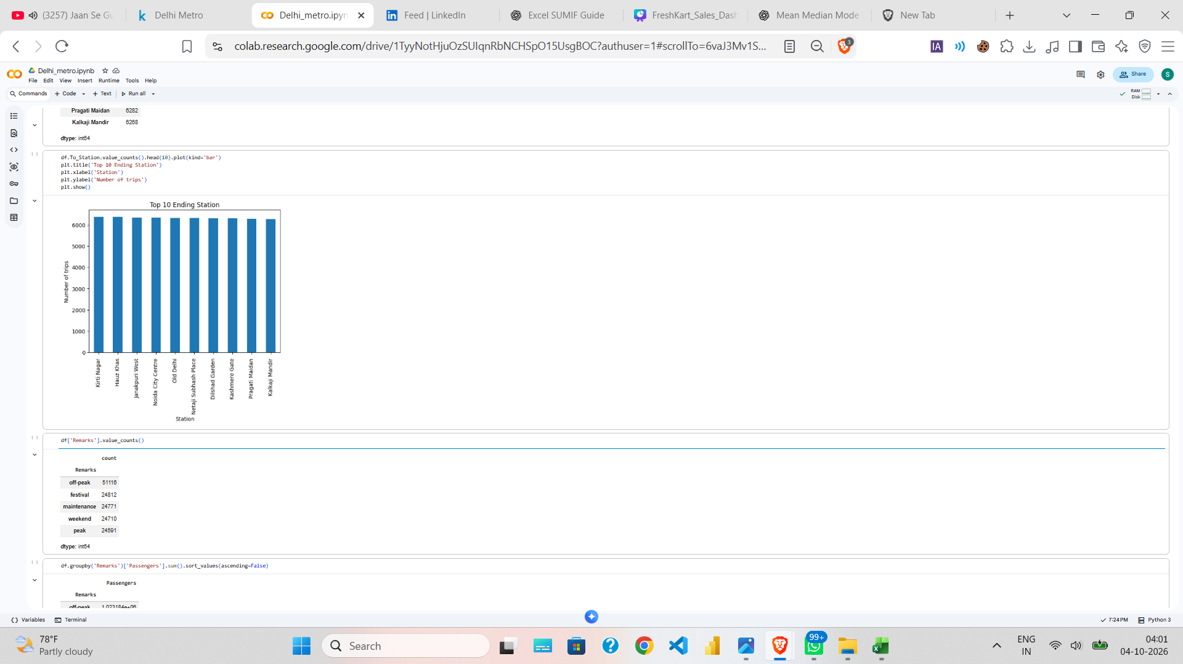
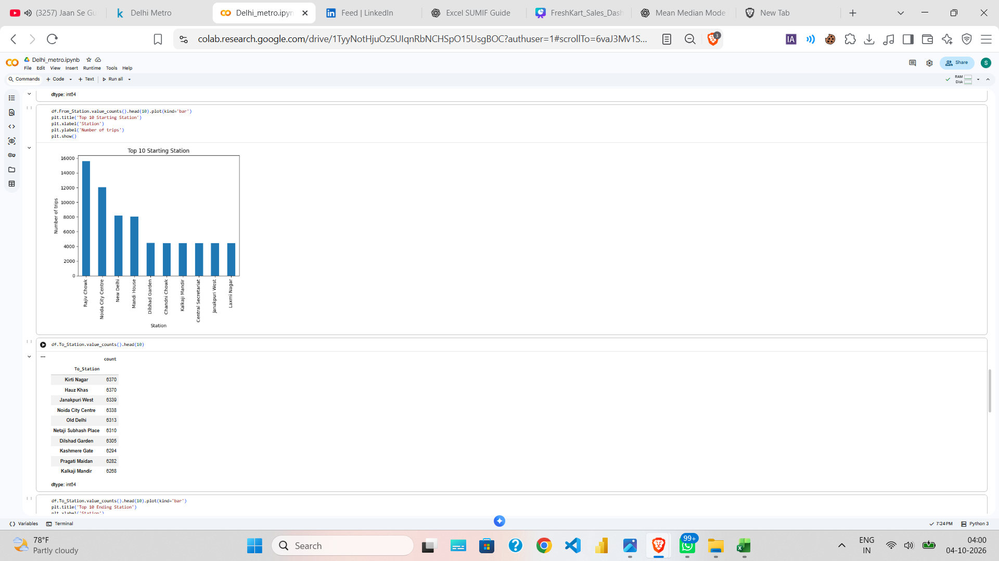
Operational Context: Remarks
Passenger volume segmented by operating condition
OPERATIONS
Delhi Metro Analysis • Sameer Raj • Data Analyst Portfolio Project

Slide 9
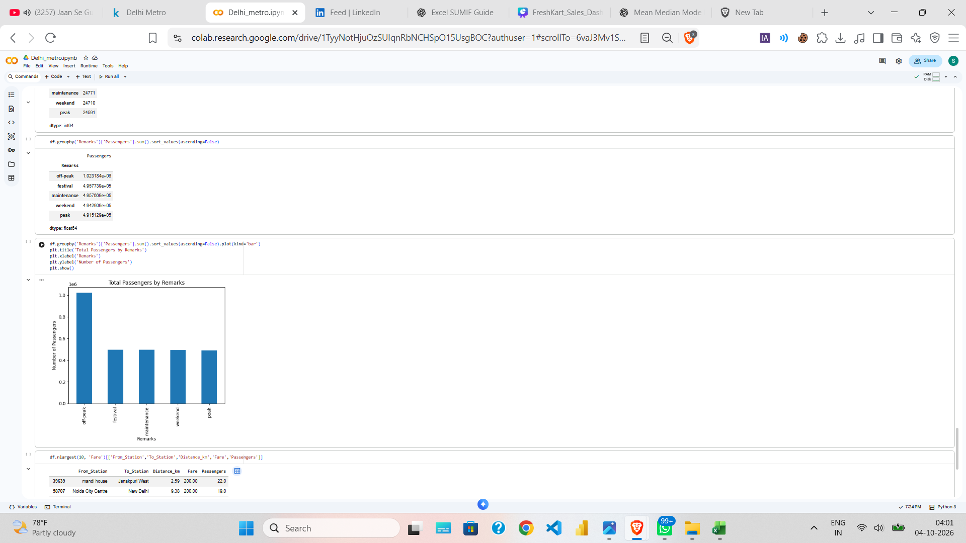
Fare & Trip-Level Data
Fields used for revenue and profit calculations
BUSINESS METRICS
• Fare is treated as a per-passenger fare.
• Cost_per_passenger is treated as a per-passenger operating cost.
• Revenue = Fare × Passengers.
• Profit = (Fare − Cost per Passenger) × Passengers.
Delhi Metro Analysis • Sameer Raj • Data Analyst Portfolio Project

Slide 10
Power BI Dashboard & KPI Layer
Business calculations moved into DAX for interactive reporting
POWER BI
Total Passengers
40,00,000+
Total Revenue
₹43,51,60,000+
Total Profit
₹19,04,60,000+
Total Trips
1,50,000
Avg Fare
₹105.12
Avg Distance
5.49 km
• Interactive slicers: Year, Month, Day, Ticket Type, From Station and To Station.
• Visuals: passenger trends, ticket-type distribution, top routes by passengers and revenue.
• DAX measures keep business logic dynamic under filter context.
Delhi Metro Analysis • Sameer Raj • Data Analyst Portfolio Project

Slide 11
Dashboard Design
Executive overview for portfolio presentation
DASHBOARD
DELHI METRO ANALYSIS DASHBOARD
FILTERS
Year
Month
Day
Ticket Type
From Station
To Station
Passengers
40L+
Revenue
₹43.5Cr+
Profit
₹19.0Cr+
Trips
1.5L
Passengers by Year
Passengers by Month
Ticket Type
Top 10 Routes by Passengers
Top 10 Routes by Revenue
Delhi Metro Analysis • Sameer Raj • Data Analyst Portfolio Project

Slide 12
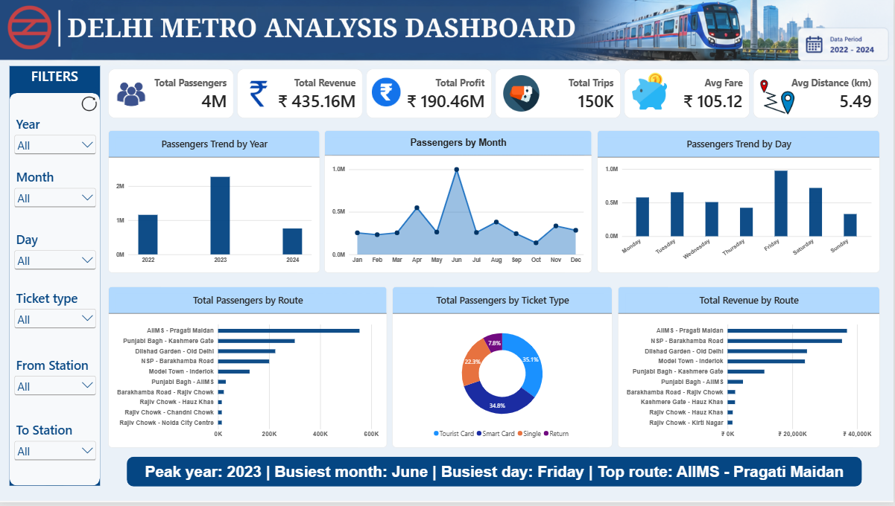
POWER BI DASHBOARD
Interactive dashboard developed using Power BI | Delhi Metro Analysis

Slide 13
Delhi Metro Network Map – Next Layer
Station coordinates can extend the dashboard into geospatial analysis
GEOSPATIAL
• Add Station, Latitude, Longitude and Metro Line as a station reference table.
• Plot stations using Latitude + Longitude in Power BI.
• Bubble size can represent passenger volume; tooltips can show passengers, revenue and station details.
• Keep this as a dedicated second page after the executive dashboard.
Station → Latitude → Longitude → Line → Passenger Volume
Delhi Metro Analysis • Sameer Raj • Data Analyst Portfolio Project

Slide 14
Key Insights & Business Questions
What the analysis enables a decision-maker to investigate
INSIGHTS
• Year, month and day aggregations support demand-pattern comparison.
• Ticket-type mix highlights Tourist Card as the largest ticket category in the cleaned dataset.
• Station analysis identifies high-volume origin and destination points for capacity planning.
• Remarks enable comparison across peak, off-peak, festival, weekend and maintenance conditions.
• Route-level passenger and revenue rankings provide a stronger business view than station counts alone.
Delhi Metro Analysis • Sameer Raj • Data Analyst Portfolio Project

Slide 15
CONCLUSION
• Built an end-to-end Delhi Metro analytics project from trip data to an interactive Power BI dashboard.
• Applied data cleaning, exploratory analysis, aggregation and business-focused DAX calculations.
• Converted 1,50,000 trip records into passenger, revenue, profit, route and ticket insights.
• Next enhancement: integrate station latitude/longitude for a geospatial network page.
Sameer Raj | Data Analyst Portfolio Project

