Slide 1


Regional Sales Analysis
Presented by Sameer Raj
1

Slide 2

Agenda
Problem Statement
Approach
Data Overview
Project Workflow
Exploratory Data Analysis
Key Insights
Recommendation
Dashboard Preview

Slide 3

Problem Statement

Slide 4
Problem Statement
Sales teams often lack a clear, data-driven understanding of regional performance, making it difficult to identify growth opportunities and optimize resources. This project aims to analyse and visualize regional sales data to uncover trends, evaluate profitability, and support strategic decision-making.
What’s the Business Question?
Inconsistent revenue and profit performance across U.S. regions
Lack of visibility into seasonal swings, top SKUs, and channel profitability
Goal: Leverage 5 years of historical data to pinpoint growth levers and optimize strategy

Slide 5
Approach

Slide 6

Approach – Two phase solution
Exploratory Data Analysis
Interactive Dashboard
1
2
Dive into historical sales, margins, products, channels, regions
Build a live view for business Users to self serve insights
Surface trend, outliers & relationships
Enable ad-hoc slicing by time, product, region, channel

Slide 7
Project Workflow

Slide 8
Project Workflow
Define Business Objective
Collect & Consolidate Data
De
De
1
1
1
Understand the core problem and expected business outcomes.
2
Gather multi-source sales data (Excel sheets) and understand schema.
De
Pre-processing & Cleaning
Data Loading & Initial Exploration
De
1
1
4
Handle nulls, join tables, format dates, and normalize columns.
3
Load into Colab for initial profiling and data understanding using Python.
De
Dashboarding & Recommendations
Exploratory Data Analysis (EDA)
De
1
1
5
Visualize trends, compare performance, and extract key insights.
6
Build Power BI dashboard and present strategic findings.

Slide 9
Exploratory Data Analysis

Slide 10
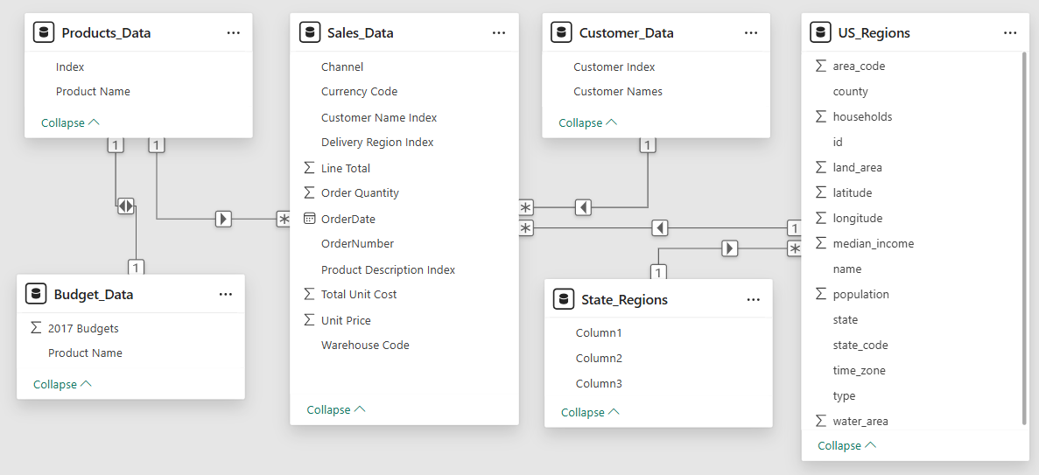
Raw Dataset Structure – Before Processing
Sales, products, budgets, customers, regions, and states were spread across unlinked tables. No relationships were defined initially— Pre-processing was required to clean, normalize, and join them for analysis.

Slide 11

Exploratory Data Analysis (EDA)
Uncovering patterns, trends, and business insights from historical data !
Understanding the “What, Where & Why” behind the sales numbers
Exploring data through visuals, aggregations, and comparisons
Laying the groundwork for informed recommendations

Slide 12
EDA: Step‑by‑Step Process
Import Libraries
Load Data
Initial Exploration
Pre-processing & Cleaning
Feature Engineering
EDA & Visualization
Key Insights
Recommendations

Slide 13
Pre-processing & Feature Engineering
The necessary steps applied to prepare this dataset for analysis.
Set header row for state – region table
Merge Sales, Customers, Products, Regions, State–Region & Budgets tables
Drop redundant columns
Standardize column names to lowercase
Select key columns that are used for that analysis
Rename columns to more sensible names
Create profit and profit_margin_pct columns
✅ Note: No missing values or duplicate rows were found in the dataset

Slide 14
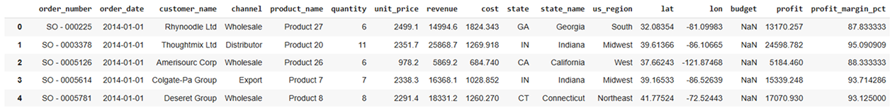
Final Dataset Structure – Ready for Analysis
Identifiers: order_number, order_date, customer_name, channel, product_name
Financials: quantity, unit_price, revenue, cost, profit, profit_margin_pct
Calendar: order_month_name, order_month_num, order_month
Geography: state (code), state_name, us_region, lat, lon
Planning: budget (2017)

Slide 15

Charts & Insights

Slide 16
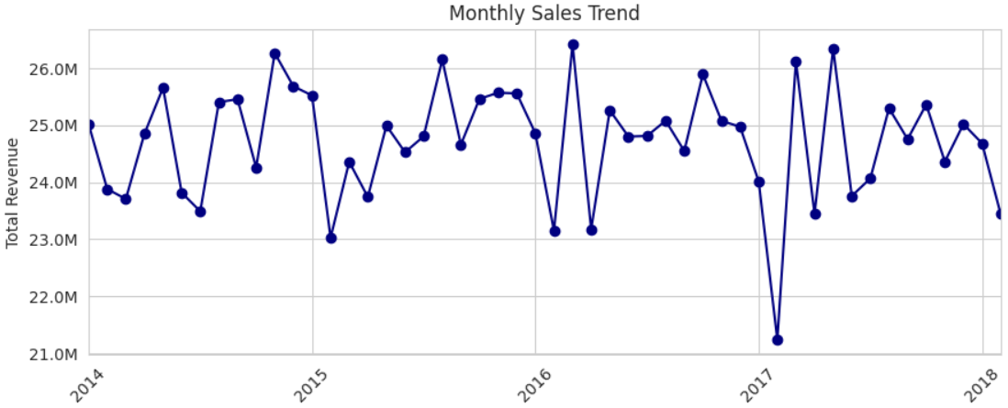

Monthly Sales Trend Over Time
Insights
Consistent sales cycle: $24M to $26M.
Seasonal peaks: Late spring/early summer (May-June).
Annual low: January.
Notable outlier: Sharp revenue drop in early 2017.

Slide 17
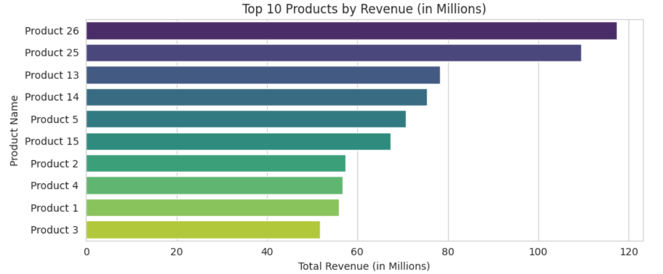
Top 10 Products by Revenue
Insights
Revenue leaders: Products 26 & 25 dominate.
Mid-range: Products 5, 13, 14, 15 show similar revenue.
Bottom cluster: Products 1, 2, 3, 4 have the lowest revenue.
Strategy: Grow mid-tier, improve lower performers.

Slide 18
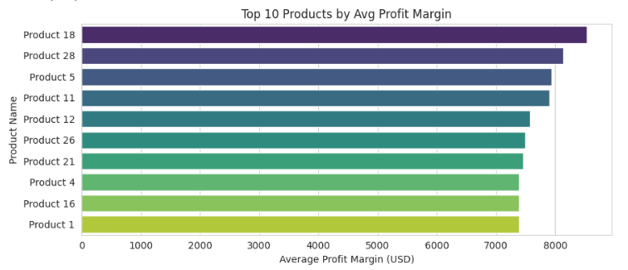
Top 10 Products by Average Profit Margin
Insights
Top: Products 18 & 28 lead at ~$8.1–8.4K.
Next tier: Products 5, 11, 12 & 26 at ~$7.5–7.8K.
Entry‑level: Products 1, 4, 16 & 21 around $7.3K.
Takeaway: Top 10 all exceed $7.3K—consistent high margins.

Slide 19
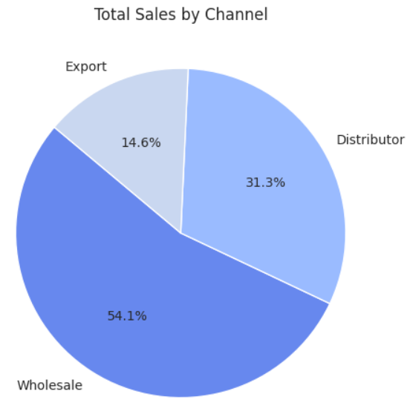
Sales by Channel
Insights
Wholesale dominates: Generates the majority of total sales at 54.1%.
Distributor is significant: Contributes a substantial 31.3% to total sales.
Export is a smaller portion: Accounts for 14.6% of the total sales.

Slide 20
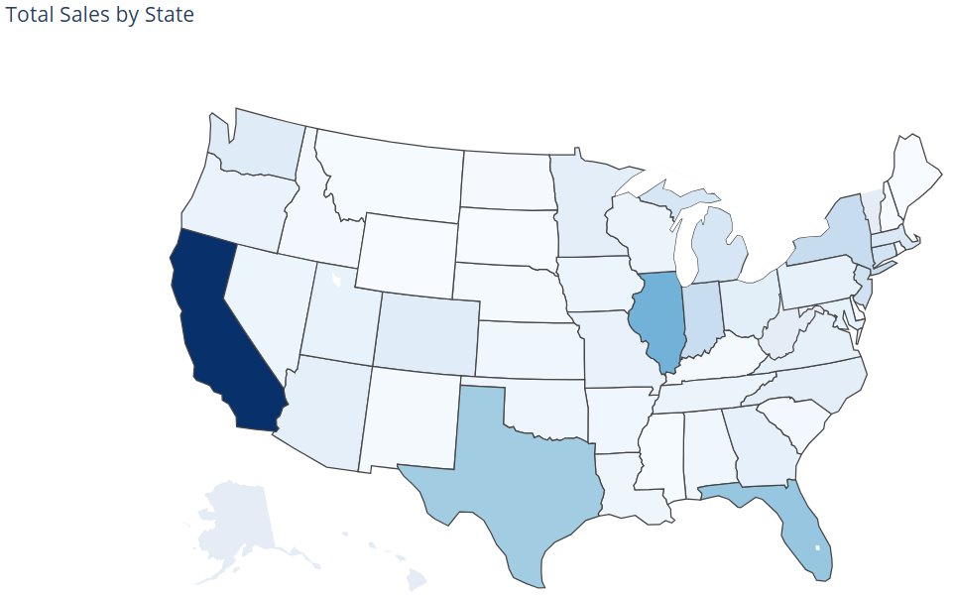
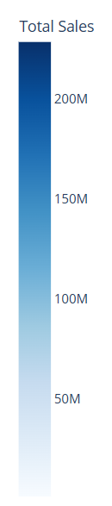
Total Sales by State (Choropleth Map)
Insights
California leads: Highest total sales.
Texas, Florida, Illinois: Significant sales.
Varying sales: Other states show moderate to low sales.
Visual pattern: Higher sales in larger and some coastal states.

Slide 21
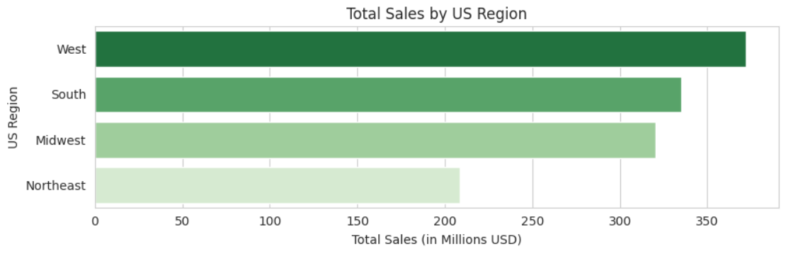
Total Sales by US Region
Insights
West: Highest sales, strong market influence.
South: Major sales contributor, key market area.
Midwest: Steady sales performance, moderate market size.
Northeast: Lowest sales, suggests need for deeper market understanding.

Slide 22
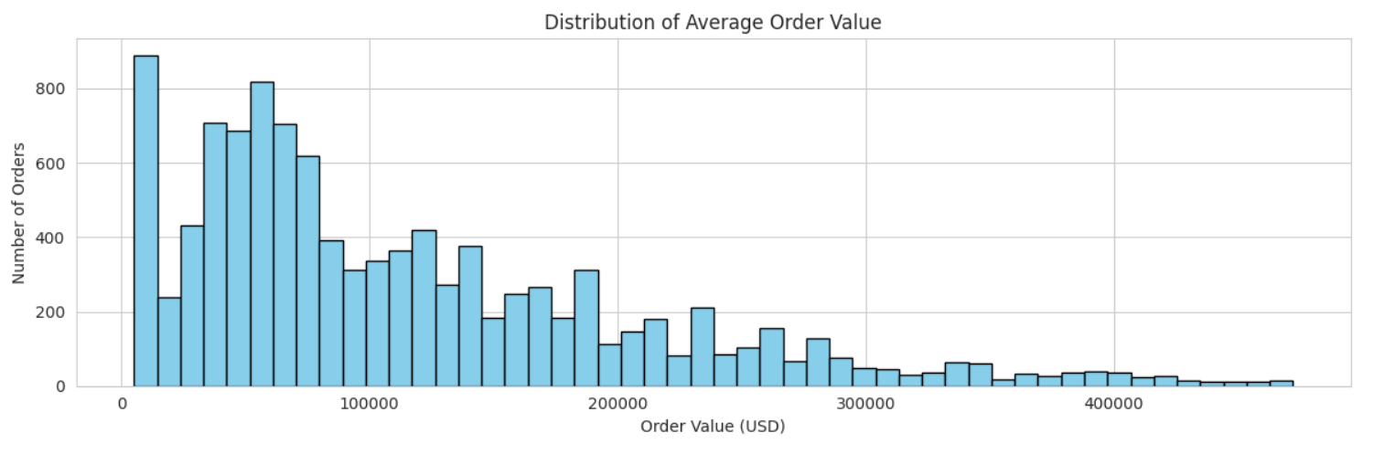
Average Order Value (AOV) Distribution
Insights
Low average order values are frequent.
Distribution is right-skewed (long tail of high-value orders).
Multiple order value clusters exist.
Higher order values are less common.

Slide 23
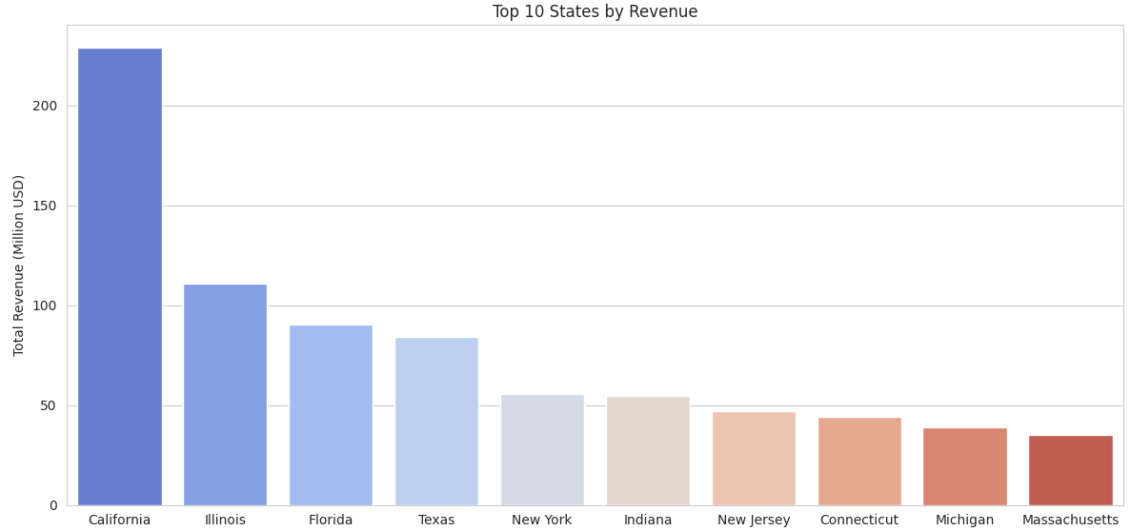
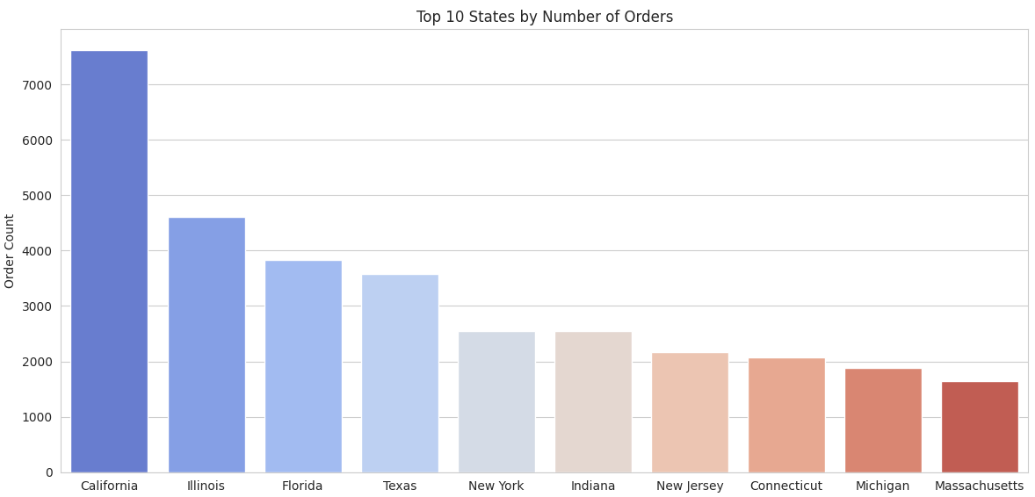
Top State Performance: Revenue vs. Orders
Insights
California tops revenue & orders.
IL, FL, TX: High in both.
Revenue & orders linked.
Other top states: Lower contribution.

Slide 24
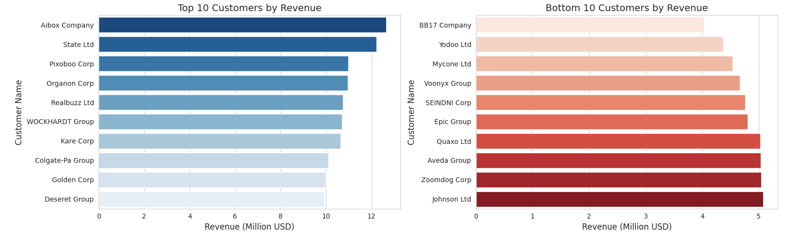
Top and Bottom 10 Customers by Revenue
Insights
Aibox Company leads significantly as the top revenue generator.
Bottom 10 customers generate substantially less revenue (around $4-5M).
Revenue concentration: Top customers drive a disproportionate share.
Large gap: Exists between the revenue of top and bottom tier customers.

Slide 25
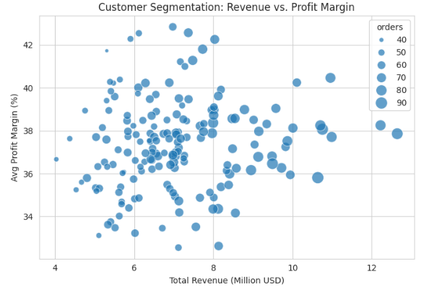
Customer Segmentation: Revenue vs. Profit Margin
Insights
Those Uniform 35–40 % margins confirm strong, consistent pricing and cost control.
>$10 M clients with <36 % margins reveal discounting hotspots—re evaluate large‑account terms.
$6–9 M clients with >40 % margins are high‑value candidates for targeted upsell.

Slide 26
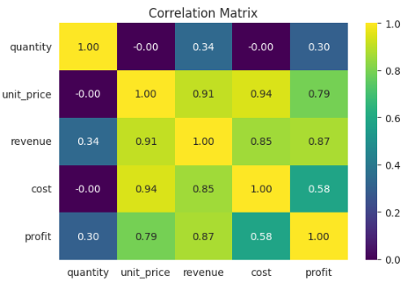
Correlation Heatmap of Numeric Features
Insights
Unit price is the primary driver, showing very strong correlations with cost (0.94), revenue (0.91) and profit (0.79).
Revenue & profit maintain a high link (0.87), underscoring direct profitability gains.
Quantity’s impact is minimal (≤ 0.34 vs. financials), indicating volume plays a secondary role.
Cost vs. profit correlation (0.58) is moderate, suggesting margin improvement focus should center on pricing.

Slide 27
Key Insights

Slide 28


Key Insights
Pronounced Seasonality: January revenues average $124 M, dipping to $95 M in April.
SKU Concentration: Products 26 & 25 together drive ~25 % of total sales.
Channel Trade‑Off: Wholesale captures 54 % of volume; Export leads with ~38 % average margin.
Geographic Dominance: California alone logs 7.6K orders ($230 M); the West region shows the largest swings.
Aibox Company and State Ltd are the most valuable customers in terms of Revenue.

Slide 29
Recommendations

Slide 30

Recommendations
Seasonal Promotions: Launch recovery campaigns in April and amplify January offers to smooth revenue swings.
SKU Optimization: Double down on top products 26 & 25 and re-evaluate pricing or phase out low‑margin SKUs.
Channel Expansion: Incentivize Export partnerships for high margins and introduce volume deals in Wholesale.
Regional Investment: Replicate California’s success in other regions and boost marketing in the Northeast & Midwest.
Margin Monitoring: Flag orders below 80 % margin and analyse cost drivers to uplift underperforming segments.

Slide 31
Dashboard Preview

Slide 32
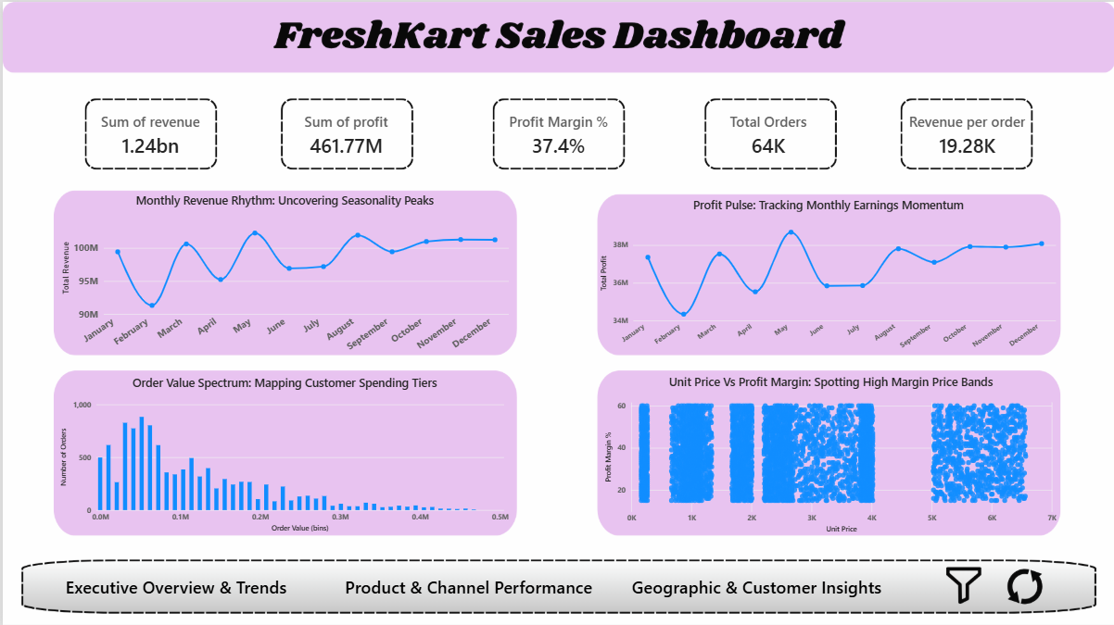
Page 1 - Performance Summary

Slide 33
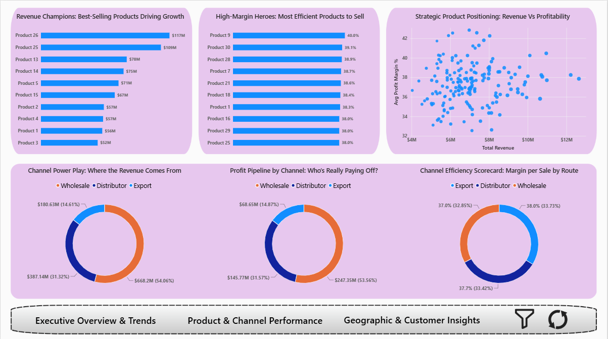
Page 2 - Customer Segmentation

Slide 34
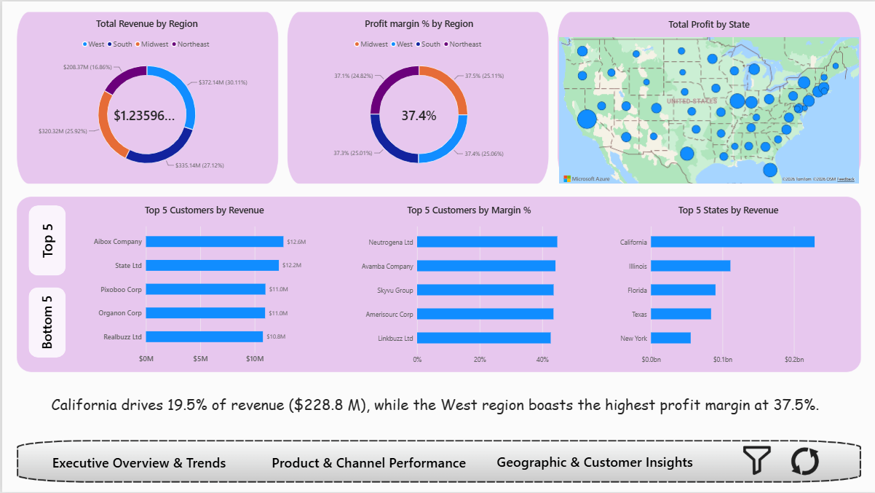
Page 3 - Revenue Scenarios

Slide 35
Conclusion

Slide 36

Conclusions
Completed end‑to‑end EDA and interactive Power BI dashboard, surfacing seasonality, SKU, channel & regional insights.
Insights inform sales policies and operational planning (store & warehouse prep aligned with annual trends).
Stakeholders can self‑serve real‑time analysis and confidently onboard new datasets for additional use cases.

Slide 37

Thank You

