Slide 1

ATTENDANCE MANAGEMENT SYSTEM
T. Sameer Reddy Semester-V
Supervised by: Dr. Kishorjit Nongmeikapam

Slide 2
ATTENDANCE MANAGEMENT SYSTEM
T. Sameer Reddy Semester-V
Supervised by: Dr. Kishorjit Nongmeikapam
1
2
3
4
5
Introduction and Motivation
Proposed System
System Design
Implementation
Results & Conclusion

Slide 3

October 21, 2024
Introduction and Motivation
Content Overview
1
2
3
4
5
Introduction and Motivation
Proposed System
System Design
Implementation
Results & Conclusion
ATTENDANCE MANAGEMENT SYSTEM
T. Sameer Reddy Semester-V
Supervised by: Dr. Kishorjit Nongmeikapam

Slide 4






Content Overview
October 21, 2024
Introduction and Motivation
Proposed System
Problem: Traditional attendance methods(e.g., paper registers) are time-consuming, prone to errors, and difficult to analyze.
Solution: An automated attendance management system streamlines the process, improves accuracy, and provides valuable data for tracking student attendance.
Motivation:
Features:
Technology: C programming language with file handling for data storage
Individual faculty logins with password protection
Course code verification to ensure accurate record-keeping
Real-time attendance marking with “present’ or ‘absent’ options
Automatic calculation of present/absent student counts
Saving attendance records with timestamps in separate files for each sessions
Search functionality to retrieve past attendance records
Deletion of records(with conformation to prevent accidental removal)
The old traditional paper registers are time-consuming and less efficient in the process of attendance recording.
This provide accurate data and reduce the manual effort that should be put in, thus making easy analysis possible.

Slide 5

Introduction and Motivation
October 21, 2024
Proposed System
System Design
Features:
Technology: C programming language with file handling for data storage
Individual faculty logins with password protection
Course code verification to ensure accurate record-keeping
Real-time attendance marking with “present’ or ‘absent’ options
Automatic calculation of present/absent student counts
Saving attendance records with timestamps in separate files for each sessions
Search functionality to retrieve past attendance records
Deletion of records(with conformation to prevent accidental removal)
Problem: Traditional attendance methods(e.g., paper registers) are time-consuming, prone to errors, and difficult to analyze.
Solution: An automated attendance management system streamlines the process, improves accuracy, and provides valuable data for tracking student attendance.
Motivation:
The old traditional paper registers are time-consuming and less efficient in the process of attendance recording.
They provide accurate data and reduce the manual effort that should be put in, thus making easy analysis possible.

Slide 6
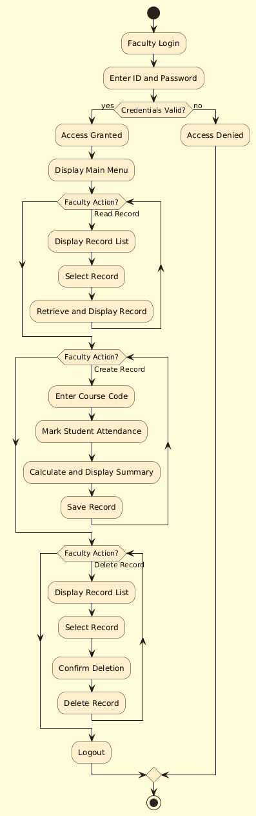
Proposed System
October 21, 2024
System Design
Implementation
Language: C programming language.
Libraries: stdio.h, string.h, time.h, conio.h, dirent.h
Key Functions:
strcmp() for string comparison (ID and password verification, Subjectcode checks).
time() and localtime() for date and time stamping.
strftime() for formatting date and time.
mkdir() for creating directories.
fopen(), fgetc(), fprint(), fclose() for file operations.
opendir(), readdir(), closedir() for directory operations.
remove() for deleting files.
Flow Chart
Features:
Technology: C programming language with file handling for data storage
Individual faculty logins with password protection
Course code verification to ensure accurate record-keeping
Real-time attendance marking with “present’ or ‘absent’ options
Automatic calculation of present/absent student counts
Saving attendance records with timestamps in separate files for each sessions
Search functionality to retrieve past attendance records
Deletion of records(with conformation to prevent accidental removal)

Slide 7
System Design
October 21, 2024
Implementation
Results and Conclusion
Language: C programming language.
Libraries: stdio.h, string.h, time.h, conio.h, dirent.h
Key Functions:
Outcome: The system successfully automates attendance recording, saving faculty time and effort.
Benefits:
Future Enhancements:
Improved accuracy of attendance data.
Efficient record-keeping and retrieval.
Enhanced security with password protection.
Generation of attendance reports and statics.
Integration with student systems.
Potentially explore web-based accessibility for remote attendance marking.
strcmp() for string comparison (ID and password verification, Subjectcode checks).
time() and localtime() for date and time stamping.
strftime() for formatting date and time.
mkdir() for creating directories.
fopen(), fgetc(), fprint(), fclose() for file operations.
opendir(), readdir(), closedir() for directory operations.
remove() for deleting files.

Slide 8

Implementation
October 21, 2024
Results and Conclusion
Outcome: The system successfully automates attendance recording, saving faculty time and effort.
Benefits:
Future Enhancements:
Improved accuracy of attendance data.
Efficient record-keeping and retrieval.
Enhanced security with password protection.
Generation of attendance reports and statics.
Integration with student systems.
Potentially explore web-based accessibility for remote attendance marking.
THANK YOU
Language: C programming language.
Libraries: stdio.h, string.h, time.h, conio.h, dirent.h
Key Functions:
strcmp() for string comparison (ID and password verification, Subjectcode checks).
time() and localtime() for date and time stamping.
strftime() for formatting date and time.
mkdir() for creating directories.
fopen(), fgetc(), fprint(), fclose() for file operations.
opendir(), readdir(), closedir() for directory operations.
remove() for deleting files.

Slide 9
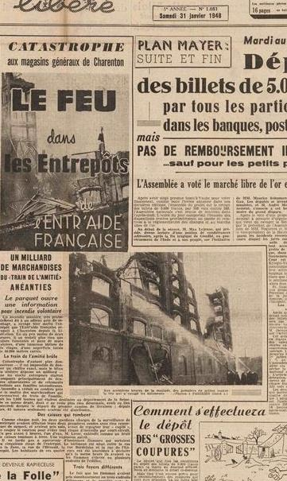




This year the Melinndrosa or flapper fashion style appears. This style is characterized by the use of thick makeup and glamorous make-up. This style replaces the Victorian style that had appeared before.
Developments in World Fashion Trends The era of World War II and the Cold War, led to the influence of world fashion styles. The material for making woolen cloth was used to finance the war, so that synthetic products appeared, such as stockings and underwear made of nylon. Clothing with a round and wide collar with a shirt Outer is becoming popular.
Add Your Title
You can add subtitle here
You can add subtitle here
THANK YOU

