Slide 1

Program Structures Algorithms
Final Project Spring 2024 Presenter: Sameer S Deshpande NUID: 002685440

Slide 2

Analyzing Internet networks communication among computers
The objective of this project is to model and analyze an internet network where nodes represent computers and the communication between them represents the edges. This implementation helps us in studying communication patterns and communication routes.

Slide 3

Collection of dataset
The dataset for this project has been collected from SNAP(Stanford Large Network Data collection) site.

Slide 4
Analysis
Vertex/nodes: Computers are represented as nodes.
Edges: Communications are represented as edges.
The choosing of algorithm was based on the consideration of time complexity and the scenario of the problem statement.

Slide 5
Why Minimum Spanning Tree
MST was chosen for analyzing network connectivity and identifying key nodes in the network that play a crucial role in maintaining connectivity.
By identifying the MST of a network, you can determine the minimum set of edges that connect all nodes without forming cycles. This information can be used to establish efficient routing strategies in a network.
The time complexity of finding an MST using algorithms like Prim's or Kruskal's is O(E log V), which is efficient for large networks.

Slide 6
Why Dijkstra?
Optimization for Shortest Paths: Dijkstra's algorithm was chosen because it efficiently finds the shortest path from a single source node to all other nodes in a weighted graph. This is crucial for optimizing data transfer routes in a network, ensuring that data packets reach their destination using the most efficient path.
Time Complexity: Dijkstra's algorithm has a time complexity of O(V^2) for an adjacency matrix representation and O(E + V log V) for an adjacency list representation, where V is the number of vertices and E is the number of edges. This time complexity is favorable for large networks compared to Bellman-Ford's O(VE) complexity.
Space Complexity: Dijkstra's algorithm requires storing the distances from the source node to all other nodes, which results in a space complexity of O(V). This is more efficient than Floyd-Warshall's O(V^2) space complexity, especially for large networks.

Slide 7
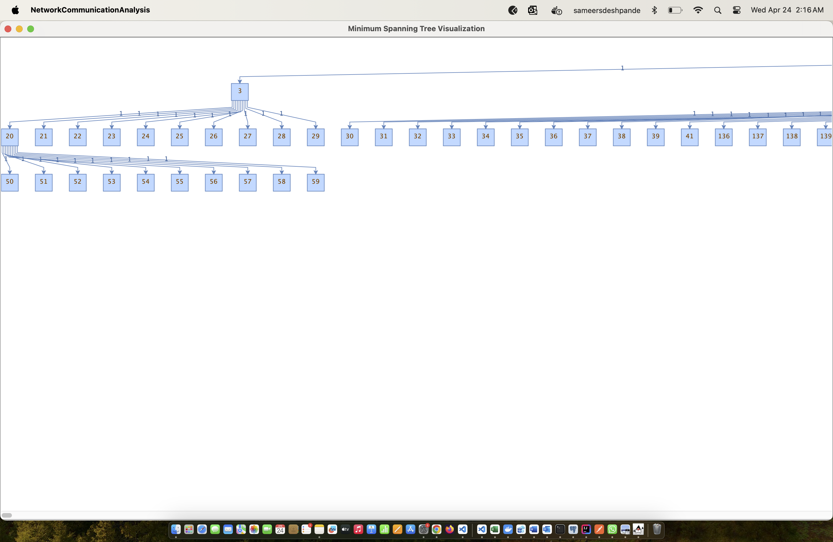
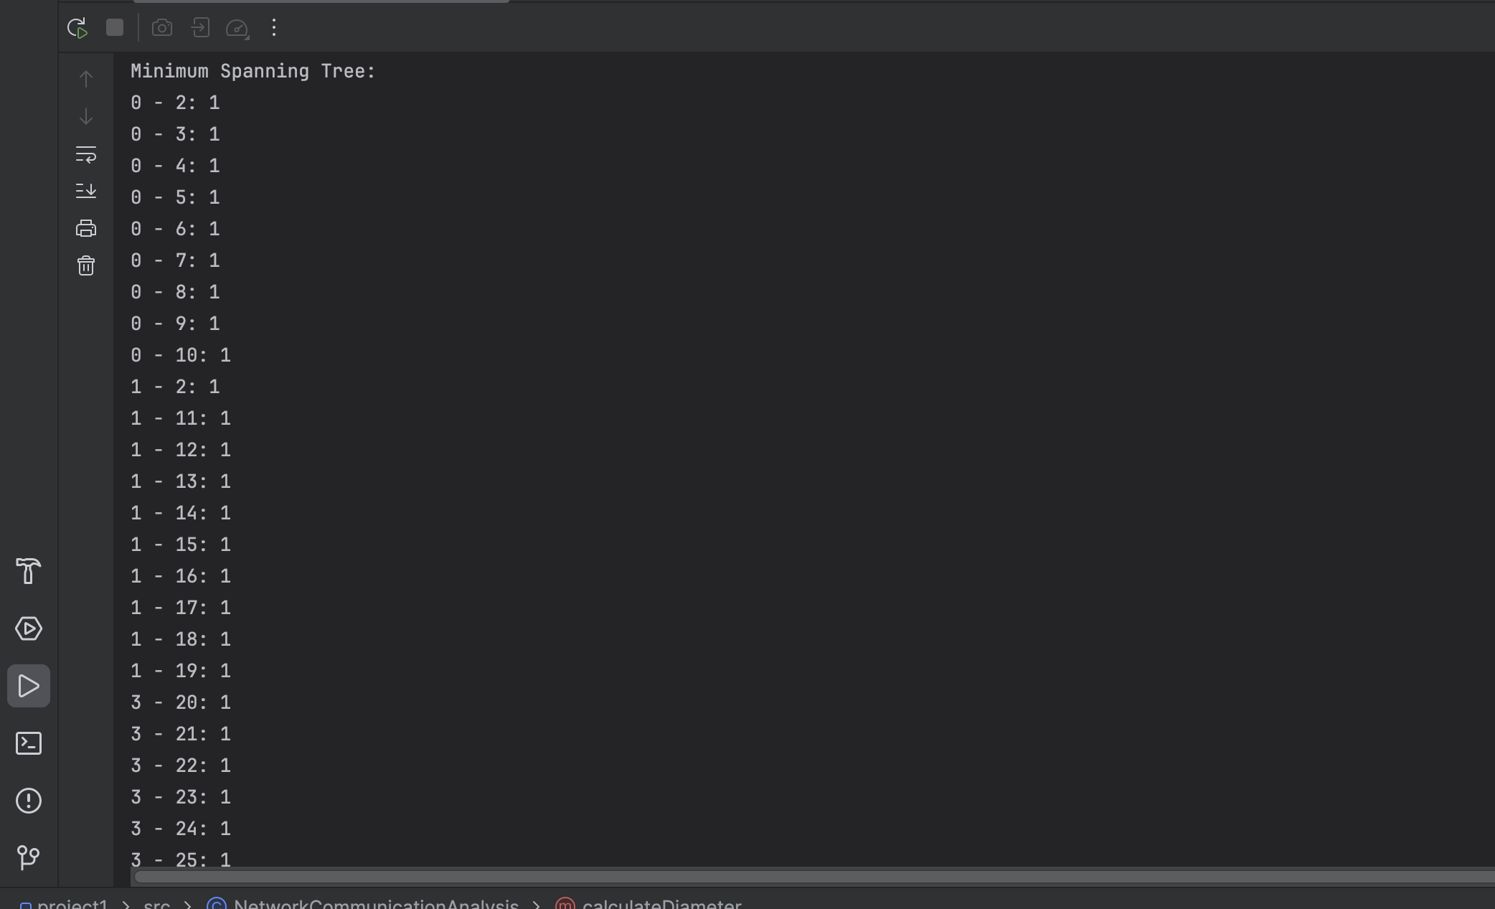
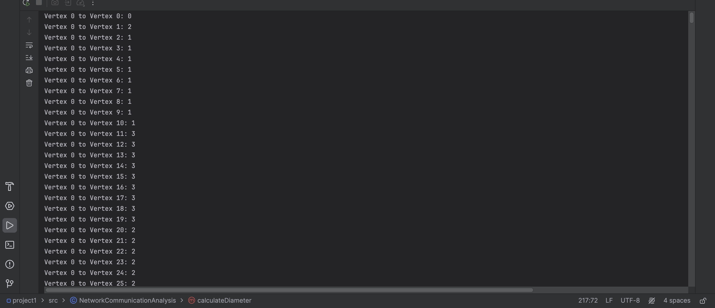
Results

Slide 8
Thank You

