Slide 1
ROBOTICS PITCH · 2026
JengaBot
The arm that BUILDS the tower —
so humans can finally just play.
Sameer · Volk · Bruce · Jonathan
A returning team. A new obsession.

Slide 2



01 · THE PROBLEM
Setting up Jenga is the worst part of Jenga.
It's tedious
It's fragile
Nobody's volunteering
54 blocks. 18 layers. Three at a time. Rotated 90° each row. Every single time.
One wobble and you're back to square one — before anyone has even taken a turn.
It's the chore that gates the fun. The host always gets stuck with the build.
JengaBot · Build. Don't Play.
2 / 9

Slide 3


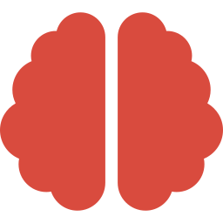

02 · OUR TRACK
An arm that builds the Jenga tower.
Note: not play it. Build it. We solve the boring half so humans get the fun half.
Sees the blocks
Vision-driven pose estimation of every loose block on the table.
Plans the stack
Layer-by-layer placement plan with alternating 90° rotation.
Places with care
INPUT
Compliant grasp + slow descent — no collapsing mid-build.
54 loose blocks
JengaBot · Build. Don't Play.
3 / 9

Slide 4



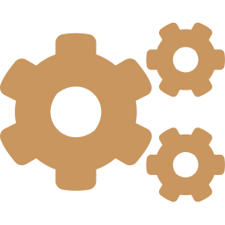
03 · TRACK RECORD
We don't just dream. We win.
Three past hackathon wins, three different robotics platforms. We've shipped real systems before — under pressure, on a deadline.
Carmello's Canine
Unitree Go2
reBot · Seeed Studio
Quadruped behavior
Quadruped platform
Robotic arm platform
Won with a dog-inspired robotic companion — gait, interaction, and personality.
Took home a win driving the Go2 — perception, locomotion, and crowd-pleasing tricks.
Won on Seeed's reBot — arm control, task planning, and a clean live demo.
JengaBot · Build. Don't Play.
4 / 9

Slide 5




04 · THE TEAM
The full crew. All four seats filled.
Sameer
Volk
Bruce
Jonathan
Team Lead
Returning Member
Returning Member
New Member
Pitch, planning, and pulling the whole thing across the finish line.
Veteran of past wins. Bringing the muscle memory and the calm.
Won with us before. Knows the platforms, knows the rhythm.
Our newest signing — fresh energy to round out the squad.
JengaBot · Build. Don't Play.
5 / 9

Slide 6
05 · APPROACH
Three loops, one tower.
01
02
03
Perception
Planning
Manipulation
Detect every loose block on the table — pose, orientation, occlusion-aware.
Compute layer-by-layer placement: 3 blocks, alternating 90° rotation, 18 layers.
Pick → align → place. Gentle descent. Detect mis-stacks and self-correct.
JengaBot · Build. Don't Play.
6 / 9

Slide 7

06 · MILESTONES
From first pick to full tower.
Hour 1
Day 1 PM
Day 2 AM
Demo
Pick one block
Stack a layer
Five layers
Full 18-layer tower
Vision + grasp on a single piece.
3 blocks, aligned, on a known base.
Alternating rotation, repeatable.
From scratch, on the clock.
Real hardware. Real blocks. Two days, four checkpoints — so the demo doesn't depend on demo-day luck.
JengaBot · Build. Don't Play.
7 / 9

Slide 8



07 · STRETCH
If the tower goes up early, we keep going.
Speed run
Messy starts
Stopwatch on the build. Iterate until we're faster than a human.
Blocks dumped anywhere — no neat trays. Pure vision-driven sort + stack.
Reset & re-stack
Crowd mode
When the game ends, the arm clears the table and rebuilds. Game-loop, hands-free.
Audience picks where blocks land. Arm adapts the plan live.
JengaBot · Build. Don't Play.
8 / 9

Slide 9
08 · WHY US
Three wins.
Three platforms.
One obsession.
Setting up Jenga is frustrating. So we're building the arm that does it — and we're the team to ship it.
Let's build.
Sameer · Volk · Bruce · Jonathan

