Slide 1



Javeline: Quality Management & Test Planning
Notes:
1
1

Slide 2
Javeline Middleware Platform: Testing Phases
Automation
Functional Testing
Non Functional Testing
Service Component Level Testing
Governance
Testing
1
1
Service Level
Testing
Performance
Testing
2
2
Service Integration Testing
Security
Testing
4
3 3
Service Regression Testing
Deployment
Testing
5
4
Workflow
Testing
6
System
Testing
7

Slide 3
Javeline Testing Approach
Service Component Level Testing
Review of Code
Unit Testing of Smallest piece of Code
Coverage Testing at
Statement
Condition
Branch
Path Level
Process/Workflow Testing
ensures services are operating collectively as specified
Test as E2E business work flow
Business Rules Validation
Error handling & Logging
Governance Testing
QoS policies on performance , Security, Transactions.
Regulatory policies
Business policies
Infrastructure policies
SOA guidelines & Standards
Service Level Testing
Service Discovery
Configuration
Schema Validation(WSDL/XML)
Javeline
Platform
Testing
Performance Testing
Load /Stress
Response Time &Throughput
Concurrency
Resource consumption and
Volumetric
Service Integration Testing
Testing of Interface s Signatures
Information Sharing between Services
Test the services across the Platform & Systems
System Testing
ensures services are operating collectively as specified
Test as E2E business work flow
Business Rules Validation
Error handling & Logging
Security Testing
Confidentiality
SQL Injections
Buffer Over Flow
Bad Parameter
Leak testing
Access Control
Security Boundary
Regression Testing
Change or Upgrade in Baseline Code
Upgrade of Service Contract (WSDL) or SLAs
Change in deployment configurations
Change in Backend system or Data source
Deployment Testing
On Demand/Hosted
Muti Tenancy
Security
Non Functional (Others)
Resource Monitoring

Slide 4
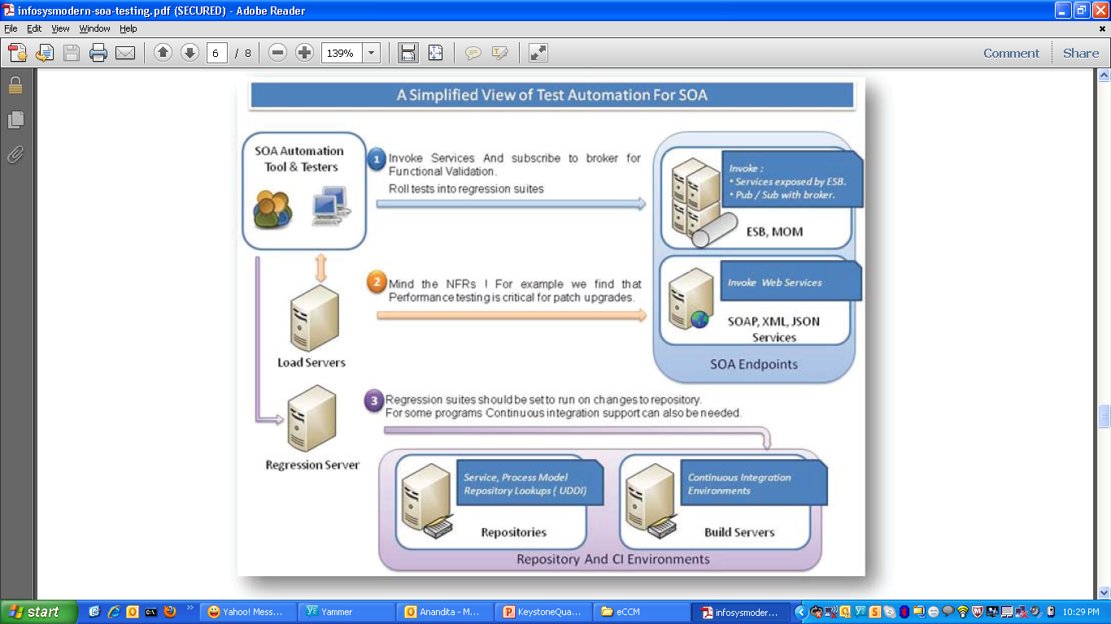
Javeline: Automation Strategy

Slide 5
Testing Process Workflow:
Requirements & Feature Planning
Epic
Feature
CI &
Unit Testing
Tools
JIRA
QTEST
Junit
Test Planning &
Management
Legends
Test Scenario
Test Cases*
Automation
Link
Automation Tools
JIRA
POSTMAN
SOAPUI
Jmeter
Selenium
Child
Backward Trace
Test Execution
Test Plan
Test Execution Scenario
Test Execution
Defect
Tools
JIRA

Slide 6
RACI MATRIX
S.No | Activity | Responsible | Accountable | Informed | Consulted
1 | Service Component Level Testing | Dev Team | Dev Lead | Dev team, QA team, Ops Lead , Mngm Team | Dev Lead
2 | Service Level Testing | QA Team | QA Lead | Dev team, QA team, Ops Lead , Mngm Team | QA Lead
3 | Service Integration Testing | QA Team | QA Lead | Dev team, QA team, Ops Lead , Mngm Team | QA Lead
4 | Regression Testing | QA Team | QA Lead | Dev team, QA team, Ops Lead , Mngm Team | QA Lead
5 | Process/Workflow Testing | QA Team | QA Lead | Dev team, QA team, Ops Lead , Mngm Team | QA Lead
6 | System Testing | QA Team | QA Lead | Dev team, QA team, Ops Lead , Mngm Team | QA Lead
7 | Deployment Testing | OPS Team | OPS Lead | Dev team, QA team, Ops Lead , Mngm Team | OPS Lead
8 | Governance Testing | QA Team | QA Lead | Dev team, QA team, Ops Lead , Mngm Team | QA Lead
9 | Security Testing | QA Team | QA Lead | Dev team, QA team, Ops Lead , Mngm Team | QA Lead
10 | Performanc Testing | QA Team | QA Lead | Dev team, QA team, Ops Lead , Mngm Team | QA Lead
11 | Non Functional (Others) | QA Team | QA Lead | Dev team, QA team, Ops Lead , Mngm Team | QA Lead

