Slide 1

Bluestock Mutual Fund Analytics Platform
End-to-End Data Engineering, Analytics and Business Intelligence Solution
Prepared by: DUDEKULA SAMEER Email: dsameer0530@gmail.com
Contact no: +919666365014

Slide 2
PROBLEM STATEMENT
Mutual fund investors face challenges in analyzing large volumes of financial data, evaluating risk-adjusted performance, tracking SIP trends, and identifying suitable investment opportunities.
A centralized analytics platform is required to transform raw mutual fund data into actionable business insights.

Slide 3
PROJECT OVERVIEWS
Build
Build a complete ETL pipeline
Clean and validate
Clean and validate mutual fund datasets
Perform
Perform EDA and performance analysis
Calculate
Calculate risk metrics
Analyze
Analyze investor behavior
Create
Create interactive dashboards
Generate
Generate actionable insights

Slide 4
DATA SOURCES
01_fund_master
02_nav_history
03_aum_by_fund_house
04_monthly_sip_inflows
05_category_inflows
06_industry_folio_count
07_scheme_performance
08_investor_transactions
09_portfolio_holdings
10_benchmark_indices

Slide 5
PROJECT ARCHITECTURE
Raw Data
↓
Data Cleaning
↓
Processed Data
↓
SQLite Database
↓
Analytics Engine
↓
Power BI Dashboard
↓
Business Insights

Slide 6
EDA HIGHLIGHTS
• State-wise investment analysis
• Investor demographic analysis
• SIP trend analysis
• Category inflow analysis
• Transaction behavior analysis

Slide 7
Investor Analytics Findings
4,803 investors identified in 2024 cohort
Strong participation across multiple states
SIP contribution trends identified
Investor segmentation performed

Slide 8
Performance metrics
• 1-Year Return
• 3-Year Return
• 5-Year Return
• Alpha
• Beta
• Sharpe Ratio
• Sortino Ratio
• Maximum Drawdown

Slide 9
Advanced analytics
Historical VaR
Conditional VaR
Rolling 90-Day Sharpe
Investor Cohort Analysis
SIP Continuity Analysis
HHI Concentration Analysis
Fund Recommendation Engine

Slide 10
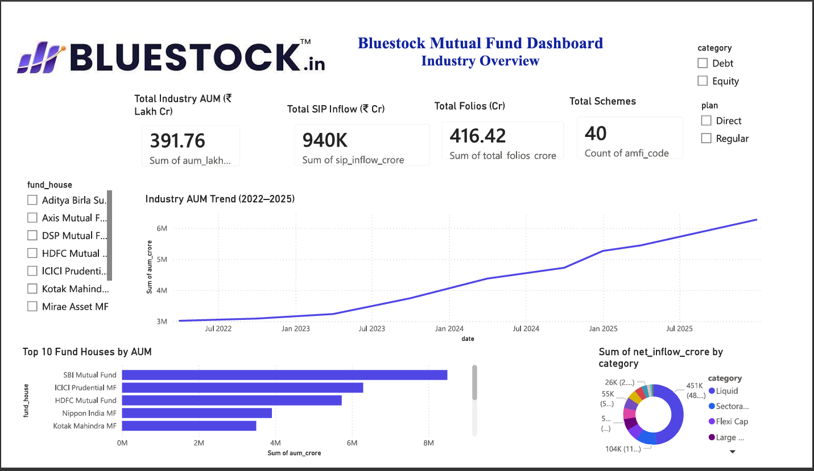
Dashboard Showcase
Industry Overview Page

Slide 11
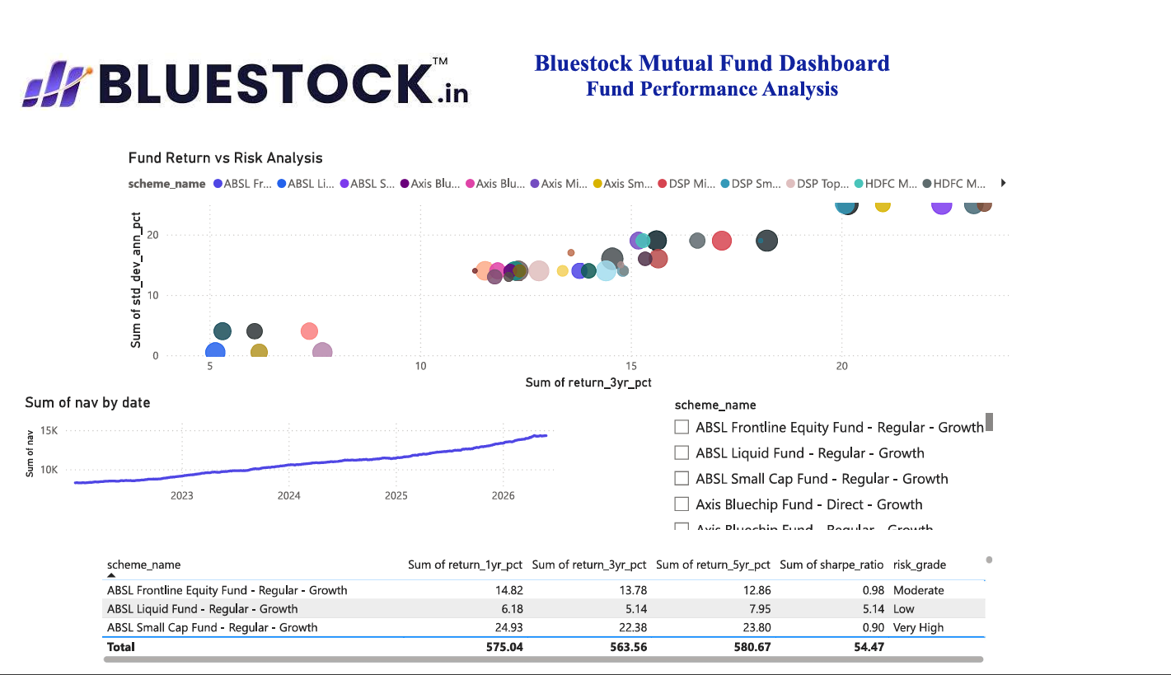
Dashboard Showcase
Fund Performance

Slide 12
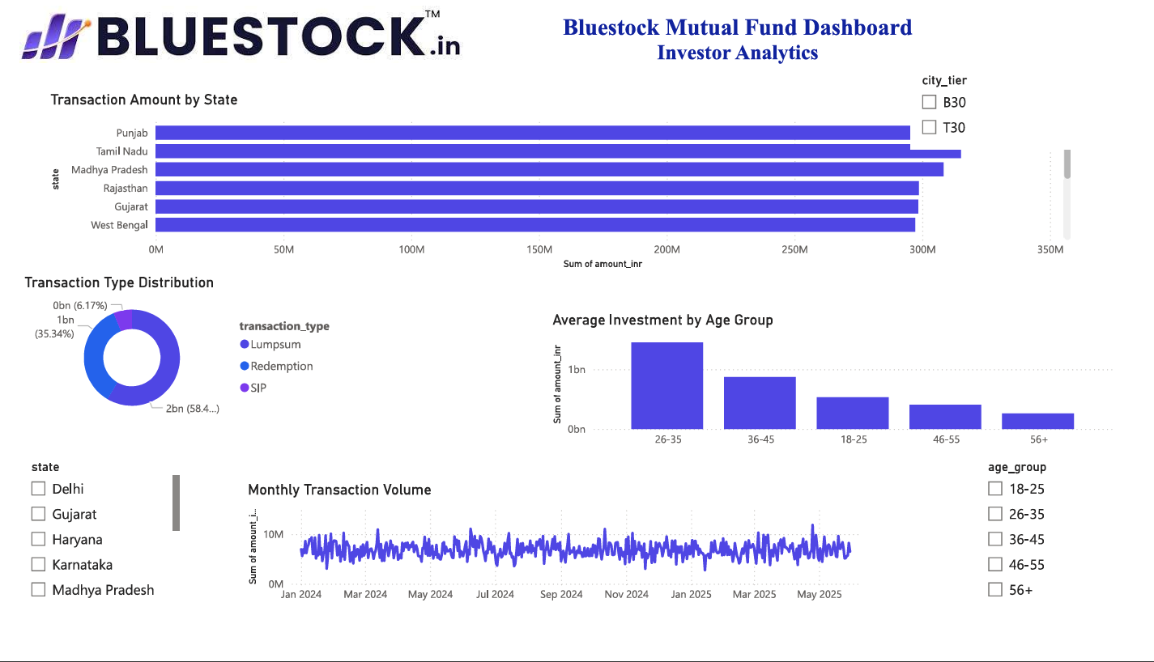
Dashboard Showcase
Investor Analytics

Slide 13
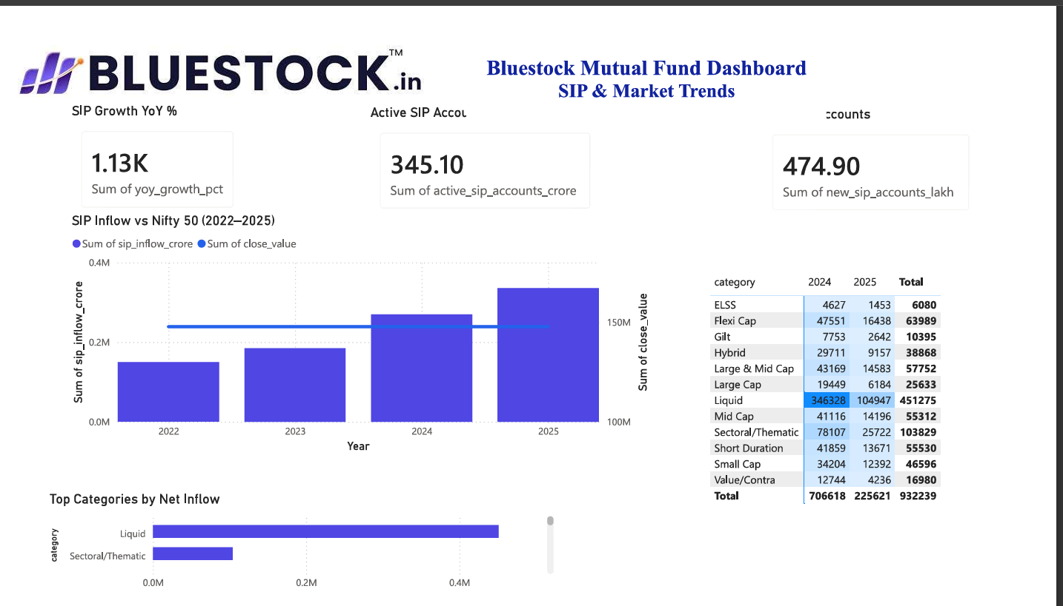
Dashboard Showcase
SIP & Market Trends

Slide 14
conclusions
The Bluestock Mutual Fund Analytics Capstone successfully integrated data engineering, advanced analytics, risk analysis, and business intelligence into a single platform.
The solution provides meaningful insights for investors, analysts, and financial institutions while demonstrating practical industry-level analytics skills.

