Slide 1


CARDIOVASCULAR DISEASE DETECTION USING IMAGE PROCESSING AND MACHINE LEARNING

Slide 2



PROJECT MENTOR
DR.Nazeerunnisa
Senior Assistant Professor
Mirza Sameeullah Baig
1604-20-735-101
Mohammed Hassan Ahmed
1604-20-735-091
TEAM
Mohammed Ilyas
1604-20-735-076

Slide 3



PROJECT OVERVIEW
General Introduction
Applications
Problem statement
Literature Survey
Design Objective
About ECG
Heart Diseases Analysis
Design Methodology and Tools
Implementation of ML Model
Generic Model of ML
Design Specifications
Block Diagram and Flow chart
Detailed Explanation
Project Timeline
Reference papers

Slide 4

GENERAL INTRODUCTION
An electrocardiogram (ECG) is a signal that measures the electric activity of the heart. The proposed approach is implemented using ML-libs and Scala language on Apache Spark framework; ML-lib is Apache Spark’s scalable machine learning library. The key challenge in ECG classification is to handle the irregularities in the ECG signals which is very important to detect the patient status

Slide 5


APPLICATIONS
Measurement of the electrical activity of the heart to detect cardiac problems.
It can be helpful for the self-diagnosis
To help the doctors with research studies

Slide 6


PROBLEM STATEMENT
Early detection of arrhythmias before major heart failures can reduce cardiac arrests in patients by suitable numbers.
The problem addressed in this project is the accurate prediction of heart status using electrocardiogram signals, which is essential for early diagnosis and treatment of cardiac diseases

Slide 7
LITERATURE SURVEY
Sl.No | Title | Authors | Conferences | Methods | Remarks
1 | Cardiologist-level arrhythmia detection and classification in ambulatory electrocardiograms using a deep neural network | Awni Hannun, Pranav Rajpurkar, Codie Bourn, Mintu P. Turakhia & Andrew | Natural Medicine Journal 2019 | Convolutional Neural Network (CNN) | The paper has proven that there is potential for developing an end-to-end deep learning approach can classify a broad range of arrythmias.
2 | Heartbeat classifcation system based on neural networks and dimensionality | Dalvi RdF, Zago GT, Andreão RV | Research on Biomedical Engineering-2022- | Neural network and SVM were used for classification. | Performance on a test set of only 18 ECG records of 30 min each achieved an accuracy of 96.97%.
3 | A generic and robust system for automated patient-specifc classifcation of ECG signals. | Ince T, Kiranyaz S, Gabbouj M. | IEEE Trans Biomed Eng-2020 | Feed-forward and fully connected artifcial neural networks aided by particle swarm optimization. | Two patterns of heatbeats are recognised with 96% accuracy.

Slide 8
LITERATURE SURVEY
Sl.No | Title | Authors | Conferences | Methods | Remarks
4 | Big data analytics in genomics: the point on deep learning solutions. | Celesti F, Celesti A, Carnevale L, Galletta A, Campo S, Romano A, Bramanti P, Villari M. B | 2019 IEEE symposium on computers and communications (ISCC) | DNN (Deep Neural Network) has been used for deep learning to classify heartbeats. | Classifcation was only two types (Normal and Abnormal) and dataset size was almost 85,000 records.
5 | ECG heartbeat classifcation: a deep transferable representation | Kachuee M, Fazeli S, Sarrafzadeh M. | 2018 IEEE international conference on healthcare informatics | Convolutional neural network for classifcation of ECG beat types has been developed by the author. | Multiply types of heartbeats have been studied and the author has reached accuracy 93.4%.
6 | Using hidden Markov models and spark to mine ECG data | O’Brien J. | Saint Mary’s College of Maryland | Combining accurate Hidden Markov models (HMM) techniques with Apache Spark to improve the speed of ECG analysis. | The paper has proven that there is potential for developing a fast classifer for heartbeats classifcation

Slide 9

WHAT IS ECG?
An electrocardiogram (ECG) is a complete representation of the electrical activity of the heart on the surface of the human body, and it is extensively applied in the clinical diagnosis of heart diseases.
ECG signals have been widely used for detecting heart diseases due to it's simplicity and non-invasive nature.

Slide 10

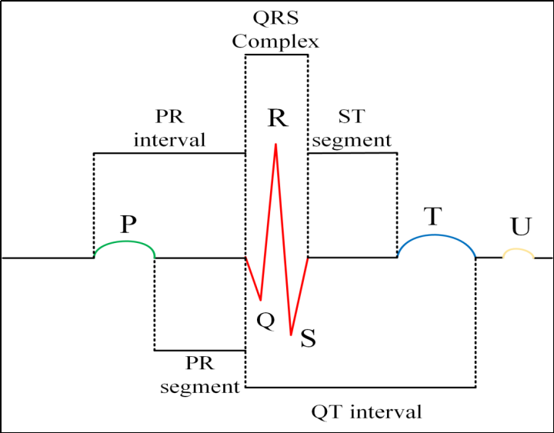
Components of ECG

Slide 11
DESIGN OBJECTIVE
To develop a machine learning model using convolutional neural network (CNN) that achieves high accuracy in classifying a broad range of distinct arrhythmias.
The CNN should demonstrate the ability to generalize its learning from the training dataset to new and unseen ECG data.
The design should prioritize computational efficiency to enable real-time or near-real-time analysis of ECG data.

Slide 12


GENERIC MODEL OF ML
Collection and Preparation of Data/Dataset
Feature
selection
Choice of
Algorithm
Selection of
Models and
Parameters
Performance Evaluation
Training

Slide 13
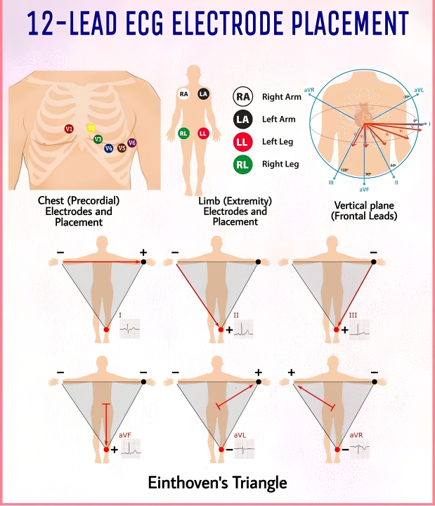
Components of ECG
The Einthoven Triangle is a concept in electrocardiography (ECG) that refers to the spatial relationship between the three standard limb leads: Lead I, Lead II, and Lead III. These leads are used to record the electrical activity of the heart.
Lead I is positioned between the right arm and left arm, Lead II is between the right arm and left leg, and Lead III is between the left arm and left leg. The Einthoven Triangle is an imaginary equilateral triangle formed by connecting the positive electrode of Lead I, the positive electrode of Lead II, and the positive electrode of Lead III.

Slide 14
Arrythmia: Heart disease caused by irregular heartbeat
Generally arrythmia refers to irregular heart beat it also refers to improper functioning of the heart beating of too fast or too slow.
Now see lets see the classification of averythmias for better understanding
• They are basically three types of Arrythmia
1)Sinus rhythms - is Classified into two types
i) Bradycardia : Generally Bradycardia is characterized by a slower than normal heartrate.
If you have bradycardia your heart beat is less than 60 times a minute.
ⅱ) Tachycardia: In the Tachycardia a heart rate over 100 beats per minutes.

Slide 15
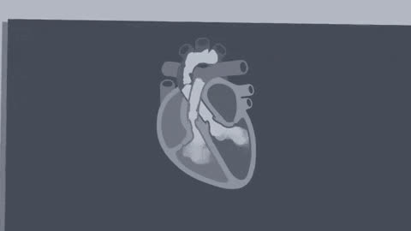
2.Atrial rhytms (it orginate from atria)
It is Classified into two ⅰ) Atrial fibrillation (AF) : This is the most common type, characterized by rapid, irregular benting of the upper chambers (atria).
AF Can lead to blood clots and increase the risk of stroke.
ⅱ) Atarial flutter: It is similar to Af, but with more organized rythm.
It can cause palpitations and lead to complication like stroke it left Untreated.

Slide 16
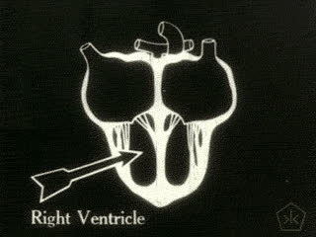
3.Ventricular rhythms (originate from the ventricles)
It is classified into two types
i) Ventricular tachycardia:-
It occurs due to a problem in the hearts electrical impulses.
• The condition may develop as a Complication of an heart attack
• In this disease, the lower chamber of the heart beat very quickly
Ventricular fibrillation (UF):
A life-threatening heart rhythm that results in a rapid, inadequate heartbeat.
VF is a rapid, life-threatening heart rhythm starting from lower chambers in the heart from this, a heart attack can be triggered.

Slide 17
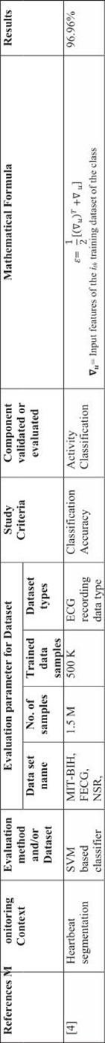
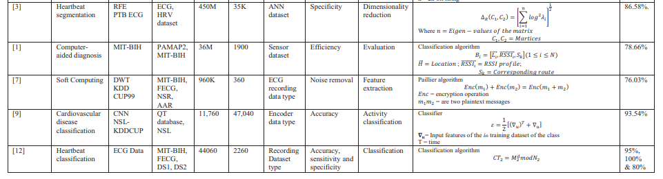
Mathematical equation’s

Slide 18
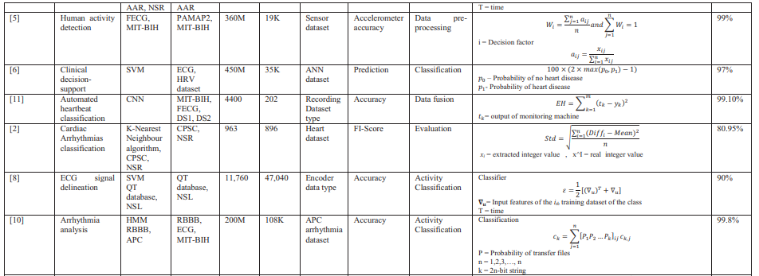
Mathematical equation’s

Slide 19
DESIGN METHODOLGY
Convolutional Neural Network are effective in capturing spatial and temporal in ECG signals
The irregularities in ECG signals classify the heartbeats under different categories.
The performance of ECG pattern depends upon the features and design of cnn model.

Slide 20
DESIGN SPECIFICATION AND HARDWARE COMPONENTS
ECG Surface Electrodes
AD8232/BMD101/ADAS1000
ECG Module
MCP3008
Serial ADC
Output by detection and
classification
Raspberry pi
Module
Machine learning model

Slide 21


MACHINE LEARNING
Machine learning is a subfield of artificial intelligence, which is broadly defined as the capability of a machine to imitate intelligent human behaviour.
Improves accuracy.
Computational Statistics to focus on making predictions.
Mathematical Optimization which relates to:-
Models, applications
Frameworks to the field of statistics.
Real-world problems make suitable applications.
Speech Recognition
Robotics and Artificial Intelligence
Web and Social Media
Healthcare

Slide 22

DEEP LEARNING- A SUBFIELD OF ML
Deep Learning
A subfield of machine learning that focuses on training and building artificial neural networks with multiple layers to learn and represent complex patterns and relationships in data, enabling them to make accurate predictions or classifications.
The different approaches to ML
Neural Networks (NN)
Computational models inspired by the structure and function of biological brains.
They consist of interconnected nodes, called neurons, organized into layers
Each neuron receives input signals, performs computations, and generates an output signal

Slide 23
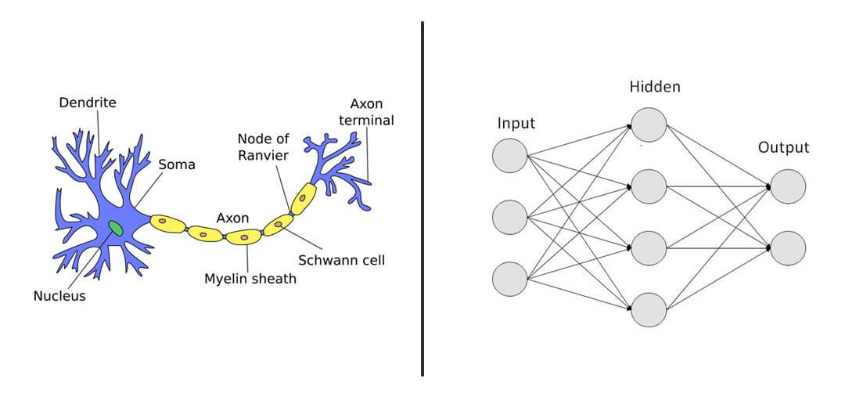
2. Deep Neural Network (DNN)
Neural networks with multiple hidden layers.
The depth of these networks allows them to capture intricate and abstract features in the data, leading to improved performance on complex tasks.
Types
i) Convolutional Neural Networks (CNN)
Specialized deep learning models
commonly used for image and signal
processing tasks.
ii) Recurrent Neural Networks (RNN)
Deep learning models suitable for sequence data, such as time-series or
natural language data.

Slide 24
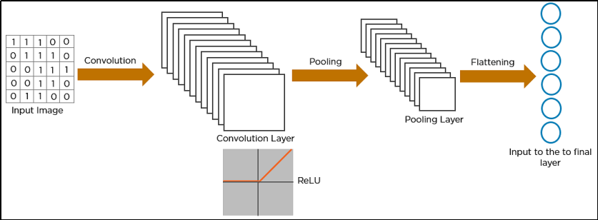
Convolutional Neural Network (CNN)
Convolutional Neural Networks (CNNs) are a type of deep learning architecture specifically designed for processing grid-like data, such as images or signals.
CNNs have been widely used in computer vision tasks, including image classification, object detection, and image segmentation.
They have also proven to be highly effective in various applications involving sequential data, such as natural language processing and time-series analysis, including electrocardiogram (ECG) analysis.
Architectuof Convolutional Neural Network

Slide 25
They have three main types of layers, which are:
1. Convolutional layer
2. Pooling layer
3. Fully-connected (FC) layer
Working of Convolutional Neural Network
1.Convolutional Layer: - The core building block of a CNN is the convolutional layer.
- It applies a set of learnable filters to input data, enabling the network to automatically
extract relevant features from ECG signals.
2.Pooling Layer: - Pooling layers are typically used after convolutional layers to reduce the spatial
dimensionality of the feature maps while retaining the most important information.
-Max pooling, for example, selects the maximum value within a small neighborhood,
effectively downsampling the feature maps.
3.Fully-Connected Layer: -These are typically employed to transform the high-level features learned from
the earlier layers into class probabilities or regression predictions.
-They connect every neuron to every neuron in the previous and subsequent layers.

Slide 26
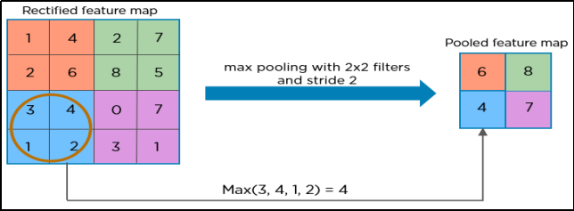
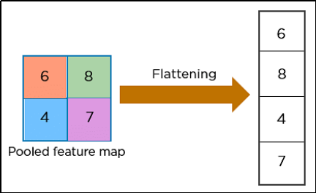
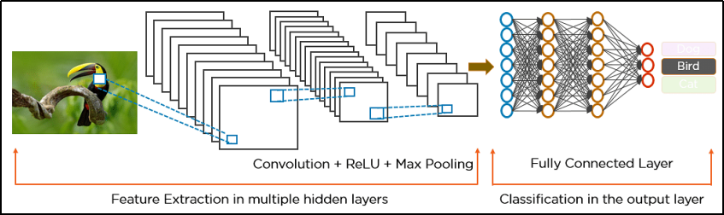
Pooling
Flattening
Example implementation of CNN

Slide 27

TOOLS
The proposed approach is implemented using ML-libs ,Tensor Flow,Keras and Python language on Flask framework.
TensorFlow is a popular open-source deep learning library that provides comprehensive support for building and training neural networks, including CNNs. It offers high-level APIs, such as Keras.
Keras is a high-level deep learning library that runs on top of TensorFlow or other backends.It offers a user-friendly API for designing and training CNN models with ECG signals.
Flask is a micro web framework. It is used for a wide range of web applications, from simple static websites to complex web applications with dynamic content and user authentication.

Slide 28
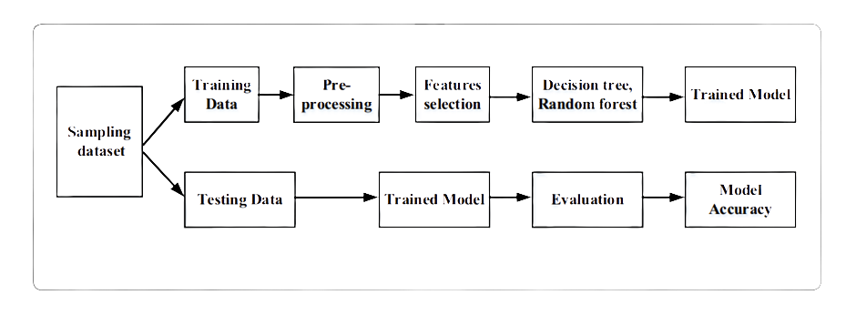


DETAILED EXPLANATION
Convolutional
Neural Network
PAGE 03

Slide 29
Libraries used
Numpy
Pandas
Sklearn
Matplotlib
Scikit-Learn
Dataset Description
The dataset used consists of the following characteristics:
1. Size: The dataset contains a total of 91,232 single-lead electrocardiograms (ECGs) from 53,549 patients who underwent ambulatory ECG monitoring. Each ECG represents a unique patient.
2. Rhythm Classes: The dataset includes 12 different rhythm classes that were used for classification purposes. The specific rhythm classes are not mentioned in the provided information.

Slide 30
Data Preprocessing
The preprocess function defines the list of ECG record numbers (nums) and features (features), and if specified, splits the dataset into test and train sets based on the split parameter.
Overall, the script downloads ECG data from the MIT-BIH Arrhythmia Database (if specified), preprocesses the data and extracts windows around peaks, retrieves annotations and saves the processed data and labels to HDF5 files. The script can be run directly to perform the preprocessing or imported as a module for reuse.

Slide 31
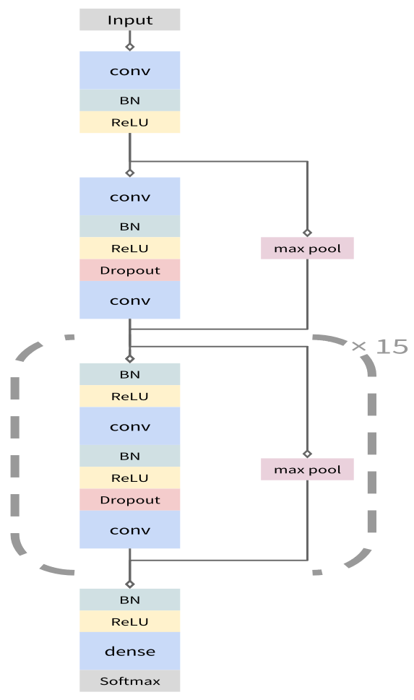
Model
The model is mainly made of 3 blocks, the input plus a reset block, and a reset loop-block and a output block
The network takes as input a time-series of raw ECG signal, and outputs a sequence of label predictions.
The 30 second long ECG signal is sampled at 200Hz, and the model outputs a new prediction once every second.
We arrive at an architecture which is 33 layers of convolution followed by a fully connected layer and a softmax.

Slide 32
Training and Testing
A computer model is trained to analyze ECG data and classify different types of heartbeats.
It takes into account the configuration, splits the data into training and validation sets (if needed), sets up the model and its training parameters, trains the model using the data, and evaluates its performance..
Evaluation of trained model
The performance of the model is evaluated to assess how well it can classify different types of heartbeats using ECG data.
After training the model, it is tested using validation data.
The model predicts the type of each heartbeat, and these predictions are compared to the actual labels.
Performance metrics like accuracy, precision, recall, and F1-score are calculated to measure how accurately the model classifies the heartbeats.

Slide 33
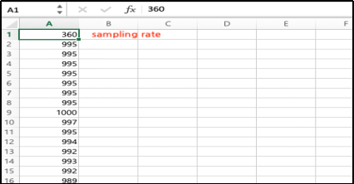
Sampled data in csv file format
PAGE 03

Slide 34
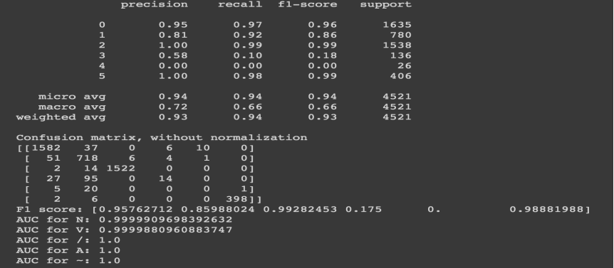
Predictions
Using the trained model, we can predict and compare the result with its true labels
PAGE 03

Slide 35
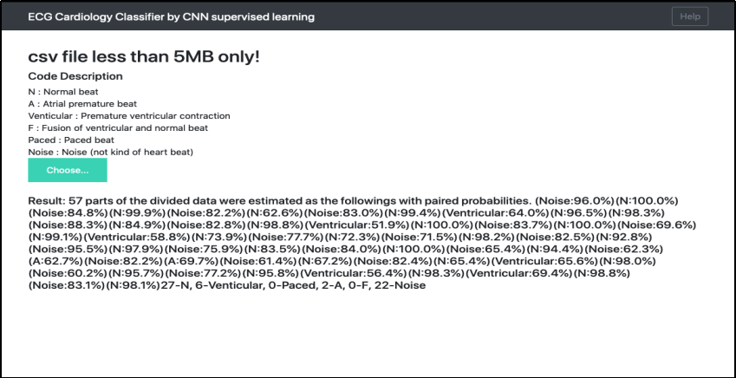
Deployment Using Flask
In the image, the signals have 57 peaks, and the signal of each peak was estimated by the trained model.
Then the whole signals consists of 27 normal beats, 6 venticular beats, 2 atrial beats, and 22 noises signals.
If the signals represent noise, the most of the signals should have been estimated as noise.
Then, the patient with the signals must be healthy or possibly have venticular contraction.
PAGE 03
PAGE 27

Slide 36



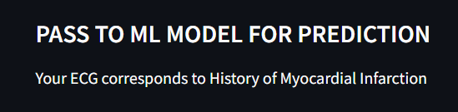

Results
PAGE 03
PAGE 28

Slide 37
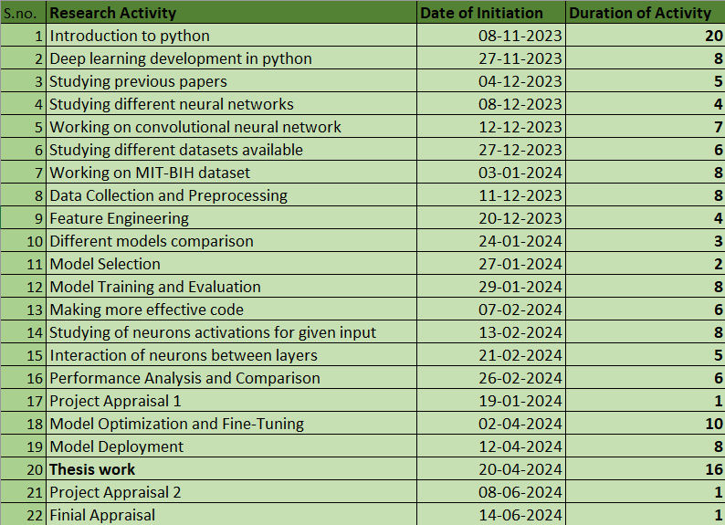
PROJECT ACTIVITIES TIMELINE
PAGE 28

Slide 38
REFERENCE PAPERS
[1] Genetic algorithm for the optimization of features andneural networks in ECG signals classificationHongqiang Li1, DanyangYuan1, Xiangdong Ma1, DianyinCui1 & Lu Cao2
[2] Heartbeat classification system based on neural networks and dimensionality reduction Rodolfo de Figueiredo Dalvi*, Gabriel Tozatto Zago, Rodrigo Varejão Andreão
[3] Machine Learning from Theory to Algorithms: An Overview To cite this article: Jafar Alzubi et al 2018 J. Phys.: Conf. Ser. 1142 012012
[4] Revealing Real-Time Emotional Responses: a Personalized Assessment based on Heartbeat DynamicsGaetano Valenza1,2,3, Luca Citi1,2,4, Antonio Lanata ́ 3, Enzo Pasquale Scilingo3 & Riccardo Barbieri1,2
[5] Understanding and using sensitivity, specifi city and predictive values Rajul Parikh, MS; Annie Mathai, MS; Shefali Parikh, MD; G Chandra Sekhar, MD; Ravi Thomas, MD
[6] Using Hidden Markov Models and Spark to Mine ECG Data Jamie O’Brien Saint Mary’sCollege of Maryland St. Mary’s City, Maryland
[7] Schläpfer, J. & Wellens, H. J. Computer-interpreted electrocardiograms: benefits and limitations. J. Am. Coll. Cardiol. 70, 1183–1192 (2017).
[8] Holst, H., Ohlsson, M., Peterson, C. & Edenbrandt, L. A confident decision support system for interpreting electrocardiograms. Clin. Physiol. 19, 410–418
[9] Schlant, R. C. et al. Guidelines for electrocardiography. A report of the American College of Cardiology/American Heart Association Task Force on assessment of diagnostic and therapeutic cardiovascular procedures (Committee on Electrocardiography). J. Am. Coll. Cardiol. 19, 473–481 (1992).
[10] Sannino G, De Pietro G. A deep learning approach for ECG-based heartbeat classifcation for arrhythmia detection.Fut Gener Comput Syst. 2018;86:446–55.
[11] Zhao Z, Yang L, Chen D, Luo Y. A human ECG identifcation system based on ensemble empirical mode decomposition. Sensors. 2013;13(5):6832–64.

Slide 39

Thank You

