Slide 1
To Infinity & Beyond
Paradoxes at the heart of Mathematics

Slide 2
Arriving at Infinity
624 - 430 BCE
The Case of the Mathematical System of Ancient Greece

Slide 3
Counting (Arithmetric), Measuring (Geometric) & Rational Numbers
The Pythagorean school
The technique of abstraction
The technique of generalisation
Mathematics first crises (square root of 2)
Geometry (over Arithmetic)
Holes on the number line
grapple with Infinity

Slide 4
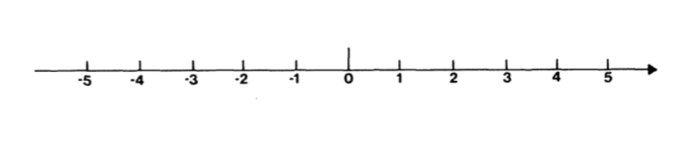
Rational Numbers
Confined to Practical purposes of counting and measuring
Natural (counting) numbers: 1, 2, 3, 4….
Axiom of natural numbers: Every natural number n has a successor, n + 1.
Add the notion of direction, we get the set of integers, or whole numbers
Rational numbers: a/b where a, b are integers
(Rational numbers > integers > natural numbers)

Slide 5
“Number rules the universe.”
– Motto of the Pythagorean School

Slide 6
Perfection rather than practical concerns
The universe could be expressed in natural numbers
High regard for rational numbers: the entire universe is constructed according to the laws of rational numbers

Slide 7
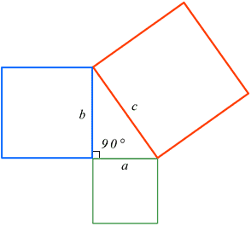
Pythagoras theorem
Technique of abstraction: - ignores the physical constraints of the domain where triangles are encountered practically, ie land surveying, so ropes, pieces of wood etc only straight lines connecting at angles

Slide 8
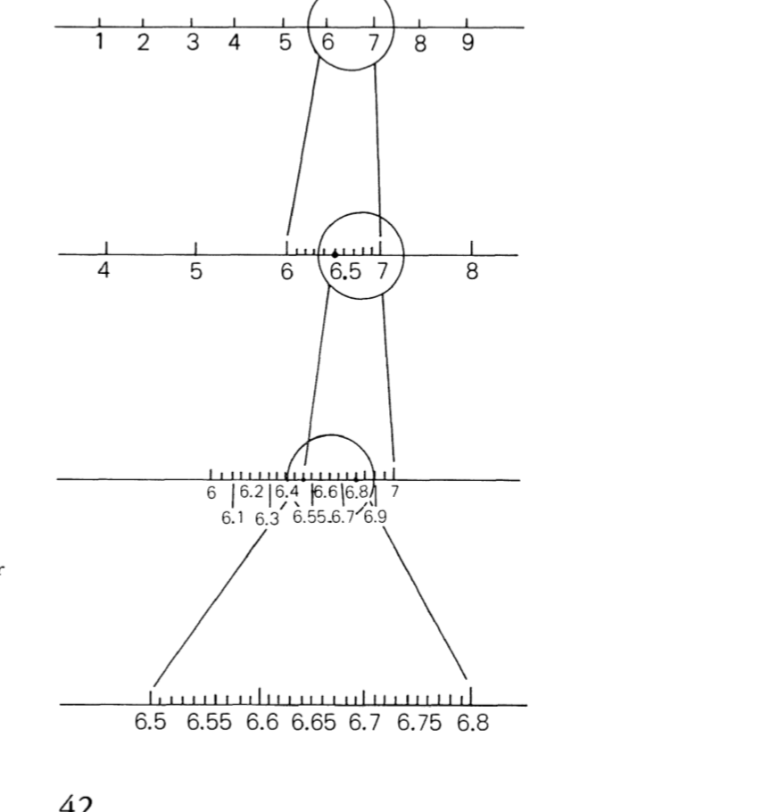
A number line dense with only rational numbers
Not only, can we squeeze a new fraction between any two given fractions, we can in fact squeeze infinitely many fractions between them.
leaving no gaps between its members, the entire number line is completely populated with rational numbers, or "rational points."

Slide 9
Mathematics’ first crisis
The Discovery of “Irrational” Numbers

Slide 10
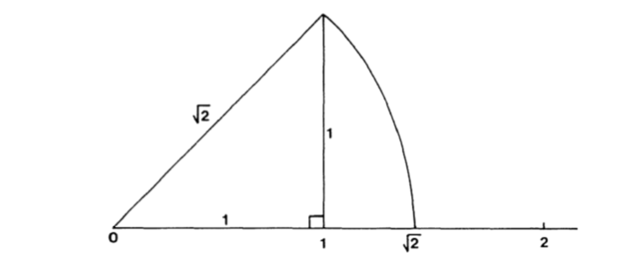
So here was something which clearly was a number (since it represented length), and yet which could be written neither as an integer nor as a ratio of integers.

Slide 11
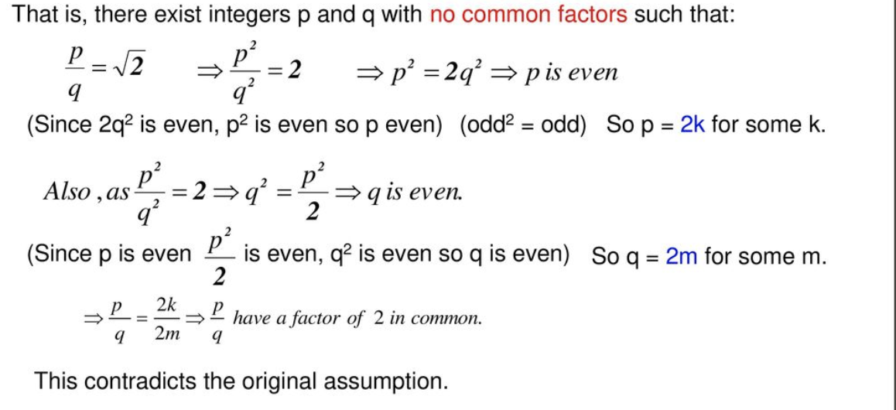
Proof by Contradiction
First assume to the contrary that it is a rational number

Slide 12
Holes in the number line
In spite of their density, the rational numbers leave "holes" in the number

Slide 13

Other irrationals
Pi, Eulers Number, the square root of prime numbers, ….
Golden ratio (divine proportion),

Slide 14
Number system recap
From the number line of Rational Numbers
To the number line of Real numbers ( rational + irrational numbers)
Real numbers: all numbers than can be written as decimals ( 0.5, 0.12121212, etc)

Slide 15
Geometry (over Arithmetic)

Slide 16
First to grapple with infinity
Philosopher Zeno of Elea’s Paradoxes
Archilles and the tortoise
Sam has 2m to distance to cover from his hostel to the exam hall and starts to walk the distance. Does he reach the exam hall at all?

Slide 17
Infinity
1845 - 1918
Georg Cantor

Slide 18
Before Cantor
Infinity as a number larger than all numbers
Every number can be succeeded by a larger one
No such thing as the largest number
No one wanted to confront the paradox
Infinity not accepted as a mathematical object

Slide 19
Potential infinite: a process that can be repeated again and again without end, but which, at any given stage, still encompasses only a finite number of repetitions. The set of natural numbers 1, 2, 3, . . .
Actual Infinite: The set of integers, when arranged in their "natural" order ..., -3, -2, -1, 0, 1, 2, 3, ..., comprises an actually infinite set, since at every stage there are already infinitely many integers present.
Cantor: removed the distinction between potential and actual infinities. Indeed, by arranging the integers not in their natural order but according to the sequence 0, 1, -1, 2, -2, 3, - 3 , . . . , we see at once that the distinction becomes meaningless.

Slide 20
Sets { collection of objects}
Finite { a, b, c} or infinite { 1, 2, 3, 4….}
{ a, b, c } 1:1 { 1, 2, 3}
Paradox: an infinite set may be matched, element for element, with a subset of itself. { 1,2,3…} 1:1 { 2, 4, 6..} regarded as inexplicable before Cantor
Violates "The whole is greater than the part. "
Cantor: whenever two sets-finite or infinite-can be matched by a 1 : 1 correspondence, they have the same number of elements.
Not a paradox but a fundamental property of infinite sets
Cantor called any set that can be matched 1: 1 with the set of counting numbers a countable, or denumerable, set.

Slide 21
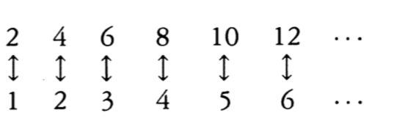
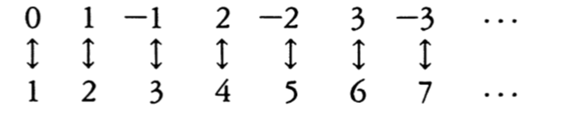
the even numbers, the odd numbers, the integers, the squares, and also the primes are all denumerable.

Slide 22
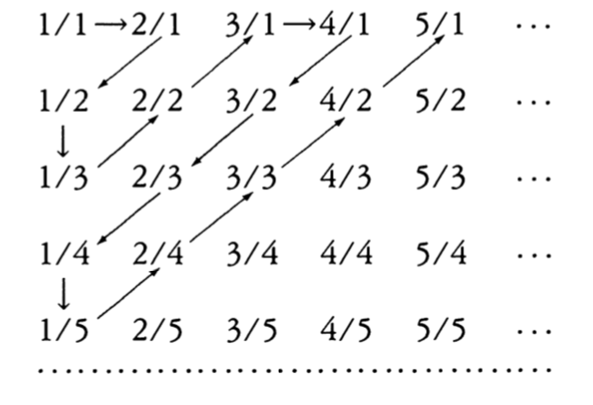
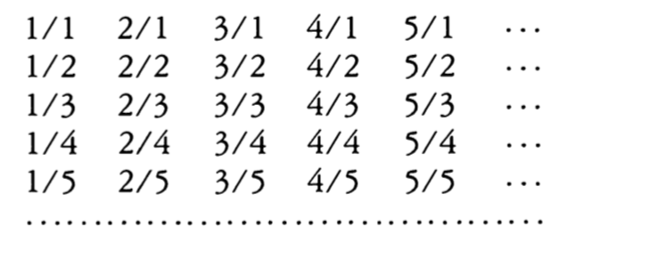
the set of fractions, despite its dense population, has just as many members as the set of counting numbers, with its big gaps.
Cantors technique ( infinite array) leaves not a single rational uncounted
Sets of Power N0 ( pronounced Aleph-Nought)

Slide 23
Are all infinite sets countable?
the set of points along an infinite line, the number line.
Correspond to The real number system of all decimals
Contains more elements than the countable(denumarable) set
Its Infinity is of a higher power than N0
Infinity of the continuum C

Slide 24
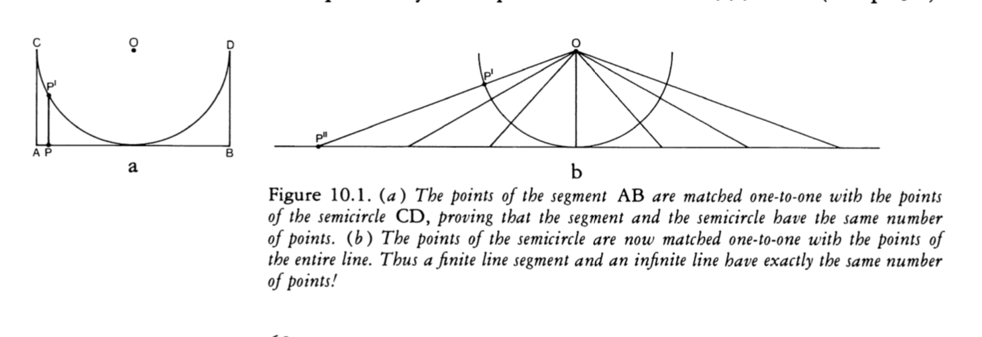
Proof by contradiction
First Cantor showed that there are as many points along an infinite straight line as there are on a finite segment of it.

Slide 25
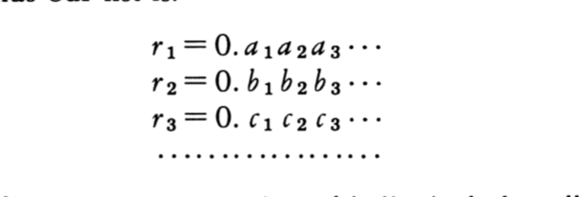
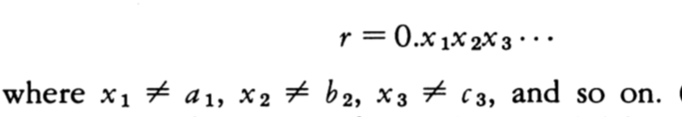
Cantor took the segment [0,1] and assumed that all real numbers between 0 and 1 was countably infinite
Meaning we could count all the decimals between 0 and 1, without leaving any of them out

Slide 26
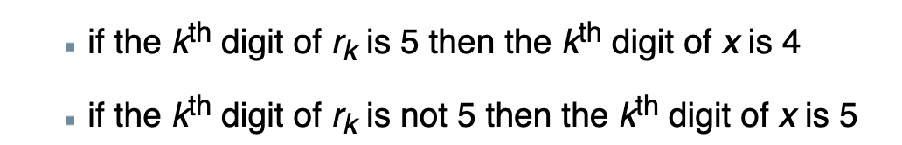
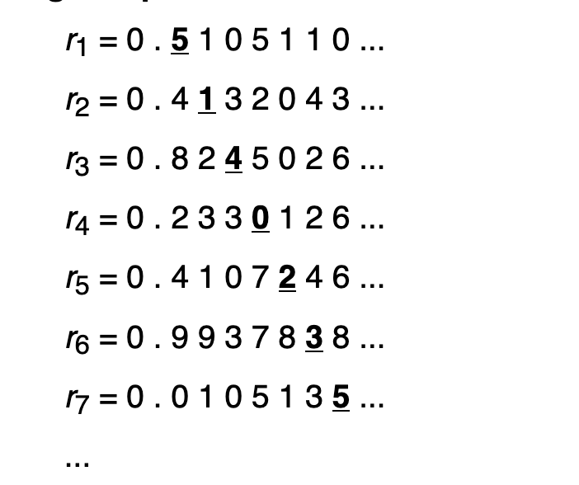

Cantor’s Slash
x is not in the sequence ( r1, r2, r3….) because for any rk there is a kth digit that is not the same kth digit in x

Slide 27
Cantor’s Slash
This new number is evidently a real number between 0 and 1, and yet by its very method of construction it differs from any of the numbers in the original list. And therein lies the contradiction, since we have assumed that our list includes all the real numbers between 0 and 1.
Therefore the list of real numbers between 0 and 1 is uncountable

Slide 28
Are there infinite sets of power < N0 (aleph-nought)?
None!

Slide 29
Are there infinite sets of power > C?
In other words is there something more numerous than the continuum, the set of all points of the number line?
The set of all subsets of a given set always has more elements than the original set.
{ a, b} < { {a}, {b}, {a, b} }
2NO the set of all subsets of NO is equal to C
Arithmetric of Transfinite Cardinals N0 + N0 = N0; N0 X N0 =N0, Nr0 = N0 for r > 0, rN0 = N0 r != 0, 2N0 = C
N0 < C = 2N0 < 2.2N0 (transfinite cardinal numbers)

Slide 30
Infinite hierarchy of infinities
N0 < C = 2N0 < 2.2N0
Create bigger infinites by creating a set of all subsets of 2.2N0
From the new set we can create a set with still more elements, and so on ad infinitum!
infinite hierarchy of infinite sets

Slide 31
Is there a set of power between N0 and C?
Cantor conjectured that the answer is NO
but he was unable to prove his conjecture.
Cantor's conjecture came to be known as the Continuum Hypothesis.
Symbolically N1 = C
of all the infinite sets larger than Aleph-0 ,the smallest (Aleph-1 or N1), is equal to the continuum (which is the large infinite set of real numbers)

Slide 32
The Continuum Hypothesis
The challenge of proving or disproving the Continuum Hypothesis would loom over the mathematical community for the next 60 years until 1963.
showed that the Continuum Hypothesis is independent of the axioms of set theory
Meaning that depending on what assumptions one starts from the Hypothesis could be both true and false.
. MORE ON THIS LATER

Slide 33
Beyond Infinity
1900 - 1925
The Foundations of Mathematics

Slide 34
Math in the 19th century
Branches disconnected from each other
Algebra
Set theory
Topology
Functional Analysis

Slide 35
Mathematicians in the 19th century
Goal: unify the branches with a foundational theory
What is the foundation of all mathematical objects ( numbers, shapes) and the relationships between them

Slide 36
Some philosophy-Plato
math objects { Numbers, shapes} as objective truth,
Numbers, shapes exist independent of us and our world
World of Forms

Slide 37
Response to Plato-Aristotle
{Numbers, shapes} not object but properties of objects
Numbers, shapes exist NOT independent of us
Belongs to our world

Slide 38
Response to Plato-Kant
Mathematical objects NOT objective truths
INTUITION: needed to understand basic math principles
Math describes our world but we also brought it to our world from our experience
So not independent of us

Slide 39
Response to Aristotle-Frege
If numbers are properties of objects then only one number should belong to any object and should not be a matter of opinion
1 pair of shoes or 2 shoes?
Numbers depend on how we conceptualise an object
Numbers are an extension of the properties/concepts

Slide 40
Response to Kant-Frege
Understanding of math not dependent on intuition and experience
Logic is all that’ required
Logic of deduction and inference

Slide 41
Frege’s Project
Logicism: to show that Logic is the foundation of mathematics
Deduction and inference from an accepted set of axioms

Slide 42
Frege’s Project
Defined: Numbers as extensions of concepts/properties
For every concept/property one can think of there’s a corresponding SET of objects (or extension) that share that property
Eg concept: duality, extension: { 2, …}

Slide 43
Frege’s Project
ambitious project to rewrite all the truths
of mathematics in the language of sets
show that all of
mathematics could be deduced all mathematics from some axioms (rules) concerning sets
generally believed that any property of objects could define
a set
the property “x is a natural number between four and seven”, { 4, 5,6,7 }, { x | x natural number btwn 4 and 7}

Slide 44
Frege’s Project
For any property P :- { x | x has property P }
Comprehension Principle: given any property there exists a set containing all objects of that property
Frege’s Axiom::General Comprehension Principle :: there are as many properties as there are extensions
Number of properties/concepts = number of extensions

Slide 45
Response to Frege-Russel
Comprehension Principle: given any property there exists a set containing all objects of that property - Leads to a Paradox
Broke Frege’s Axiom::General Comprehension Principle :: there are as many properties as there extensions
Found a property/concept where finding the corresponding extension/set leads to contradiction

Slide 46
Russel’s Paradox
Reminder: sets are a collection of objects { 1,2, 3}
It’s possible for a set to contain other sets { 1, 2, {3,4}}
It’s possible to construct the set that satisfies the property/concept F a set that is a member of itself …thus fulfilling Frege’s axiom
{ x| x is a set and x has at least one element } = B
B = { {1}, {2} {1,2} …………., B}
F = { B, …..} satisfying Frege’s axiom

Slide 47
Russel’s Paradox
Consider the opposite property/concept R
R is the property a set that is not a member of itself
It the corresponding extension/set of this property is { r1, r2, …}
{ r1, r2..} is the set of all sets that are not members of themselves
Question: does { r1, r2…} contain itself? { r1, r2…, {r1, r2…} } ?

Slide 48
Russel’s Paradox
Question: does { r1, r2…} contain itself? { r1, r2…, {r1, r2…} } ?
If YES, it means {r1, r2…} contains itself {r1, r2, …,{r1, r2…}}, a set that contains a set that contains itself
but its supposed to be the extension of the concept R , a set that does contain itself, so no member should be a set that contains itself
Therefore {r1, r2…} does not contain itself or doesn’t have a member that is itself: {r1, r2…}

Slide 49
Russel’s Paradox
But if {r1, r2…} does NOT contain itself as a member then like r1, r2 and the other members, its a set that does not contain itself as a member and fulfils the concept R, so should contain itself {r1, r2,.., {r1, r2,…}}
Therefore {r1, r2…} contains itself and does not contain itself: a Paradox

Slide 50
Barber’s Paradox
A town with only one Barber
Mission to shave all and only those who do not shave themselves
Question: does the Barber shave himself
A: If not: he should shave himself
B: If yes ie he shaves himself then he shouldn’t

Slide 51
“My efforts to throw light on the question surrounding the word number seems to have ended in COMPLETE FAILURE.”
–Gottlob Frege
( 1848 - 1925)

