Slide 1


Image-Based Text Steganography Using Basic Python
Youssef sameh
202400436

Slide 2

Introduction to steganography
Definition: concealing a secret message inside a normal picture
Unlike cryptography, it hides the existence of the message itself

Slide 3

Project purpose
Goal: creating a python program that can encode and decode a text in an image
Requirements: must be created with basic programming functions without using libraries
Type of data: the image has to be .BMP

Slide 4

High level app mechanisms
Method: least significant bit steganography
  The messages bits are put into the LSB of the image's pixel bytes
  Editing LSB causes minimal changes to the pixels making it unnoticeable to the human eye

Slide 5
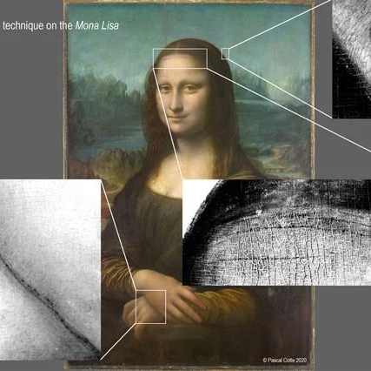
Encoding
Prepare data: convert text and delimiter into bits
Find start: read image file and find where the picture data starts
Check size: make sure the message is not too long for the image
Replace bits: loop through picture data, replacing the last bit of each pixel byte with one bit of the message
Save: save the ne encoded image

Slide 6
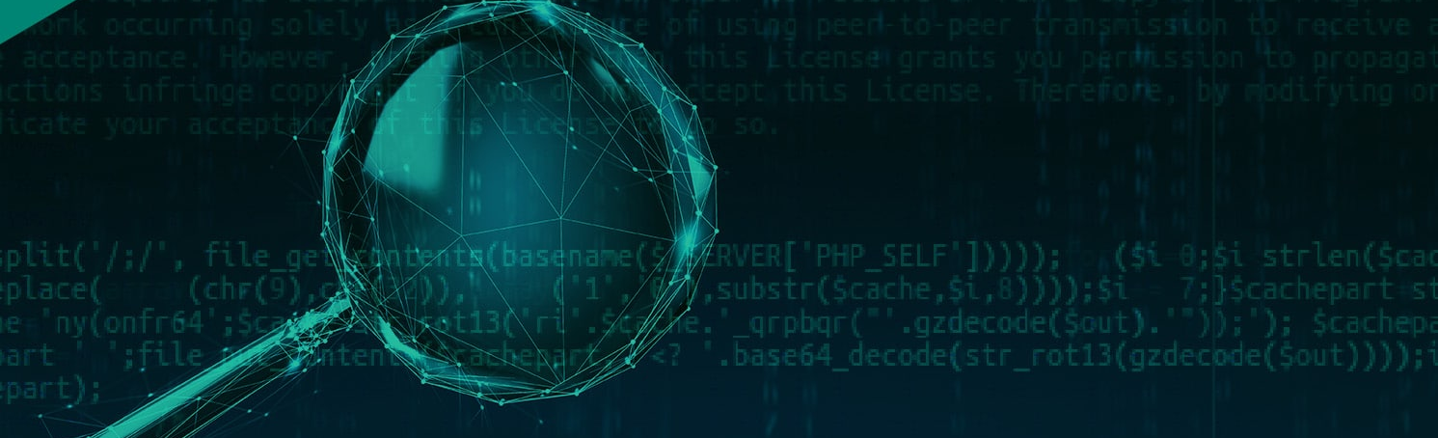
decoding
Read image: open the encoded image
Collect bits: start going through picture data and extract only the last bit from every byte
Look for end: keep extracting until the delimiter is found
Convert back to text and print:
  Remove delimiter bits
  Group to 8 bit blocks
  Turn to bytes then to text
  Print final message found

Slide 7

How to use the application

Slide 8

Running the program
Open python application
Run the code
Choose: a.encode , b.decode , c.exit

Slide 9

Encoding
Choose a
Enter the path for the image from your computer
Enter the path you want the new image saved
Type in your message or enter the file that contains the message

Slide 10

Decode
Choose b
Enter the path for the image containing the secret message
The application extracts the message and prints it for the user to see it

Slide 11
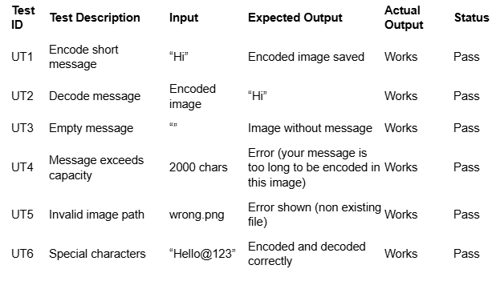
Unit testing table

Slide 12
Git Hub link
https://github.com/sameh-06/youssef-sameh-course-work-1.git

Slide 13

Time complexity
Encoding:
O(n) because the biggest step that happens is the for loop going through the image pixel bytes
Decoding:
O(n) because the biggest step is the loop going through pixel bytes until the delimiter is found

Slide 14
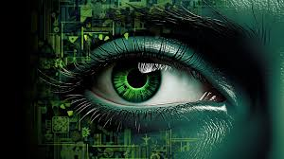
Conclusion
Result: successfully built a working steganography program only suing simple python
Skills learnt: file handling, and learning new file formats

Slide 15

Thank you

