Slide 1
Data center
What I need to create On-prem data center?

Slide 2
Data center infrastructure
Place
security (security man, cams, fire alarm)
electricity (power, battery, backup)
cooling system

Slide 3
Data center infrastructure
Servers
Storage
Networking
Virtualization
Hardware [ Router, Switches, Racks, Cables ]
teams and license and Maintenance.

Slide 4
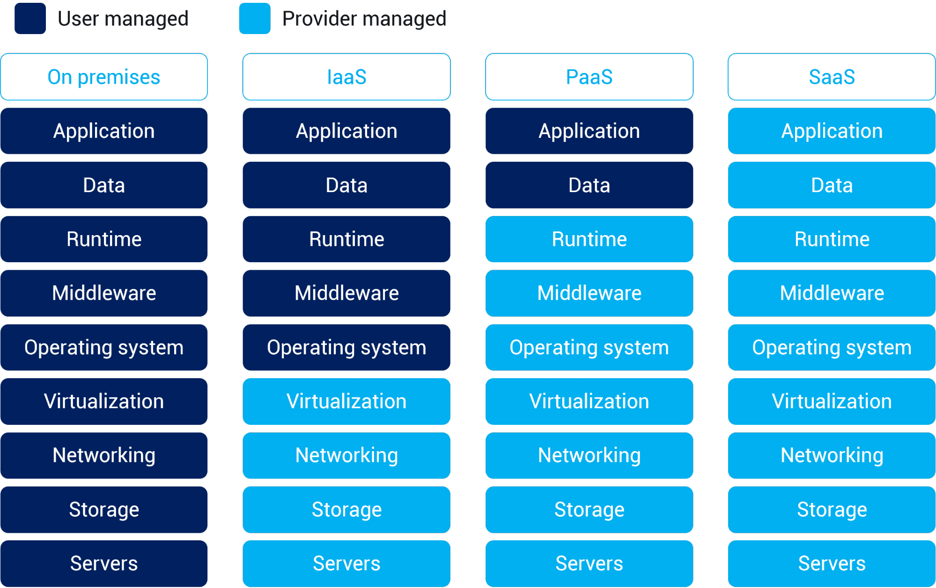

Slide 5
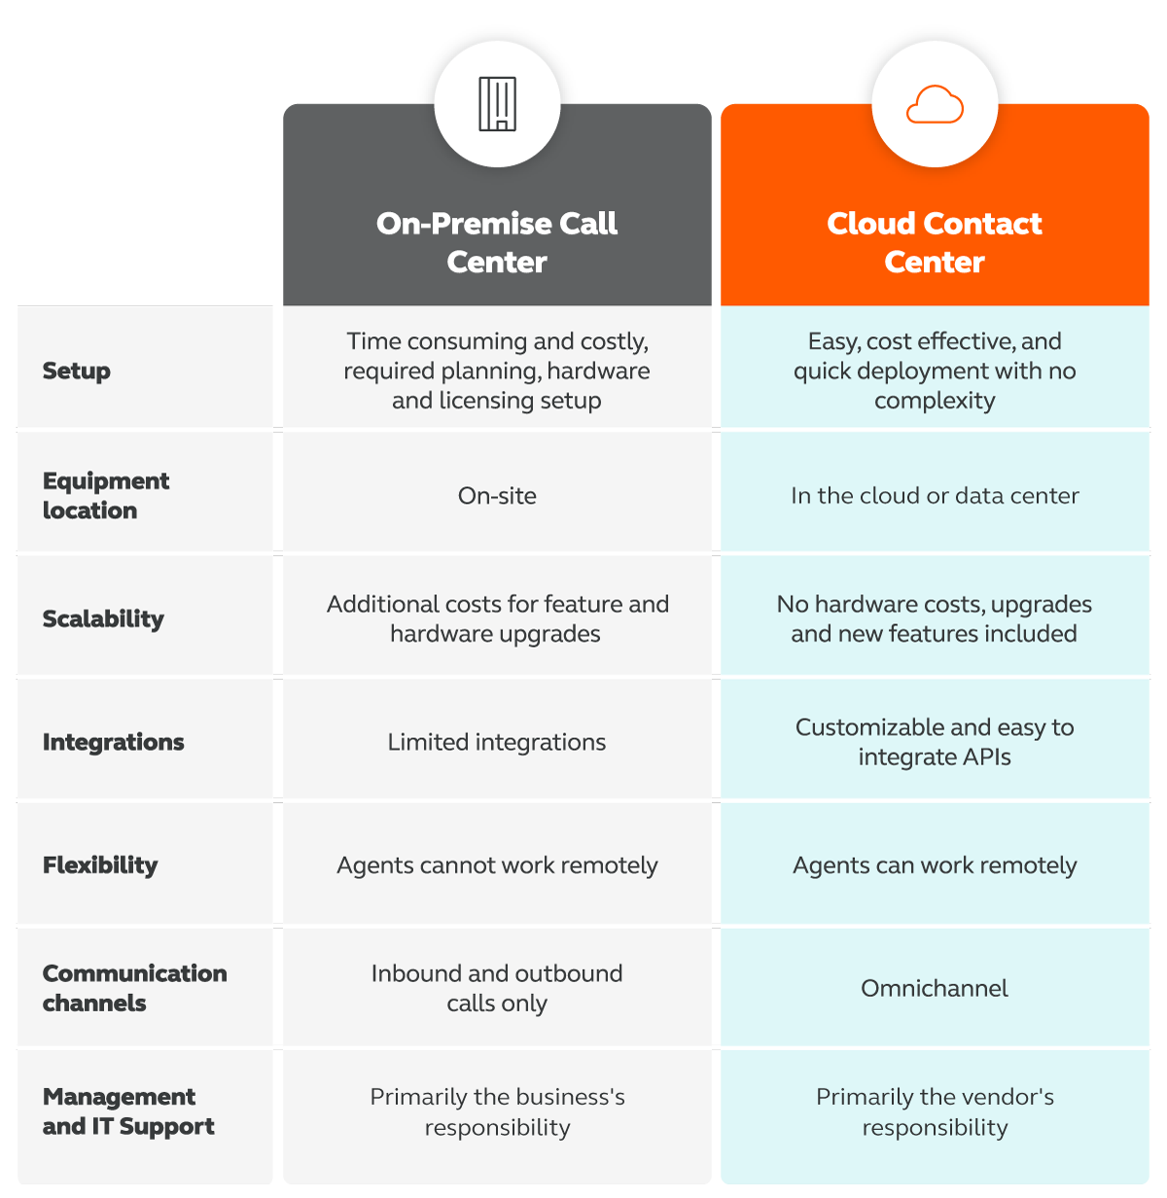

Slide 6
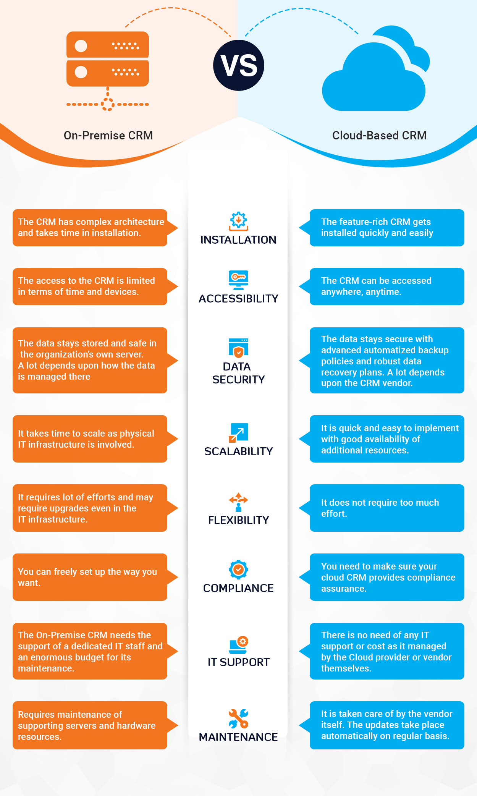

Slide 7
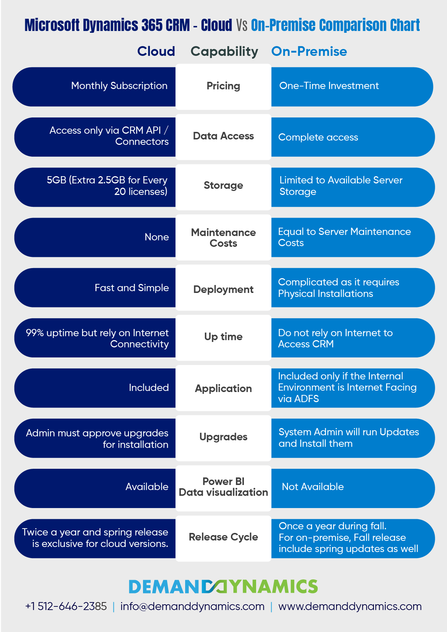

Slide 8
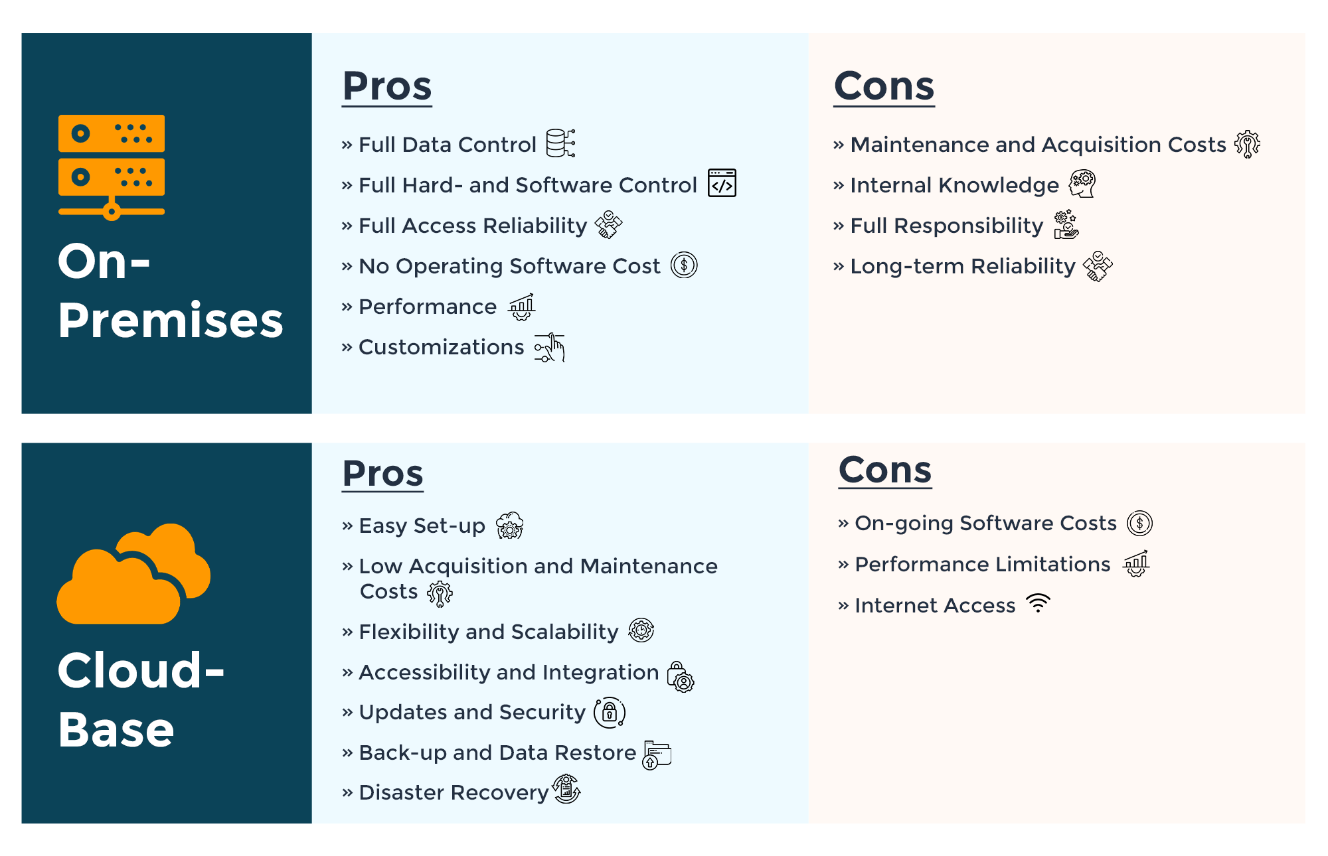

Slide 9
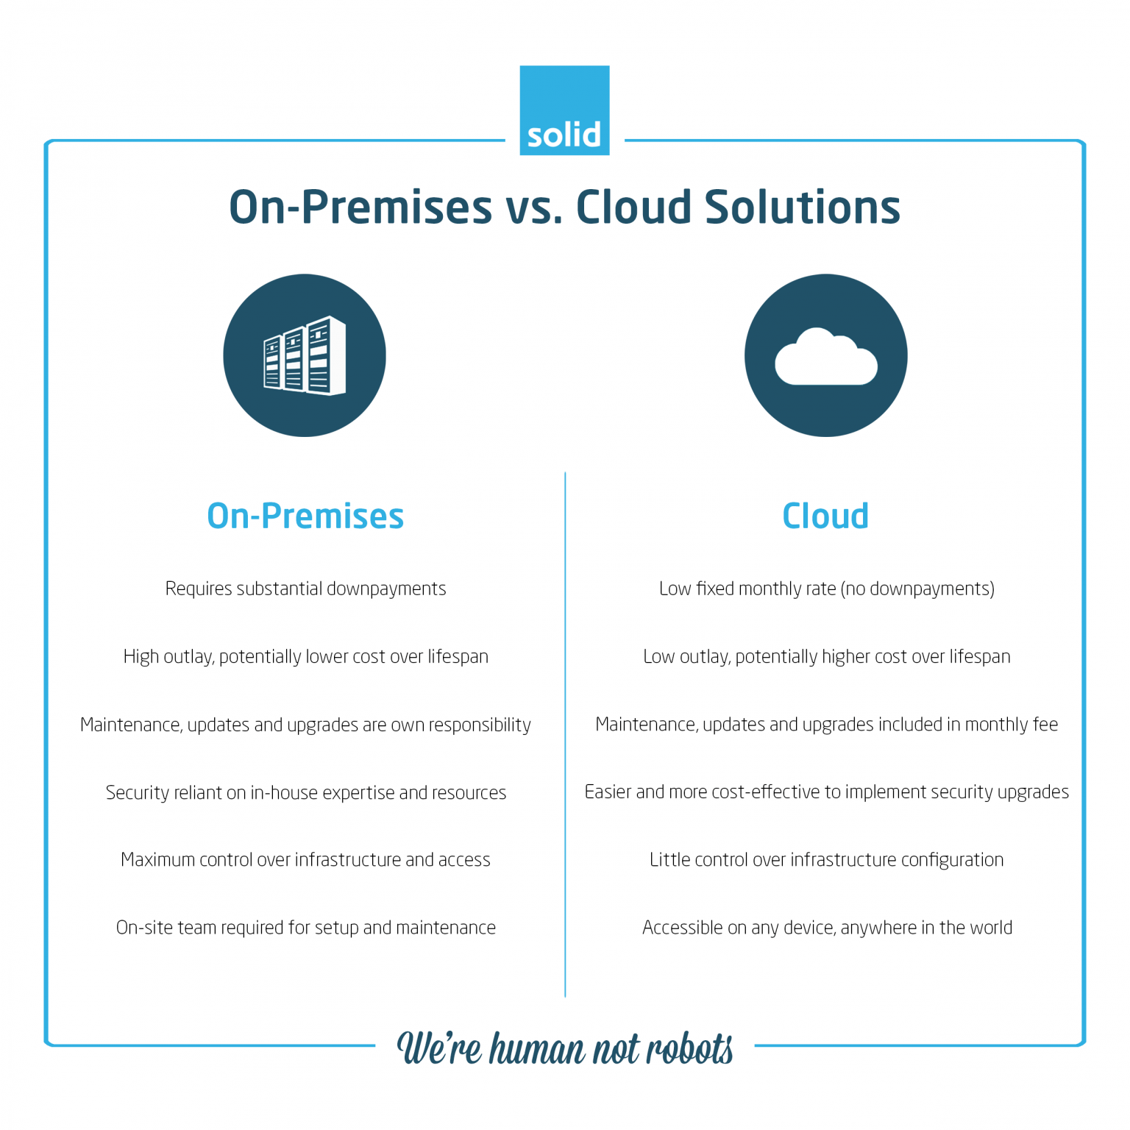

Slide 10
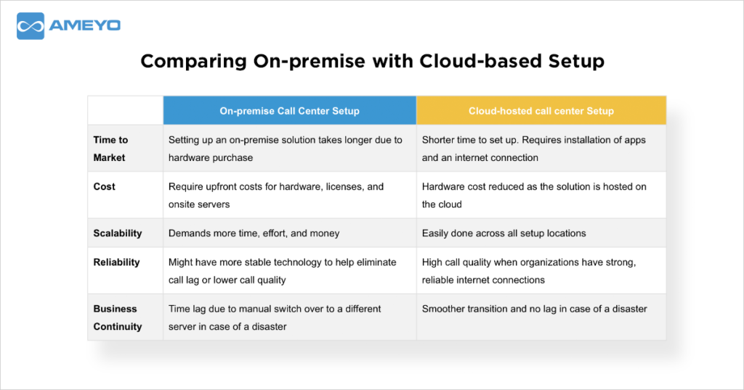

Slide 11
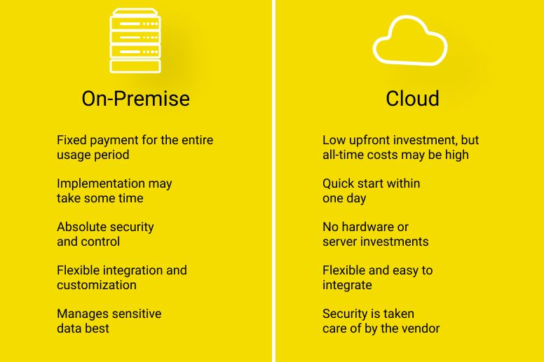

Slide 12
