Slide 1
DATA ENGINEERING CAPSTONE | 2026
Sephora Reviews Analytics Pipeline
Raw CSVs -> clean data -> 3NF OLTP -> star schema -> Airflow -> live Streamlit
1.09M
16
10
51
warehouse facts
Airflow tasks
analytics views
passing tests
Samekshya Baniya | PostgreSQL | Python | Airflow | Streamlit
1
Notes:
0:40 - Introduce the complete pipeline and emphasize that every number in the deck is measured from live runs.

Slide 2
01 | EXPLORE AND CLEAN
Source data first; rules second
The catalogue and review stream arrive at different grains, so profiling drives the cleaning contract.
1,094,411
8,494
503,216
304
14
raw reviews
catalogue products
review authors
brands
profiling checks
Deduplicate at the right grain
Standardize, do not invent
Keep traceability
Remove 1,040 rows on (author, product, date). Keep 4,485 legitimate re-reviews that a coarser key would destroy.
Grey -> gray. notSureST -> Unknown at the staging boundary. Helpfulness nulls stay undefined when nobody voted.
Cleaning drops rows, never columns. Every source column reaches raw; scope trims happen explicitly at raw -> 3NF.
Result: 1,093,371 clean reviews - exactly the population reconciled through 3NF, staging, and the warehouse.
Sephora Reviews Analytics Pipeline
2
Notes:
0:50 - Explain the measured dedup key, two standardizations, and why cleaning does not drop columns.

Slide 3
02 | END-TO-END ARCHITECTURE
A traceable path from files to decisions
Each layer has one job; the same Python package runs locally or under Airflow.
6 CSV files
clean.py
raw
3NF
staging
etl/
star schema
raw source
standardize + dedup
1:1 mirror
9 related tables
analytics-ready
E | T | R | Q | L
5 dims + fact
sephora_oltp
Two orchestrators
sephora_dw
PostgreSQL database raw -> 3NF -> staging 0 row gap
pipeline.py for local runs 16-task Airflow DAG full | historical | incremental
Star schema + 10 views Streamlit reads views only validation shares definitions
Grain of fact_reviews: one row per review. PostgreSQL generates every surrogate key.
Sephora Reviews Analytics Pipeline
3
Notes:
1:05 - Walk left to right. Stress raw traceability, 3NF correctness, staging convenience, and the separate warehouse.

Slide 4
03 | DIMENSIONAL MODELLING
The profile belongs to the review
A one-row-per-author customer dimension would silently assign the wrong skin profile to roughly one review in seven.
D2 - measured before modelling
dim_product
dim_customer
8,494 products brand + categories + price
503,216 authors identity only
fact_reviews
1,093,371 rows one review per row 4 foreign keys
dim_date
dim_reviewer_profile
5,379 dates YYYYMMDD integer key
1,896 combinations skin | eye | hair
22,503 authors changed profile attributes 149,788 reviews affected | 13.69% of the dataset
Sephora Reviews Analytics Pipeline
4
Notes:
1:10 - Defend the junk dimension with measured author variability. Explain that plausible-looking wrong joins are more dangerous than visible failures.

Slide 5
04 | ETL, QUALITY AND INCREMENTALS
Make silent data loss impossible
The course reference structure is preserved, with reconciliation and severity-aware gates added where this dataset needs them.
Extract
Transform
Reconcile
Quality
Load
named SQL reads
resolve keys
count every drop
gate, not fixer
idempotent inserts
full
historical
incremental
Every staged review No date bound Safe re-run: conflicts insert 0
Before 2023-01-01 1,043,868-row demo baseline 49,503 held back, not lost
Strictly after watermark 2022-12-31 -> 2023-03-21 Empty batch is a clean no-op
Hard failures stop before writes | warnings remain visible | ON CONFLICT DO NOTHING enforces idempotency
Sephora Reviews Analytics Pipeline
5
Notes:
1:05 - Explain the five module boundaries, row accounting identity, quality severities, and the three honest mode names.

Slide 6
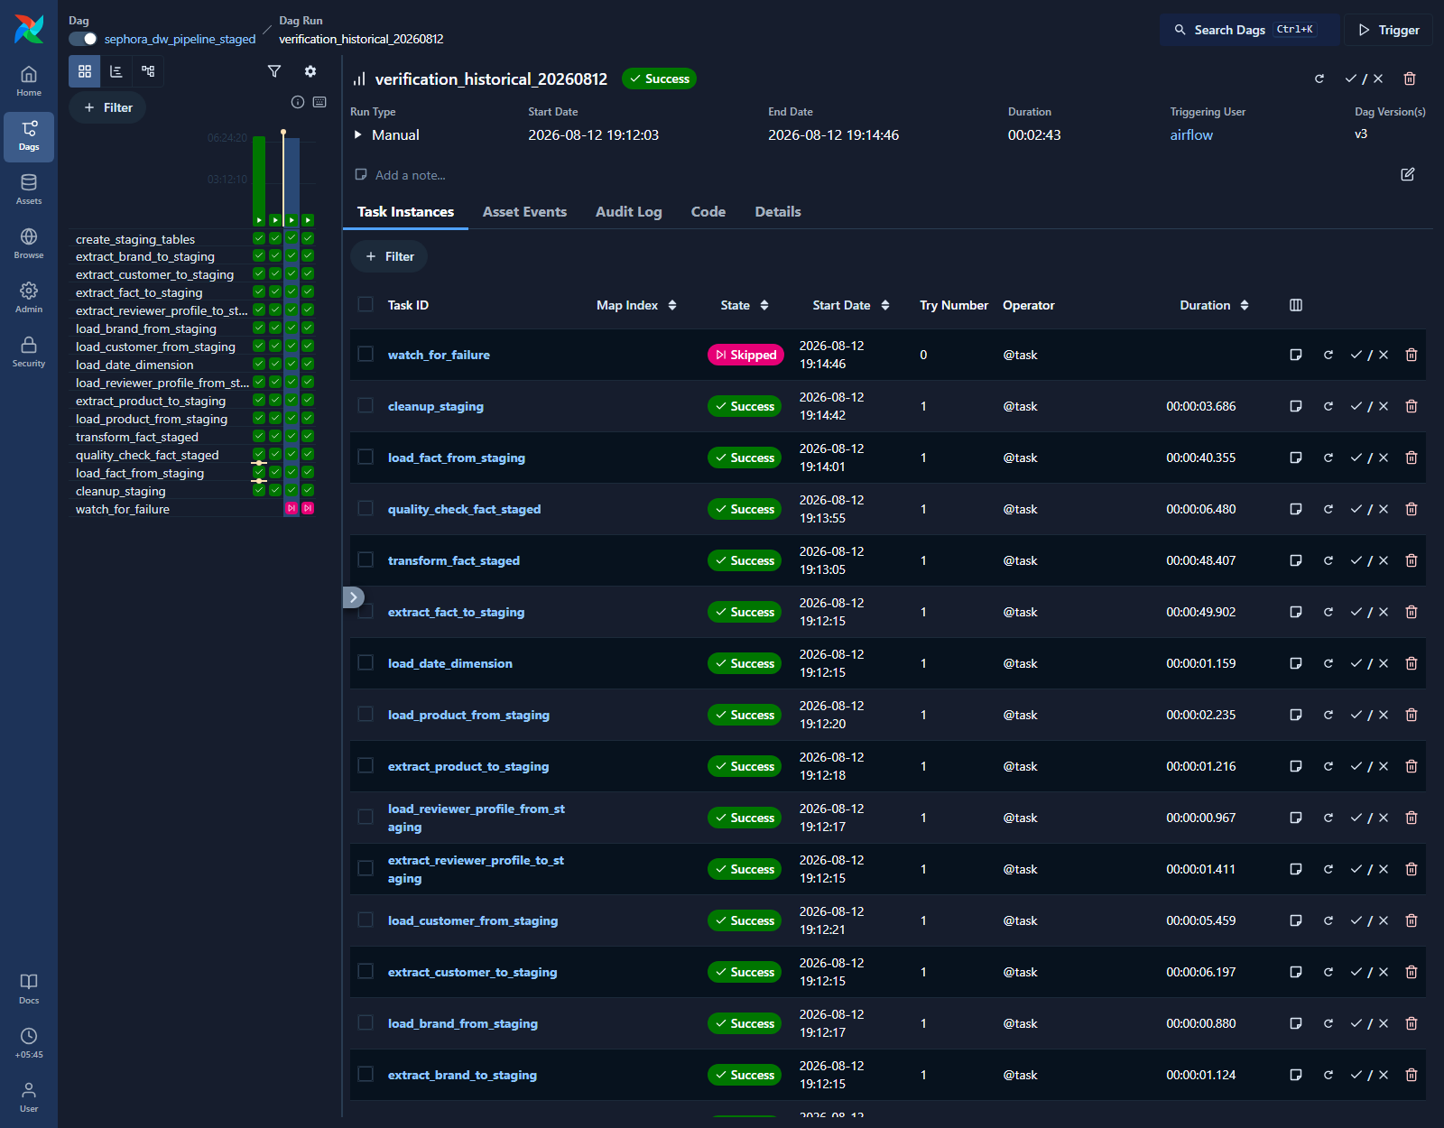
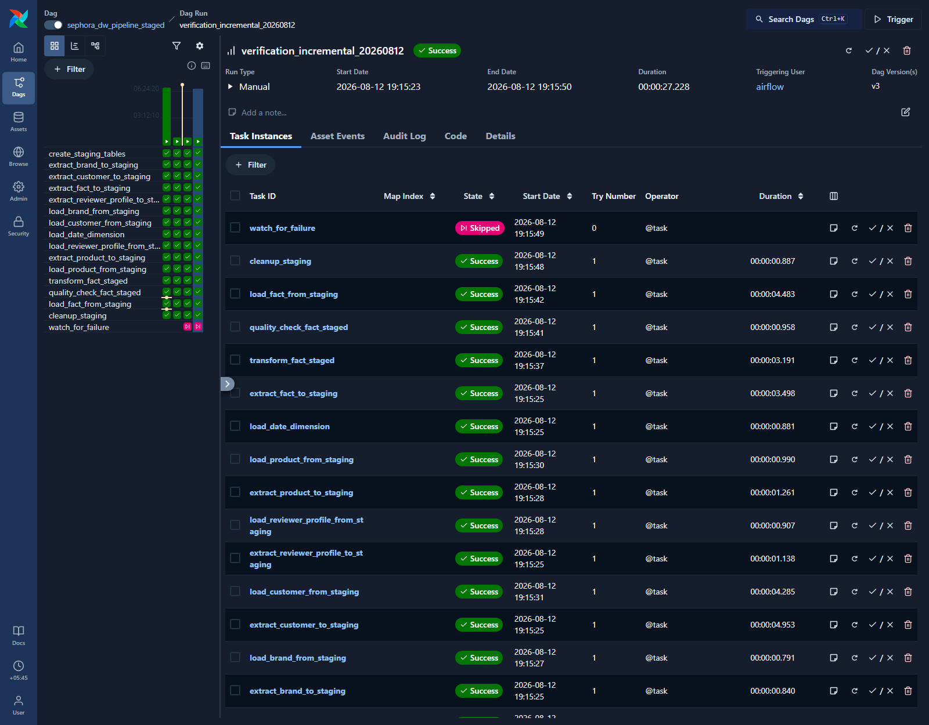
05 | AIRFLOW ORCHESTRATION
The DAG ran both paths successfully
Controlled verification on 12 Aug 2026 | 16 tasks | 15 success + the intentionally skipped one_failed watcher
Historical re-offer | SUCCESS | 164 seconds
Incremental restore | SUCCESS | 27 seconds
Deleted only the verified 2023 fact slice -> restored all 49,503 rows -> watermark returned to 2023-03-21.
Sephora Reviews Analytics Pipeline
6
Notes:
1:10 - Point to task states and durations. Historical was idempotent; incremental restored the controlled 2023 slice; all staging tables ended empty.

Slide 7
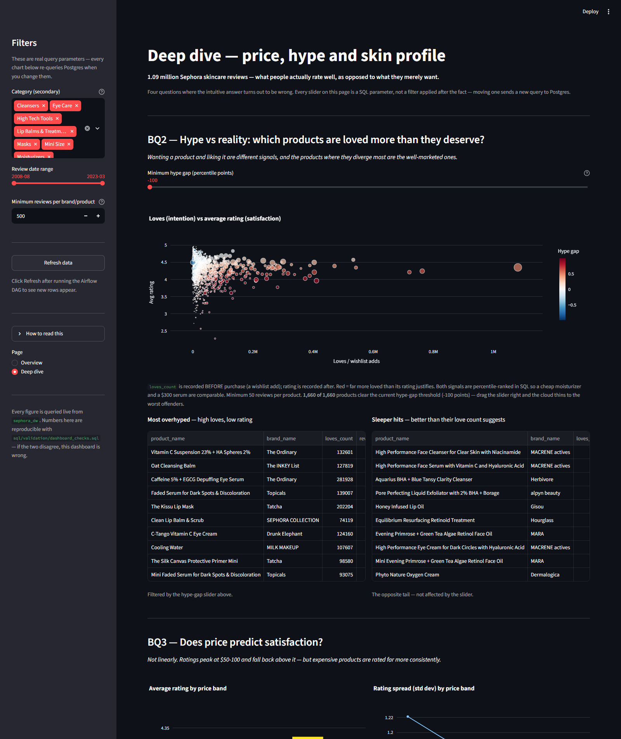
06 | ANALYTICS AND STREAMLIT
The dashboard leads with decisions, not decoration
Price vs satisfaction: an inverted U
Under $15
4.238
$15-30
4.276
$30-50
4.306
$50-100
4.334
$100+
4.271
Ratings peak at $50-100, then fall back above $100. Variation narrows as price rises.
- Hype separates wishlist intention from satisfaction - March 2023 is labelled partial - Skin-profile effects are real but weak - Every slider binds into SQL
Default page: summary first. Deep dive: hype, price, reviewer profile, and review-length polarisation.
Sephora Reviews Analytics Pipeline
7
Notes:
1:25 - Present the price curve as the headline. Then explain hype, partial-month labelling, weak skin signals, and SQL-backed controls.

Slide 8
07 | CLOSE AND LIVE DEMO
A complete, reproducible capstone
The final state is measured, source-backed, and runnable from an empty Docker environment.
1,093,371
0
0
51 + 11
facts = staging rows
orphan fact keys
duplicate fact keys
host tests + DAG asserts
Live demo in four moves
Where to verify it
1. Show the successful incremental run 2. Open the live Overview KPIs 3. Move one Deep dive SQL control 4. Reconcile views to fact_reviews
README.md - setup + diagrams docs/ - decisions + evidence dashboard/ - app + metric model sql/validation/ - source-of-truth checks
Questions?
Sephora Reviews Analytics Pipeline
8
Notes:
0:35 - Close with the exact verified totals and give the four-step live demo route.

