Slide 1
An Introduction to Scrum

Slide 2


The Agile Manifesto–a statement of values
Individuals and interactions
Process and tools
over
Working software
Comprehensive documentation
over
Customer collaboration
Contract negotiation
over
Responding to change
Following a plan
over
Source: www.agilemanifesto.org

Slide 3
Our highest priority is to satisfy the customer through early and continuous delivery of valuable software.
Welcome changing requirements, even late in development. Agile processes harness change for the customer's competitive advantage.
Deliver working software frequently, from a couple of weeks to a couple of months, with a preference to the shorter timescale.
Business people and developers must work together daily throughout the project.
Build projects around motivated individuals. Give them the environment and support they need, and trust them to get the job done.

Slide 4
The most efficient and effective method of conveying information to and within a development team is face-to-face conversation. Working software is the primary measure of progress.
Agile processes promote sustainable development. The sponsors, developers, and users should be able to maintain a constant pace indefinitely.
Continuous attention to technical excellence and good design enhances agility.
Simplicity--the art of maximizing the amount of work not done--is essential.
The best architectures, requirements, and designs emerge from self-organizing teams.
At regular intervals, the team reflects on how to become more effective, then tunes and adjustsits behavior accordingly.

Slide 5
Scrum in 100 words
Scrum is an agile process that allows us to focus on delivering the highest business value in the shortest time.
It allows us to rapidly and repeatedly inspect actual working software (every two weeks to one month).
The business sets the priorities. Teams self-organize to determine the best way to deliver the highest priority features.
Every two weeks to a month anyone can see real working software and decide to release it as is or continue to enhance it for another sprint.

Slide 6

Scrum origins
Jeff Sutherland
Initial scrums at Easel Corp in 1993
IDX and 500+ people doing Scrum
Ken Schwaber
Scrum presented in '96 with Sutherland
Author of 3 books on Scrum
Ken Schwaber and Mike Cohn
Co-founded Scrum Alliance in 2002,
initially within the Agile Alliance

Slide 7
Scrum has been used by:
Microsoft
Yahoo
Google
Electronic Arts
Lockheed Martin
Philips
Siemens
Nokia
IBM
Capital One
BBC
Intuit
Nielsen Media
First American Real Estate
BMC Software
Ipswitch
John Deere
Lexis Nexis
Sabre
Salesforce.com
Time Warner
Turner Broadcasting
Oce

Slide 8
Scrum has been used for:
Commercial software
In-house development
Contract development
Fixed-price projects
Financial applications
ISO 9001-certified applications
Embedded systems
24x7 systems with 99.999% uptime requirements
the Joint Strike Fighter
Video game development
FDA-approved, life-critical systems
Satellite-control software
Websites
Handheld software
Mobile phones
Network switching applications
ISV applications
Some of the largest applications in use

Slide 9
Characteristics
Self-organizing teams
Product progresses in a series of month-long “sprints”
Requirements are captured as items in a list of “product backlog”
No specific engineering practices prescribed
Uses generative rules to create an agile environment for delivering projects
One of the “agile processes”

Slide 10
Sprints
Scrum projects make progress in a series of “sprints”
Analogous to Extreme Programming iterations
Typical duration is 2–4 weeks or a calendar month at most
A constant duration leads to a better rhythm
Product is designed, coded, and tested during the sprint

Slide 11
Sequential vs. overlapping development
Requirements
Design
Code
Test
Rather than doing all of one thing at a time...
...Scrum teams do a little of everything all the time
Source: “The New New Product Development Game” by Takeuchi and Nonaka. Harvard Business Review, January 1986.

Slide 12


No changes during a sprint
Change
Plan sprint durations around how long you can commit to keeping change out of the sprint

Slide 13
Scrum framework
Roles
Product owner
ScrumMaster
Team
Ceremonies
Sprint planning
Sprint review
Sprint retrospective
Daily scrum meeting
Artifacts
Product backlog
Sprint backlog
Burndown charts

Slide 14
Scrum framework
Roles
Product owner
ScrumMaster
Team
Ceremonies
Sprint planning
Sprint review
Sprint retrospective
Daily scrum meeting
Artifacts
Product backlog
Sprint backlog
Burndown charts

Slide 15

Product owner
Define the features of the product
Decide on release date and content
Be responsible for the profitability of the product (ROI)
Prioritize features according to market value
Adjust features and priority every iteration, as needed
Accept or reject work results

Slide 16

The ScrumMaster
Represents management to the project
Responsible for enacting Scrum values and practices
Removes impediments
Ensure that the team is fully functional and productive
Enable close cooperation across all roles and functions
Shield the team from external interferences

Slide 17





The team
Typically 5-9 people
Cross-functional:
Programmers, testers, user experience designers, etc.
Members should be full-time
May be exceptions (e.g., database administrator)
Teams are self-organizing
Ideally, no titles but rarely a possibility
Membership should change only between sprints

Slide 18
Scrum framework
Roles
Product owner
ScrumMaster
Team
Ceremonies
Sprint planning
Sprint review
Sprint retrospective
Daily scrum meeting
Artifacts
Product backlog
Sprint backlog
Burndown charts

Slide 19


Team capacity
Sprint planning meeting
Sprint prioritization
Product backlog
Sprint
goal
Analyze and evaluate product backlog
Select sprint goal
Business conditions
Sprint planning
Decide how to achieve sprint goal (design)
Create sprint backlog (tasks) from product backlog items (user stories / features)
Estimate sprint backlog in hours
Current product
Sprint
backlog
Techno-logy

Slide 20

Sprint planning
Team selects items from the product backlog they can commit to completing
Sprint backlog is created
Tasks are identified and each is estimated (1-16 hours)
Collaboratively, not done alone by the ScrumMaster
High-level design is considered
As a vacation planner, I want to see photos of the hotels.
Code the middle tier (8 hours)
Code the user interface (4)
Write test fixtures (4)
Code the foo class (6)
Update performance tests (4)

Slide 21
Sprint retrospective
Periodically take a look at what is and is not working
Typically 15–30 minutes
Done after every sprint
Whole team participates
ScrumMaster
Product owner
Team
Possibly customers and others

Slide 22

Product backlog
The requirements
A list of all desired work on the project
Ideally expressed such that each item has value to the users or customers of the product
Prioritized by the product owner
Reprioritized at the start of each sprint
This is the product backlog

Slide 23
A sample product backlog
Backlog item
Estimate
Allow a guest to make a reservation
3
As a guest, I want to cancel a reservation.
5
As a guest, I want to change the dates of a reservation.
3
As a hotel employee, I can run RevPAR reports (revenue-per-available-room)
8
Improve exception handling
8
...
30
...
50

Slide 24
The sprint goal
A short statement of what the work will be focused on during the sprint
Life Sciences
Support features necessary
for population genetics studies.
Database Application
Make the application run on SQL Server in addition to Oracle.
Financial services
Support more technical indicators than company ABC with real-time, streaming data.

Slide 25
Managing the sprint backlog
Individuals sign up for work of their own choosing
Work is never assigned
Estimated work remaining is updated daily
Any team member can add, delete or change the sprint backlog
Work for the sprint emerges
If work is unclear, define a sprint backlog item with a larger amount of time and break it down later
Update work remaining as more becomes known

Slide 26
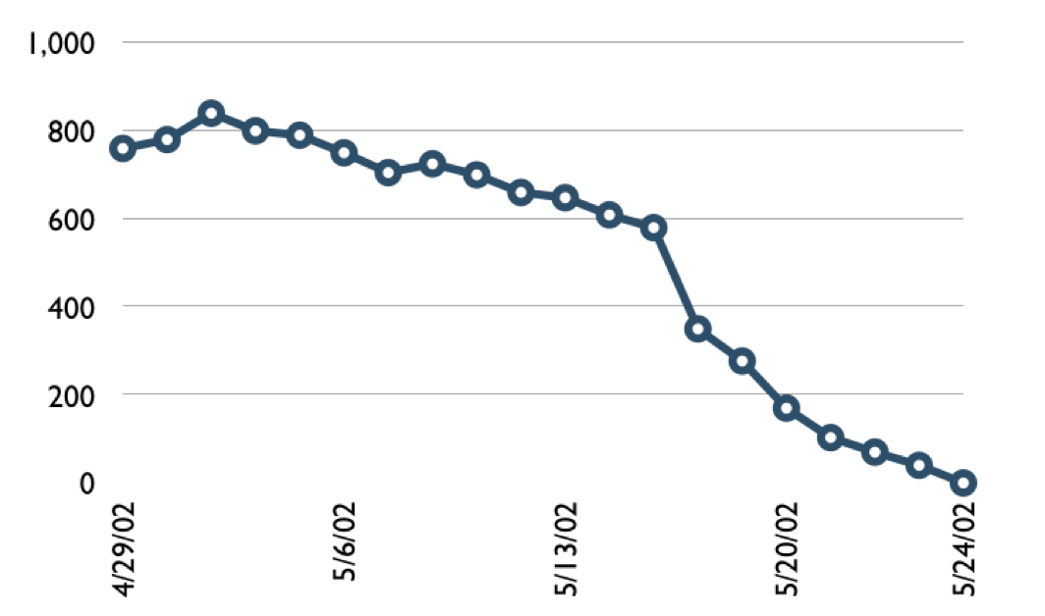

A sprint burndown chart
Hours

Slide 27
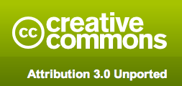
Copyright notice
You are free:
to Share―to copy, distribute and transmit the work
to Remix―to adapt the work
Under the following conditions
Attribution. You must attribute the work in the manner specified by the author or licensor (but not in any way that suggests that they endorse you or your use of the work).
Nothing in this license impairs or restricts the author’s moral rights.
For more information see http://creativecommons.org/licenses/by/3.0/

Slide 28

Contact information
Presentation by: Mike Cohn
mike@mountaingoatsoftware.com
www.mountaingoatsoftware.com
(720) 890-6110
You can remove this (or any slide) but you must credit the source somewhere in your presentation. Use the logo and company name (as at bottom left, for example) or include a slide somewhere saying that portions (or all) of your presentation are from this source. Thanks.

