Slide 1

Kholoud srour
Demonstrator in the Information Technology Department

Slide 2
Introduction to TypeScript
What is TypeScript?
_TypeScript is a programming language developed by Microsoft.
_It is a superset of JavaScript.
_Any valid JavaScript code is also valid in TypeScript.
_TypeScript adds powerful features such as:
Static Typing
Error Checking
Better Autocomplete
Object-Oriented Programming Features

Slide 3
Introduction to TypeScript
Where Is TypeScript Used?
Frontend Development → (react , angular , vue)
Backend Development → (express.js , nestjs)
Mobile Applications →(react native)
Desktop Applications →(electron)
Full Stack Development

Slide 4
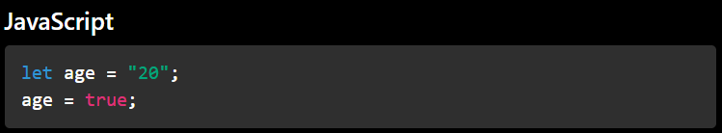
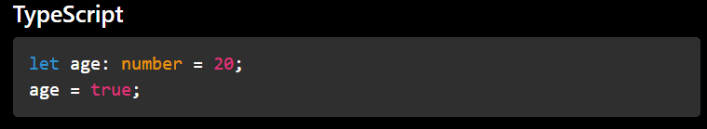
Introduction to TypeScript
Main Idea
_TypeScript helps developers detect errors while writing code instead of discovering them after running the application.
error

Slide 5
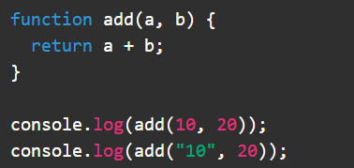

Introduction to TypeScript
The Problem with JavaScript
_JavaScript is flexible, but this flexibility can create problems in large applications. Common issues in JavaScript:
Weak typing
Runtime errors
Difficult maintenance in large projects
Harder teamwork in big applications
Bugs appear after running the code

Slide 6
Introduction to TypeScript
Why Do Companies Use TypeScript?
_Reduces bugs in large projects.
_Makes code more organized.
_Easier teamwork and collaboration.
_Suitable for scalable applications.
_Commonly used with React, Angular, and Node.js.
Important Note
TypeScript does not run directly in the browser. It must first be compiled into JavaScript. TypeScript → JavaScript → Browser

Slide 7
Introduction to TypeScript
JavaScript vs TypeScript
JavaScript | typescript
Dynamically Typed | Statically Typed
Errors appear during runtime | Errors appear during development
Easier for small projects | Better for large projects
No compilation required | Must be compiled
Less strict | More strict and safer
Simpler setup | Slightly more setup

Slide 8
Requirements for TypeScript
Node.js
Node.js allows JavaScript to run outside the browser
.TypeScript depends on Node.js tools during development.
Node.js provides:
Runtime Environment
npm Package Manager →(Install TypeScript, Install libraries Manage project dependencies)
Development Tools

Slide 9
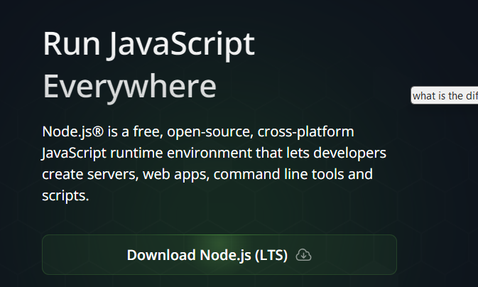
Install node.js
https://nodejs.org/en

Slide 10
Install packages
1) Check node :
node -v 2) npm package:- npm init
3) Go to typescript website to install it: https://www.typescriptlang.org/
npm install typescript --save-dev
npm install -g typescript
npm i
4) To start typescript:- tsc --init
5) Transpillation:-
npx tsc
tsc –w
6) Run file :- node dist/index.js

Slide 11

Basic Data Types in TypeScript
Data types define:
What kind of value a variable can store
Main Basic Types
TypeScript basic data types include:
number
string
boolean
any
unknown
void
null
undefined

Slide 12



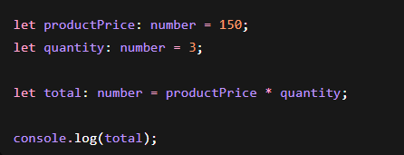
Basic Data Types in TypeScript
Explicit Typing
1) number Type:-
The number type is used to store:
Integers
Floating-point numbers
Negative numbers
NAN

Slide 13





Basic Data Types in TypeScript
Explicit Typing
2) String Type:
The string type is used to store:
Text
Characters
Sentences
boolean Type

Slide 14
Basic Data Types in TypeScript
Task :-
Return the word from long sentence if the first letter contains a vowel
Input "Apple orange banana";
Output " Apple orange"

Slide 15
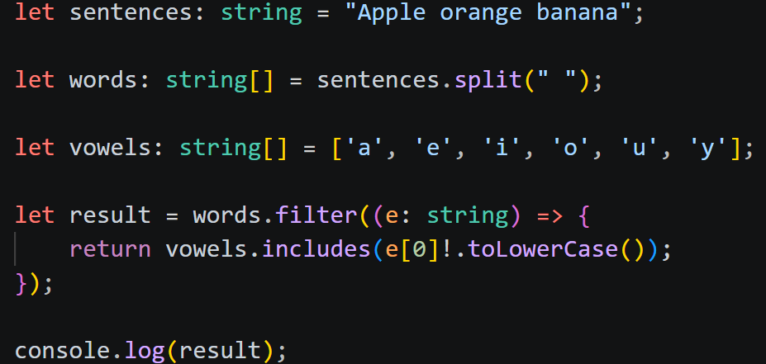
Basic Data Types in TypeScript
Task :-

Slide 16



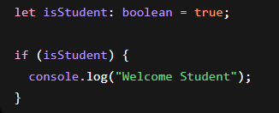
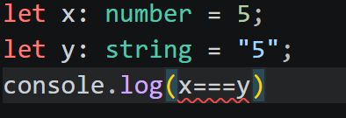
Basic Data Types in TypeScript
Explicit Typing
3) Boolean Type:
The boolean type stores only two values:
True
false

Slide 17
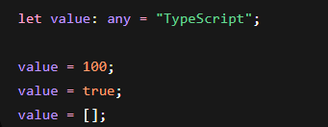
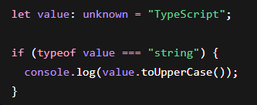
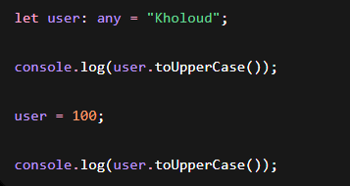
Basic Data Types in TypeScript
Explicit Typing
4) any Type: the any type disables TypeScript type checking for a variable.
5) unknown Type:-
unknown is a safer alternative to any.
It allows storing any value, BUT:
TypeScript forces you to check the type before using it

Slide 18


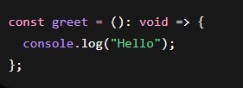

Basic Data Types in TypeScript
Explicit Typing
6) void Type:-
"No return value"

Slide 19




Basic Data Types in TypeScript
Explicit Typing
7) null and undefined:-
Both represent: absence of value
undefined means:
A variable has been declared but not assigned a value yet.
null means:
An intentional empty value.

Slide 20

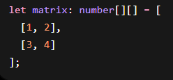

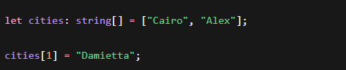

Basic Data Types in TypeScript
Explicit Typing
7)Array :-

Slide 21
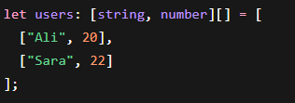


Basic Data Types in TypeScript
Explicit Typing
8)tuple :-
A tuple is a special type of array where:
The number of elements is fixed
The type of each element is fixed
The order matters

Slide 22
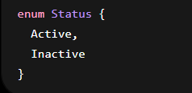
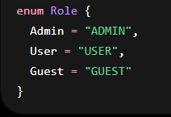
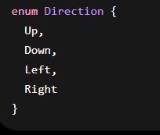

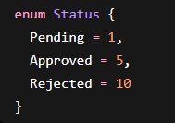

Basic Data Types in TypeScript
Explicit Typing
9) Enums :-
Enumeration allow developers to create:
A group of named constant values

Slide 23
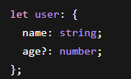
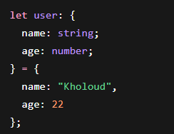
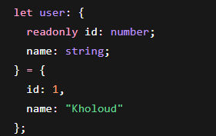
Basic Data Types in TypeScript
Explicit Typing
9) object :-

Slide 24



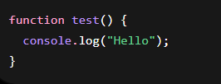
Basic Data Types in TypeScript
Type Inference
TypeScript automatically understands:

Slide 25

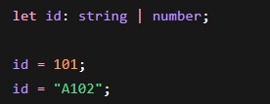



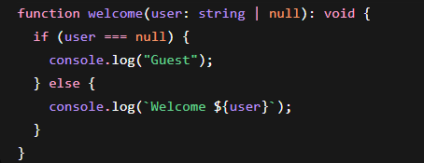
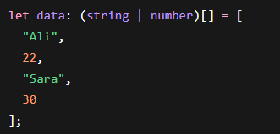

Basic Data Types in TypeScript
Union Types in TypeScript
error

Slide 26



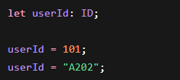
Basic Data Types in TypeScript
Type Aliases in TypeScript
A type alias allows developers to: create custom names for types

Slide 27
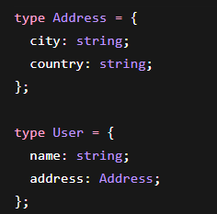
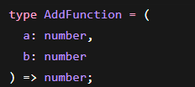

Basic Data Types in TypeScript
Type Aliases in TypeScript
A type alias allows developers to: create custom names for types

Slide 28


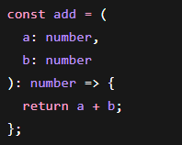
Functions Basics in TypeScript

Slide 29
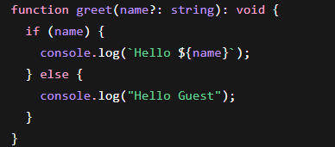
Optional Parameters in TypeScript

Slide 30
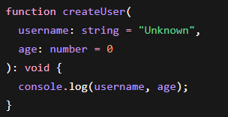
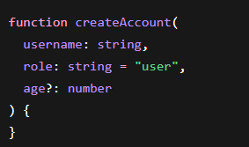
Default Parameters in TypeScript

Slide 31
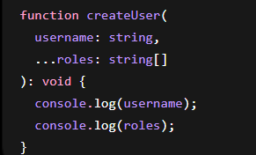
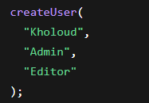
Rest Parameters in TypeScript

Slide 32
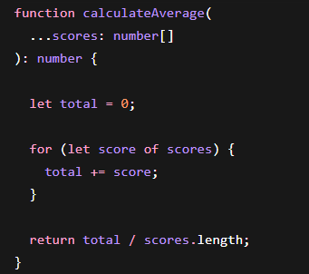
Rest Parameters in TypeScript

Slide 33
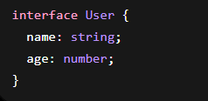
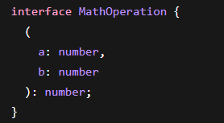
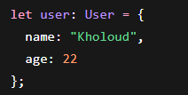
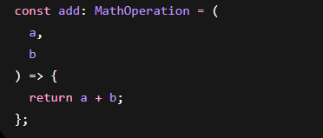
Interfaces in TypeScript

Slide 34

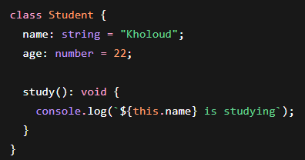

Classes in TypeScript
A class is a blueprint used to create:
objects with shared properties and methods

Slide 35
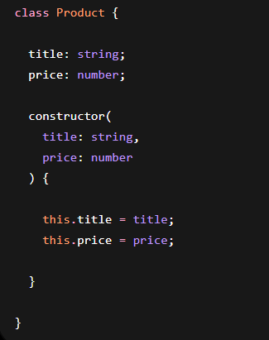
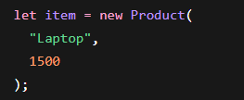
Constructors in TypeScript
constructor is a special method inside a class that:runs automatically when an object is created

Slide 36
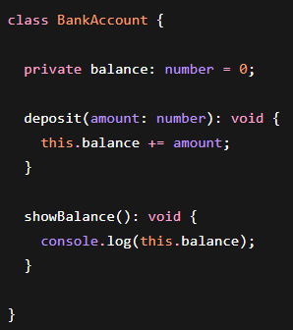
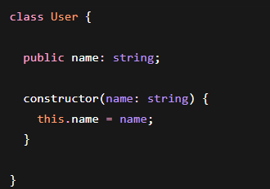
Access Modifiers in TypeScript
Access modifiers control:
who can access class properties and methods

Slide 37
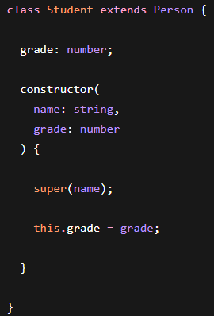
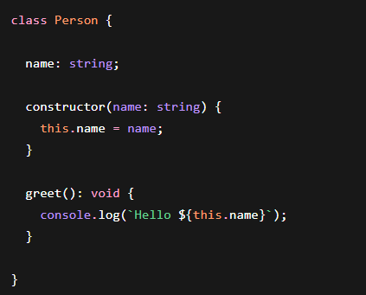
Inheritance in TypeScript
inheritance allows one class to:
inherit properties and methods from another class

Slide 38
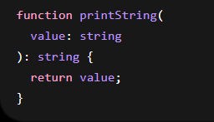
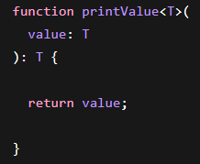
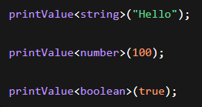

Generics in TypeScript
Generics allow developers to create:
reusable components that work with different data types
T is a: type parameter
It a placeholder for any type

Slide 39

Fetch APi

Slide 40

Fetch APi

Slide 41
Thank You

